Slide 1
Louisiana’s Volunteer and Donated Resources Toolbox (DRAFT)
E. Carroll W. Carroll Tensas Jackson Sabine Winn Natchitoches Grant LaSalle Vernon Rapides Avoyelles Catahoula Terrebonne LaFourche

Slide 2
GOHSEP’s Volunteer Initiative
Kimberly Poorbaugh, Senior Project Coordinator
Kimberly.Poorbaugh@la.gov
(225) 358-5600

Slide 3
Background
Events which impacted Louisiana State Resources
December 28, 2015 – February 1, 2016: Flooding
February 2016: 13 Tornadoes (no Federal assistance)
March 2016: Flooding
August 2016: Flooding
February 2017: Tornadoes

Slide 4
Louisiana – Critical Data Points
$4.666+ BILLION of A + B work since 2005 (including Katrina)
$1.166+ BILLION of cost share (includes those at 75%, 10% or 0%)
57 Louisiana Parishes had declarations last year alone

Slide 5
Potential
Disasters Federal Resources
Value of Volunteers
Improved Management System
Disaster Vulnerability vs. Disaster Resiliency
Focus must shift from disaster-driven, reactive systems to proactive strategies and sustainable practices

Slide 6
Challenges
Collaboration, Communication, and Training:
Establish a Taskforce to ensure collaboration, problem identification, and solution building
Create an annual training schedule that brings state agencies, Parish government, and volunteer organizations together
Utilization of Technology:
Institute a single platform database that address interoperability issues and allows for data collection and information sharing among the State, local government, and volunteer agencies
Shouldering the economic burden:
Utilize volunteer labor and donated resources to offset state and local cost share
Develop one universal “form” that all organizations use to capture volunteer hours and donated resources that meets FEMA reporting requirements

Slide 7
An Innovative Solution
Volunteer Training Initiative:
Strengthening public-private sector relationships
Improving collaboration among the State, local government, volunteer organizations, and the community:
Integrated trainings
Volunteer Management Toolkit
Utilization of technology
Assign a LNO to the most impacted Parishes
Institution of a Volunteer Reception Center
Innovative expansion of our Volunteer Management EOC operations

Slide 8
Phase 1
Conducted 3 focus groups:
Volunteer Agencies and Nonprofits
Parish OEP Directors and Local Elected/Appointed Leadership
State Partners:
Lieutenant Governor’s Office
Louisiana Department of Health
Louisiana VOAD

Slide 9
Phase 2
Develop a Process and Toolbox
Institute a Collaborative Database
Plan Workshops and Trainings

Slide 10
The Toolbox
Overview
Purpose and Scope
Offsetting the Non-Federal Cost Share
Staffing Roles
Step-by-Step Guidance
Getting Started
Planning
Appendices
Tools and Sample Materials

Slide 11
Overview
GOHSEP encourages the strategic use of volunteers and the management and distribution of unsolicited donations.
We offer a process and tools that are scalable to any emergency or disaster to capture and quantify eligible volunteer work and donations to offset the non-Federal cost share.

Slide 12
Offsetting the Non-Federal Cost Share
Documentation Requirements
Donated Resources include volunteer labor, donated equipment, goods, and materials
Must come from a third party
Limited to eligible Emergency Work (Category A & B)
Must be the legal responsibility of the Subrecipient
Documentation should capture and quantify the time, activity, location, and type of work performed and/or donations received
Staffing the Roles of Volunteer & Donated Resources Coordinator (VDRC) and Organization Contact
The VDRC position can be filled 1 of 3 ways
The Parish identified staff member to fill the role during activation
GOHSEP liaison
A volunteer organization within the Parish identifies and provides a person to fill this role and work with the Parish

Slide 13
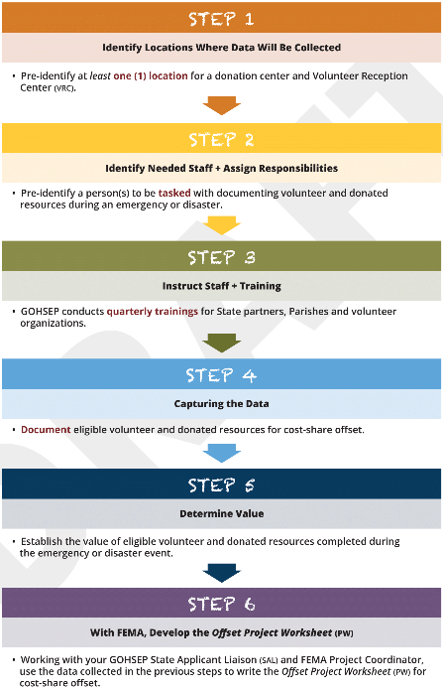
6 Steps to Offsetting the Non-Federal Cost Share

Slide 14
Getting Started
GOHSEP encourages Parish authorities to develop a comprehensive Local Volunteer and Donated Resources Management Plan.
This will help ensure the best use of volunteer time and donated resources using sound management practices and systems to address:
registering, organizing, managing, and overseeing “all things” related to volunteer and donated resources, including documentation.
Communication (and coordination) with the public, individual volunteers, and volunteer organizations is essential.

Slide 15
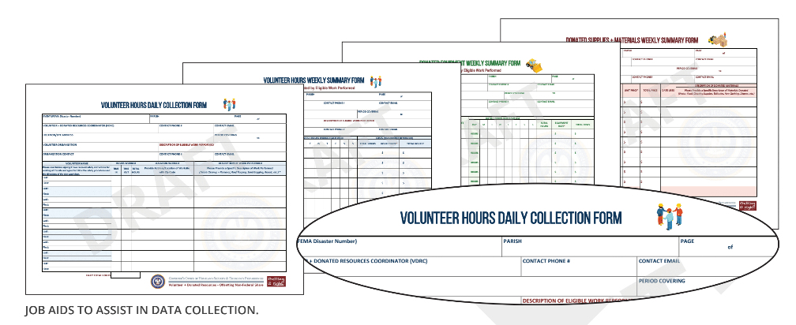
Appendices
The Tools and Sample Materials:
Sample Documentation Forms
Volunteer Hours Form
Donated Equipment Form
Donated Goods and Materials Form
Sample Training Calendar
Planning and Communications Materials
Planning Tips
Sample Volunteer and Donated Resources Management Plan
Key Activities Throughout a Disaster Cycle
Roles and Responsibilities
Volunteer Reception Center Materials
Role of Technology
Resources

Slide 16
Questions?
E. Carroll W. Carroll Tensas Jackson Sabine Winn Natchitoches Grant LaSalle Vernon Rapides Avoyelles Catahoula Terrebonne LaFourche

