Slide 2
Introductions

Slide 3
Summit Material
Today all participants will leave with the following…
Elected Officials Manual
Recovery Tool Packet

Slide 4
Agenda
Overview
Prepare
Prevent
Respond
Recover
Resources + Tools
Closing Comments

Slide 5
GOHSEP Organization
James B. Waskom
Director
Chris Guilbeaux
Deputy Director
Preparedness, Response & Interoperability
Christina Dayries
Deputy Director
Grants & Administration
Mark Riley
Deputy Director
Disaster Recovery
Preparedness
Training
Exercise
CI/KR
Planning
Recovery Grants Administration
Facility Management
DR Management
Doc Services, Recovery Operations, Application Services
Public Assistant
Grants
Grants Mgmt
SALs
Technical Services
Closeout
Hazard Mitigation
Grants
Grants Mgmt
SALs
Technical Services
Closeout
Sub Recipient Monitoring
Will Rachal
Chief of Staff
Operations
EOC
Logistics
Mapping
Cyber Security
Interoperability
Toni Rochelle Cyrus
Executive Assistant
Kevin Breaux
Asst. Deputy Director
Regional Support
Fusion Center
Fixed Nuclear Facilities
Casey Tingle
Asst Dep Director
Hazard Mitigation
Homeland Security Grants Admin
Sean Wyatt
Asst Dep Director
Mike Steele
Communications Director
Danielle Aymond
Executive Counsel
Legal/Appeals
Mark DeBosier
Asst Dep Director
Public Assistance
Administrative Services
(Fin, Contracts, Bud, HR, IT, Audit, Travel)
State Management Cost

Slide 6
Overview

Slide 7
Overview
Summary of Louisiana Homeland Security & Emergency Assistance & Disaster Act (RS: 29-721-739)
Provides structure for State + local governments when preparing, preventing, responding + recovering from natural or manmade events
Defines roles for State + local government + nongovernmental organizations

Slide 8
Overview
Disaster Act…
Provides guidance related to:
Shelters
Evacuations
Curfews
Financing
Assistance Identification
Interstate Cooperation
Liability Limitations
Responder Immunities

Slide 9
Parish Office of Homeland Security and Emergency Preparedness (Parish OHSEP)

Slide 10
Overview
Local OHSEP Director
Appointed by the Parish President + commissioned by the State’s Director of GOHSEP.
Should be a qualified + experienced emergency manager.
Is responsible for coordinating local disaster response.

Slide 11
Overview
Local OHSEP Director’s Responsibilities
Organize + administer + operate the local OHSEP.
Create + maintain + adhere to a Parish Emergency Operations Plan (EOP).
Prepare Parish for evacuation + rescue + sheltering.
Is the primary point of contact between the State and Parish officials.

Slide 12
Overview
Local OHSEP Director’s Responsibilities
Directs response + deployment of Parish agencies & resources during an incident.
Alerts + advises the Parish citizenry.
Advisor to the chief elected Parish official.
Applies for + properly administers specific State + Federal grants, on behalf of the Parish’s chief elected official.

Slide 13
Overview
Parish Emergency Management Advisory Committee (PEMAC)
Louisiana Disaster Act mandates the Parish form a PEMAC committee.
Purpose:
To offer advice + counsel to the Parish President on homeland security and emergency management.
Ensures planning between Parish + municipalities is consistent.

Slide 14
Overview
Parish Emergency Management Advisory Committee (PEMAC)
Meets at least twice a year.
Parish President or the OHSEP Director serves as chairperson.
Functional areas of interest include:
Hazard Mitigation
Emergency Preparedness
Response
Recovery
Grant Requests
Expenditure of Grant Funds

Slide 15
Overview
Local Emergency Planning Committee (LEPC)
Title III of the Superfund Amendments and Reauthorization Act (SARA) requires each State to create planning districts and appoint an LEPC in each Parish.
Purpose:
To address hazardous materials issues.
Create public awareness of hazardous materials risks + improve community preparedness.

Slide 16
Subcommittees as Defined in the Disaster Act

Slide 17
Overview
Regional Parish OHSEP Director’s Subcommittee
Composed of one (1) Parish OHSEP Director from each of the nine (9) GOHSEP Regions + the Director of GOHSEP.
Provides planning + advice on strategic emergency management issues from a regional perspective.
Representatives are selected from among their peers + represent their Region.

Slide 18
Overview
First Responders Subcommittee
Composed of emergency response professionals.
Provides:
Law enforcement + fire service + emergency medical service + intelligence gathering + dissemination solutions.
Planning + advice on issues identified by GOHSEP + the Unified Command Group (UCG).
Establishes advisory subcommittees for specific issues when required.

Slide 19
Overview
Statewide Interoperability Executive Subcommittee (SIEC)
Administers the Louisiana Wireless Information Network (LWIN).
Is composed of all appropriate first responder + support organizations.
Has full authority to design + construct + administer + maintain a statewide interoperable communications system.
Establishes advisory subcommittees as needed.

Slide 20
Overview
Intrastate Mutual Aid Subcommittee (IMAC)
IMAC is a system of parish-to-parish mutual aid for Parishes that do not have existing mutual aid agreements.
IMAC maximizes response capabilities for emergency personnel to respond to all hazard incidents utilizing Parish-owned equipment + material + personnel resources.

Slide 21
Governor’s Office of Homeland Security and Emergency Preparedness (GOHSEP)

Slide 22
Overview
GOHSEP
Leads and supports Louisiana and its citizens …
In the preparation for + prevention of + response to + recovery from + mitigation against all emergencies and disasters.
Operates and manages …
The State Emergency Operations Center (SEOC) during an emergency event.

Slide 23
Overview
GOHSEP
Coordinates support to Applicants for pre-disaster + post-disaster Federal grant funding.
Works with partners from State + Federal agencies + Parish + local governments + nongovernmental organizations + businesses on emergency preparedness initiatives.

Slide 24
Overview
GOHSEP: Preparedness
Develops + maintains the State EOP.
Provides technical assistance to local governing authorities for Parish-related plans.
Provides training + exercises + stakeholder outreach.
Serves as the State Administrative Agent (SAA) for management of the State’s preparedness (non-disaster) grant programs.

Slide 25
Overview
GOHSEP: Response
Plays a significant role in the:
Activation + staffing of the State EOC.
Coordination of State + Federal Emergency Support Functions (ESFs).
Management + response to requests from State + local governments.

Slide 26
Overview
GOHSEP: Recovery
Presidential-disaster declaration process.
Coordinates the Preliminary Damage Assessment (PDA) process.
Directs the recovery of 11 open disasters.
Manages 1,500 unique Public Assistance (PA) Applicants + approximately $15 billion in Federal recovery dollars.
Processes more than $15 million in reimbursements weekly.

Slide 27
Overview
GOHSEP: Mitigation
Creates + maintains the State Hazard Mitigation Plan (SHMP).
SHMP identifies the most likely threats to Louisiana + prescribes mitigation strategies to address.
Provides technical assistance to local governments in developing their hazard mitigation plans.
Administers grant funding through FEMA’s Hazard Mitigation Assistance (HMA) programs.

Slide 28
Overview
National Incident Management System (NIMS)
Provides standardized organizational structures that improve integration + connectivity among jurisdictions + disciplines.
Federal homeland security and emergency preparedness grants require State + local agencies to be NIMS compliant.
Agencies MUST complete specific training, education and planning requirements.

Slide 29
Prepare

Slide 30
Prepare
Pre-Disaster Preparation
Includes review + revision of the Parish EOP.
Focuses on:
Threats + Hazards Identification + Risk Assessment (THIRA)
Mutual Aid Agreements
Pre-disaster contracts (e.g., debris + generators + portable shelters + fuel + food for EOC staff)

Slide 31
Prepare
Planning
Planning + preparation are key to timely + effective + successful response to + recovery from a disaster.
Local required plans include:
Parish Emergency Operations Plan (EOP)
Parish Hazard Mitigation Plan (HMP)

Slide 32
Prepare
Preparedness (Non-Disaster) Grants
Federal preparedness grants provide assistance to State + local + tribal authorities to enhance homeland security + emergency management.
Types of preparedness (non-disaster) grants:
Emergency Management Performance Grant (EMPG) Program
Homeland Security Grant Program (HSGP)
Other grant opportunities

Slide 33
Prepare
Emergency Management Performance Grant (EMPG)
Provides for a comprehensive system of emergency preparedness for the protection of life + property from all hazards.

Slide 34
Prepare
Homeland Security Grant Program (HSGP)
Funds a range of preparedness activities, including planning + training + exercises + operations + equipment.
Is comprised of three (3) main grant programs:
State Homeland Security Program (SHSP)
Urban Areas Security Initiative (UASI)
Operation Stonegarden (OPSG)

Slide 35
Prepare
Other Grant Opportunities
Grants are awarded directly to local fire departments to enhance abilities to protect the public + fire service personnel.
Assistance to Firefighters Grants (AFG)
Staffing for Adequate Fire & Emergency
Response (SAFER) Grants
Assistance to Firefighters Station Construction Grants (SCG)

Slide 36
Prevent

Slide 37
Prevent
Louisiana State Analytical + Fusion Exchange (LA-SAFE)
LA-SAFE Products
Subject profiles
Alert Bulletins
Threat & vulnerability assessments
Graphics - maps, charts, time lines, etc.
Daily reports
Bulletins:
Law Enforcement Sensitive
Open Source
Special Bulletins
Suspicious Activity Report Analysis
LA-SAFE Partners
LSP
EBRSO
DHS
BRPD
GOHSEP
CYBER
HIDTA
LANG
FBI
CBP
ATF

Slide 38
Respond

Slide 39
Emergency Management Process
State
Agency
Assets
LEGEND
ESF
Contracts
Rentals
etc.
Business
EOC
Status Feedback
Request for Support
Parish
Assets
Parish EOC
State
Operations
Federal
Assistance
Municipal
Assets
Municipal EOC
Contracts
Rentals
etc.
Intrastate
Mutual
Aid
EMAC State
To State Assets
Contracts
Rentals
etc.

Slide 40
Respond
State Emergency Operations Center (SEOC)
Is the State’s command + control center.
Serves as a central operations center for emergency response + provides support for other State agencies + local governments.
Assists + coordinates all actions during an incident when the need for resources have exceeded local government capabilities.

Slide 41
Respond
Unified Command Group (UCG)
Provides a unified + coordinated approach to emergency incidents.
Members appointed by Executive Order of the Governor.
State’s strategic decision-making body for emergencies.
Coordinates + manages State response activities with the Federal government + nonprofit + faith-based + volunteer + private sector partners.

Slide 42
Respond
WebEOC
Is a secure, web-based emergency information management application.
Provides operational details from various government + public safety groups in response to an imminent threat, emergency or disaster.
Serves as the primary means for requesting resources from the State + other Parishes.

Slide 43
Respond
Point of Distribution (POD)
Local authorities play a critical role in the success of a POD by pre-selecting suitable sites before an event.
Local authorities must request PODs to be opened through WebEOC.
Certain criteria should be met warranting a POD.

Slide 44
Respond
Intrastate Mutual Aid Compact (IMAC)
Provides + promotes mutual assistance among Parishes in the prevention of + response to + recovery from an emergency or any other event that exceeds a Parish’s capability or resources.
Requests are processed through WebEOC.
Each Parish must declare an emergency.
Serves as the legal document for both agencies.

Slide 45
Respond
Emergency Management Assistance Compact (EMAC)
A nationally adopted mutual aid agreement that enables States to share resources during disasters.
Requests must go through GOHSEP.

Slide 46
Respond
Difference between IMAC & EMAC
IMAC provides for parish-to-parish assistance when a mutual aid agreement between Parishes is not already in place.
EMAC provides state-to-state assistance.

Slide 47
Recover

Slide 48
Declaration Process
Presidential
Authorizes use of
Federal Resources
State
Authorizes use of
State Resources
Parish
Authorizes use of
Local Resources

Slide 49
Recover
Local authorities play a significant role in the declaration process.
The accuracy and quality of the information provided at the local level regarding damage assessments + their economic impact is critical to obtaining a Presidential declaration.

Slide 50
Recover
A Presidential declaration opens the door for Federal assistance:
FEMA Public Assistance (PA)
FEMA Individual Assistance (IA)
Direct Federal Assistance (DFA) for other Federal support

Slide 51
Recover

Slide 52
Recover
Grantee + Subgrantee Relationship
The State is represented by GOHSEP.
GOHSEP is the grantee.
Federal assistance from FEMA will come to GOHSEP.
Local authorities receiving FEMA PA + Hazard Mitigation Assistance (HMA) are subgrantees/Applicants.

Slide 53
Recover
Obtain & Maintain (O & M) Insurance Requirement
FEMA requires Applicants to obtain + maintain insurance coverage at least equal to the amount of the eligible damage to the facility receiving Federal assistance.
If the requirement is NOT MET:
FEMA may de-obligate funds provided for damage sustained in the current disaster.
Future funding will not be available for the same type of peril.

Slide 54
Recover
Obtain & Maintain (O&M) Insurance Requirement
If you believe you cannot reasonably meet the O & M requirement, pay particular attention to the Insurance Commissioner’s Certification (ICC) portion of the Manual.
It details how the Louisiana Insurance Commissioner can help + the process for relief.

Slide 55
Recover
Debris Removal
Event-related debris.
Property + right of-ways that are the responsibility of the Applicant.
It is an Applicant’s responsibility to understand and follow all local, State & Federal regulations for debris removal + management + monitoring + operations.

Slide 56
Recover
Individual Assistance (IA)
FEMA Individuals + Households Program (IHP) provides financial assistance needed as a direct result of a Presidentially declared disaster or emergency.
Grants provide for special + personal needs. For example:
Currently the grant amount is $32,400 (updated annually).
Temporary housing
Medical bills
Dental
Personal property (e.g. computers)
Funeral expenses
And more

Slide 57
Recover
Other Funding Opportunities
Small Business Administration (SBA) Disaster Loans
Provides loans to homeowners + renters + businesses + organizations to repair or replace real estate + personal property + equipment + business assets damaged in a disaster.
Community Development Block Grants (CDBG)
Is a part of the Department of Housing & Urban Development (HUD), administered through the Louisiana Division of Administration’s Office of Community Development (OCD).

Slide 58
Recover
FEMA Disaster Recovery Center (DRC)
Local authorities play a critical role in the success of a DRC by having potential sites pre-selected before an event.
Is a location where individuals impacted by disaster can go for information about FEMA + other disaster assistance programs.

Slide 59
Recover
Dept. of Children and Family Services: DSNAP
Local authorities play a critical role in the success of a Disaster Subsistence Nutrition Assistance Program (DSNAP) by having potential sites pre-selected before an event.
Is a location where individuals impacted by disaster can go for registration to receive disaster subsistence assistance programs.

Slide 60
Recover
National Disaster Recovery Framework (NDRF)
Enables effective recovery support to disaster-impacted States (including local agencies) and Tribes through a unified and collaborative process. The focus is on how best to restore, redevelop and revitalize the health, social, economic, natural and environmental fabric of the impacted areas and to build resilience.
Recovery Support Functions (RSFs) Community Planning and Capacity Building Economic Health and Social Services Housing Infrastructure Natural and Cultural Resources | Coordinated Outreach to Locals Foster Coordination Facilitate problem solving Improve access to resources Identify Priorities Build Projects Track Progress

Slide 61
Recover
Appeals + Arbitration: Success for YOU!
$1.1 BILLION in recovery assistance our Applicants would NOT have otherwise had.

Slide 62
Mitigation

Slide 63
Mitigation
Hazard Mitigation
Reduces vulnerabilities so that communities are better protected from disaster impacts, more resilient and better prepared to face future disasters.
Hazard mitigation guidance & technical assistance is provided by the State Hazard Mitigation Plan (SHMP).
Local plans provide prioritization of mitigation projects.

Slide 64
Mitigation
Hazard Mitigation
Grants are available both pre and post disaster for mitigation activities:
ANNUAL NON-DISASTER GRANTS
Flood Mitigation Assistance (FMA)
Pre-Disaster Mitigation (PDM)
POST-DISASTER FUNDING
Hazard Mitigation Grant Program (HMGP)
Funding amount is set as a percentage of the PA obligation.
For every dollar spent on mitigation, $4 are saved on future loses.

Slide 65
Resources + Tools

Slide 66
Resources + Tools
Alert FM
Statewide Redundant Notification System
Accessible by each Parish OHSEP
Methods of Notifications
FM Receivers issued to each Parish and available to the public for purchase
Smartphone App available to receive notifications (iPhone and Android)

Slide 67
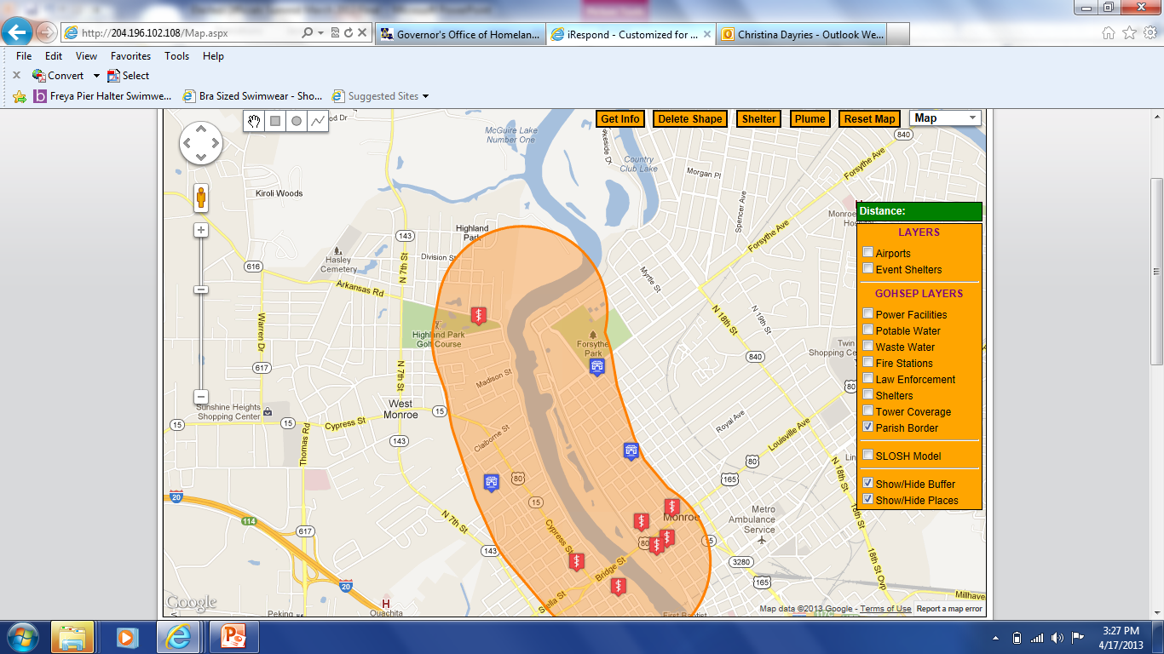
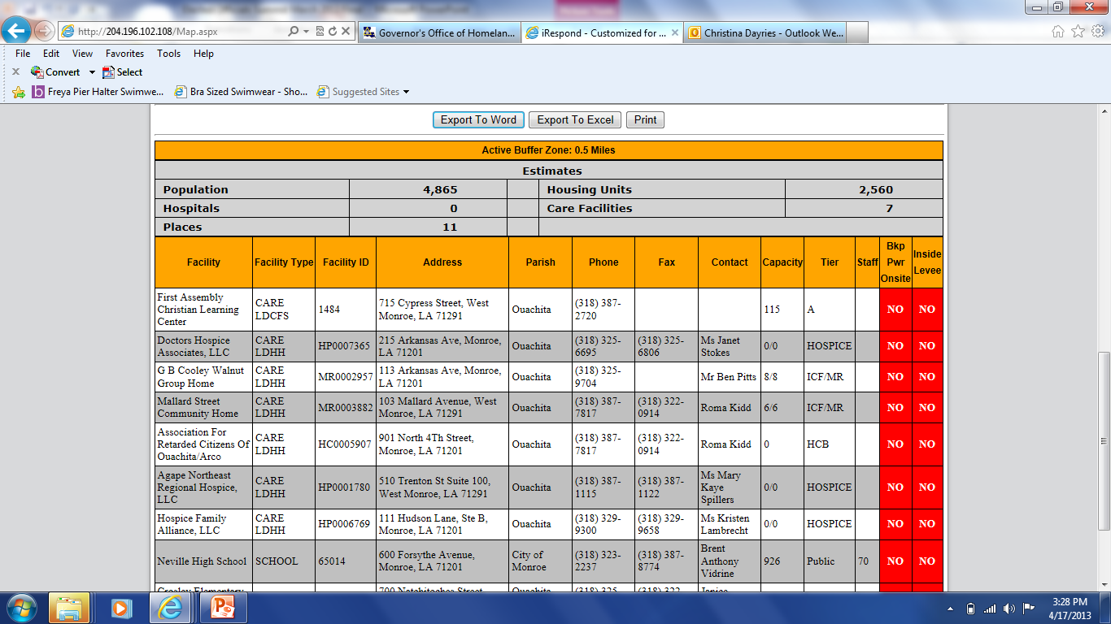
LEAD Portal

Slide 68
Resources + Tools
Virtual Louisiana
Louisiana Emergency Assessment Data Portal (LEAD)
Louisiana Business Emergency Operations Center (LA BEOC)
Louisiana Public Assistance (LAPA/LAHM) websites
Get A Game Plan website
virtualla.la.gov
lead.gohsep.la.gov
labeoc.org
louisianapa.com
louisianahm.com
getagameplan.org

Slide 69
Closing Comments
Points of Contact
James Waskom, Director 225-925-7345 james.waskom@la.gov
Will Rachal, Chief of Staff 225-925-7345 william.rachal@la.gov
Christina Dayries, Deputy Director, Grants & Administration 225-358-5599 christina.dayries@la.gov
Mark Riley, Deputy Director, Disaster Recovery 225-376-5493 mark.riley@la.gov
Chris Guilbeaux, Deputy Director, Prep, Response & Interop 225-925-7333 christopher.guilbeaux@la.gov

Slide 70
W
W
MOREHOUSE
E
MOREHOUSE
E
CLAIBORNE
CLAIBORNE
WEST
WEST
EAST
UNION
EAST
BOSSIER
UNION
BOSSIER
B
B
S
S
CARROLL
7
8
CARROLL
T
T
GOHSEP Regions
E
E
LINCOLN
R
LINCOLN
CADDO
R
CADDO
RICHLAND
OUACHITA
RICHLAND
OUACHITA
MADISON
JACKSON
MADISON
BIENVILLE
JACKSON
BIENVILLE
FRANKLIN
RED
FRANKLIN
RED
CALDWELL
CALDWELL
TENSAS
N
TENSAS
DESOTO
N
DESOTO
RIVER
RIVER
A
A
T
T
WINN
C
WINN
C
H
H
CATAHOULA
I
CATAHOULA
I
6
Regional Coordinators (RCs) are the primary points of contact for Parish officials.
T
T
C
LASALLE
C
O
LASALLE
O
O
SABINE
O
SABINE
C
C
GRANT
GRANT
N
H
N
H
C
E
C
E
O
S
O
S
R
R
D
D
I
I
A
RAPIDES
A
VERNON
RAPIDES
VERNON
AVOYELLES
AVOYELLES
T
WEST
WEST
EAST
EAST
A
FELICIANA
A
9
FELICIANA
WASHINGTON
SAINT
WASHINGTON
FELICIANA
SAINT
FELICIANA
N
HELENA
N
HELENA
G
EVANGELINE
2
G
EVANGELINE
I
BEAUREGARD
I
BEAUREGARD
P
POINTE
P
SAINT
POINTE
SAINT
A
ALLEN
A
ALLEN
COUPEE
LANDRY
COUPEE
LANDRY
EAST
EAST
SAINT
H
SAINT
BATON
H
4
BATON
TAMMANY
O
TAMMANY
WEST
O
WEST
ROUGE
5
BATON
ROUGE
BATON
A
LIVINGSTON
A
ROUGE
LIVINGSTON
ROUGE
ACADIA
ACADIA
SAINT
JEFFERSON
SAINT
CALCASIEU
JEFFERSON
CALCASIEU
LAFAYETTE
LAFAYETTE
MARTIN
DAVIS
MARTIN
DAVIS
ASCENSION
IBERVILLE
ASCENSION
IBERVILLE
SAINT
SAINT
ORLEANS
JOHN
ORLEANS
ST.
JOHN
ST.
JAM ES
JAM ES
J
SAINT
J
IBERIA
SAINT
IBERIA
ASSUMPTION
ASSUMPTION
E
1
CHARLES
E
CAMERON
CHARLES
CAMERON
F
VERMILION
F
VERMILION
SAINT BERNARD
ST.
3
SAINT BERNARD
ST.
F
F
P
L
P
MARTIN
L
MARTIN
E
E
L
A
L
A
R
SAINT
R
SAINT
A
F
A
F
S
MARY
S
MARY
Q
O
Q
O
O
O
N
N
U
U
U
IBERIA
U
E
VER
R
E
R
M
C
M
TERREBONNE
C
TERREBONNE
I
H
I
H
N
E
N
E
E
E
S
S

Slide 71
Questions + Answers

