Slide 1
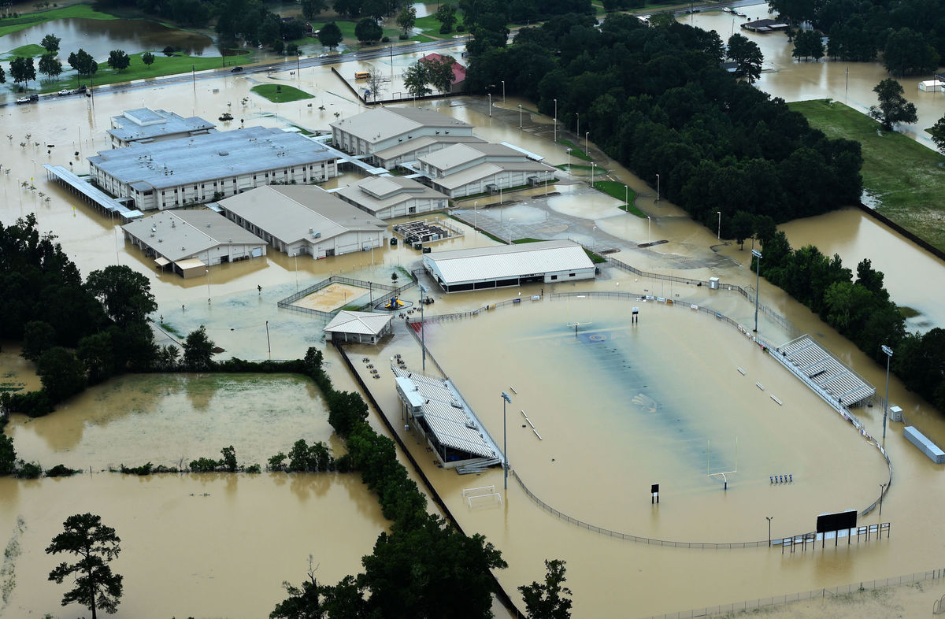
Contracting under FEMA grants
Do you know what to do?

Slide 2
You need to know the source of the money
When contracting from services before, during or after a disaster, you need to know the source of the money:
State dollars – State Procurement Code
Local – Most restrictive rule
PNPs – Federal rules
Federal
FEMA
HUD

Slide 3
Procurement for FEMA grants
Improper procurement and compliance remains the #1 reason nationally for deobligation.
FEMA – Monitors and enforces grant compliance, educates and informs, de-obligates and recoups money from noncompliant grantees
DHS – Office of Inspector General (OIG) – Provides oversight of agency, grantees, and subgrantees
GOHSEP- We are here to help applicants and also protect the State interest

Slide 4
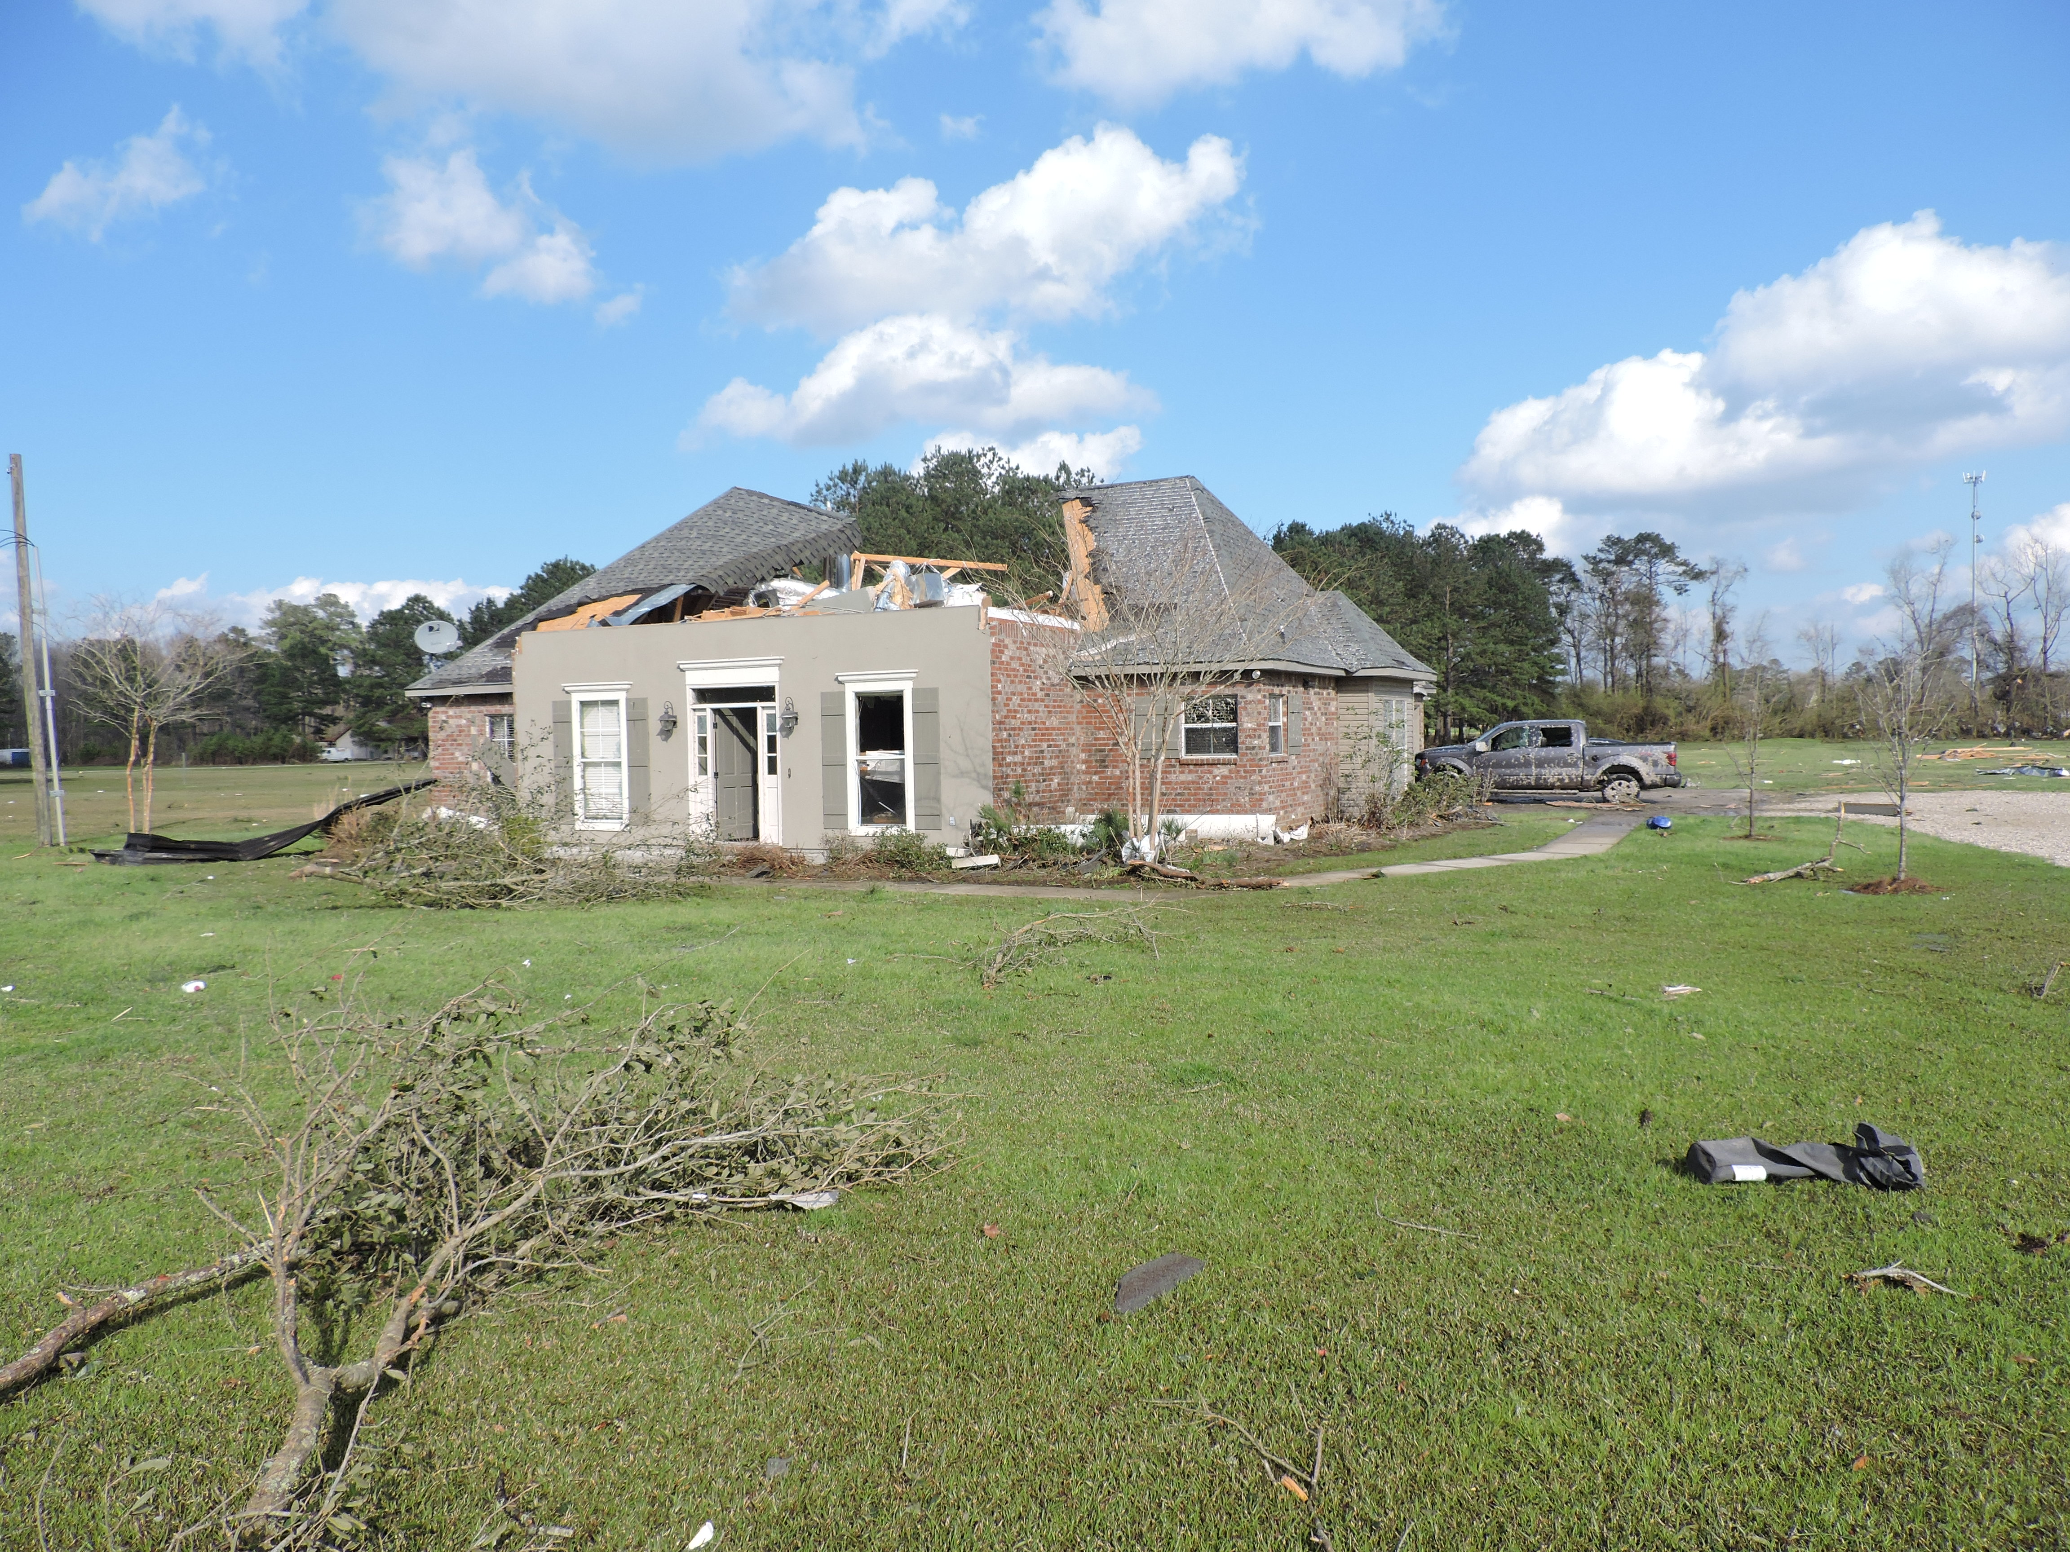
Pre-disaster contracts
Why its
recommended
to applicants:
Time
Better prices
More competition
More support
WARNING: Re-compete and review these contracts annually

Slide 5
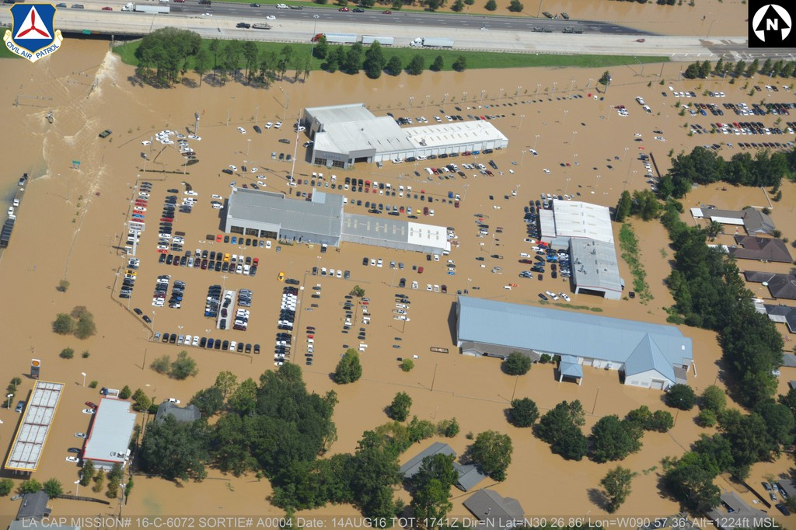
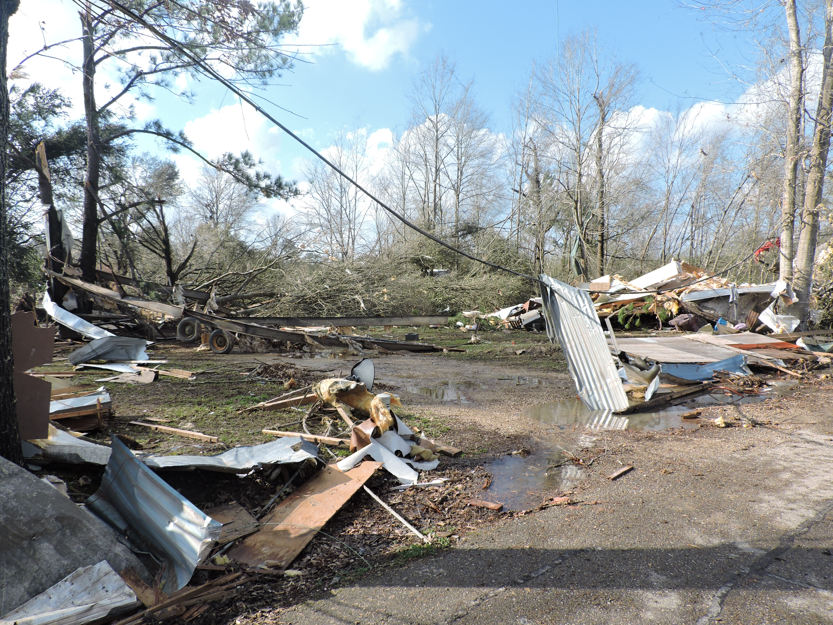
When disaster strikes
Emergency procurement -> low to no competition
Emergency- threats to health, life or safety
Exigency- threats that require an immediate response

Slide 6
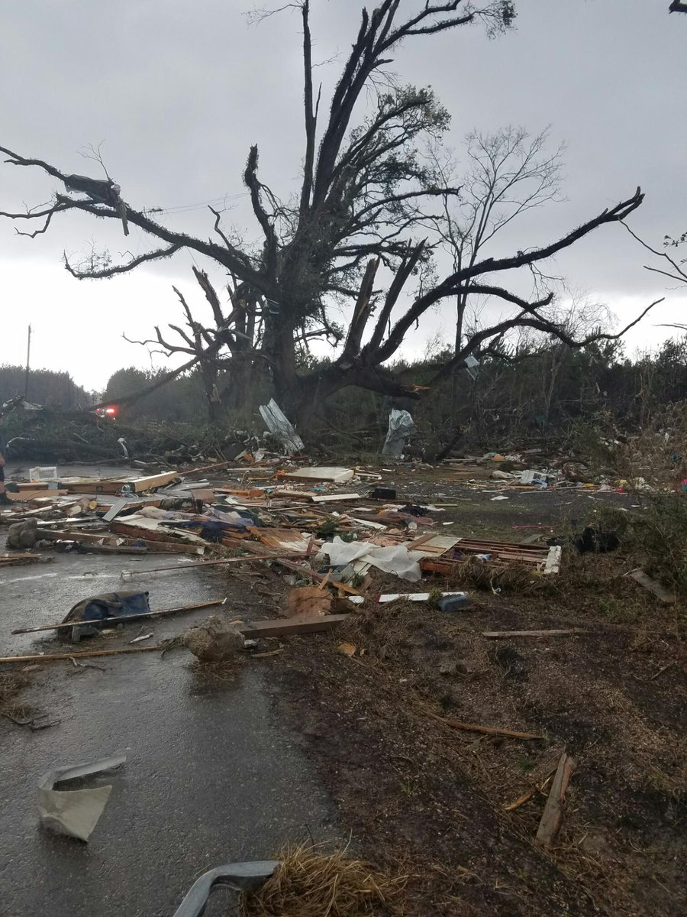
Transitioning to Recovery
Transitioning away
from Emergency
Procurement
protects dollars.
Should be done
as soon as
reasonably possible.

Slide 7
WATCH OUT
If you are contracting as a result of a disaster PRE-December 2014, different rules may apply
44 CFR 13.36 (State, local and tribal)
2 CFR part 215 (Higher Education, Hospitals, PNPs)
If you are a State agency
State Procurement Code
Procurement of Recovered Materials (2 CFR 200.322)
Contract Clauses in 2 CFR 200.326

Slide 8
Recovery Contracting: Procurement Standards for non-State agencies
Written Procedures: Conflict of Interest, standards of conduct, etc.
Maintaining records with details
Cost analysis (expenditure above $150,000)
6 affirmative steps for small and women/minority owned businesses (2 CFR 200.320)
No Geographical preferences (mostly)
2 CFR 200.318-200.326

Slide 9
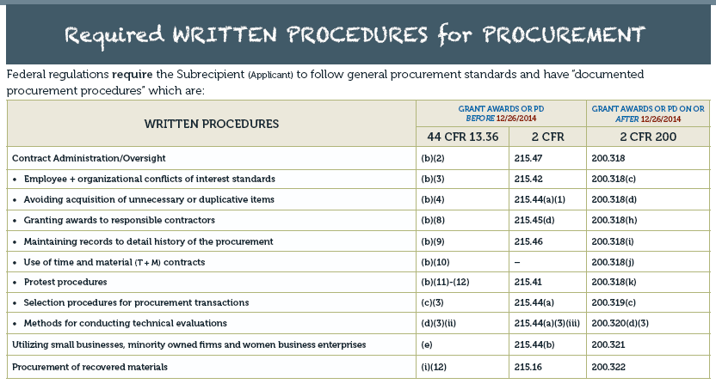

Slide 10
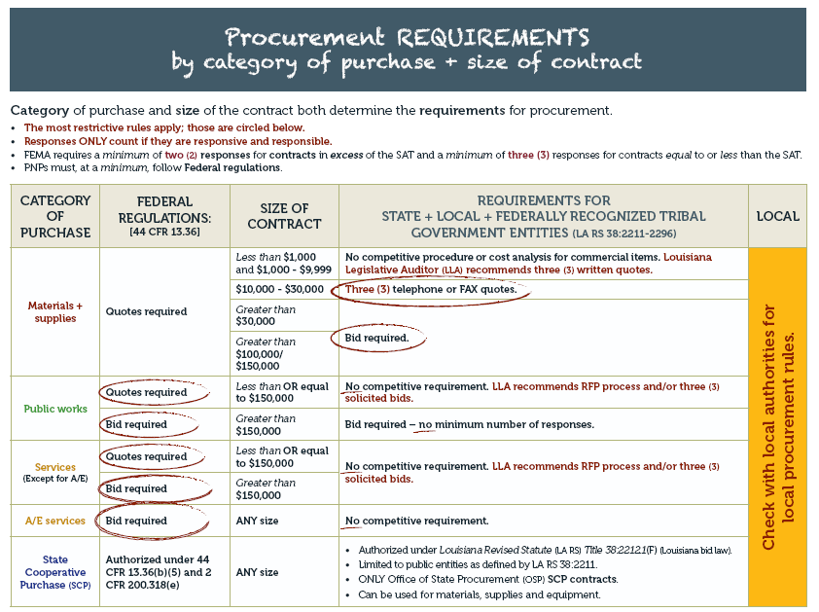
Category and Price matter too…

Slide 11
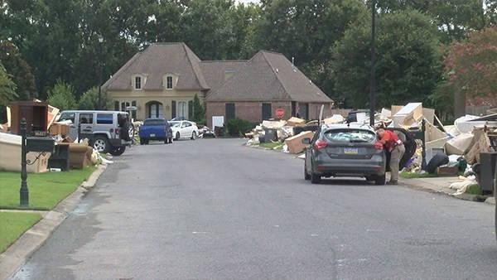
Methods of Procurement
Micro Purchase procedures (under $3500)
Small Purchase Procedures (Simplified Acquisition threshold $150,000)
Sealed Bids
Competitive Proposals
Non-competitive
Emergency
Single Source
Insufficient Response

Slide 13
Types of Acceptable Contracts
Lump sum- clear scope and price
Unit price- price per unit
Cost plus fixed fee- known cost + fixed fee
Intergovernmental agreements- common goods and services
Time and Materials (T&M) – ONLY if no other type of contract is suitable. Must have ceiling clause

Slide 14
Problem Contracts
Pre-awarded/pre-positioned/pre-disaster/standby- still needs to comply with current federal procurement standards; Scope of work; Price/costs fair and reasonable
Time & Materials (T&M) – limited use only when scope or duration of work in unclear
Cost-Plus-Percentage-of-Cost & Percentage-of-Construction- explicitly prohibited
Piggyback- RARELY allowed by FEMA

Slide 15
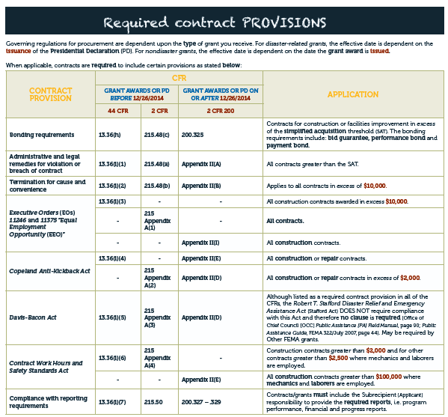

Slide 17
Where to get more information
http://gohsep.la.gov/RESOURCES/OVERVIEW/PUBLICATIONS
https://www.fema.gov/procurement-disaster-assistance-team
Procurement under Grants 2.0 Webinar series
GOHSEP can not give specific recommendations of private contractors

Slide 18
Role that clip….

Slide 19
Volunteer and Donated Resources
Third party donated resources may be eligible to offset the non-Federal portion of the cost for emergency work.
Donated Resources are:
volunteer labor
donated equipment
donated materials
The Applicant may apply the offset if all of the following conditions are met:
1. The donated resource is from a third party
2. The Applicant uses the resource in the performance of eligible Emergency Work; and
3. The Applicant or volunteer organization tracks the resources and work performed, including description, specific locations, and hours.

Slide 21
KEY
TAKEAWAYS

Slide 22
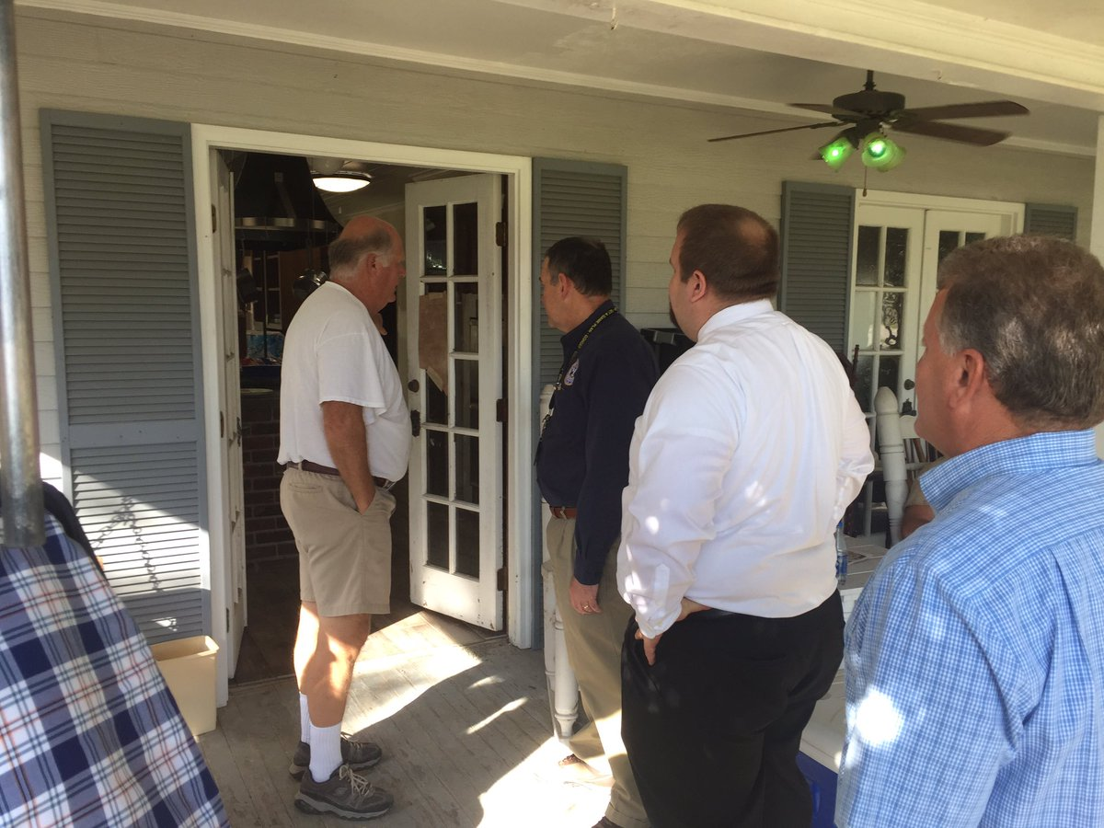
Procurement
FEMA requires applicants to maintain strict oversight to ensure contractors perform according to the terms, conditions and specifications of their contracts or purchase orders
Review of model
monitoring contract clause
Required reports
as a monitoring tool

Slide 23
Procurement
conflicts of interest issues: employees who engage in the selection, award and administration of contracts
Record maintenance: Maintain records sufficient to detail the history of the procurement. These records will include, but are not limited to the following: rationale for the method of procurement, selection of contract type, contractor selection or rejection, and the basis for the contract price.
Maintain records for 3 years until the ENTIRE grant closes at the State level

Slide 24
HUD has even more rules
http://restore.la.gov/
Read the Program Policies regarding the event (2016 floods)
Community Disaster Block Grant (CDBG)- granted by Congress
Davis Bacon
No small threshold

Slide 25
QUESTIONS ?

