Slide 1
L.W.I.N.
Louisiana Wireless
Information Network
System Management & Maintenance Updated January 31, 2023
Department of Public Safety-State Police
Mobility and Communication Services
(225) 925-6036

Slide 2

Infrastructure Update

Slide 3
SYSTEM SUMMARY
144* Total Tower Sites in Operation
6 Operational Mobile Sites

Slide 4
Zone 1:
42 Sites in Full Operation
Pan Am
Bridge City
Livonia
Laplace
St. Tammany Simulcast
Lacombe
Abita Springs
Waldheim
Pearl River
Covington
Slidell
Talisheek
Blond
Sheridan
Geismar
St. James
Larose
Gibson
BR Simulcast
BR
Central
LSU
WBR
Hammond
Gray
Berwick
Baywood
Ramah
Sage Hill
Parker Road
Iberville
Livingston
Jackson
Greensburg
Superdome
South Baton Rouge
Baldwin
Pointe Coupee
Theriot
Paincourtville
Boothville
Mobile Units
94
96
97
98
99
100
Denham Springs
Clinton
St. George

Slide 5
Zone 2:
17 Sites in Full Operation
N. Simulcast
Gretna
Galleria
NO East
Lafitte
Bayou Gauche
Hahnville
St. Rosalie
Kenner
Airport
Port Fourchon
Reggio
Montegut
Houma
Bourg
Buras
Wilmer
Grand Isle

Slide 6
Zone 3:
53 Sites in Full Operation
Clearwater
Monroe
Winnfield
Delhi
Chopin
Dry Prong
Hagewood
Bossier(City)
Farmerville
Minden
Natchitoches
Bastrop
Greenwood
Ruston
Hineston
Ashland
Vivian
Newellton
Noble
Transylvania
Alexandria
Avoyelles
Bellevue
Bernice
Calhoun
Columbia
Ferriday
Homer
Jena
Jonesboro
Mansfield
Many
Marion
Oak Grove
Plain Dealing
Ringgold
Sentell
Tallulah
Wheeling
Shreveport
West Monroe
Chase
Keachi
Coushatta
Shongaloo
Sibley
Vick
Calvin
Arcadia
Enterprise
Holloway
Chatham
Cypress

Slide 7
Zone 4:
32 Sites in Full Operation
Abbeville
Acadia
Arsene LeBleu
DeQuincy
Dry Creek
Jeanerette
Jennings
Johnson Bayou
Lafayette
Lake Charles
Leesville
Merryville
Opelousas
Parks
Rockefeller
Rosepine
Scott
Sulphur
Vermillion
Ville Platte
Vinton
Craven
Hicks
Hornbeck
Oakdale
Roseland
E. Jennings
Anacoco
Oberlin
Moss Bluff
New Iberia
Eunice

Slide 8
Channel Summary
Total Channels 1310
1259 Channels on 144 Sites
51 Channels on 6 Mobile Sites

Slide 9
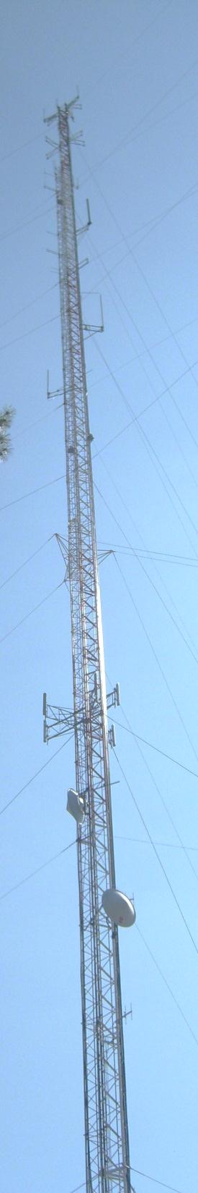
System
Statistics

Slide 10
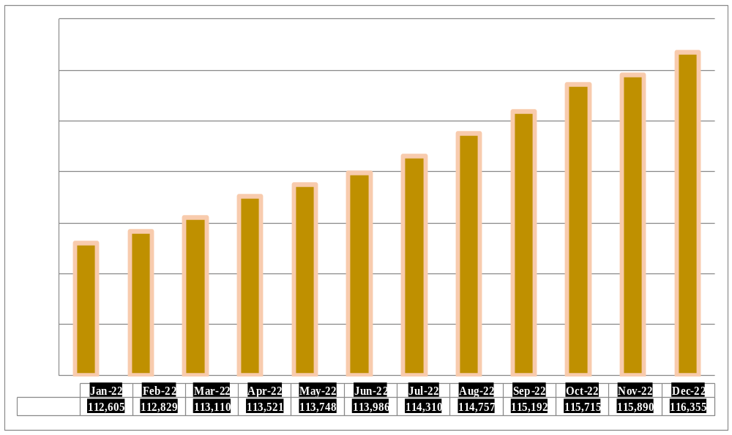
SUBSCRIBERS

Slide 11
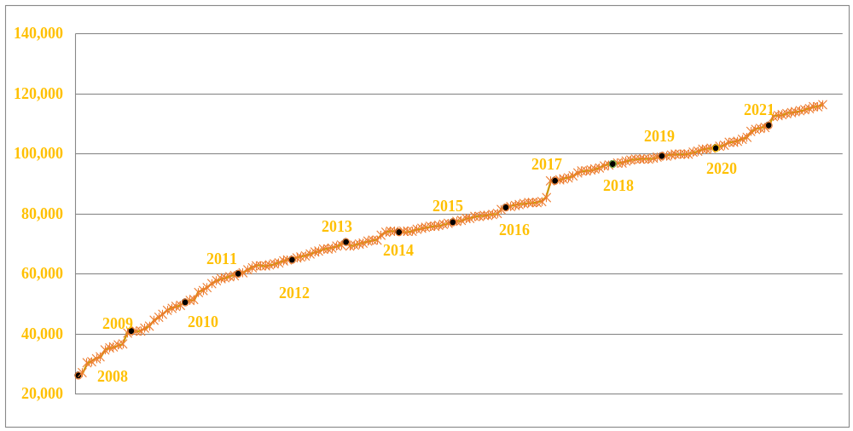
Subscribers 2008 to 2022
2022

Slide 12
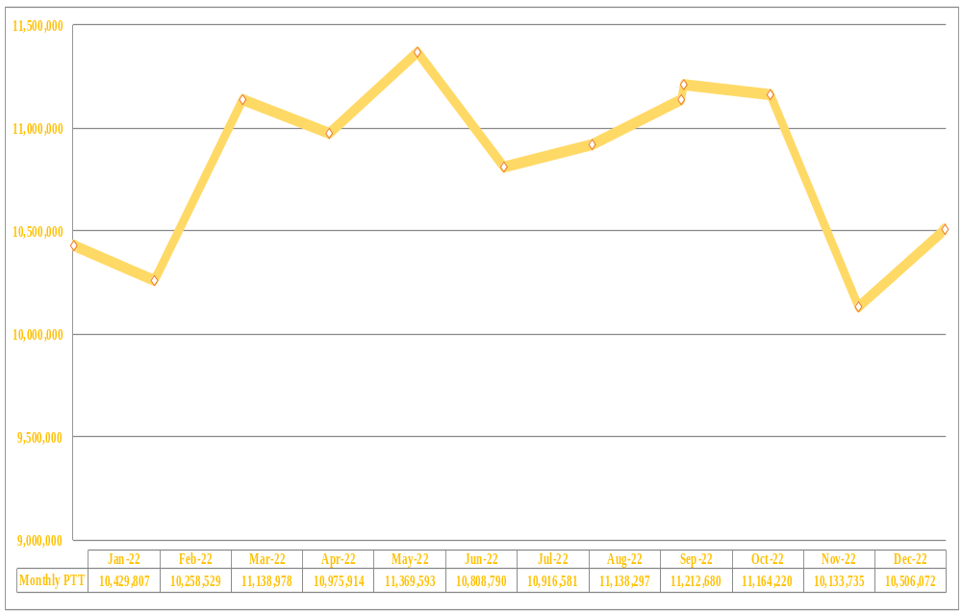
PUSH TO TALK
PTT

Slide 13
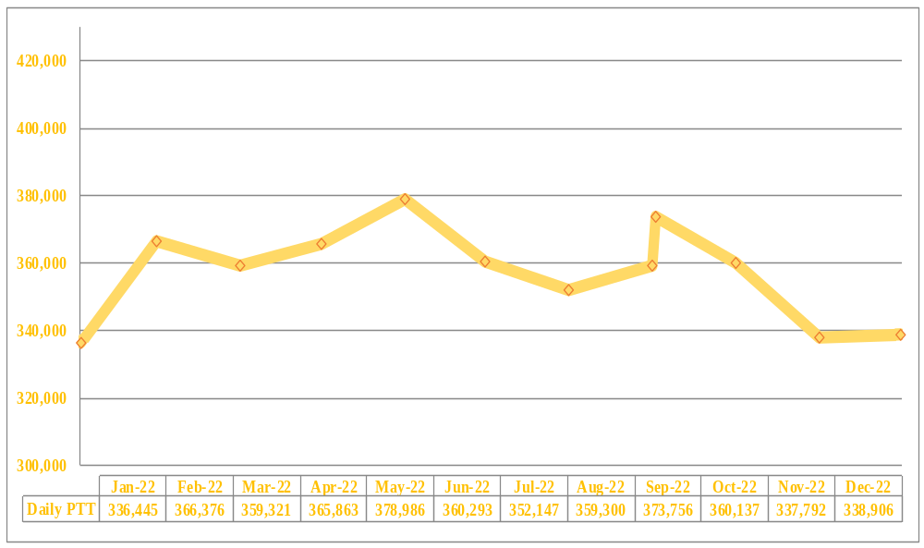
PUSH TO TALK PER DAY

Slide 14
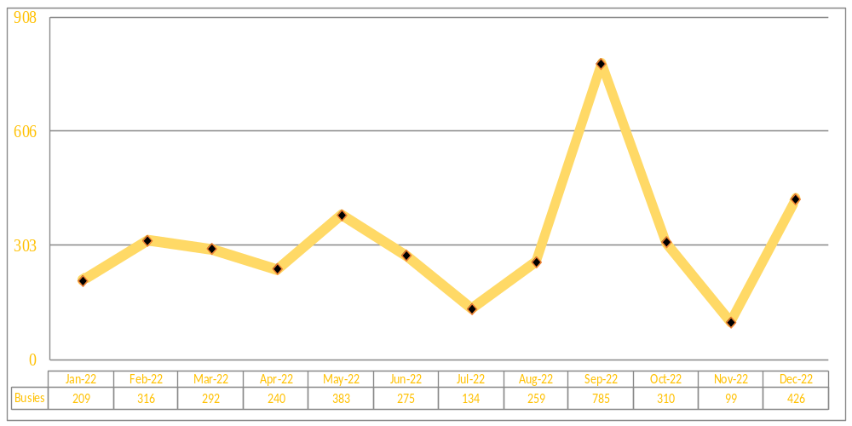
BUSIES

Slide 15
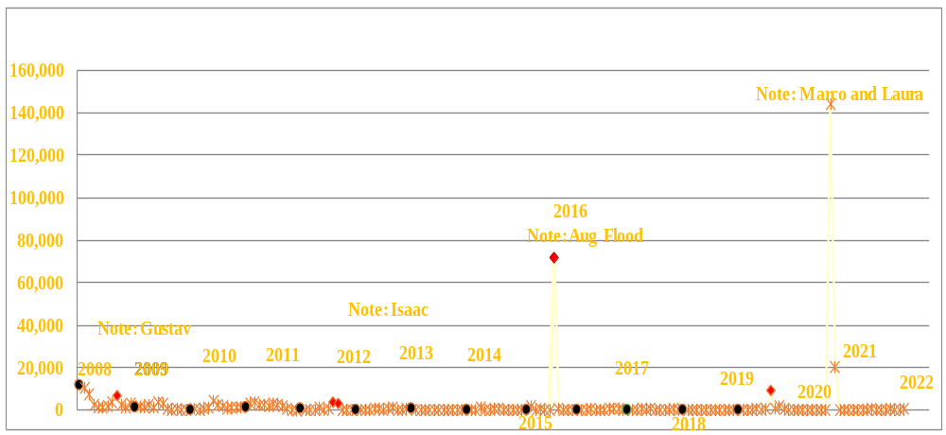
Busies 2008 to 2022

Slide 16

Top Busy Sites
Hahnville 309
PanAm 259
Abbeville 110

Slide 17
SITE OUTAGES
Abbeville | Berwick | Clinton | Farmerville | Hahnville
Acadia | Bridge City | Columbia | Geismar | Houma
Arsene Lebleu | Calhoun | Coushatta | Gray | Iberville
Ashland | Cameron | Denham Springs | Greensburg | Jeanerette
Baywood | Chopin | Dequincy | Gretna | Jennings
Bellevue | Clearwater | Enterprise | Hagewood | Lake Charles
Total Downtime: 2,291 Hours

Slide 18
SITE OUTAGES
LaPlace | Montegut | Reggio | St. James | Wilmer
Larose | Natchitoches | Ringgold | Sulphur | Winnfield
Leesville | Opelousas | Rockefeller | Transylvania
Livonia | Parker | Sentell | Vermillion
Many | Pointe Coupee | Shreveport | Vick
Merryville | Ramah | Slidell | Vinton
Total Downtime: 2,291 Hours

Slide 19
SITE OUTAGE DATA
Telco 71%

Slide 20
SYSTEM SATISTICS

Slide 21
Subscriber Statistics
Security Groups
192
Agencies
606
Talkgroups
6420

Slide 22

Agencies Added Last 4 Months
Jefferson davis parish mosquito control

Slide 23
System Coverage

Slide 24
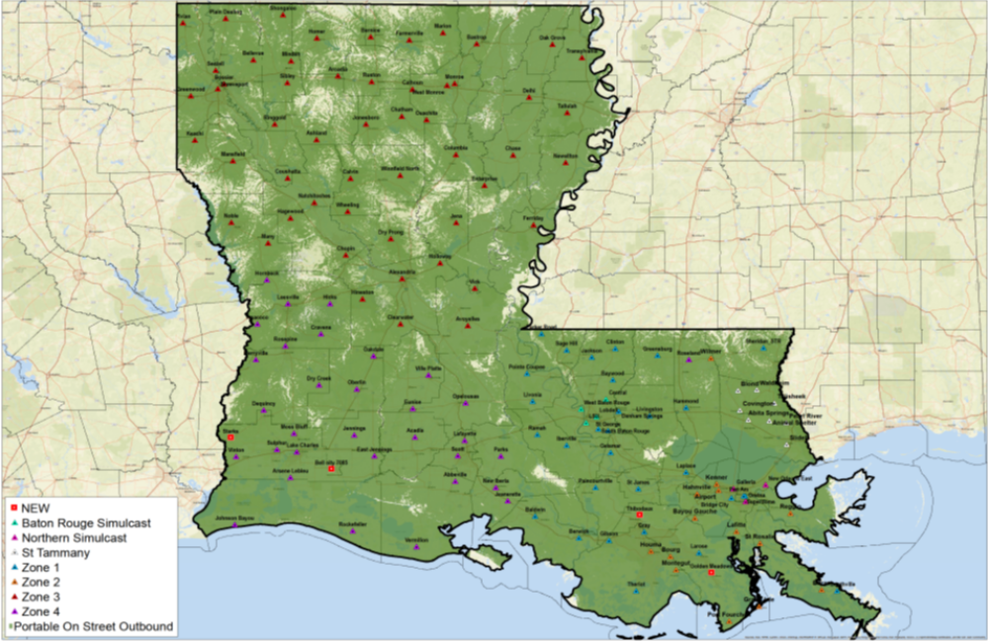
Present Coverage

Slide 25
Questions?

Slide 26
Thank You!

