Slide 1
Cost Analysis

Slide 2
Objective
Who has the responsibility to perform a cost analysis.
What is a cost analysis, when is it required and why.
What is cost reasonableness and how it is determined.

Slide 3
Objective (Continued . . . )
Discuss the cost analysis process and some of the speed bumps that might impact it.

Slide 4
Responsibility
The Subrecipient (Applicant) has the sole responsibility to prepare/perform a cost analysis.
GOHSEP can assist and validate the cost analysis.

Slide 5
Why must a cost analysis be performed?
Because it is REQUIRED by 44 Code of Federal Regulations (CFR) 13.36(f)(1) and 2 CFR 200.318.
If one is procuring with Federal funds, cost analyses must be performed.

Slide 6
Competitive procurement can minimize cost analysis requirements
GOHSEP/FEMA usually views a competitively procured contract with an adequate number of responses as sufficient.

Slide 7
Other situations requiring a cost analysis
When there is . . .
Lack of competition/noncompetitive procurement.
Sole source contract.

Slide 8
Other situations requiring a cost analysis (Continued . . . )
For all . . .
Scope alignments
Contract amendments
Change orders

Slide 9
What is a cost analysis?
A Recipient’s demonstration that the cost of an acquisition is reasonable:
It is the “story” of recipient's procurement.
An analytical explanation of why the procurement decisions were reasonable.

Slide 10
What is “cost reasonableness”?
A cost that is both fair and equitable for the type of work performed under given circumstances. FEMA 321

Slide 11
What is “cost reasonableness”? (Continued . . . )
In determining reasonableness of a given cost, consideration shall be given to:
Cost that is within reasonable market prices for comparable goods or services.

Slide 12
What is “cost reasonableness”? (continued)
Whether the Subrecipient (Applicant) acted with prudence in the given circumstances.
Cost does not show significant deviations from the established practices.

Slide 13
How is cost reasonableness determined?
Using comparisons, which might include:
Historic data for cost of similar work.
Average costs for similar work in the same market.

Slide 14
How is cost reasonableness determined? (Continued . . . )
Catalogs
Internet

Slide 15
How is cost reasonableness determined? (Continued . . . )
Using cost comparisons, which might include:
Published unit costs from nationally – or industry – recognized cost estimating standards like RSMeans, BNi Costbooks, Marshal & Swift and others.

Slide 16
How complex does a cost analysis need to be?
The method and degree of analysis depends on the facts surrounding each procurement.

Slide 17
Is a specific format required?
No specific format is required.
A sample cost analysis has been provided that follows the process outlined in this presentation.

Slide 18
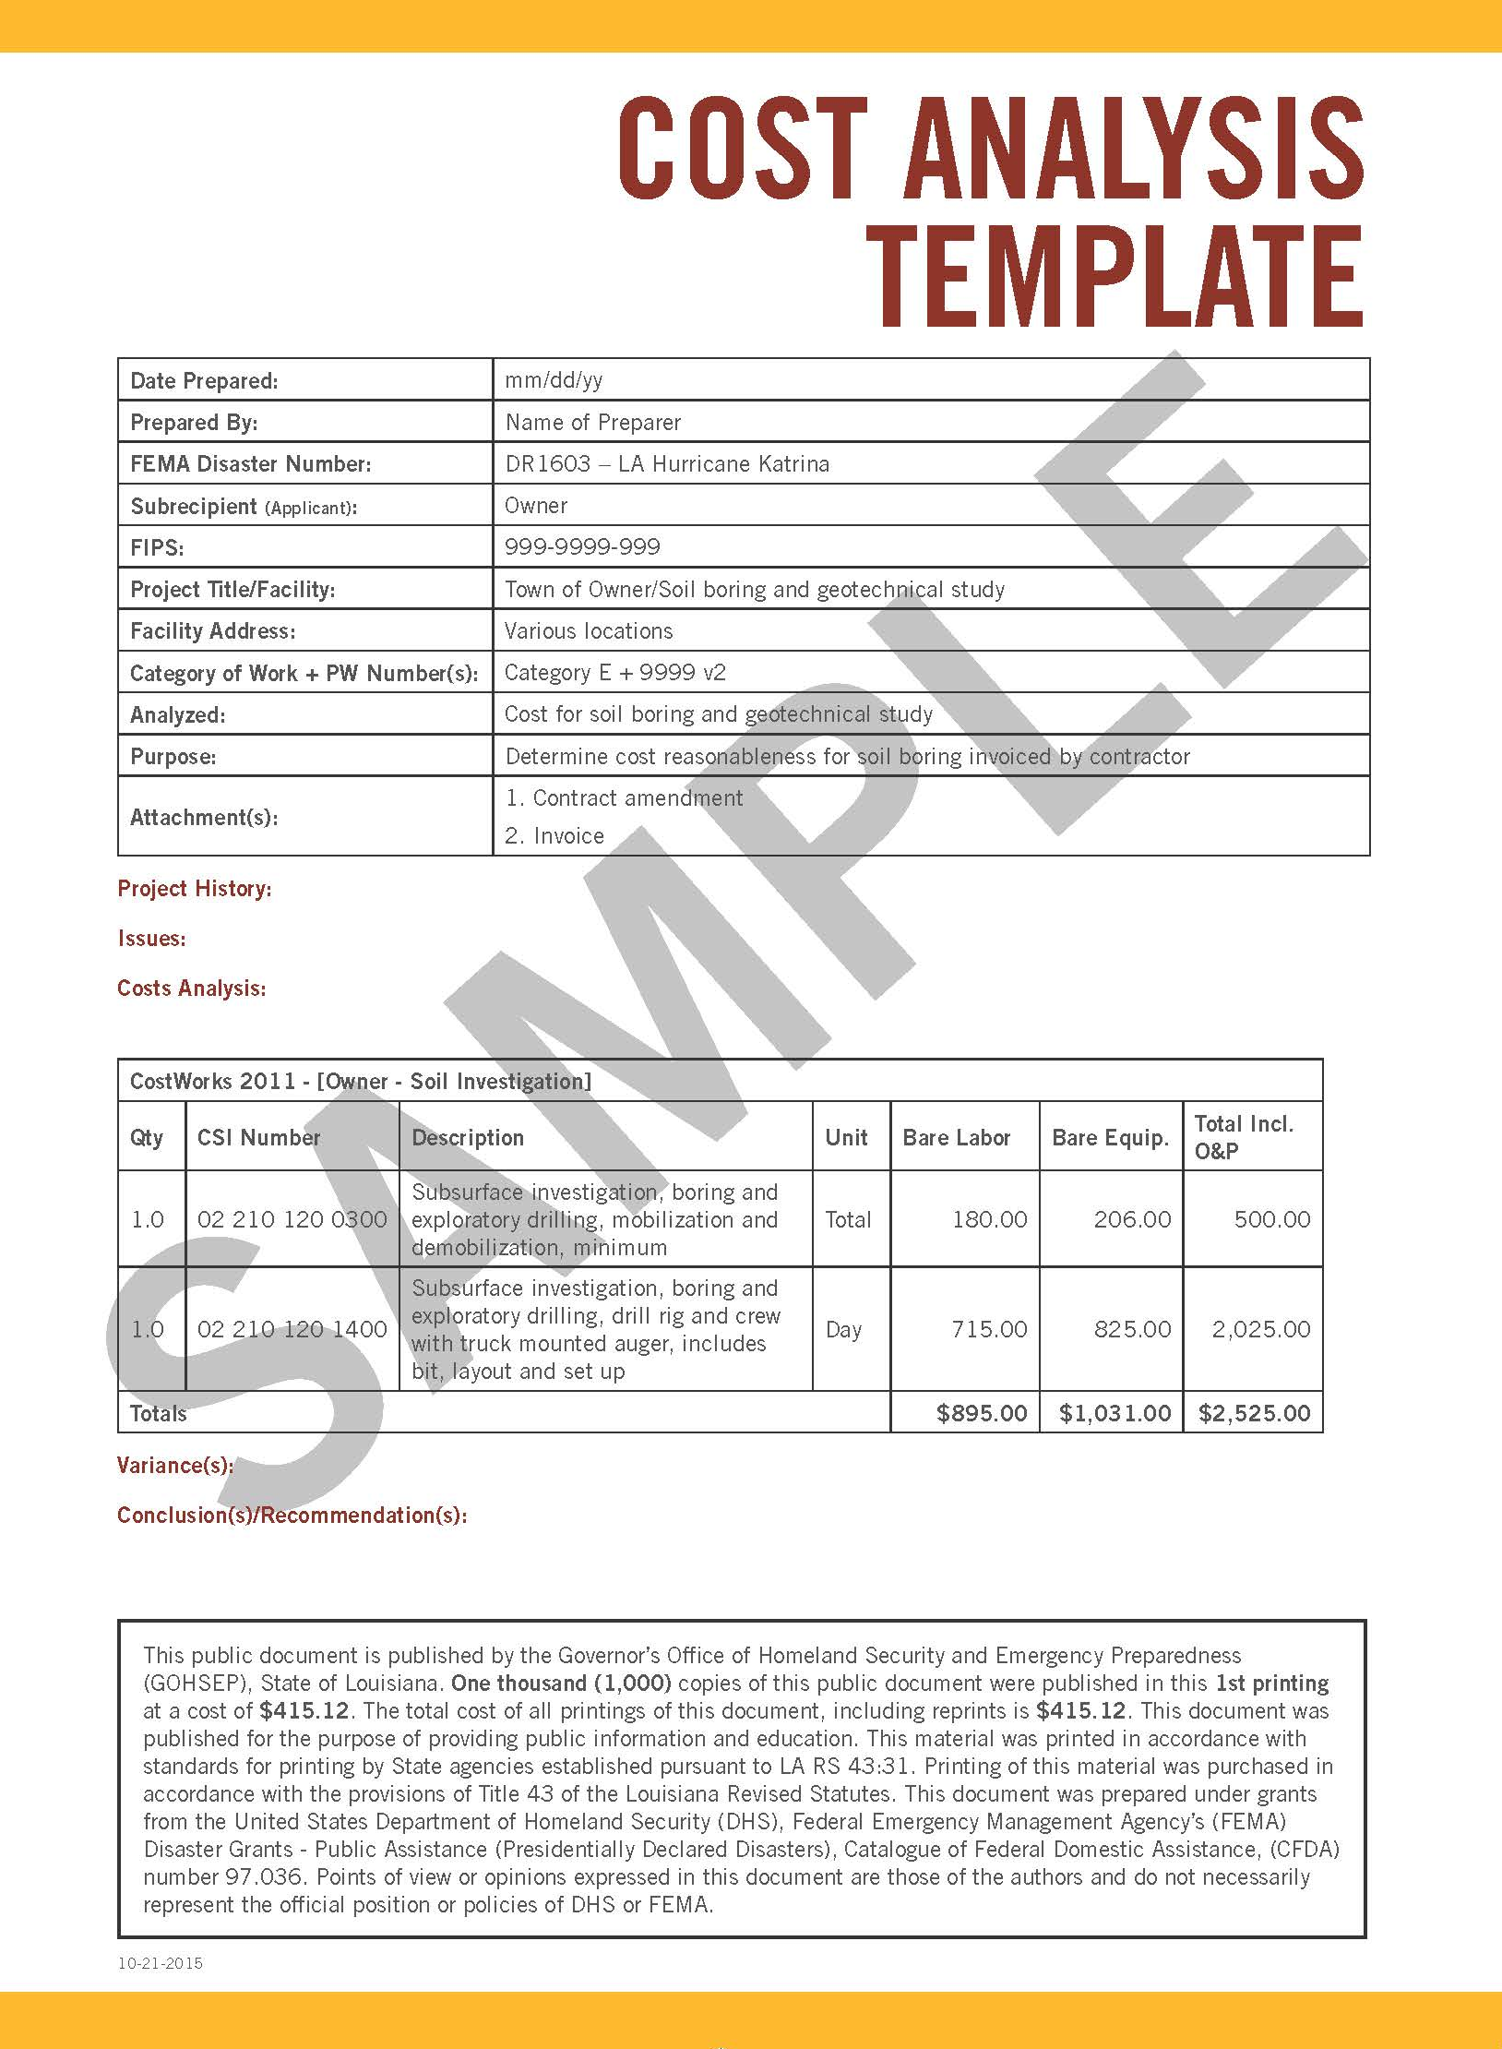
Date Prepared:
Facility Address:
Prepared By:
Category of Work + PW Numbers(s):
FEMA Disaster Number:
Analyzed:
Subrecipient (Applicant):
Purpose:
FIPS:
Attachment(s):
Project Title/Facility:

Slide 19
Cost analysis process
Identify the who, what, when, where and why:
Person preparing the analysis and the date prepared.

Slide 20
Cost analysis process (Continued . . . )
FEMA disaster number.
Recipient/Subrecipient (Applicant) and Federal Information Processing System (FIPS)/applicant ID number.

Slide 21
Project History:
Issues:
Cost Analysis:

Slide 22
Cost analysis process (Continued . . . )
Identify the methods to justify the cost estimation:
There are many different methods of comparison that can be used to establish cost reasonableness.

Slide 23
Cost analysis process (Continued . . . )
Adjust the data to account for any relevant differences such as:
Inflation/time value of money (CPI, etc.).
Price volatility and raw materials.

Slide 25
Variance(s):
Conclusion(s)/Recommendations(s):

Slide 26
Cost analysis process (Continued . . . )
Conclusion:
Is the cost reasonable or not?
If the project cost is within 10% of the adjusted cost, then it is deemed to be reasonable.

Slide 27
Cost analysis process (Continued . . )
Recommendation (if applicable):
If the cost is determined to be reasonable, and depending on what purpose the cost analysis is being performed for, one may make a recommendation about the desired outcome.

Slide 28
Cost analysis process (Continued . . . )
Last but not least, provide references and citations to back up all cost analyses.
Back up, Back up, Back up.

Slide 29
Cost analysis competitive procurement can minimize cost analysis requirements
Procuring competitively does not eliminate the need for cost analyses, but . . .

Slide 30
Sole source procurement
Procurement from one and only one source that possesses a unique product/services having singular characteristics or performance capability.

Slide 31
What about sole source or non-competitive procurement?
Cost analysis is still required.
To be approved must meet the specific requirements in 44 CFR 13.36(d)(4)(i) A-D and 2 CFR 200.321(f).

Slide 32
What about sole source or non-competitive procurement? (Continued . . . )
Sole source cost analyses are difficult because of their exceptional nature:

Slide 33
What about sole source or non-competitive procurement? (Continued . . . )
Compelling narrative required which should include specific technical requirements of the product or service and supportable evidence that due diligence has been performed in an objective market analysis.

Slide 34
What about sole source or non-competitive procurement? (Continued . . . )
Previous transactions from sole source vendor may be the only option.
Acceptability is determined on a case-by-case basis by GOHSEP/FEMA.

Slide 35
Does this all overwhelm you?

Slide 36
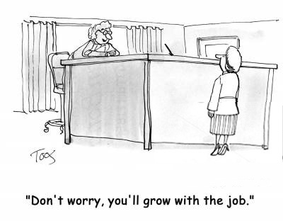

Slide 37
Questions?

Slide 38
Recovery Division Legal Contacts
Ben Plaia, Jr.
Legal Counsel
Disaster Recovery Division
(225) 242-6030
ben.plaia@la.gov
LaShaunté S. Martin
Deputy Legal Counsel
Disaster Recovery Division
(225) 379-4048
lashaunte.martin@la.gov

