Slide 1
Hazard Mitigation
Notes:
Starting October 1, 2014 all HMGP Closeouts will be processed through LAHM
Non-Disaster Grant Closeouts (PDM, FMA, SRL, RFC) will continue to be submitted via paper files. These grants are not yet in LAHM.

Slide 2
Overview
Current Initiatives
Organizational Update
Notes:
Starting October 1, 2014 all HMGP Closeouts will be processed through LAHM
Non-Disaster Grant Closeouts (PDM, FMA, SRL, RFC) will continue to be submitted via paper files. These grants are not yet in LAHM.

Slide 4
Hazard Mitigation
State Applicant Liaison
Shontae Davis
Section Chief
Notes:
Starting October 1, 2014 all HMGP Closeouts will be processed through LAHM
Non-Disaster Grant Closeouts (PDM, FMA, SRL, RFC) will continue to be submitted via paper files. These grants are not yet in LAHM.

Slide 5
Hazard Mitigation State Applicant Liaisons
Shontae Davis- SAL, Section Chief
  Kim Ryals- SAL, Team Lead
    Regions 1, 3, 6, 8
  Leanne Guidry- SAL, Team Lead
    Regions 2, 4, 5, 7, 9, State Agencies

Slide 6
Hazard Mitigation State Applicant Liaisons
Hazard Mitigation Assistance (HMA)
  Builds safer + stronger communities.
SALs help you through the entire HMA grant cycle (application, approval, closeout).
There is a SAL for every Region!!

Slide 7
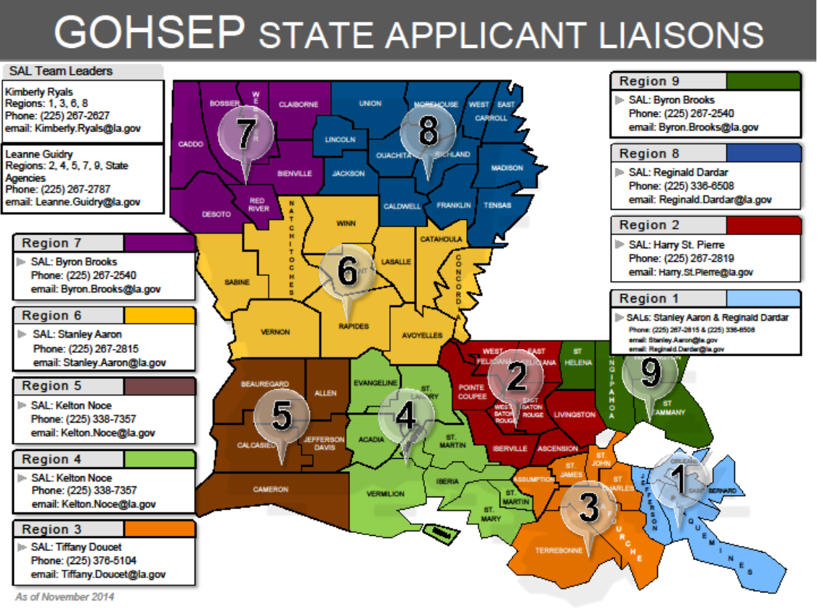

Slide 8
Hazard Mitigation State Applicant Liaisons
Why are SALs important to you?
  Source of Information.
    Common Questions
  Provide Assistance with applications, outreach, and training.
  Link between OEP, Parish, and FEMA.
  Advocate for your Parish or local government.
Notes:
Common Questions: 1. Procurement 2. Application Process 3. Project Status- When will my project be approved? Can I start work now? Add more questions and narrow down!

Slide 9
Hazard Mitigation State Applicant Liaisons
  3 Things you should Remember
  Who is your SAL?
  SALs provide assistance for every phase of your HMA grant cycle.
  We are here to Help!!

Slide 10
Hazard Mitigation State Applicant Liaisons
QUESTIONS??

Slide 11
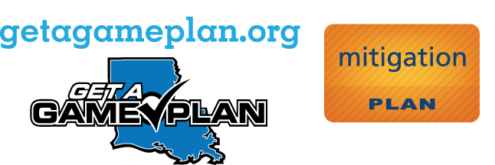
For more information
Visit:
11
www.fema.gov/government/grant/hma/grant_resources.shtm

Slide 12
Contact Info
Shontae Davis
shontae.davis@la.gov
Section Chief-Hazard Mitigation SALS

Slide 13
Hazard Mitigation
Grants Management
Tenesha Wilson
Section Chief
Notes:
Starting October 1, 2014 all HMGP Closeouts will be processed through LAHM
Non-Disaster Grant Closeouts (PDM, FMA, SRL, RFC) will continue to be submitted via paper files. These grants are not yet in LAHM.

Slide 14
Payments
Reimbursement Process
  Reimbursement is the preferred method of payment to Subgrantees.
    Cancelled checks are no longer required to receive the reimbursement.
      Cancelled checks must be submitted not later than 45 days following payment.
Notes:
GOHSEP has amended the process for reimbursements to allow processing without cancelled checks as an alternative to blanket advances. This addresses cash flow challenges and also allows for an expedited review process. Cancelled checks should be uploaded into LAHM within 30-45 days following payment. Advances are still allowed, but the new reimbursement process is highly encouraged.

Slide 15

Payments cont’d
Timeframe for Payment
  Payments are made in 45 days with a complete and accurate packet.
  Documents uploaded to LAHM should include:
    Completed and signed RRF Form
    Documentation to support expenses (i.e. invoices, procurement, contracts, etc.)

Slide 16
What is necessary to submit for a reimbursement? (Continued . . . )

Slide 17

Potential delays for any payment request
Missing or improper documentation.
Improper procurement or lack thereof.
Project amendments.
Contract amendments.
Material changes.
Need for cost analysis.

Slide 18
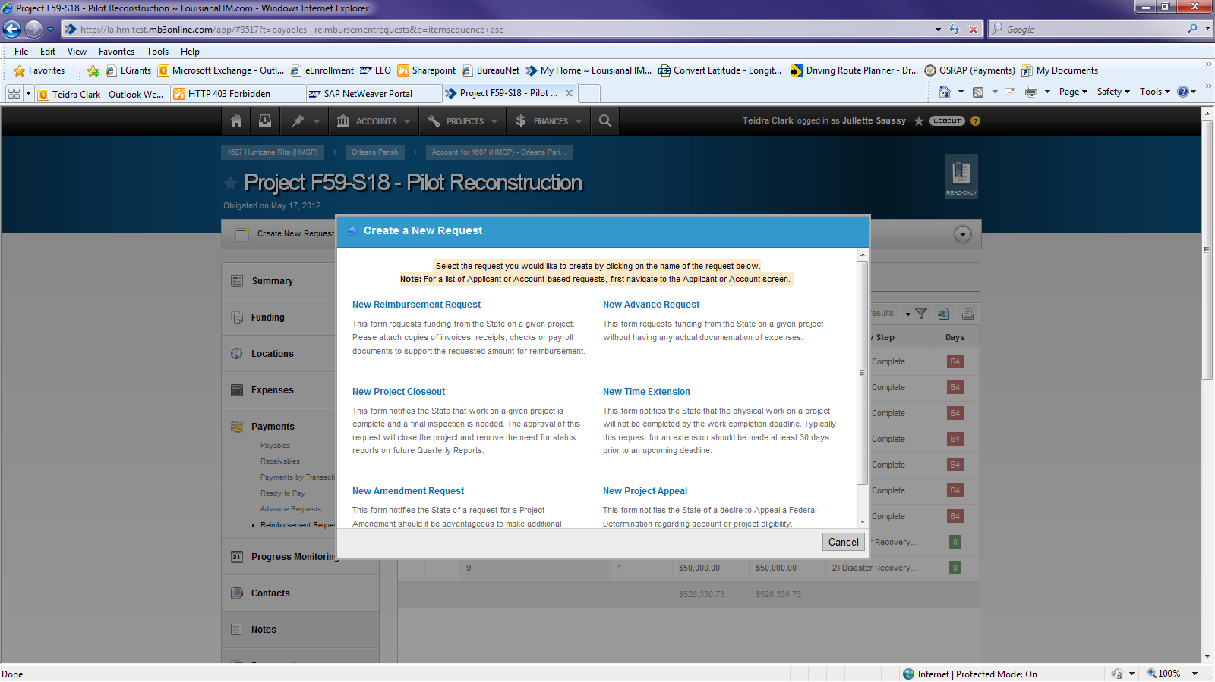

Slide 19
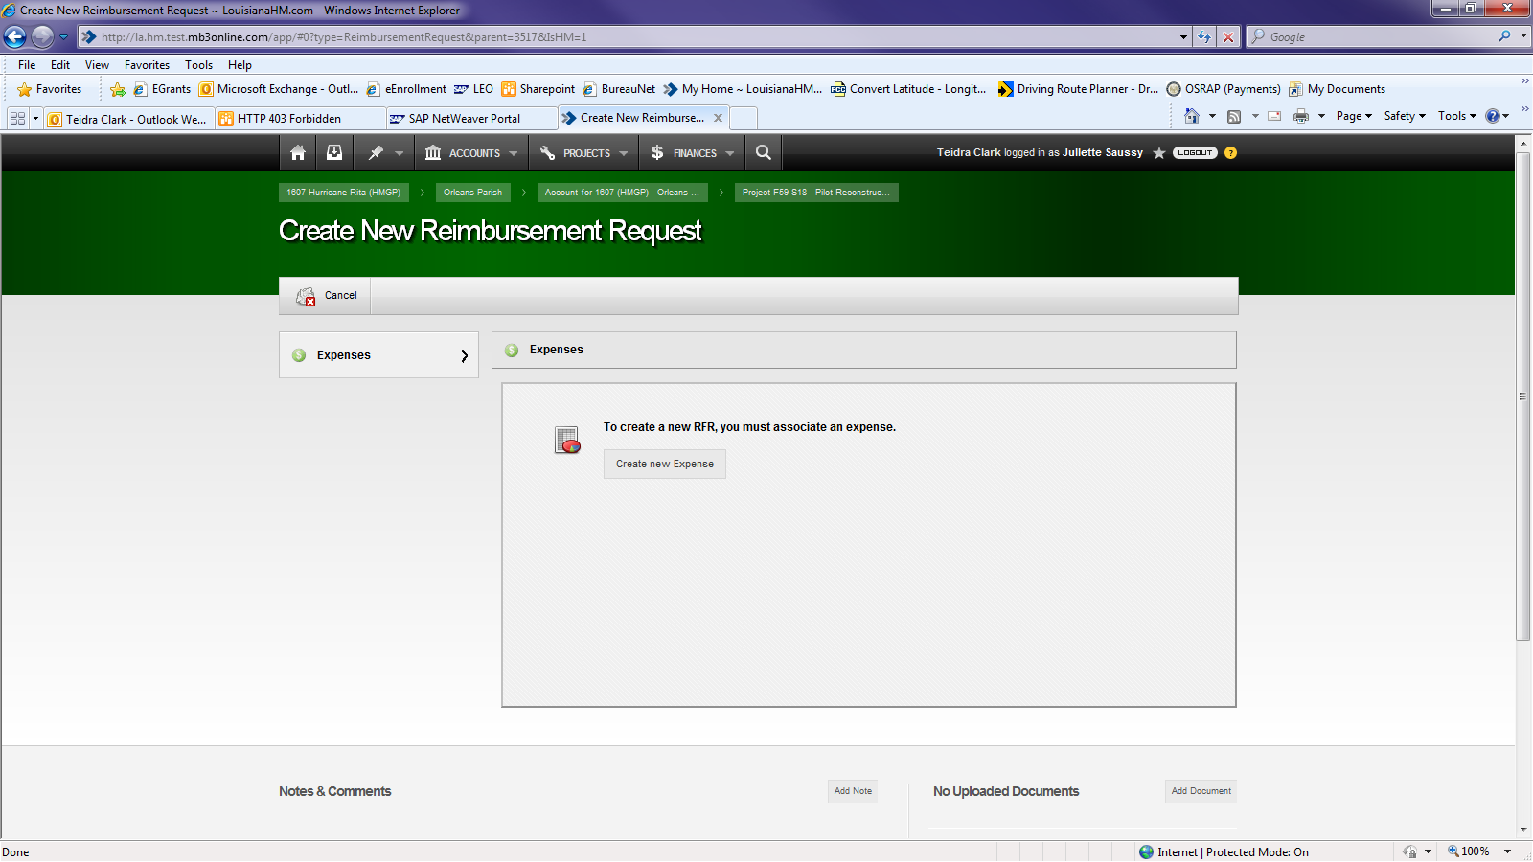

Slide 20
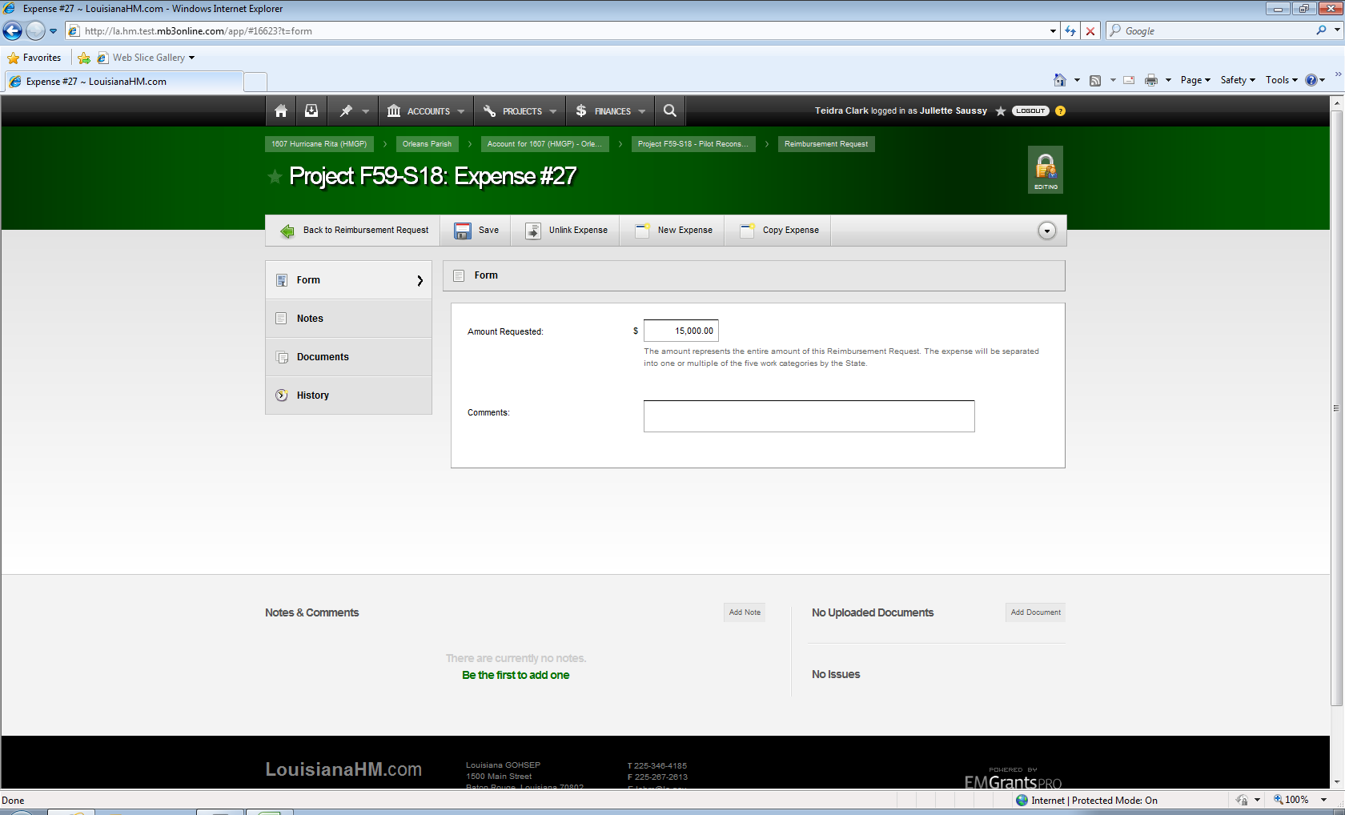

Slide 21
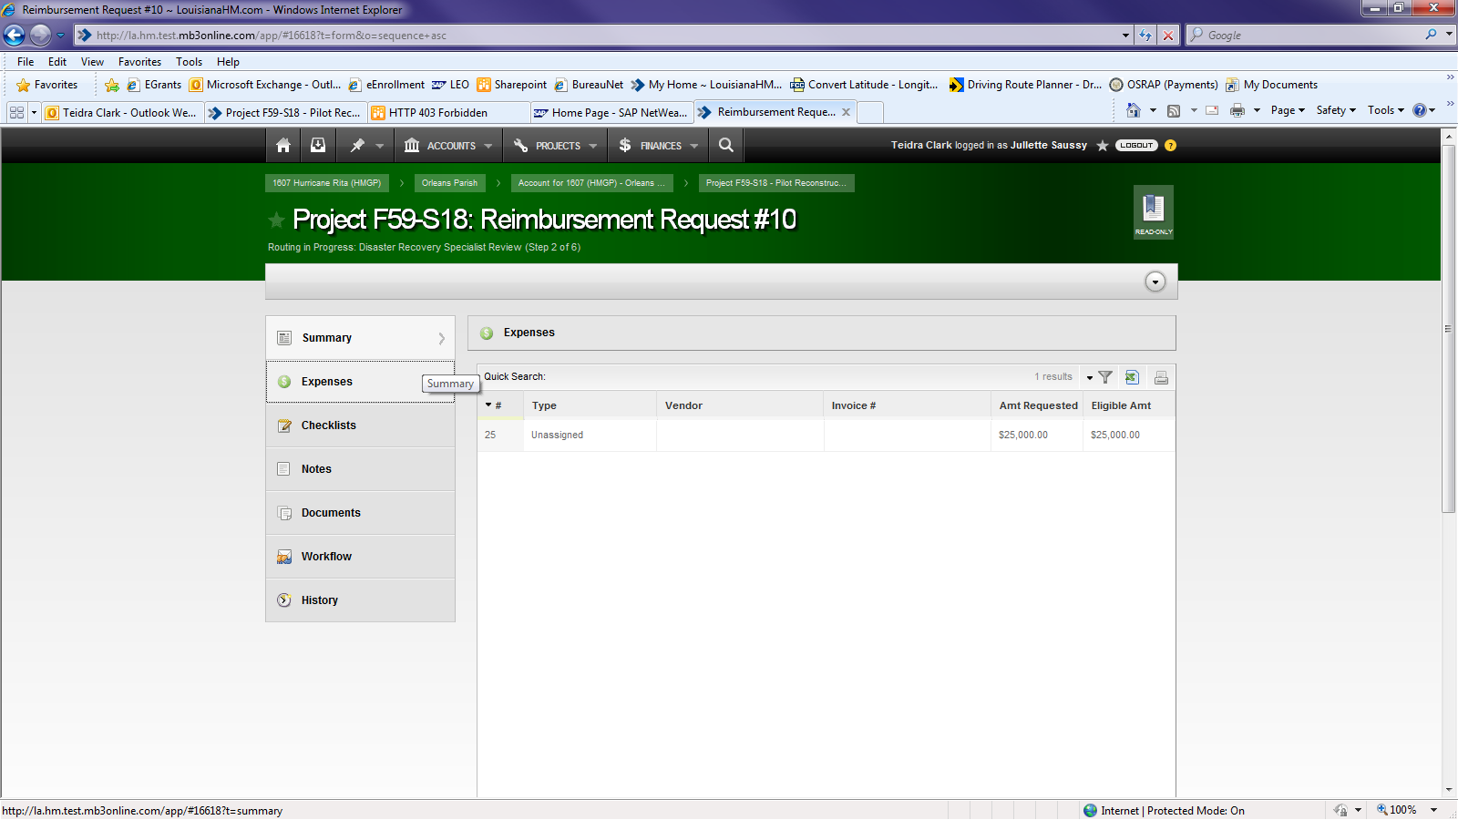

Slide 22
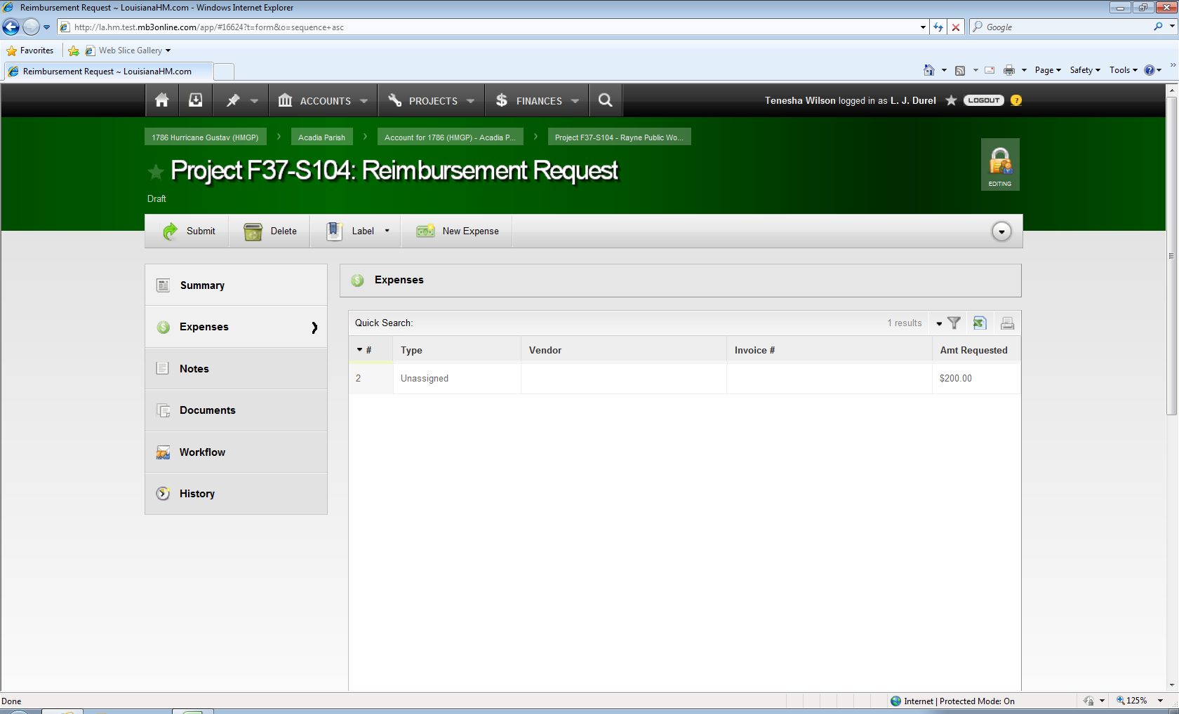

Slide 23
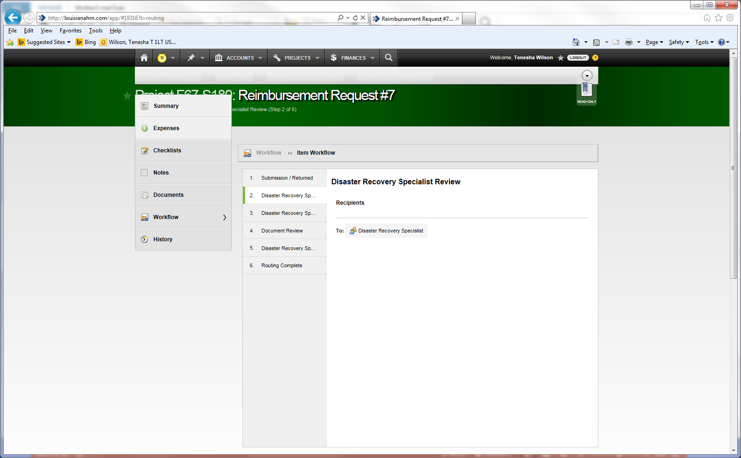
Notes:
Workflow

Slide 24


NEW site visits
Previously, site visits were “as needed.”
NOW, site visits will be done on a periodic basis, at least three (3) times during the project.
  Kickoff site visit.
  Interim site visit (may vary based on milestone completion).
  Final site visit.

Slide 25
Monitoring + site visits
Grantee conducts site visits to:
  Confirm that projects align with the approved SOW + projected timelines.
    Projects should proceed in accordance with milestones as outlined in approved applications.
    Phase I deliverables are due no later than one (1) year following phase I approval.

Slide 26
Monitoring + site visits
Grantee conducts site visits to (continued):
  Identify cost issues that may result in delayed or no reimbursements + resolve in a timely manner.
  Ensure accurate reporting – project status + financials.
  Prepare applicants for closeout.

Slide 27
Monitoring + site visits (Continued . . . )
Subgrantees can request additional site visits at anytime.
New process implemented beginning next quarter (APR ‘15).

Slide 28
Quarterly Reports are important to YOU because . . .
Quarterly Reports are a tool used by GOHSEP + FEMA for monitoring.
Lack of progress and inaccurate reporting can generate more questions and work.

Slide 29
What Quarterly Reports identify . . .
Status + completion date for project.
Comparison of actual accomplishments to the objectives established for that period.
Financial status.

Slide 30
What Quarterly Reports identify . . . (Continued . . . )
Problems, delays or adverse conditions that affect the following:
  SOW
  Project completion dates
  Project costs

Slide 31
Reporting periods
Quarter | Quarter End Date | Due to GOHSEP
1st | Dec 31 | Jan 15
2nd | Mar 30 | Apr 15
3rd | Jun 30 | Jul 15
4th | Sep 30 | Oct 15

Slide 32
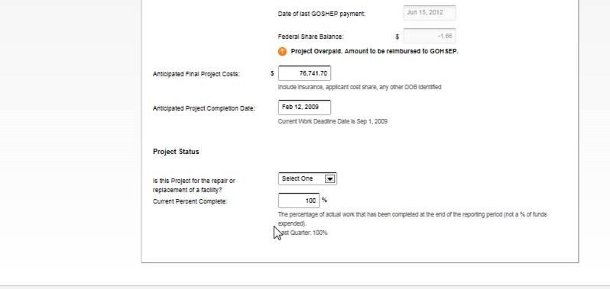
Quarterly Reports
Quarterly Report in LAHM

Slide 33
Hazard Mitigation Grants Management
QUESTIONS??

Slide 34
Contact Info
Tenesha Wilson
Tenesha.wilson@la.gov
Section Chief-Hazard Mitigation Grants Management

Slide 35
Hazard Mitigation
Closeout
Sandra Dugas
Section Chief
Notes:
Starting October 1, 2014 all HMGP Closeouts will be processed through LAHM
Non-Disaster Grant Closeouts (PDM, FMA, SRL, RFC) will continue to be submitted via paper files. These grants are not yet in LAHM.

Slide 36
Benefits to Completing and Closing Projects Timely
Completed project begins to benefit the community as quickly as possible.
Documentation Retention & effects of Staff Turnover: less chance for documentation and knowledge to be lost if project is completed and closed quickly.

Slide 37
Purpose of Closeout Process
Validate completed activities were approved in the Scope of Work.
Ensure that funds were spent on eligible activities.
Ensure compliance with all State + Federal regulations.

Slide 38
Authorities
Robert T. Stafford Disaster Relief and Emergency Assistance Act (Stafford Act), Section 404
44 Code of Federal Regulations (CFR)
2 Code of Federal Regulations 200, “Supercircular”
Hazard Mitigation Assistance (HMA) Unified Guidance July 12, 2013

Slide 39
Traditional Closeout Breakdown
Closed Projects
Disaster | Count of Project Number | Sum of Fed Share Obligated Amt
1603 | 133 | $25,150,382.00
1607 | 66 | $9,559,839.00
1786 | 7 | $1,085,637.00
Grand Total | 206 | $35,795,858.00
Projects Not Closed
Disaster | Count of Project Number | Sum of Fed Share Obligated Amt
1603 | 222 | $1,242,591,375.00
1607 | 41 | $102,327,247.00
1786 | 87 | $85,839,191.00
1792 | 10 | $9,966,374.00
Grand Total | 360 | $1,440,724,187.00
Notes:
Total of the 4 disasters, Plan Closeouts:
Closed 111
Open 14
Sent to FEMA 2
Total 127
Total Closed 206- closed plans 111 =95 traditional projects closed outside of plans

Slide 40

Preparing for Closeout
70% project completion- begin looking at closeout
Final payment.
  Final photos.
  Final QR
Return any unused funds remaining in subgrantee account
Complete documentation file.

Slide 41
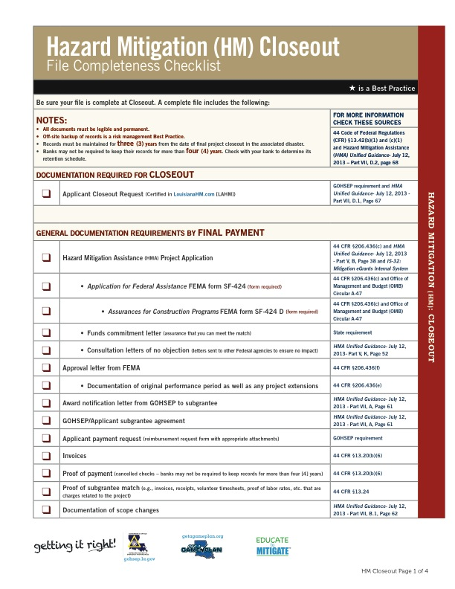

Documentation Requirements Checklist
Closeout
Tool to assist with
completion of file

Slide 42
The Closeout Documentation Requirements Checklist can be found online at:
-gohsep.la.gov/outreach.aspx , under
-Getting it Right! Workshops
-Documentation+Insurance
-Hazard Mitigation (HM)Documentation (Download)
-HM Documentation Checklists
-4closeoutHMDocumentation_Checklist

Slide 43
Documentation specific to the Closeout Request
Subgrantee provides . . .
  Letter requesting closeout.
    Includes request for de-obligation of unused funds.
  Project Closeout Certification in LAHM.
  Project Closeout Checklist
  Final Quarterly Report.
  Final photos

Slide 44
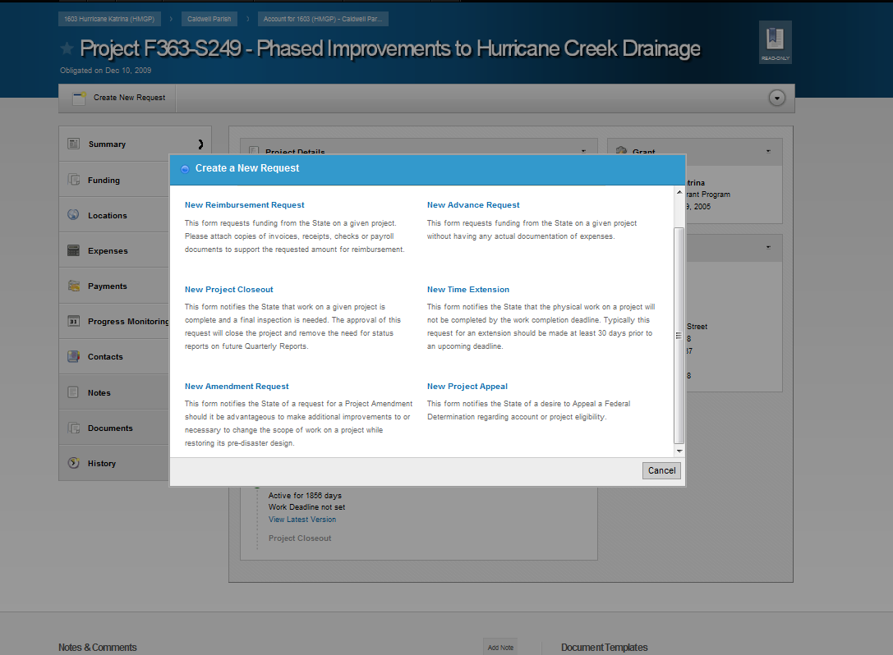
To initiate Closeout in LAHM:
-Go into project to be closed out
-Click “Create New Request” on upper left side of screen.
-Click “New Project Closeout”

Slide 45
LAHM Project Closeout Certification

Slide 46
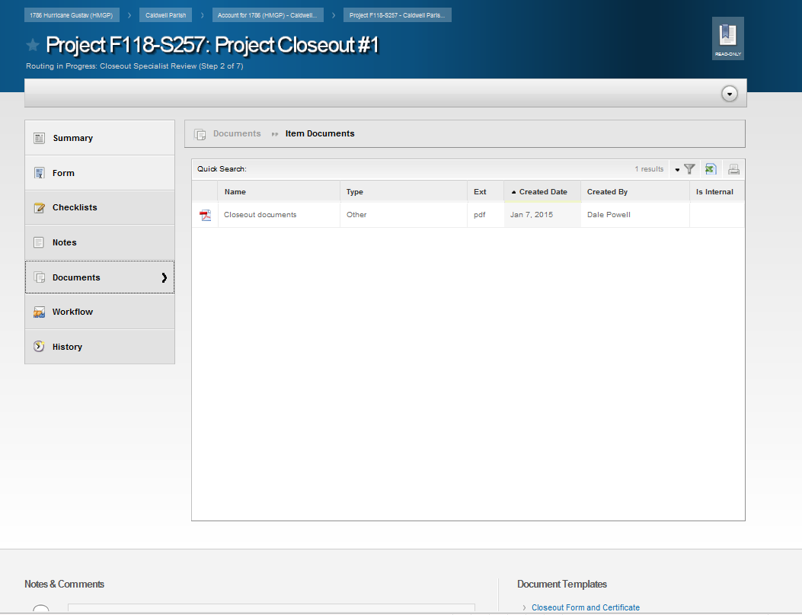
  Documentation specific to the closeout request is uploaded into LAHM at the Project Closeout Request Level.
  -Letter requesting closeout.
  (Includes request for de-obligation of unused funds.)
  -Project Closeout Certification in LAHM.
  -Project Closeout Checklist
  -Final Quarterly Report.
  -Final photos

Slide 47
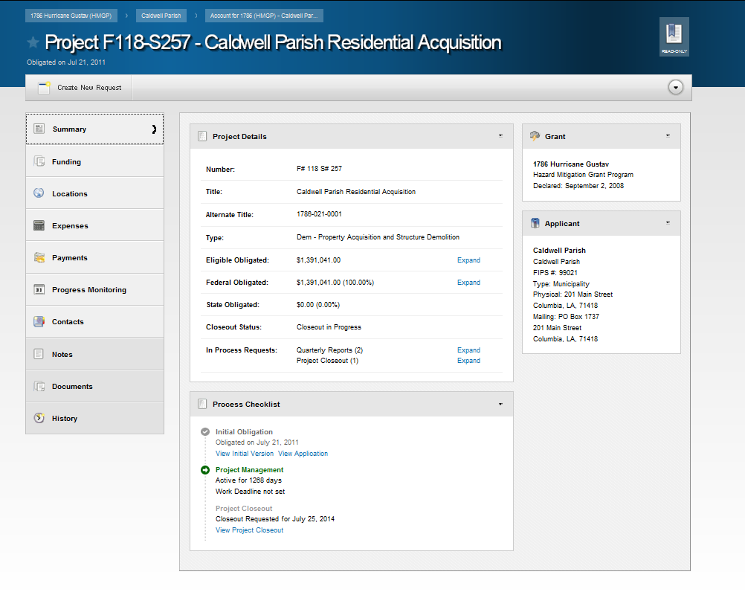
All other documents are uploaded into LAHM at the Project level or other designated place (ex. into the appropriate payment)
Notes:
Processing Closeout:
GOHSEP reviews . . .
Documentation.
File completeness.
Compliance with State + Federal regulations.
GOHSEP requests FEMA Closeout.
Could include de-obligation for ineligible items or cost underruns.

Slide 48

Documentation
DOCUMENT!
Your documentation is proof of eligibility for any Federal funds you have received and spent.
To keep the funds you receive

Slide 49

Recordkeeping
Records must be maintained for three (3) years from the date of FEMA closeout of your last project associated with the specific disaster.

Slide 50
Hazard Mitigation Closeout
QUESTIONS??

Slide 51
Contact Info
Sandra Dugas
Sandra.dugas@la.gov
Section Chief-Hazard Mitigation Closeout

Slide 52
Hazard Mitigation
Technical Services
Jeffrey Giering
Section Chief
Notes:
Starting October 1, 2014 all HMGP Closeouts will be processed through LAHM
Non-Disaster Grant Closeouts (PDM, FMA, SRL, RFC) will continue to be submitted via paper files. These grants are not yet in LAHM.

Slide 53
Hazard Mitigation Technical Services
Is comprised of GOHSEP and contract staff, we are responsible for providing technical assistance and guidance to applicants with regards to Planning, Benefit Cost Analysis and Policy

Slide 54
Planning
All parish plans are in process of being updated.
  The majority of plans are being updated through a planning grant with SDMI developing the updates.
  See handout for plan expiration date and update status

Slide 55
Benefit Cost Analysis (BCA’s)
The goal is to demonstrate the activity is cost effective.
  Common issues associated with BCA’s are:
    documenting building construction type
    documenting benefits
    validating replacement values
    social benefits and mental stress benefits

Slide 56
Community Education and Outreach (CEO)
Mitigation Plan Goals
  Goal 1: Improve education & outreach efforts on hazard identification and risk reduction
  Goal 2: Improve vulnerability and risk-related data collection
  Goal 3: Improve interagency coordination to develop coherent mitigation – related strategies
Notes:
The Statewide community Hazard Mitigation Community Education and Outreach grant provides strategic assistance for implementation of theses State Hazard Mitigation Plan goals . READ GOALS

Slide 57
CEO Partners
  State Historic Preservation Office (SHPO)
    Providing information about cultural resources and historic preservation to citizens and leaders of Louisiana – in progress
  UNO CHART
    Providing disaster education/awareness through risk literacy (English and Spanish), and through the Community Executives Program focusing on risk management – both in progress
Notes:
Sustained partnerships are critical to the success of the education and outreach campaign.
SHIPO Objective; To communicate information about cultural resources and historic preservation to the citizens and leaders of Louisiana. - IA Term: Started July 1, 2012 and ends June 30, 2015.
UNO CHART Objectives; Continuity Contingency Planning and Mitigation for Community Organizations: Risk Literacy: Disaster Resistant Universities: Community Executives Program in Risk management - IA Term: Started August 1,2012 and ends July 31, 2015.
NIMSAT Objectives: Provide research and development services and technical support to GOHSEP and its stakeholders in developing and launching a web-based risk data management platform and disaster analytics framework - IA Term: Started January 1, 2013 and ends December 31, 2015.
LSU Ag Center Objectives; Recruiting and engaging audiences for mitigation information: Delivering construction-related mitigation information: Delivering hazard-appreciation programs to local communities with the use of visually enhanced displays: Supporting state agency, jurisdictions and Community Education Outreach partner events that benefit from hands-on use of computers: Training and oversight of youth-led groups in hazard mitigation planning and project development - IA Term: Started December 1, 2012 and ends November 30, 2015.

Slide 58
CEO Partners
  University of Lafayette, National Incident Management Systems and Advanced Technologies (NIMSAT)
    Providing research and development services to GOHSEP and its stakeholders through the LAHIP portal – in progress
  LSU Ag Center
    Providing education and outreach regarding construction related mitigation activities and materials. Also providing hands on outreach to communities regarding flood map awareness, training to youth led organizations in hazard planning and project development – in progress
Notes:
Sustained partnerships are critical to the success of the education and outreach campaign.
SHIPO Objective; To communicate information about cultural resources and historic preservation to the citizens and leaders of Louisiana. - IA Term: Started July 1, 2012 and ends June 30, 2015.
UNO CHART Objectives; Continuity Contingency Planning and Mitigation for Community Organizations: Risk Literacy: Disaster Resistant Universities: Community Executives Program in Risk management - IA Term: Started August 1,2012 and ends July 31, 2015.
NIMSAT Objectives: Provide research and development services and technical support to GOHSEP and its stakeholders in developing and launching a web-based risk data management platform and disaster analytics framework - IA Term: Started January 1, 2013 and ends December 31, 2015.
LSU Ag Center Objectives; Recruiting and engaging audiences for mitigation information: Delivering construction-related mitigation information: Delivering hazard-appreciation programs to local communities with the use of visually enhanced displays: Supporting state agency, jurisdictions and Community Education Outreach partner events that benefit from hands-on use of computers: Training and oversight of youth-led groups in hazard mitigation planning and project development - IA Term: Started December 1, 2012 and ends November 30, 2015.

Slide 59
Statewide Community Education and Outreach
Somewhere Over The Bayou
Vermillion 4 – H Youth Hazard Mitigation Project
http://lnkd.in/e76EUVY
Notes:
Mitigation film made by Vermilion Parish 4-H youth! These very talented kids were part of the youth mitigation program to complete a HMGP application for a building in their parish. The students decided to showcase what they learned through a Cajun adaptation of Wizard of Oz.

Slide 60
Policy
Currently under development Elevation Policy
  This will be a tool that will assist applicants with implementing elevations in your jurisdiction.
  Upcoming policies include: safe rooms, duplication of benefits, time extensions, cost overruns, Increased Cost of Compliance (ICC) uses/waivers and acquisitions

Slide 61
Hazard Mitigation Technical Services
QUESTIONS??

Slide 62
Contact Info
Jeffrey Giering
Jeffrey.giering@la.gov
Section Chief-Hazard Mitigation Tech Services

