Slide 1
Procurement

Slide 2
Review of Procurement Guide

Slide 6
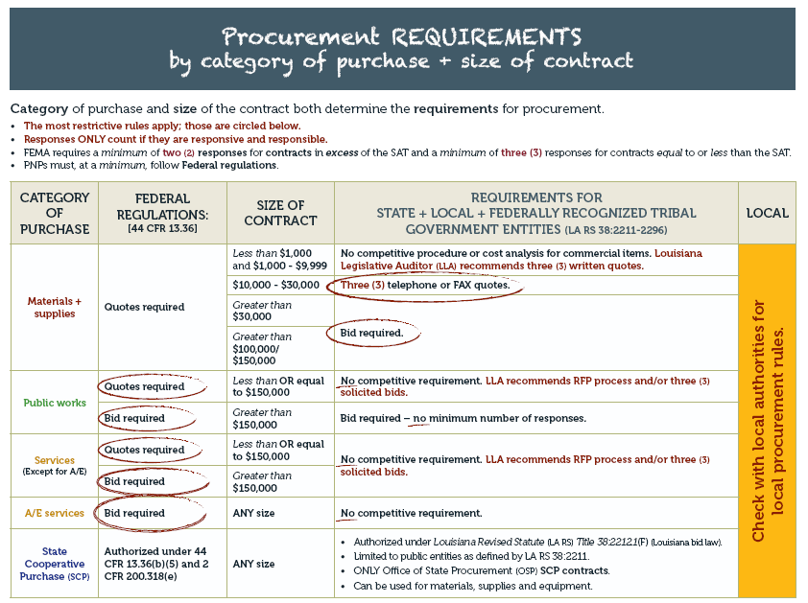

Slide 8
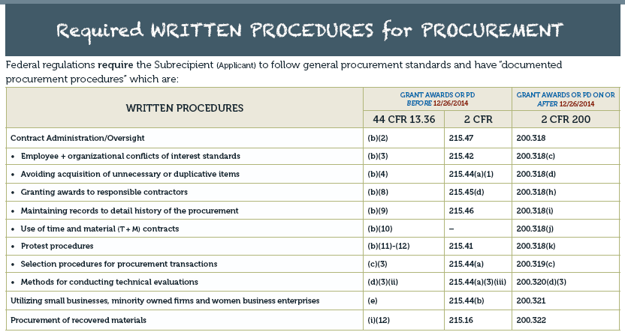

Slide 10
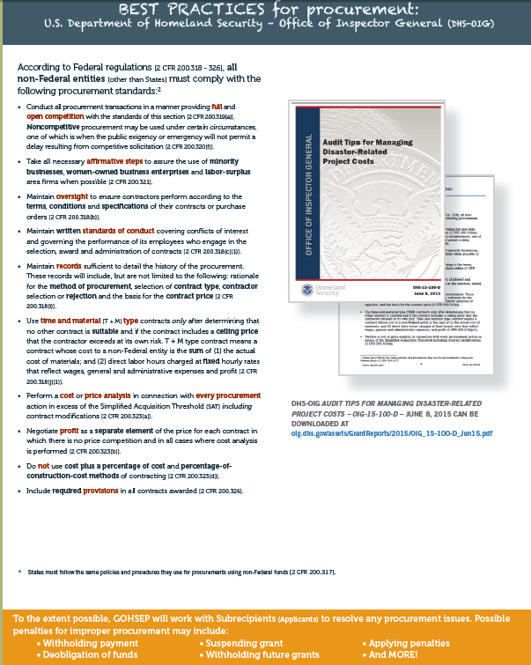
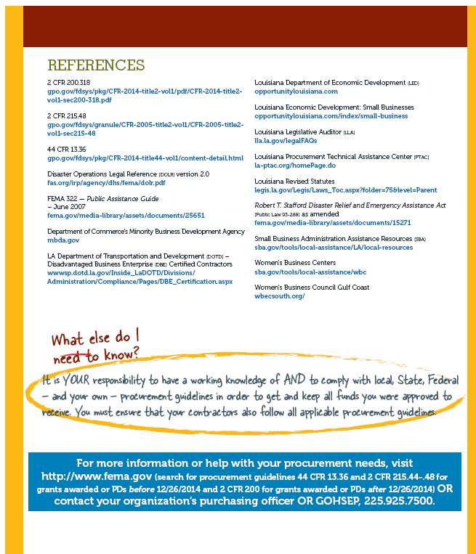

Slide 11
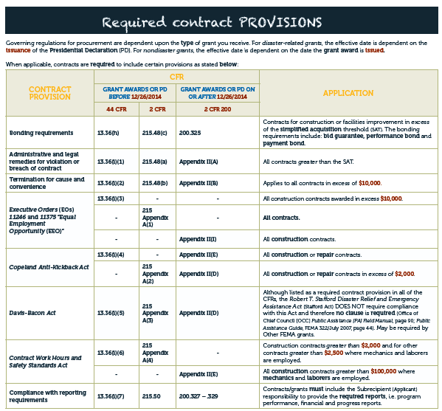
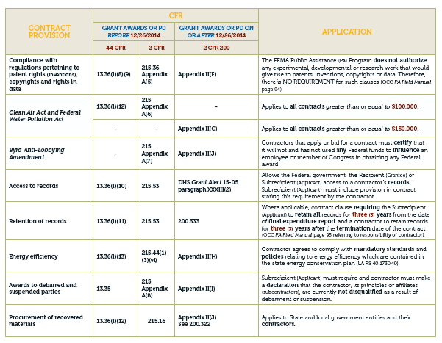

Slide 12
KEY
TAKEAWAYS

Slide 13
Procurement
Full and open competition
Advertisement vs. publicizing
List of qualified vendors
Exceptions
Non-competitive bid
Sole source contract
Emergency contract

Slide 14
Procurement
Affirmative steps to assure the use of minority businesses, women-owned enterprises and labor surplus firms*, when possible.
Not a requirement to award; notification of bid is sufficient
Use GOHSEP suggested procedure
*Required policy

Slide 15
Procurement
Maintain oversight to ensure contractors perform according to the terms, conditions and specifications of their contracts or purchase orders*
Review of model monitoring contract clause
Required reports as a monitoring tool
*Required policy

Slide 16
Procurement
Maintain written standards of conduct covering conflicts of interest and governing the performance of its employees who engage in the selection, award and administration of contracts*
*Required policy

Slide 17
Procurement
Maintain records sufficient to detail the history of the procurement. These records will include, but are not limited to the following: rationale for the method of procurement, selection of contract type, contractor selection or rejection, and the basis for the contract price.*
*Required policy

Slide 18
Procurement
Maintain records…
Method of procurement
Micro-purchases
Small purchase
Sealed bids
Competitive proposal
Non-competitive proposal

Slide 19
Procurement
Selection of contract type…
Lump sum
Unit price
Cost plus fixed fee
Time and materials
Inter-governmental agreements

Slide 20
Procurement
Use of time and material contracts*…
Document why T&M is suitable over other types
Contract contains ceiling price (not to exceed)
Expressed as an hourly rate the sum of materials, labor, administrative expenses and profit.
*Required policy

Slide 21
Procurement
Perform a cost or price analysis in connection with every procurement action in excess of the Simplified Acquisition Threshold (SAT) including contract modifications
A usual business practice
Also required for: change in SOW, change orders

Slide 22
Procurement
Do not use cost plus a percentage of cost and percentage-of-construction-cost methods of contracting
Piggy back contracts
Illegal or highly discouraged

Slide 23
Procurement
Include required provisions in all contracts awarded
See Procurement Guide insert

Slide 24
Procurement
Other Job Aids in Procurement Tool Kit
Procurement Checklist
Policy Templates
Cost Analysis Guide
Desk Reference

Slide 25
QUESTIONS ?

