Slide 1
L.W.I.N
Louisiana Wireless
Information Network
System Management & Maintenance
OCTOBER 25, 2023
Department of Public Safety-State Police
Mobility and Communication Services
(225) 925-6036

Slide 2

Infrastructure Update

Slide 3
SYSTEM SUMMARY
144* Total Tower Sites in Operation
6 Operational Mobile Sites

Slide 4
Zone 1:
42 Sites in Full Operation
Pan Am
Bridge City
Livonia
Laplace
St. Tammany Simulcast
Lacombe
Abita Springs
Waldheim
Pearl River
Covington
Slidell
Talisheek
Blond
Sheridan
Geismar
St. James
Larose
Gibson
BR Simulcast
BR
Central
LSU
WBR
Hammond
Gray
Berwick
Baywood
Ramah
Sage Hill
Parker Road
Iberville
Livingston
Jackson
Greensburg
Superdome
South Baton Rouge
Baldwin
Pointe Coupee
Theriot
Paincourtville
Boothville
Mobile Units
94
96
97
98
99
100
Denham Springs
Clinton
St. George

Slide 5
Zone 2:
17 Sites in Full Operation
N. Simulcast
Gretna
Galleria
NO East
Lafitte
Bayou Gauche
Hahnville
St. Rosalie
Kenner
Airport
Port Fourchon
Reggio
Montegut
Houma
Bourg
Buras
Wilmer
Grand Isle

Slide 6
Clearwater
Monroe
Winnfield
Delhi
Chopin
Dry Prong
Hagewood
Bossier(City)
Farmerville
Minden
Natchitoches
Bastrop
Greenwood
Ruston
Hineston
Ashland
Vivian
Newellton
Noble
Transylvania
Alexandria
Avoyelles
Bellevue
Bernice
Calhoun
Columbia
Ferriday
Homer
Jena
Jonesboro
Mansfield
Many
Marion
Oak Grove
Plain Dealing
Ringgold
Sentell
Tallulah
Wheeling
Shreveport
West Monroe
Chase
Keachi
Coushatta
Shongaloo
Sibley
Vick
Calvin
Arcadia
Enterprise
Holloway
Chatham
Cypress
Zone 3:
53 Sites in Full Operation

Slide 7
Zone 4:
32 Sites in Full Operation
Abbeville
Acadia
Arsene LeBleu
DeQuincy
Dry Creek
Jeanerette
Jennings
Johnson Bayou
Lafayette
Lake Charles
Leesville
Merryville
Opelousas
Parks
Rockefeller
Rosepine
Scott
Sulphur
Vermillion
Ville Platte
Vinton
Craven
Hicks
Hornbeck
Oakdale
Roseland
E. Jennings
Anacoco
Oberlin
Moss Bluff
New Iberia
Eunice

Slide 8
Channel Summary
Total Channels 1310
1259 Channels on 144 Sites
51 Channels on 6 Mobile Sites

Slide 9
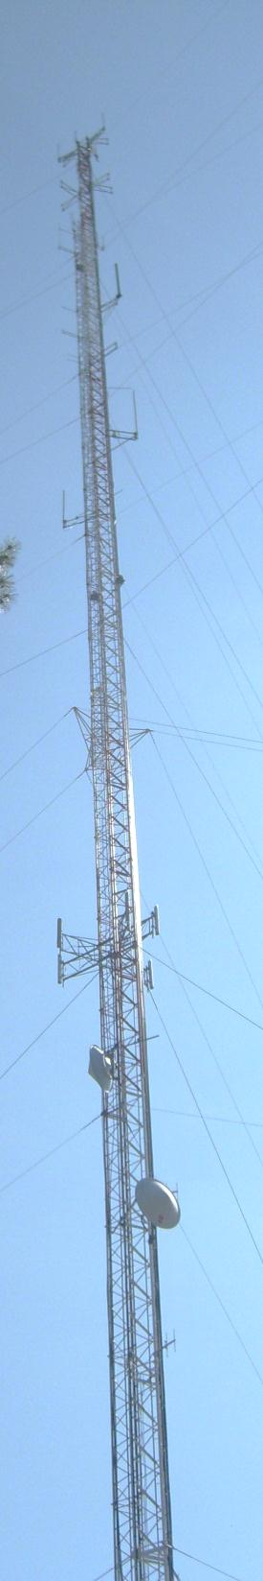
System
Statistics

Slide 10
SUBSCRIBERS

Slide 11
PUSH TO TALK PER DAY

Slide 12
MONTHLY PUSH TO TALK

Slide 13
BUSIES

Slide 14

Top Busy Sites
Merryville 5,951
Hornbeck 526
Cravens 387

Slide 15
SITE OUTAGES
Alexandria | Ashland | Baywood | Berwick | Bourg
Chopin | Coushatta | Denham Springs | Dequincy | Enterprise
Gray | Hagewood | Hicks | Hineston | Holloway
Iberville | Jeanerette | Keachi | LaRose | Livonia
Many | Merryville | Opelousas | Paincourtville | Parker Road
Port Fourchon | Rockefeller | Roseland | Ruston | Sage Hill
Sentell | Shreveport | Sibley | St. James | Theriot
Transylvania | Vick | Wilmer
Total Downtime: 614 Hours

Slide 16
SITE OUTAGE DATA

Slide 17
SYSTEM STATISTICS

Slide 18
Subscriber Statistics
Security Groups
192
Agencies
609
Talkgroups
6522

Slide 19

Agencies Added Last 2 Months
OUACHITA PARISH SCHOOL BOARD

Slide 20
System Coverage

Slide 21
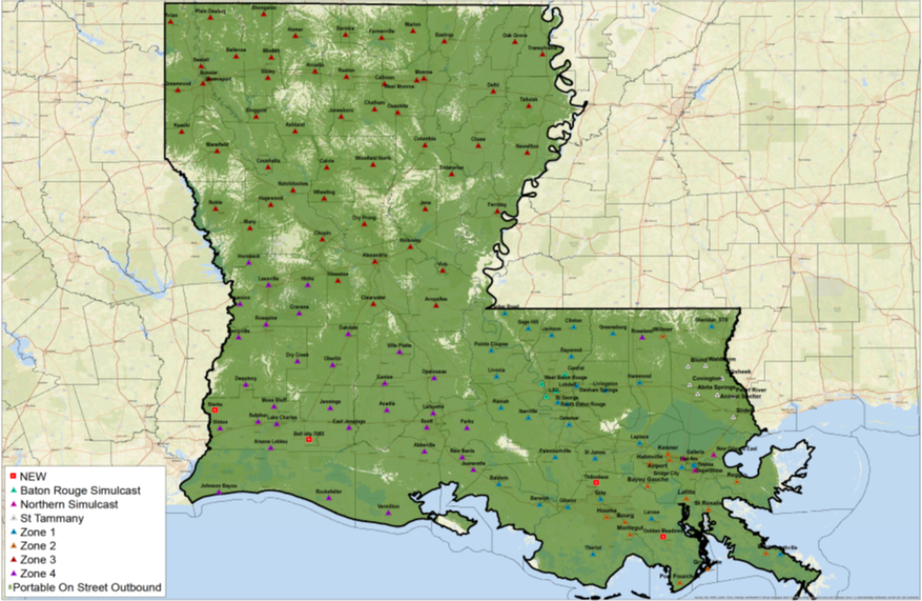
Present Coverage

Slide 22
THE 52 GENERATOR PROJECT

Slide 23
TOP 10 of the 52 GENERATOR SITES
SITE | PARISH | STATUS
Jackson | East Feliciana Parish | Currently with FEMA
Bridge City | Jefferson Parish | Currently with FEMA
Arsene LeBleu | Calcasieu Parish | Currently with FEMA
Abbeville | Vermillion Parish | Currently with FEMA
Berwick | St. Mary Parish | Currently with FEMA
DeQuincy | Calcasieu Parish | Currently with FEMA
Larose | Lafourche Parish | Currently with FEMA
Ramah | Iberville Parish | Currently with FEMA
Rockefeller | Cameron Parish | Currently with FEMA
Vinton | Calcasieu Parish | Currently with FEMA

Slide 24
QUESTIONS?

Slide 25
ETHERNET UPDATE

Slide 26
IMPLEMENTATION
ATT and Motorola completed all Zones and all zones are now operating on the new fiber Inter-zone link since June 7, 2023.
The 3 pilot sites. Denham Springs fiber and equipment are installed and waiting for the final test before we connect it to the new system. Baywood and Jackson fiber and AT&T equipment have been completed. Cradlepoint installation for both sites is scheduled for the end of October and the first week in November.
Fiber for the rest of the 13 challenge sites has been ordered. No ETA as of today.
Tower sites utilizing the DS3 from Shreveport and Monroe connected to Zone 3 will be the next fiber installation order.
The rest of the tower sites and dispatch centers for Zones 1, 2, and 4 will be scheduled as the project advances.
Project projected completion timeline: late 2024 or mid-2025.

Slide 27
QUESTIONS?

Slide 28
THANK YOU

