Slide 1
What goes into a Project Worksheet (PW)

Slide 2
Project Formulation
Public Assistance Categories of Work
Category A—Debris Removal
Category B—Emergency Protective Measures
__________________________________________
Category C—Roads and Bridges
Category D—Water Control Facilities
Category E—Buildings & Equipment
Category F—Utilities
Category G—Parks + Recreational + Other

Slide 3
Project Formulation
Damage Description and Dimensions (DDD)
Simply put this is where the damages and cause of peril are described
It helps to be as detailed as possible because this description will be where the Scope of Work is developed.

Slide 4
Project Formulation

Slide 5
Project Formulation
1 PW?
OR
PW 1
PW 2
PW 3

Slide 6
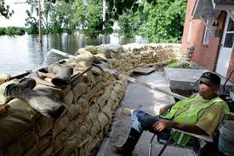
Project Formulation
Scope of Work (SOW)
Work Completed
Work Not completed

Slide 7
Project Formulation
Public Assistance Categories of Work
Category A—Debris Removal
Category B—Emergency Protective Measures
__________________________________________
Category C—Roads and Bridges
Category D—Water Control Facilities
Category E—Buildings & Equipment
Category F—Utilities
Category G—Parks + Recreational + Other

Slide 8
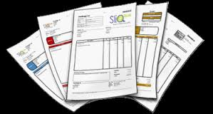
Project Formulation
Work Completed
This work is developed off work already done and comes from:
Contracts
Purchase Orders
Invoices
Work Orders
Timesheets
Etc.

Slide 9
Project Formulation
Work Not Completed
This scope and estimated costs are developed from the damage descriptions.

Slide 10
Project Formulation
Things to be aware of prior to and during completion of repair work that may affect FEMA funding
Environmental and Historical concerns (EHP)
Applicable codes and Standards
Floodplain Management
Mitigation opportunities
Duplication of benefits (Other funding sources)
Alternatives to repair of damages

Slide 11
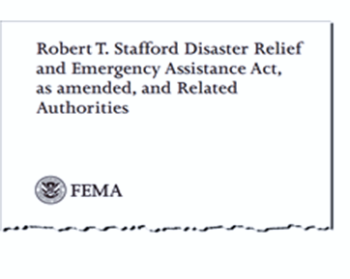
Hazard Mitigation Funding Authorities
Stafford Act
Title 4
Section 406 – Public Assistance (PA)
Section 404 – Hazard Mitigation (HM)

Slide 12
Hazard Mitigation

Slide 13
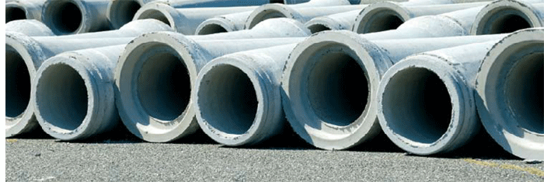
Eligible 406 Hazard Mitigation Measures
Must be:
Permanent Work
Related to a Damaged Element
COST EFFECTIVE

Slide 14
Funding 406 Mitigation
FEMA must approve proposed Hazard Mitigation Projects prior to funding.
FEMA will evaluate the proposed mitigation for:
Technical Feasibility
Statutory/Regulatory Compliance

Slide 15
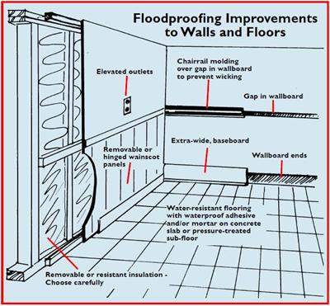
Examples of Mitigation Measures
Wet/Dry Flood Proofing
Relocation
Elevation above Base Flood Elevation (BFE)

Slide 16
406 Mitigation Measure
Mechanical, Electrical, Plumbing (MEP) Elevations

Slide 17
406 Mitigation Measure
Upgraded Drainage Structure
Rip Rap
Increased Culvert Size
Wing Walls

Slide 18
Project Formulation
Daniel Crothers
Technical Services Group Lead
GOHSEP
Daniel.Crothers@la.gov
225-267-2761

Slide 19
Project Formulation
Environmental and Historical Preservation (EHP)
All federally funded projects must go through an EHP Review

Slide 20
Project Formulation
If you start your work before FEMA arrives, you are not exempt from meeting the same environmental standards.
Permits
Consults with Regulatory Agencies
Required Coordination documents

Slide 21
Project Formulation
Ellen Ibert
Problem Resolution Officer II
Ellen.ibert@la.gov
225-334-7748

Slide 22
Project Formulation
Alternate and Improved Projects
The PA program allows you to use grant funding from disaster damages in ways that may better meet your community’s recovery needs. There are two options:
Alternate Project
Improved Project

Slide 23
Project Formulation
Alternate Project
The use of your obligated funding for work other than the repairs for which it was written.
If you choose the Alternate Project option, there will be a 10% reduction in the federally obligated amount. (25% for Private Non-profit applicants)

Slide 24
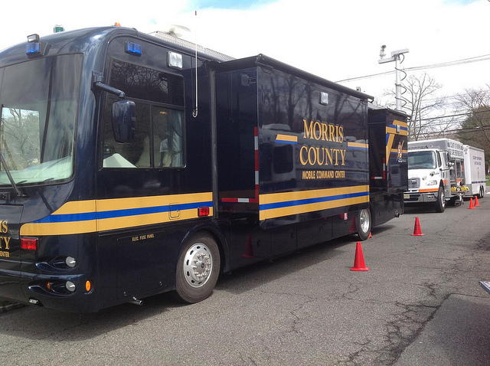
Project Formulation

Slide 25
Project Formulation
Improved Project
You may wish to make improvements to a damaged facility. These may include improved materials and increased size as long as the facility retains the same function
The amount of the obligation will be capped at the repair estimate

Slide 26
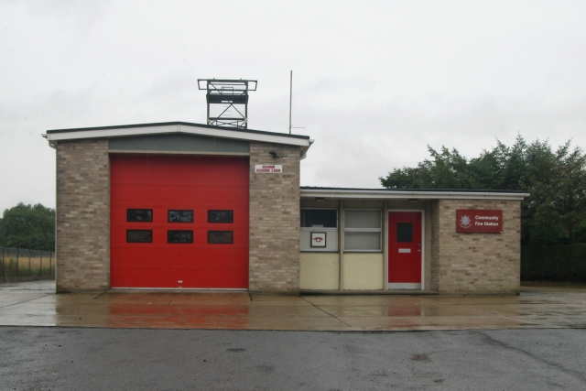
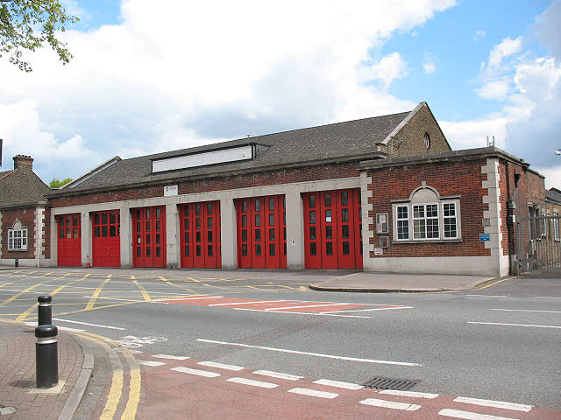
Improved projects (Continued . . . )

Slide 27
Project Formulation
Brittany Ward
Problem Resolution Officer II
GOHSEP
Brittany.Ward@la.gov
225-334-7749

Slide 28
Project Formulation
Duplication of Benefits (DOB)
FEMA is the disaster funding resource of last resort.
The main one of these is INSURANCE PROCEEDS

Slide 29
Project Formulation
Insurance Proceeds
FEMA funding will be reduced by the amount of insurance you receive for your damaged facilities.
Costs to recover your insurance proceeds (litigation costs, attorney fees, etc.) will lessen the reduction.

Slide 30
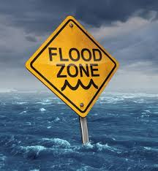
Project Formulation
NFIP Insurance
FEMA will apply a MANDATORY reduction in funding for the amount of flood coverage you should have had on the facility.
Building
Contents

Slide 31
Project Formulation
First Project Worksheet may not capture all requirements.
PW can have subsequent versions.
GOHSEP will assist. SAL, PRO, DRS.

Slide 32
Obtain and Maintain
ICC
Although the ICC does allow the applicant to meet the O&M requirement for its current disaster and makes it eligible for the next disaster, it does not affect the reductions in the next disaster.
FEMA only pays for things once.
If a facility is damaged in a subsequent disaster and requires permanent repair, FEMA will only fund those damages over and exceeding the amount of damages in the previous disaster.

