Slide 1
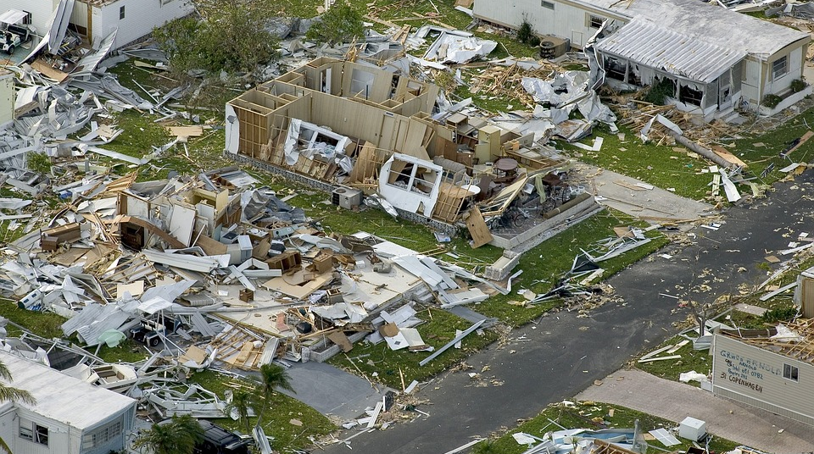


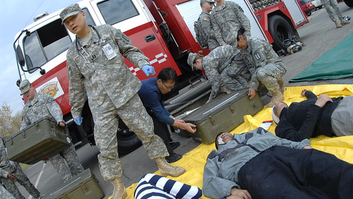

Mass Casualty Incident Family Reunification Planning: A Coordinated Approach to Reuniting Families After Disaster
Presenters:
Chad Sonnier, Director, Lafayette Parish Office of Homeland Security and Emergency Preparedness
Matthew Duhon, Title Placeholder, Lafayette Parish Office of Homeland Security and Emergency Preparedness
Dr. Tina Stefanski, Medical Director Region 4, Louisiana Department of Health/Office of Public Health
Heather Gauthier, LEM, Emergency Preparedness Project Specialist, Louisiana Hospital Association
Kim Beetz, GOHSEP Region 3 Coordinator
Danielle Maples, MS, NRP, CEM, LEM, LA Region 4 ESF-8 ADRC, Emergency Management Specialist, Ochsner Lafayette General Medical Center
Keith Talamo, Region 4 Mass Fatality Coordinator
Chris Hector, LERN Administrative Director
Notes:
Each presenter will give introduction and background.

Slide 2


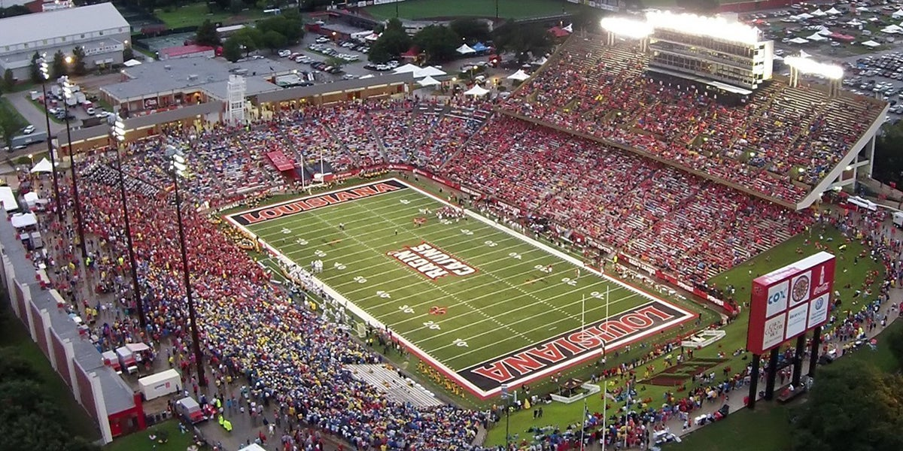
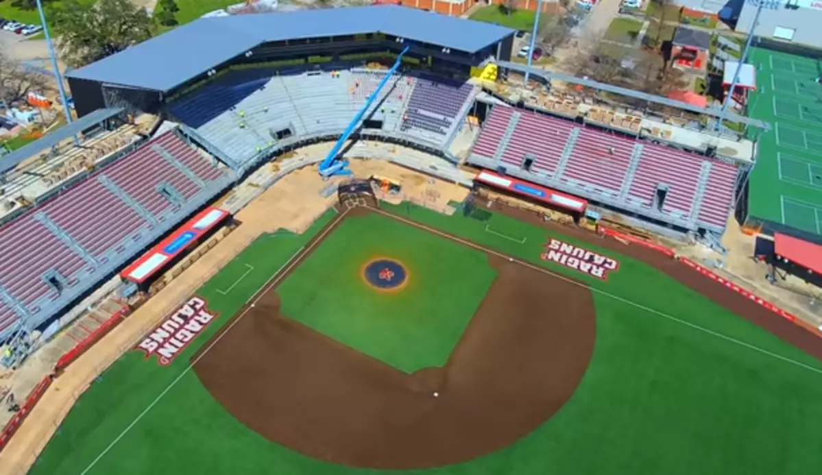

Lafayette Parish is host to a variety of large-scale public events—including festivals, parades, and sporting events—that attract local and out-of-town attendees. Additionally, the presence of Lafayette Regional Airport increases daily population flux and complexity in emergency response coordination.
In the event of a natural disaster, man-made incident, or catastrophic event during one of these gatherings, there is a high probability that individuals—especially children, elderly, or those with special needs—may become separated from their loved ones.
Until recently, Lafayette Parish lacked a formal Reunification Plan. Without a coordinated approach to reunification before, during, and after emergencies, first responders, local agencies, and the public faced significant challenges in managing the aftermath of such events.
Notes:
Why reunification plan in Lafayette Parish.

Slide 3
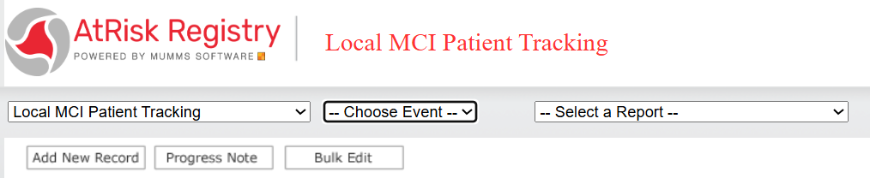
Reunification Then and Now
HICS form 254 filled out by EMS and receiving hospital
Faxed
Receiving Hospital
Receiving Hospital
Receiving Hospital
Email
Parish EOC
Heather add a test MCI Screen here,

Slide 4
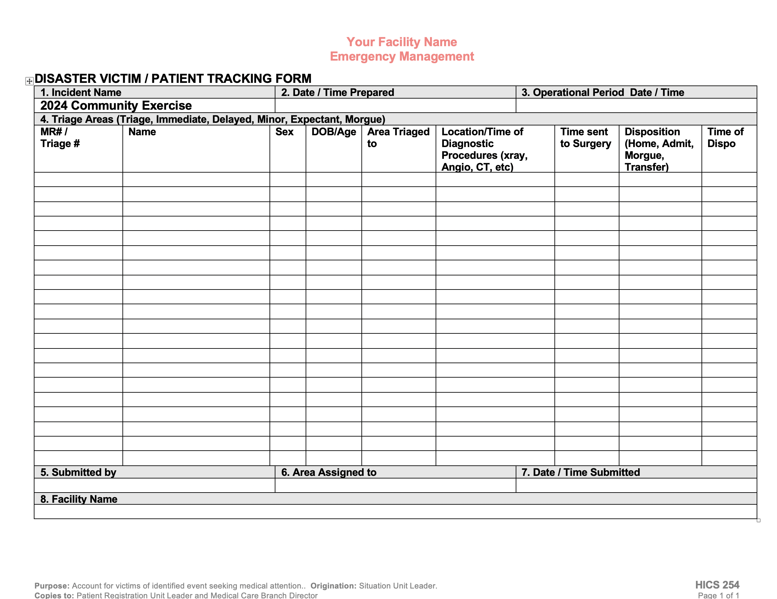





Local EOC
LDH
State EOC
** Before the Portal**

Slide 5
Historical Data
2005 – Hurricane Katrina
Thousands of calls, over 1000 deaths, estimated 12,000 reported missing
Took months to reunify families
2013 – Williams Olefin Plant Explosion (Region 2)
77 patients, 6 hospitals
2016 – MCI Screen Created in the At-Risk Registry
2022 – First exercise using ARR MCI Screen (Regions 1,3,9)
2023 – Superfog I-55
70 patients, 12 hospitals
2024 – Region 4 Bus Accident MCI
13 patients, 5 hospitals
2024 – Region 9 Causeway MCI
28 patients, 4 hospitals
2025 – Region 1 Bourbon Street Attack
49 patients, 7 hospitals
2025 – Region 6 Elementary School Chemical Exposure MCI
34 patients, 3 hospitals
2025 – Region 4 Mamou MCI
19 patients, 4 hospitals

Slide 6
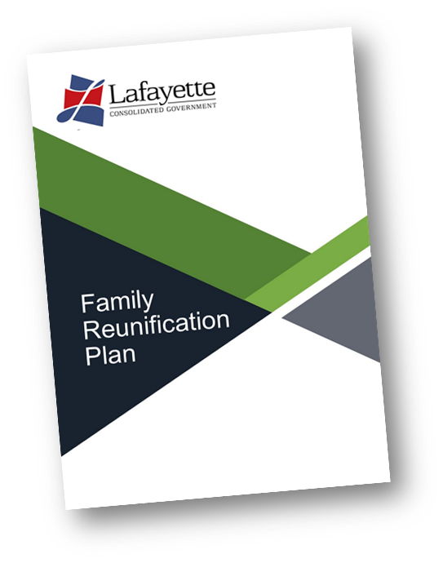
The FRP manages the ability of Lafayette emergency officials and other agencies to quickly reorganize resources to assist families in the hours and days after an emergency.
In general, the primary goals of the Family Reunification Plan are to:
Facilitate the process of identifying survivors and fatalities of an incident
Facilitate the reunification process of separated family members and friends impacted by a Mass Casualty Incident (MCI)
Ensure the provision of emergency social services to survivors and their families in the immediate aftermath of an incident
Timeline:
November 24 – Began Research
December 24 – Began Initial Draft
January 25 – Meeting began with partners to develop specific portions of the plan
February 25 – Exercised the medical portion of the plan with R4 ESF8 partners
March 2025 – Ready for activation in the event of any sort of incident during Mardi Gras Festivities
April 2025 – Plan Exercised once more as a whole with all ESF partners
Notes:
This slide for Chad and Dr. Stefanski to transition to the new plan for Lafayette Parish and introduce the plan/Timeline of actions.

Slide 7
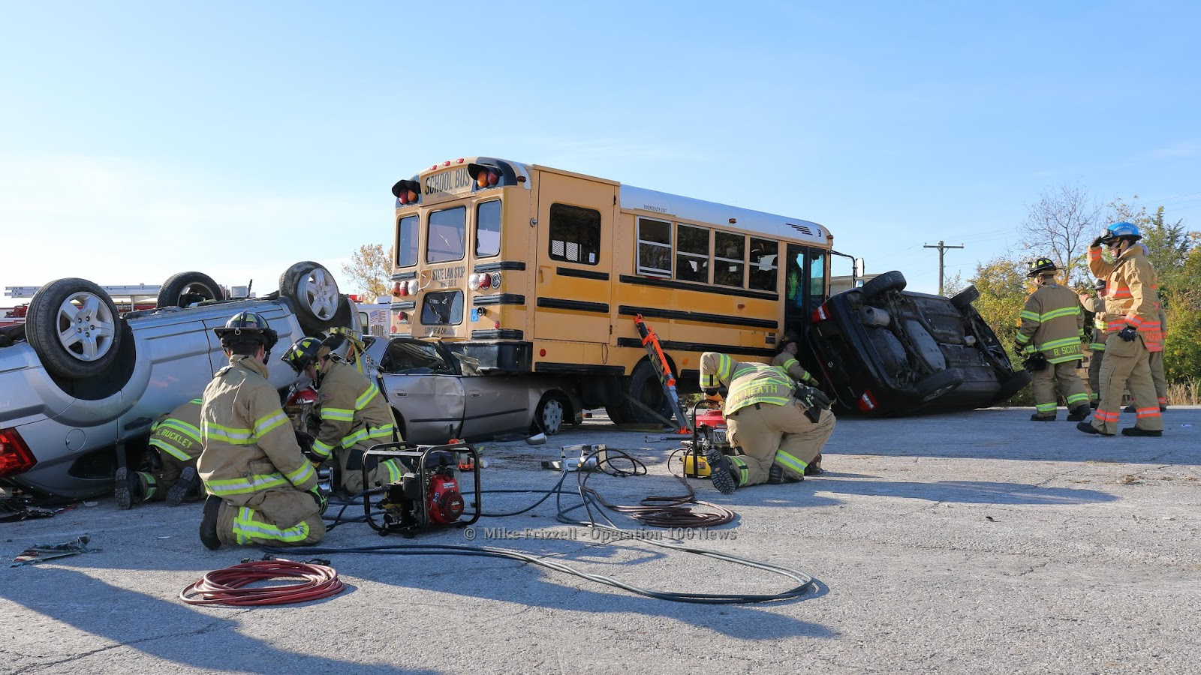
MCI Recognition and EMS Response
Does your jurisdiction have a pre-determined definition of what would constitute as a Mass Casualty Incident?
Are all responder types trained in MCI recognition?
Is there a defined plan for information sharing within your jurisdiction?
Notes:
Danielle to highlight a couple challenges of the Festival MCI from a couple years ago in Lafayette. Police who were first on scene did not recognize that an MCI existed due to the competing priority of threat elimination. It was not until the LCC put the pieces together by the multiple calls that were coming in from EMS crews.
-DRC, GOHSEP, LOHSEP, Coroner, OPH Call Tree

Slide 8
Hospital Response
Notifies Hospitals via ESF-8 Portal
Triage and Treat Patients
Register Involved Patients into At-Risk Registry
EMS DRC ADRC
Hospitals
Office of Public Health and Lafayette Consolidated Government/OHSEP
Activate Internal Reunification Reception Site
Notifies Multi-Agency Coordination Group
Takes Data Received on LCG Site and Identifies Victims Based on ARR Input and Routes Families to Appropriate Facilities
Notes:
Danielle’s Slide

Slide 9
What About HIPAA? (Health Insurance Portability and Accountability Act of 1996)
Disclosures to Family, Friends, and Others Involved in an Individual’s Care
A covered entity may share protected health information with a patient’s family members, relatives, friends, or other persons identified by the patient as involved in the patient’s care. A covered entity also may share information about a patient as necessary to identify, locate, and notify family members, guardians, or anyone else responsible for the patient’s care, of the patient’s location, general condition, or death. This may include, where necessary to notify family members and others, the police, the press, or the public at large.
The treating facility must still maintain privacy if requested by an of age, awake and oriented patient.
See 45 CFR 164.510(b).
Notes:
Danielle’s Slide

Slide 10
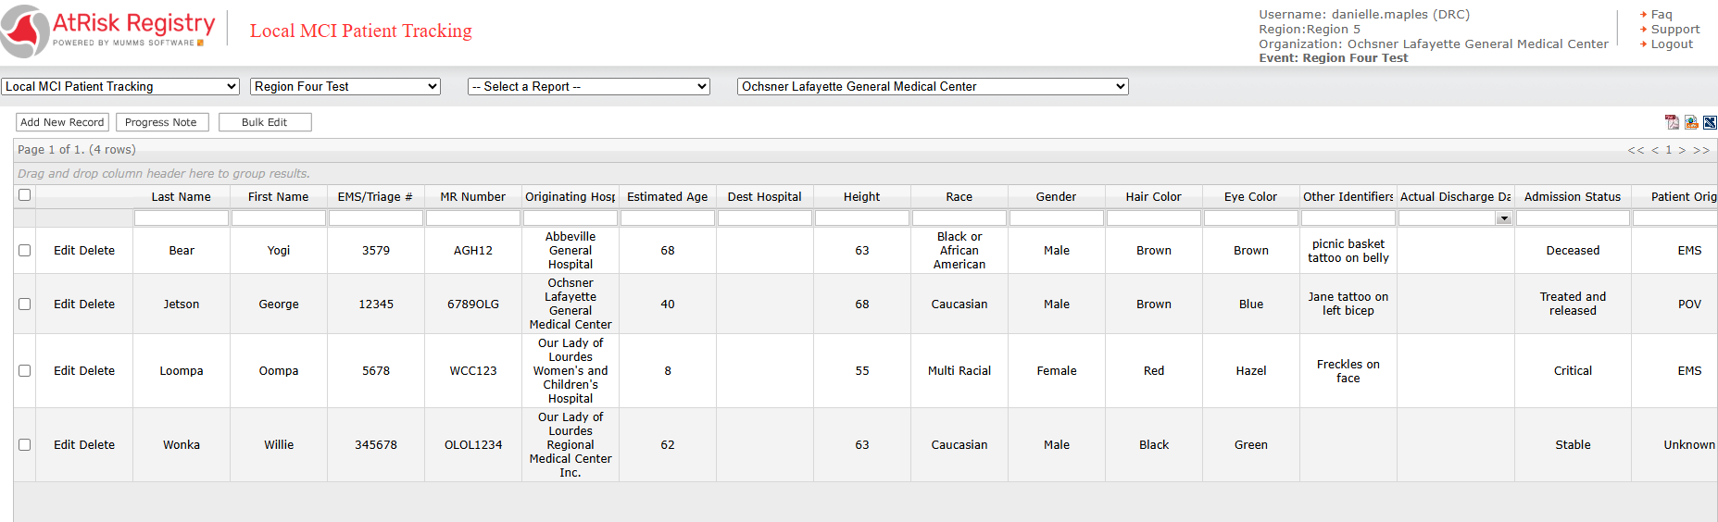
At-Risk Registry-What is it?
Notes:
Danielle’s Slide

Slide 11






The Lafayette Reunification Plan is effective and successful as a result of government & nonprofit collaboration.
By working together, we ensure that the reunification of person(s) affected by or involved in a disaster or emergency incident with loved ones (friends and family) is completed in a thoughtful and timely manner.
Lafayette Consolidated Government and the Lafayette Parish OHSEP office is committed to this effort.
Notes:
What the parish does as part of their response.

