Slide 1
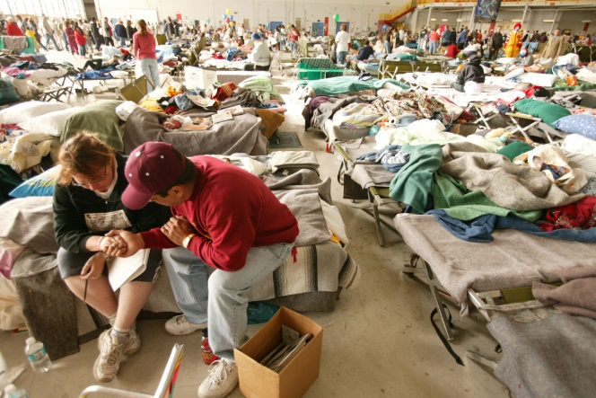
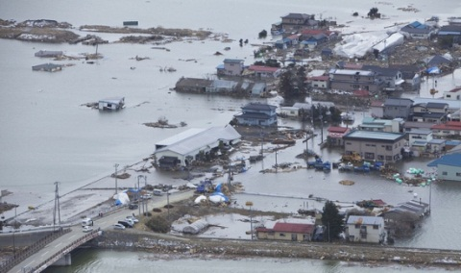
Governor’s Office of Homeland Security & Emergency Preparedness
Louisiana Elected Officials
Emergency Management Summit
Prepare Prevent Respond Recover Mitigate

Slide 2
Agenda
Introductions
Overview
Prepare
Prevent
Respond
Recover
Resources & Tools
Closing Comments

Slide 3
W
W
W
W
E
E
E
E
CLAIBORNE
CLAIBORNE
UNION
UNION
MOREHOUSE
MOREHOUSE
WEST
WEST
WEST
WEST
EAST
EAST
EAST
BOSSIER
EAST
BOSSIER
B
B
B
B
S
S
S
S
CARROLL
CARROLL
CARROLL
T
CARROLL
T
T
T
8
7
E
E
E
E
LINCOLN
Elected Officials
Seminars
R
LINCOLN
R
R
CADDO
R
CADDO
RICHLAND
OUACHITA
RICHLAND
OUACHITA
MADISON
MADISON
MADISON
JACKSON
MADISON
BIENVILLE
JACKSON
BIENVILLE
RED
RED
FRANKLIN
FRANKLIN
TENSAS
CALDWELL
TENSAS
N
CALDWELL
N
N
DESOTO
N
DESOTO
RIVER
RIVER
A
A
A
A
T
T
T
T
WINN
WINN
WINN
C
WINN
C
C
C
H
H
H
H
CATAHOULA
CATAHOULA
CATAHOULA
I
CATAHOULA
I
I
I
Region 6 - April 2
Region 5 - April 11
T
T
T
T
6
C
C
C
O
C
O
O
O
O
O
O
LASALLE
O
C
LASALLE
C
C
C
GRANT
Region 3 - April 3
GRANT
N
Region 4 - April 16
N
N
SABINE
N
SABINE
H
H
H
H
C
C
C
E
C
E
E
E
O
O
O
S
O
S
S
S
R
Region 9 - April 4
Region 7 - April 17
R
R
R
D
D
D
D
I
I
I
I
Region 1 - April 5
Region 8 - April 18
A
A
A
RAPIDES
A
VERNON
RAPIDES
VERNON
AVOYELLES
AVOYELLES
Region 2 - April 19
T
WEST
T
WEST
EAST
EAST
A
A
WASHINGTON
WASHINGTON
ST
9
FELICIANA
ST
FELICIANA
FELICIANA
N
FELICIANA
HELENA
N
2
HELENA
G
G
G
G
I
EVANGELINE
I
BEAUREGARD
EVANGELINE
BEAUREGARD
P
P
P
ST.
P
ST.
POINTE
POINTE
A
ALLEN
A
ALLEN
ALLEN
ALLEN
COUPEE
LANDRY
COUPEE
LANDRY
EAST
EAST
ST
H
ST
H
H
BATON
H
BATON
TAMMANY
O
TAMMANY
WEST
O
5
4
WEST
ROUGE
ROUGE
A
BATON
A
BATON
LIVINGSTON
ROUGE
LIVINGSTON
ROUGE
ST.
ACADIA
ST.
JEFFERSON
ACADIA
JEFFERSON
LFAYETTE
LFAYETTE
LAFAYETTE
CALCASIEU
LAFAYETTE
CALCASIEU
MARTIN
MARTIN
ASCENSION
DAVIS
ASCENSION
DAVIS
IBERVILLE
IBERVILLE
ST
ST
ORLEANS
JOHN
ORLEANS
ST.
JOHN
ST.
JAM ES
JAM ES
J
ST
J
IBERIA
ST
IBERIA
ASSUMPTION
ASSUMPTION
E
CHARLES
E
1
CAMERON
CHARLES
CAMERON
F
F
ST BERNARD
ST.
ST BERNARD
VERMILION
ST.
VERMILION
3
F
F
P
P
P
L
P
L
L
MARTIN
L
MARTIN
E
E
L
L
L
A
L
A
A
A
R
ST.
R
ST.
A
A
A
F
A
F
F
F
S
MARY
S
MARY
Q
Q
Q
O
Q
O
O
O
O
O
U
U
U
U
U
U
U
U
N
VER
N
VER
E
E
E
R
E
R
R
R
M
M
M
C
M
C
C
TERREBONNE
C
TERREBONNE
I
I
I
H
I
H
H
H
N
N
N
E
N
E
E
E
E
E
E
E
S
S
S
S

Slide 4
Overview
Summary of Louisiana Homeland Security & Emergency Assistance & Disaster Act (RS: 29-721-739)
OHSEP Director responsibilities
Parish Emergency Management Advisory Committee (PEMAC)
Specially created subcommittees
Governor’s Office of Homeland Security & Emergency Preparedness (GOHSEP)
National Incident Management System (NIMS)

Slide 5
Prepare
Pre-Disaster preparation
Threats + Hazards Identification + Risk Assessment (THIRA)
Mutual Aid Agreements (MAAs)
Pre-disaster contracts
Required plans
Emergency Operations Plan (EOP)
Parish Hazard Mitigation (HM) Plan
Preparedness (non-disaster) grants
Hazard Mitigation

Slide 6
Prevent
Louisiana State Analytical & Fusion Exchange (LA-SAFE)
LA-SAFE Products
Subject profiles
Alert Bulletins
Threat & vulnerability assessments
Graphics - maps, charts, time lines, etc.
Daily reports
Bulletins:
Law Enforcement Sensitive
Open Source
Special Bulletins
Suspicious Activity Report Analysis
LA-SAFE Partners
LSP
EBRSO
DHS
BRPD
GOHSEP
CYBER
HIDTA
LANG
FBI
CBP
ATF

Slide 7
Respond
Declaration Process: Parish + Governor + President
State Emergency Operations Center (SEOC)
WebEOC
Intrastate Mutual Aid Compact (IMAC)
Preliminary Damage Assessment (PDA)

Slide 8
Recover
FEMA Public Assistance (PA)
Obtain & Maintain (O&M) insurance requirement
Debris removal
FEMA Individual Assistance (IA)
Other Funding Opportunities
Small Business Administration (SBA) disaster loans
Community Development Block Grants (CDBG) & other federal resources
Interim Emergency Board (IEB) & other prospective funding sources

Slide 9
Resources & Tools
Virtual Louisiana
Louisiana Business Emergency Operations Center (LA BEOC)
Louisiana Public Assistance (LAPA) website
Get A Game Plan website
www.virtualla.la.gov
www.labeoc.org
www.louisianapa.com
www.getagameplan.org

Slide 10
Closing Comments
Points of Contact
Kevin Davis Phone: 225-925-7345 email: kevin.davis@la.gov
Christina Dayries Phone: 225-358-5599 email: christina.dayries@la.gov
Mark Riley Phone: 225-376-5493 email: mark.riley@la.gov
Pat Santos Phone: 225-925-3506 email: pat.santos@la.gov

Slide 11
STATE OF LOUISIANA

