Slide 1
New Job Aids

Slide 2
PA Toolbox Brochures

Slide 3

Environmental + Historic Preservation
(EHP)

Slide 4
Environmental + historic preservation (EHP)
All Federally funded projects must comply with the National Environmental Policy Act of 1970 (NEPA).

Slide 5
EHP (Continued . . . )
Under NEPA, the responsible Federal agency must consider the project’s impact on natural, cultural, historical and socioeconomic conditions.

Slide 6
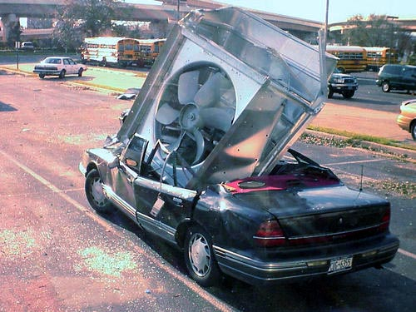
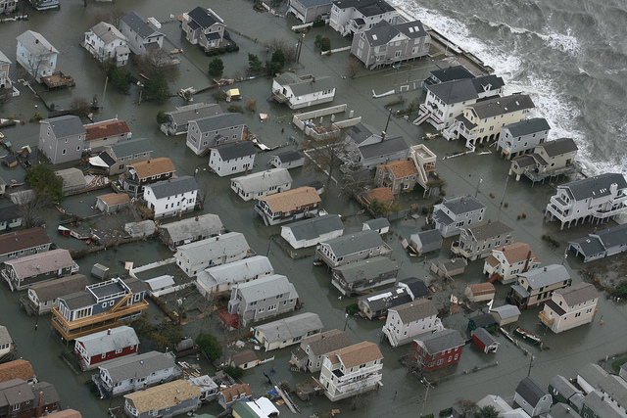
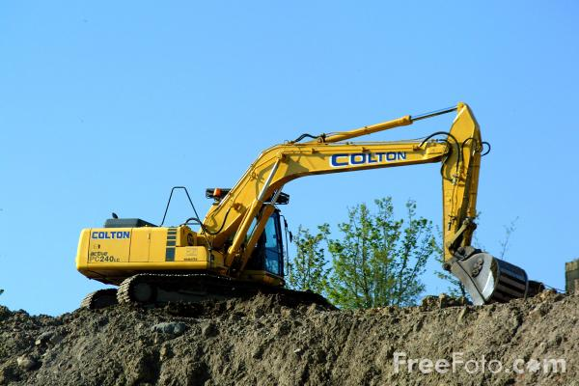
EHP (Continued . . . )
What determines the need for EHP review?
  All projects funded by FEMA receive an EHP review.
  The level of that review is determined by the type of project.

Slide 7
EHP (Continued . . . )
Different results of an EHP review.
  Record of Environmental Consideration (REC)
  Finding Of No Significant Impact (FONSI)
  Environmental Assessment (EA)
  Adverse Effect
  Environmental Impact Statement (EIS)

Slide 8
EHP (Continued . . . )
Some projects can be excluded from EHP review.
  STATEX - Statutorily excluded.
  CATEX - Categorically excluded.

Slide 9
EHP (Continued . . . )
Your role in EHP review.
  Prior to starting work, obtain permits and approval letters from the respective agencies for compliance.

Slide 10
EHP (Continued . . . )
“It is easier to beg for forgiveness than ask for permission”.
  NOT IN EHP REVIEW. Do not begin a project before all of the necessary approvals and permits have been obtained.

Slide 11



EHP (Continued . . . )
The insert to the brochure contains a list of “WHO TO CALL”.
These are the certain regulatory and compliance agencies who you may need to contact based off of the possible impacts of your project.

Slide 12

Alternate + Improved (A/I) Projects
(Coming Soon)

Slide 13
Alternate projects
If replacing a facility’s form or function is not in the best interest of your community or organization, request to use those funds towards an Alternate Project.

Slide 14
Alternate projects (Continued . . . )
  For Category C-G Permanent Work only.
  Funding reduction
    25% reduction for PNP.
    10% for governmental organizations.

Slide 15
Alternate projects (Continued . . . )
  Cannot be used to pay the non-Federal share of another facility or another grant.

Slide 16
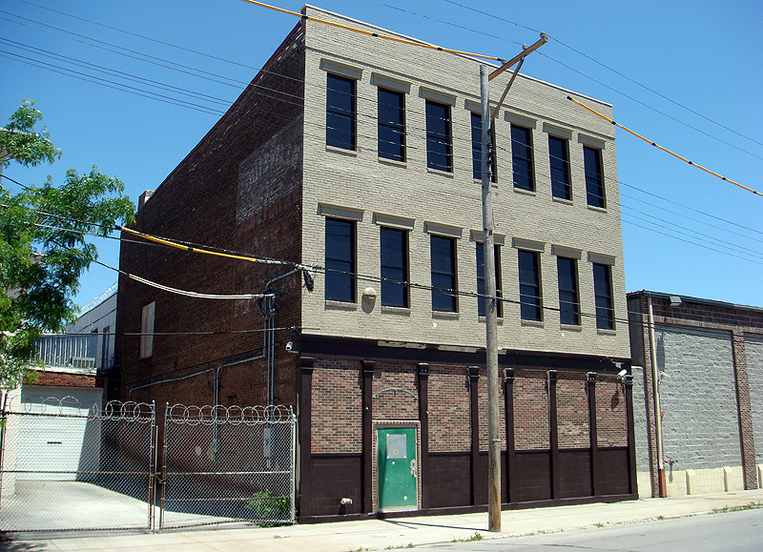
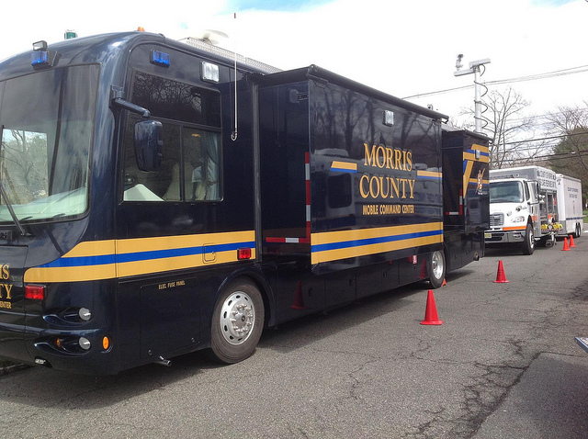
Alternate projects (Continued . . . )

Slide 17
Improved projects
An improved project is a project where you want to upgrade your facility but keep the same function.
  Add square footage (more than required by new codes and standards).
  Improved materials.

Slide 18
Improved projects (Continued . . . )
Important facts about Improved Projects:
  FEMA does not fund costs of improvements.
  Improved projects are capped at the amount of eligible damages.

Slide 19
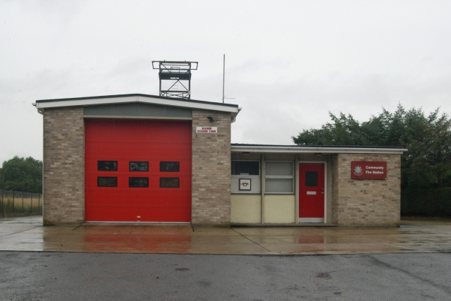
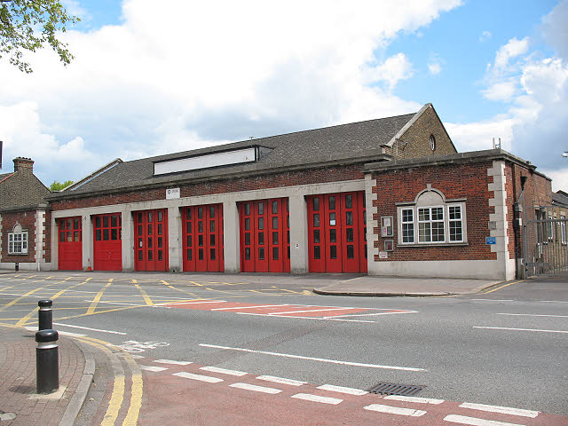
Improved projects (Continued . . . )

Slide 20
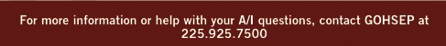
225.925.7500

Slide 21
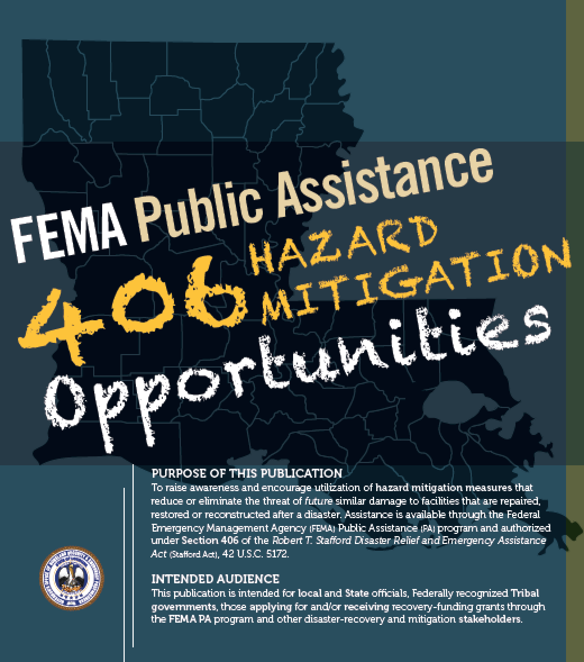
406 Hazard Mitigation (HM)

Slide 22
406 HM
Hazard Mitigation
  Any sustained action to reduce or eliminate the long term risk to human life and property from hazards.

Slide 23
406 HM (Continued . . . )
There are three (3) different sources of HM funding:
  406 HM
    Part of Public Assistance (PA).

Slide 24
Hazard Mitigation
  404 HM
    Disaster related but is its own grant program.
  203 HM
    Pre-disaster mitigation efforts.

Slide 25
406 HM (Continued . . . )
Can ONLY be used to fund measures:
  That will reduce SIMILAR damages
  Technically feasible to hazard and location.
  Cost effective.

Slide 26
406 HM (Continued . . . )
All HM projects must be cost-effective.
  Mitigation measures may cost up to 15% of total eligible repair costs.

Slide 27
406 HM (Continued . . . )
  Some measures are pre-determined as cost effective as long as they don’t exceed 100% of eligible repair costs.
  All other measures require benefit cost analysis.

Slide 28
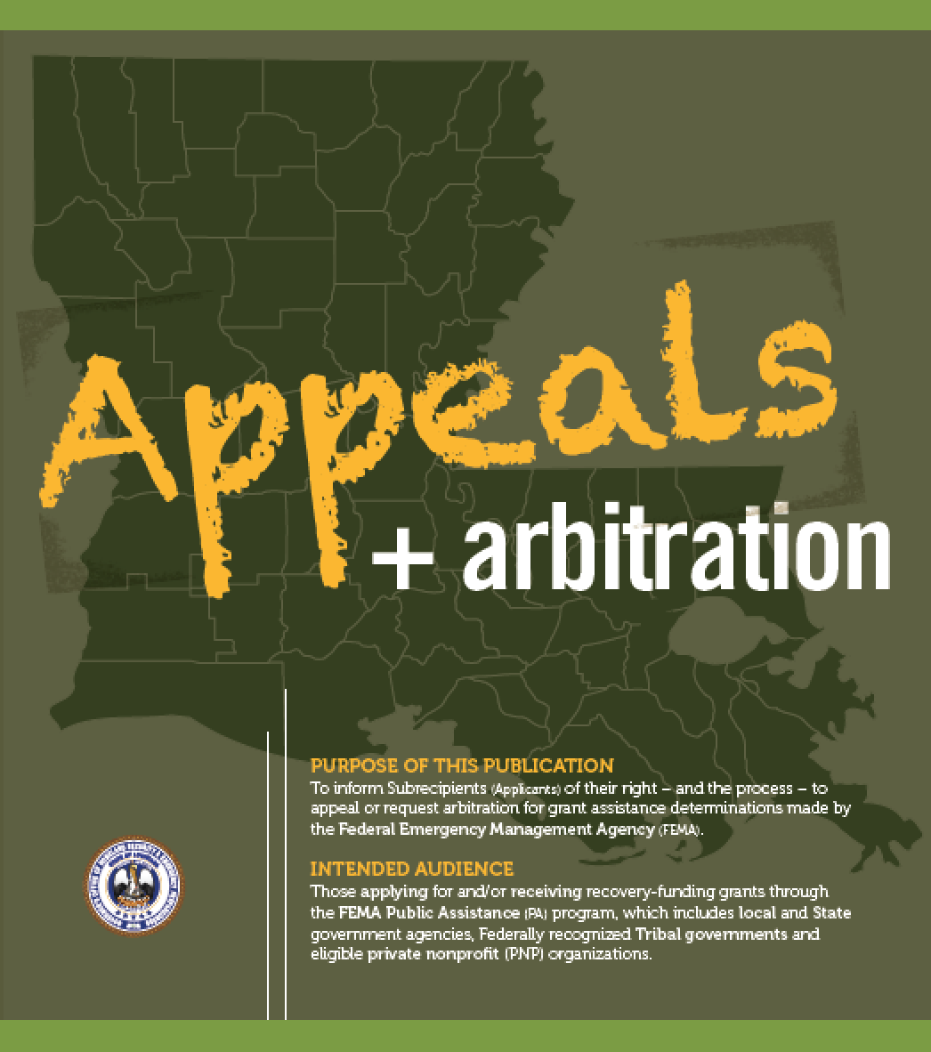
  Appeals + Arbitration

Slide 29

Appeals + Arbitration
Two (2) options if you find yourself in disagreement with a FEMA decision:
  Appeals Process
  Arbitration

Slide 30
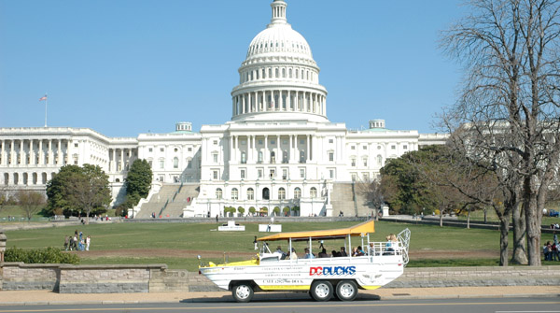
Appeals
Appeal Process
  Governed by 44 CFR 206.206.
  Two (2) opportunities
    First appeal is heard by Region 6 HQ in Denton.
    Second appeal is heard by FEMA HQ in D.C.

Slide 31
Appeals (Continued . . . )
Key things to know about the appeals process.
  Certain strict deadlines that must be adhered to.
  Certain minimum information that must be presented.

Slide 32
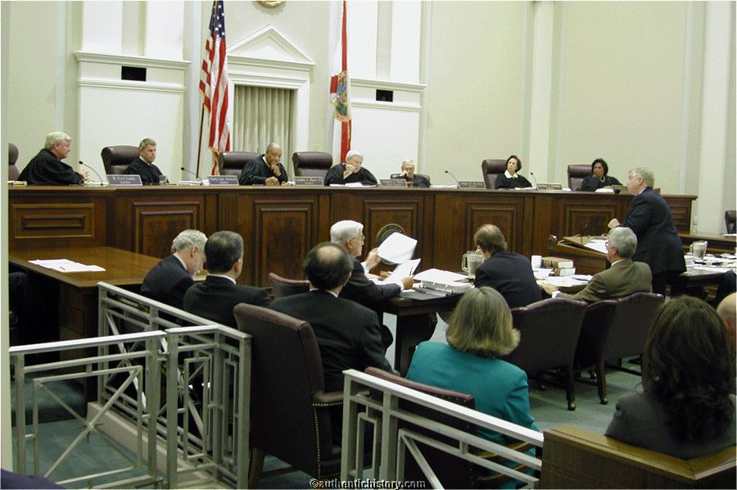
Arbitration
Arbitration
  An alternative method to dispute resolution.
  Facts

Slide 33
Arbitration
    Hearing by an independent party.
    Shorter deadlines require you to be efficient in your argument.

Slide 34
Appeals + arbitration
Appeals + arbitration summary
  Two (2) different options of dispute resolution.
  Both have different strict deadlines that must be met.

Slide 35
Appeals + arbitration (Continued . . . )
  One is reviewed by FEMA. The other is reviewed by an independent third party.

Slide 36
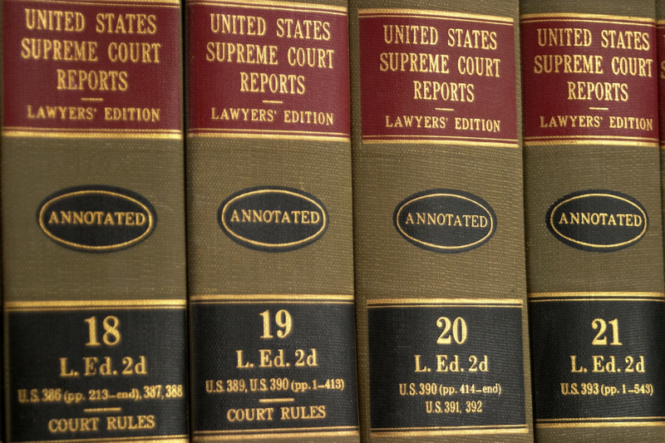
Appeals + arbitration (Continued . . . )
GOHSEP’s appeals team will assist you from start to finish.

Slide 37
Appeals + arbitration (Continued . . . )
  Contact Carla Richard 225-379-4019 GOHSEP’s Appeals Manager

Slide 38

Private
Non-Profit (PNP) Organizations

Slide 39
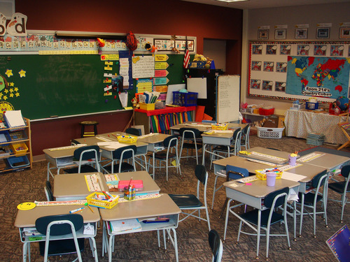
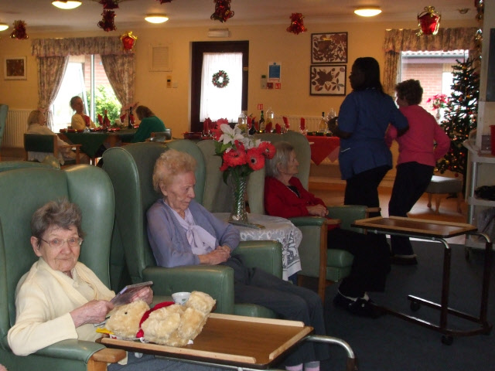
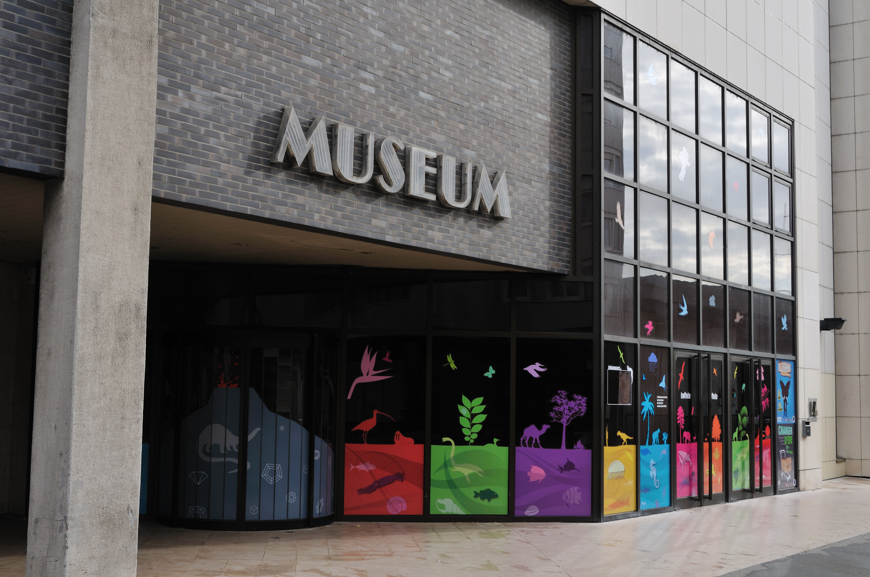

PNP
PA eligible non-profit organization
  A tax-exempt organization that provides essential governmental-type services.

Slide 40
PNP (Continued . . . )
Requirements for eligible PNPs
  Effective ruling letter from IRS granting tax exemption under 501(c), (d), or (e) of the Internal Revenue Code of 1954.

Slide 41
PNP (Continued . . . )
  Satisfactory evidence from the State that your organization is a non-revenue producing or nonprofit doing business under State law LRS 33:9204, and
  Must be generally open to the public.

Slide 42

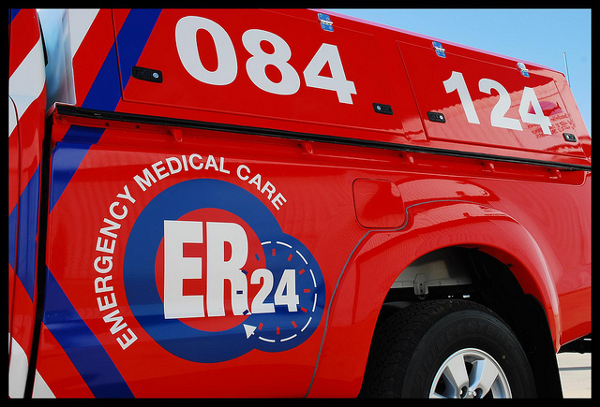
PNP (Continued . . . )
Two (2) categories of PNP
  Critical
  Non-critical – other essential services

Slide 43
PNP (Continued . . . )
Critical PNPs are defined in 44 CFR 206.221(e) as providing the following services:
  Power
  Water
  Irrigation facilities
  Nursing homes
  Emergency Medical Care
  Fire Dept./Emergency Rescue

Slide 44
PNP (Continued . . . )
  Sewer/wastewater treatment
  Communications
  Education
  Facilities that are used in support of the above (Hospital admin building for example)

Slide 45
PNP (Continued . . . )
Non-Critical PNP – that provide essential government-type services – are defined as providing the following services:
  Community arts centers
  Libraries
  Homeless shelters
  Museums
  Zoos
  Performing arts facilities

Slide 46
PNP (Continued . . . )
  Community centers
  Senior citizen centers
  Rehab facilities
    Shelter workshops
    Health/safety services of a governmental nature

Slide 47
PNP (Continued . . . )
Non-Critical PNP must also apply for assistance from the Small Business Administration (SBA) and . . .
  Receive a decision prior to receiving FEMA funding for Permanent Work.

Slide 48
PNP (Continued . . . )
SBA funding
  FEMA reduces the amount of its assistance by the amount of the SBA loan for which you qualify for permanent FEMA PA eligible work.

Slide 49
PNP (Continued . . . )
  Emergency work (Cat A + B) is still funded by FEMA with or without an SBA determination.

Slide 50
PNP (Continued . . . )
PNP eligibility determined by functional usage.
  At least 50% of the facility (sq. ft.) OR
  50% of the time the space is used must be for PA eligible functions as previously defined.

Slide 51
PNP (Continued . . . )
New for PNP
  Procurement regulations have been adjusted:
    For disasters declared prior to December 26, 2014 PNPs are required to follow 2 CFR 215.40-48 and the cost principles in 2 CFR 230.

Slide 52
PNP (Continued . . . )
For disasters declared after December 26, 2014, PNPs follow 2 CFR 200 for both administrative requirements and cost principles.

Slide 53

Recovery technical contacts
John Gonzales
Section Chief
  (225) 379-4028
  john.gonzales@la.gov
  Daniel Crothers
Group Lead
  (225) 267-2761
  daniel.crothers@la.gov

Slide 54
Questions?

