Slide 1
Emergency Management Cycle
Notes:
Although Hazard Mitigation is technically housed in Recovery, it can go a long way in preparing for a disaster.

Slide 2
Planning Regulatory Requirement
Per 44 CFR 201.4 (a) (1) - For all disasters declared on or after November 1, 2004, all states, local governments, and tribes must have a FEMA approved Hazard Mitigation plan in order to become eligible for all types of FEMA funding.
Notes:
If you want FEMA funding you must have a hazard mitigation plan.

Slide 3
State and Parish Plan Update Cycle
A State is required to update its FEMA approved State Hazard Mitigation Plan every three (3) years. A Parish Hazard Mitigation Plan every five(5) years for continued eligibility of the following grant programs:
Hazard Mitigation Grant Program
Pre-Disaster Mitigation Grant Program
Flood Mitigation Assistance Program
Severe Repetitive Loss Program
Repetitive Flood Claims Programs
Public Assistance (beyond Parts A & B)
Notes:
The state is required to update its FEMA approved plan every three (3) years. Parishes are required to update their hazard mitigation plans every five (5) years. With out an approved State Hazard Mitigation Plan the state and parishes would not be eligible for public assistance and HMGP funding. Later in the presentation we will review some of the different hazard mitigation projects that can be funded through these grants.

Slide 4
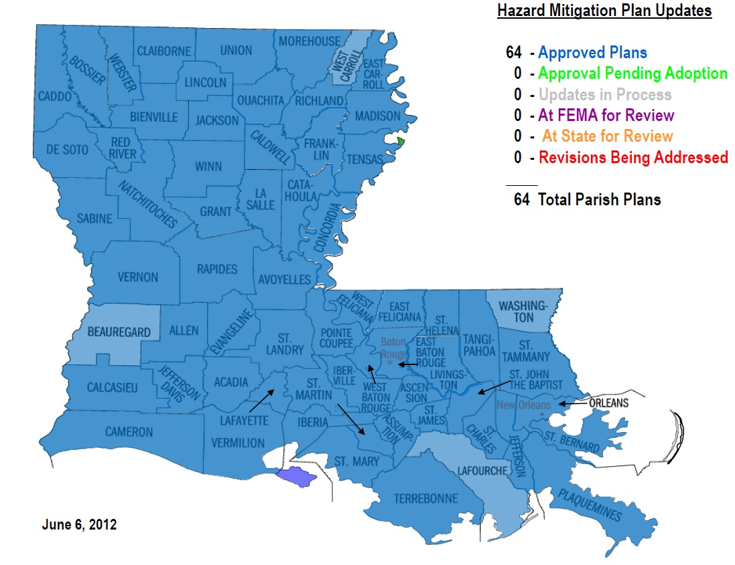
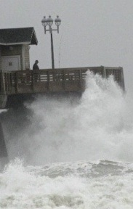
Status of LA Mitigation Plans
Louisiana Standard State Mitigation Plan:
- approved: April 6, 2011
- expires: April 5, 2014
Local Hazard Mitigation Plans:
Notes:
I am proud to say that the State of Louisiana and all 64 Parishes have a FEMA approved Hazard Mitigation Plan.

Slide 5
What is a “Hazard Mitigation Plan”?
Hazard Mitigation Plan:
A plan to reduce a community’s risk and exposure to disasters.
…which is different from an…
Emergency Operations Plan (EOP):
A plan to guide a community’s response to an emergency or
disaster.
A Hazard Mitigation Plan is typically written before hazard events occur (pre-disaster).
Hazard mitigation projects can be implemented either before or after a disaster (pre-disaster or post-disaster).
Notes:
Read first two bullets

Slide 6
Benefits of Mitigation Planning
Mitigation Plans form the foundation for a community’s long-term strategy to reduce disaster losses and break the cycle of disaster damage, reconstruction, and repeated damage.
Ongoing planning process is as important as the plan itself because it creates a framework for risk-based decision making.
Prevent loss of life.
Protect existing development.
Strengthen first responder safety.
Ease recovery after disaster strikes.
Encourage smart development practices.
Increase business continuity and economic stability.
Notes:
The benefit of mitigation planning – break the cycle of disaster damage, reconstruction and repeated damage. The ongoing planning process is as important because it creates a framework for risk-based decision making.

Slide 7
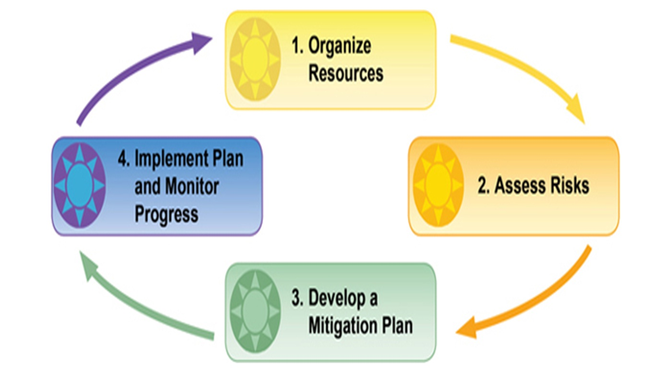
The Four-Step Planning Process
Notes:
Hazard mitigation planning is the process of determining how to reduce or eliminate the loss of life and property damage resulting from natural and human-caused hazards. There are four basic phases of the hazard mitigation planning process. Organize resources… form your team/committee with people from fire, police, public works, red cross, school board, other departments/ agencies with in the parish, federal or state agencies with interest or ties to community. Assess risks– what are your hazards flooding, earthquake, wind etc. Develop a Plan…. Put all the knowledge into writing. Implement Plan and Monitor progress…have a meeting once an year and after a disaster to talk about the plan, record what happened and see if mitigation actions are on the right track. Ex is there more or less damage compared to last time? If less, mitigation is working.

Slide 8
Contents of the Mitigation Plan
Planning process
Hazard Identification
Risk Assessment
Capability Assessment
Mitigation Strategy
Plan implementation and maintenance process.
Notes:
The HM plan is broken down into 6 basic parts

Slide 9
Post-Disaster Risk Assessment
What did you see? TAKE PHOTOGRAPHS!
Capture high water marks.
Oral history matters.
Share with the local Hazard Mitigation Planning Team.
Document and archive.
Engage with State Hazard Mitigation Office.
Notes:
The plan is a living document. Information should be gathered during the 5 year cycle. Updating is not as intimidating as it sounds. After events just sit down and write down the who, what, when, where and why of each event and file the information away. This will be a huge help to you when the plan needs to be updated. By doing this you will have the information available when the time comes to update the plan.

Slide 10
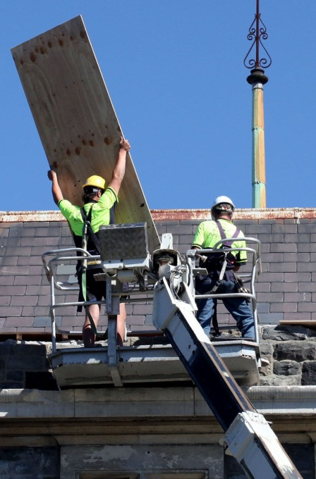
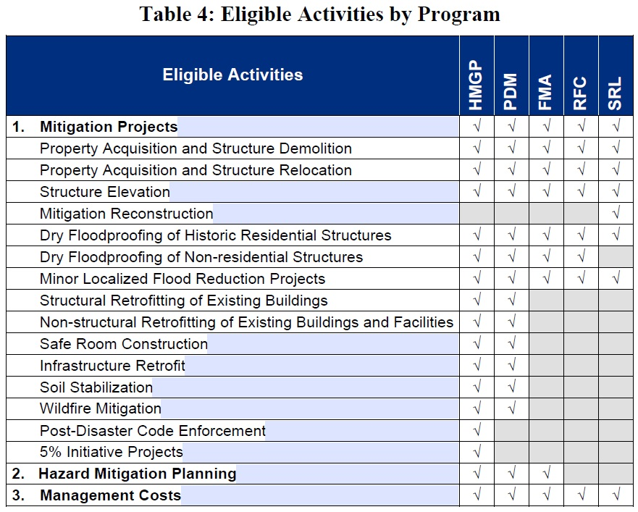
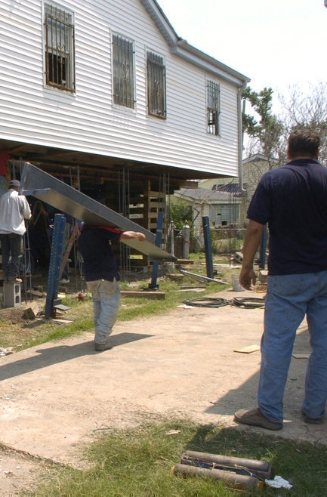
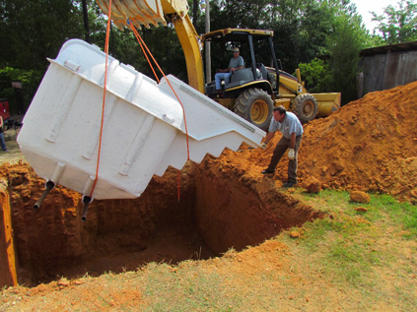
FEMA HMA Grant Projects
Notes:
As promised this slide shows you some of the different projects that can be funded through the FEMA hazard mitigation assistance programs. Note that structural elevation is allowed in all programs. More to come on as to why this project type may be of particular interest to you and the homeowners in your parish.

Slide 11
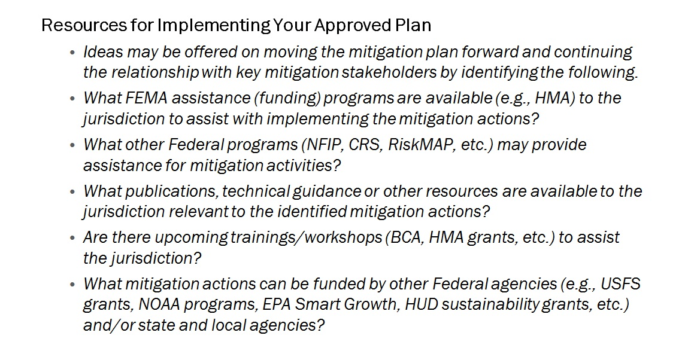
Implementing Your Plan - Resources
Notes:
Other funding sources including the FEMA HMA programs are available in the funding hazard mitigation workbook that we will make available to you after this session.

Slide 12
The Importance of Mitigation Projects
Mitigation projects have the potential to:
Reduce costs for NFIP flood insurance and other forms of insurance.
NFIP flood insurance rates are based on lowest floor elevation in relation to the base flood elevation.

Slide 13
Biggert Waters National Flood Insurance Program (NFIP)
Reform Act of 2012
Ensure the NFIP’s survival so that homeowners will NOT have to take their chances in a virtually non-existent private market for flood insurance.
Bring certainty to half-a-million real estate transactions in 21,000 communities nationwide where flood insurance is required for a federally related mortgage.
Maintain comprehensive coverage and program access for all properties, including second and vacation homes.
Establish a formula for NFIP and wind insurers to pay where property damage cannot be attributed to wind or water, settling to long-standing dispute and avoiding further lawsuits.
Eliminate subsidized insurance rates on properties with repeated flood losses and claims.
Notes:
On July 6, 2012, the President signed into law the Surface Transportation Bill (H.R. 4348), which re-authorizes the National Flood Insurance Program (NFIP).
This legislation will extend the NFIP for five years, until Sept. 30, 2017, It also calls for reforms including phasing out subsidies for many properties, raising the cap on annual premium increases from 10 percent to 20 percent, allowing multifamily properties to purchase NFIP policies, imposing minimum deductibles for flood claims, requiring the NFIP administrator to develop a plan for repaying the debt incurred from Hurricane Katrina, and establishing a technical mapping advisory council to deal with map modernization issues. In addition to the 5-year program reauthorization, the bill includes many program reforms which: (Read from Slide)

Slide 14
Biggert Waters National Flood Insurance Program (NFIP)
Reform Act of 2012
The federal government will no longer subsidize premium rates in areas with certain levels of risk.
The new rates individuals will begin to see will reflect the full flood risk of the insured structure.
Notes:
It is important to note: (Read from the slide). Next we will look at an example of how the flood insurance premium for a sever repetitive loss property could change if not mitigated with the enactment of this new legislation. (Go to next slide)

Slide 15
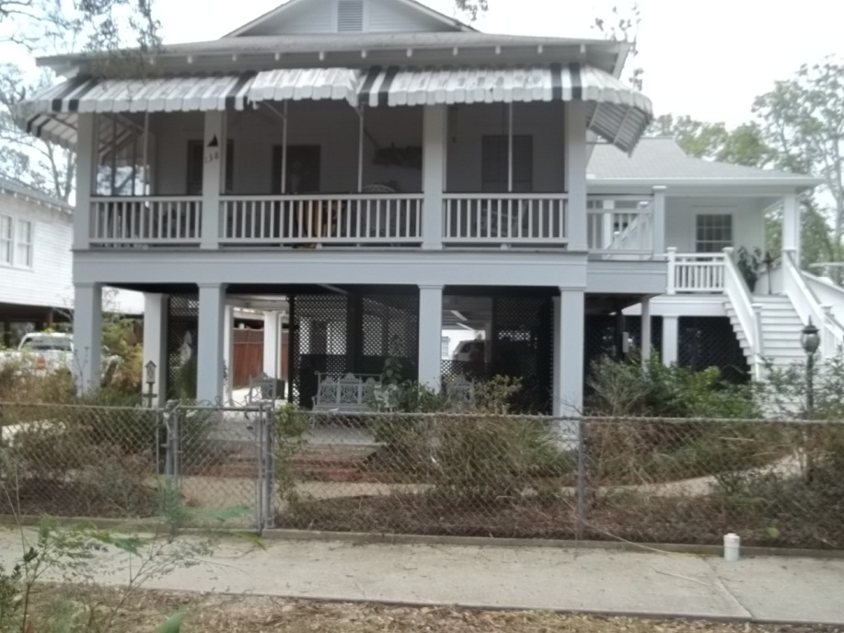
Case Study
Flood Insurance / Year
BFE + 3 = $300
BFE + 0 = $900
BFE - 1 = $3,500
BFE - 3 = $9000
FFE After Mitigation = 15.1
BFE = AE 12’
Isaac High Water Mark = 8.25
Completed Elevation Project
Notes:
This slide is an example of what the future flood insurance rates could be based on the various elevation levels for a sever repetitive loss property. As you can see the Base Flood Elevation (BFE) is twelve feet. Fortunately for this homeowner their house has a first floor elevation (FFE) of 15.1 feet which is 3.0 feet above the required BFE. Therefore they would pay the lowest flood insurance rate that equates to $300.00 per year. However if this home was not elevated the homeowners flood insurance could be as high as $9000 per year. We are still awaiting further guidance from FEMA on this new act and how and when it will affect flood insurance rates on sever repetitive loss properties. For now you can get more information by Goggling Biggert-Waters Flood Insurance Reform Act of 2012.

