Slide 1
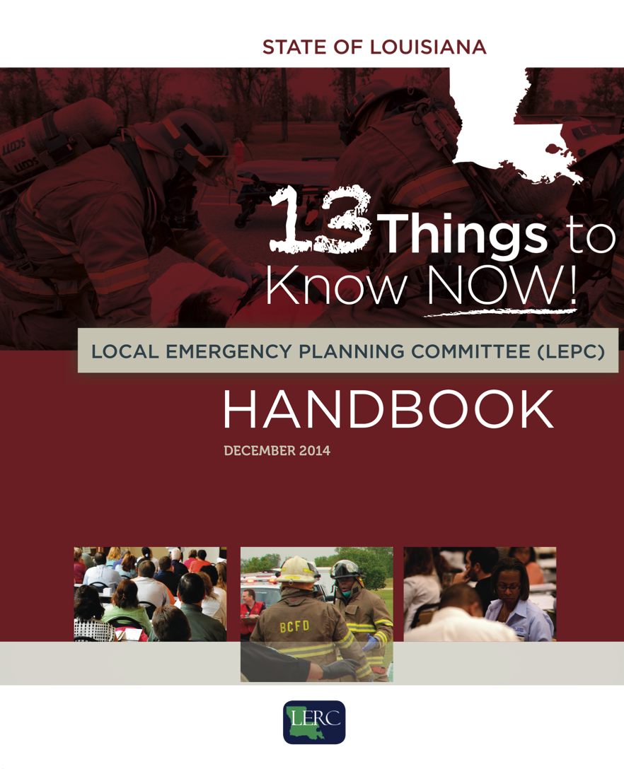

IT IS
HERE…
Notes:
We are pleased to tell you that GOHSEP in partnership with the LERC, the Department of Public Safety and Corrections and YOU, have created a Handbook to guide LEPC activities.

Slide 2
Local Emergency Planning Committees (LEPCs)
Notes:
Louisiana Emergency Planning Committees – also called LEPCs – play an important role in emergency planning, the collection of data and in the safe guarding of local communities. This Handbook will help identify what that role is.

Slide 3
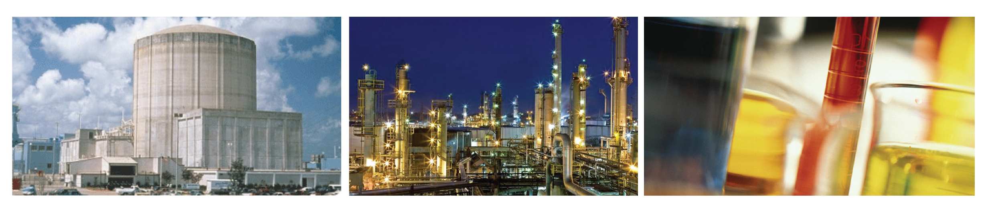
There are Federal and State requirements for State, local governments and industry regarding emergency planning and community right-to-know reporting on hazardous and toxic chemicals.
Notes:
To bring clarity for who's responsible for what and to identify opportunities and Best Practices in ensuring the public’s right to know about chemicals and hazardous materials in their community, we have developed this Handbook to provide a path forward in identifying responsibilities for the State, local authorities and industries that manufacture, store or use hazardous materials.

Slide 4


Slide 5
Sections +
Important Contact Information + Appendix

Slide 6
Contents:
Federal/State Laws + Regulations
Roles + Responsibilities
LEPCs/Programs
Funding LEPC Activities
Training + Outreach Activities
Planning
Clean up + Cost of Recovery
Incident Command System (ICS)
Protection of the Population
Enforcement
HAZMAT Response Activities
Notes:
The handbook has 13 chapters that discuss the following topics:

Slide 7

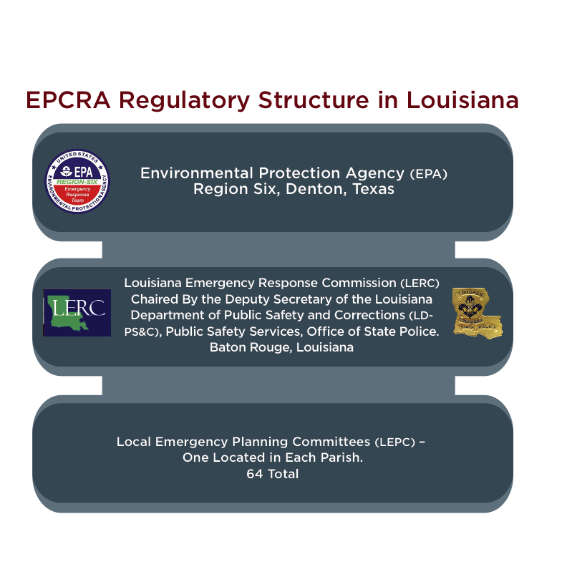
Federal + State + EPA
EPCRA Regulatory Structure in Louisiana
Notes:
• It discusses the governing mandates including Federal and State regulations that create and govern the Louisiana Emergency Response Commissions and Local Emergency Planning Committees and the role of the Environmental Protection agency and others.
• It also provides a brief tabular recap of important Federal legislation that provides the foundation for right-to-know reporting and the formation of Louisiana Emergency Response Commissions and Local Emergency Planning Committees.

Slide 8
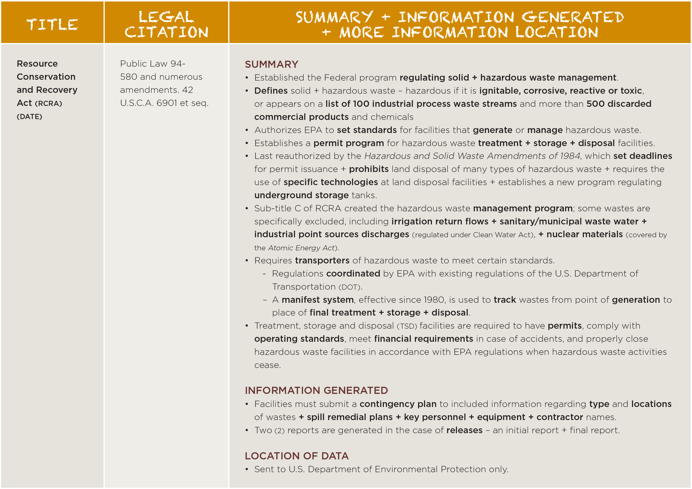
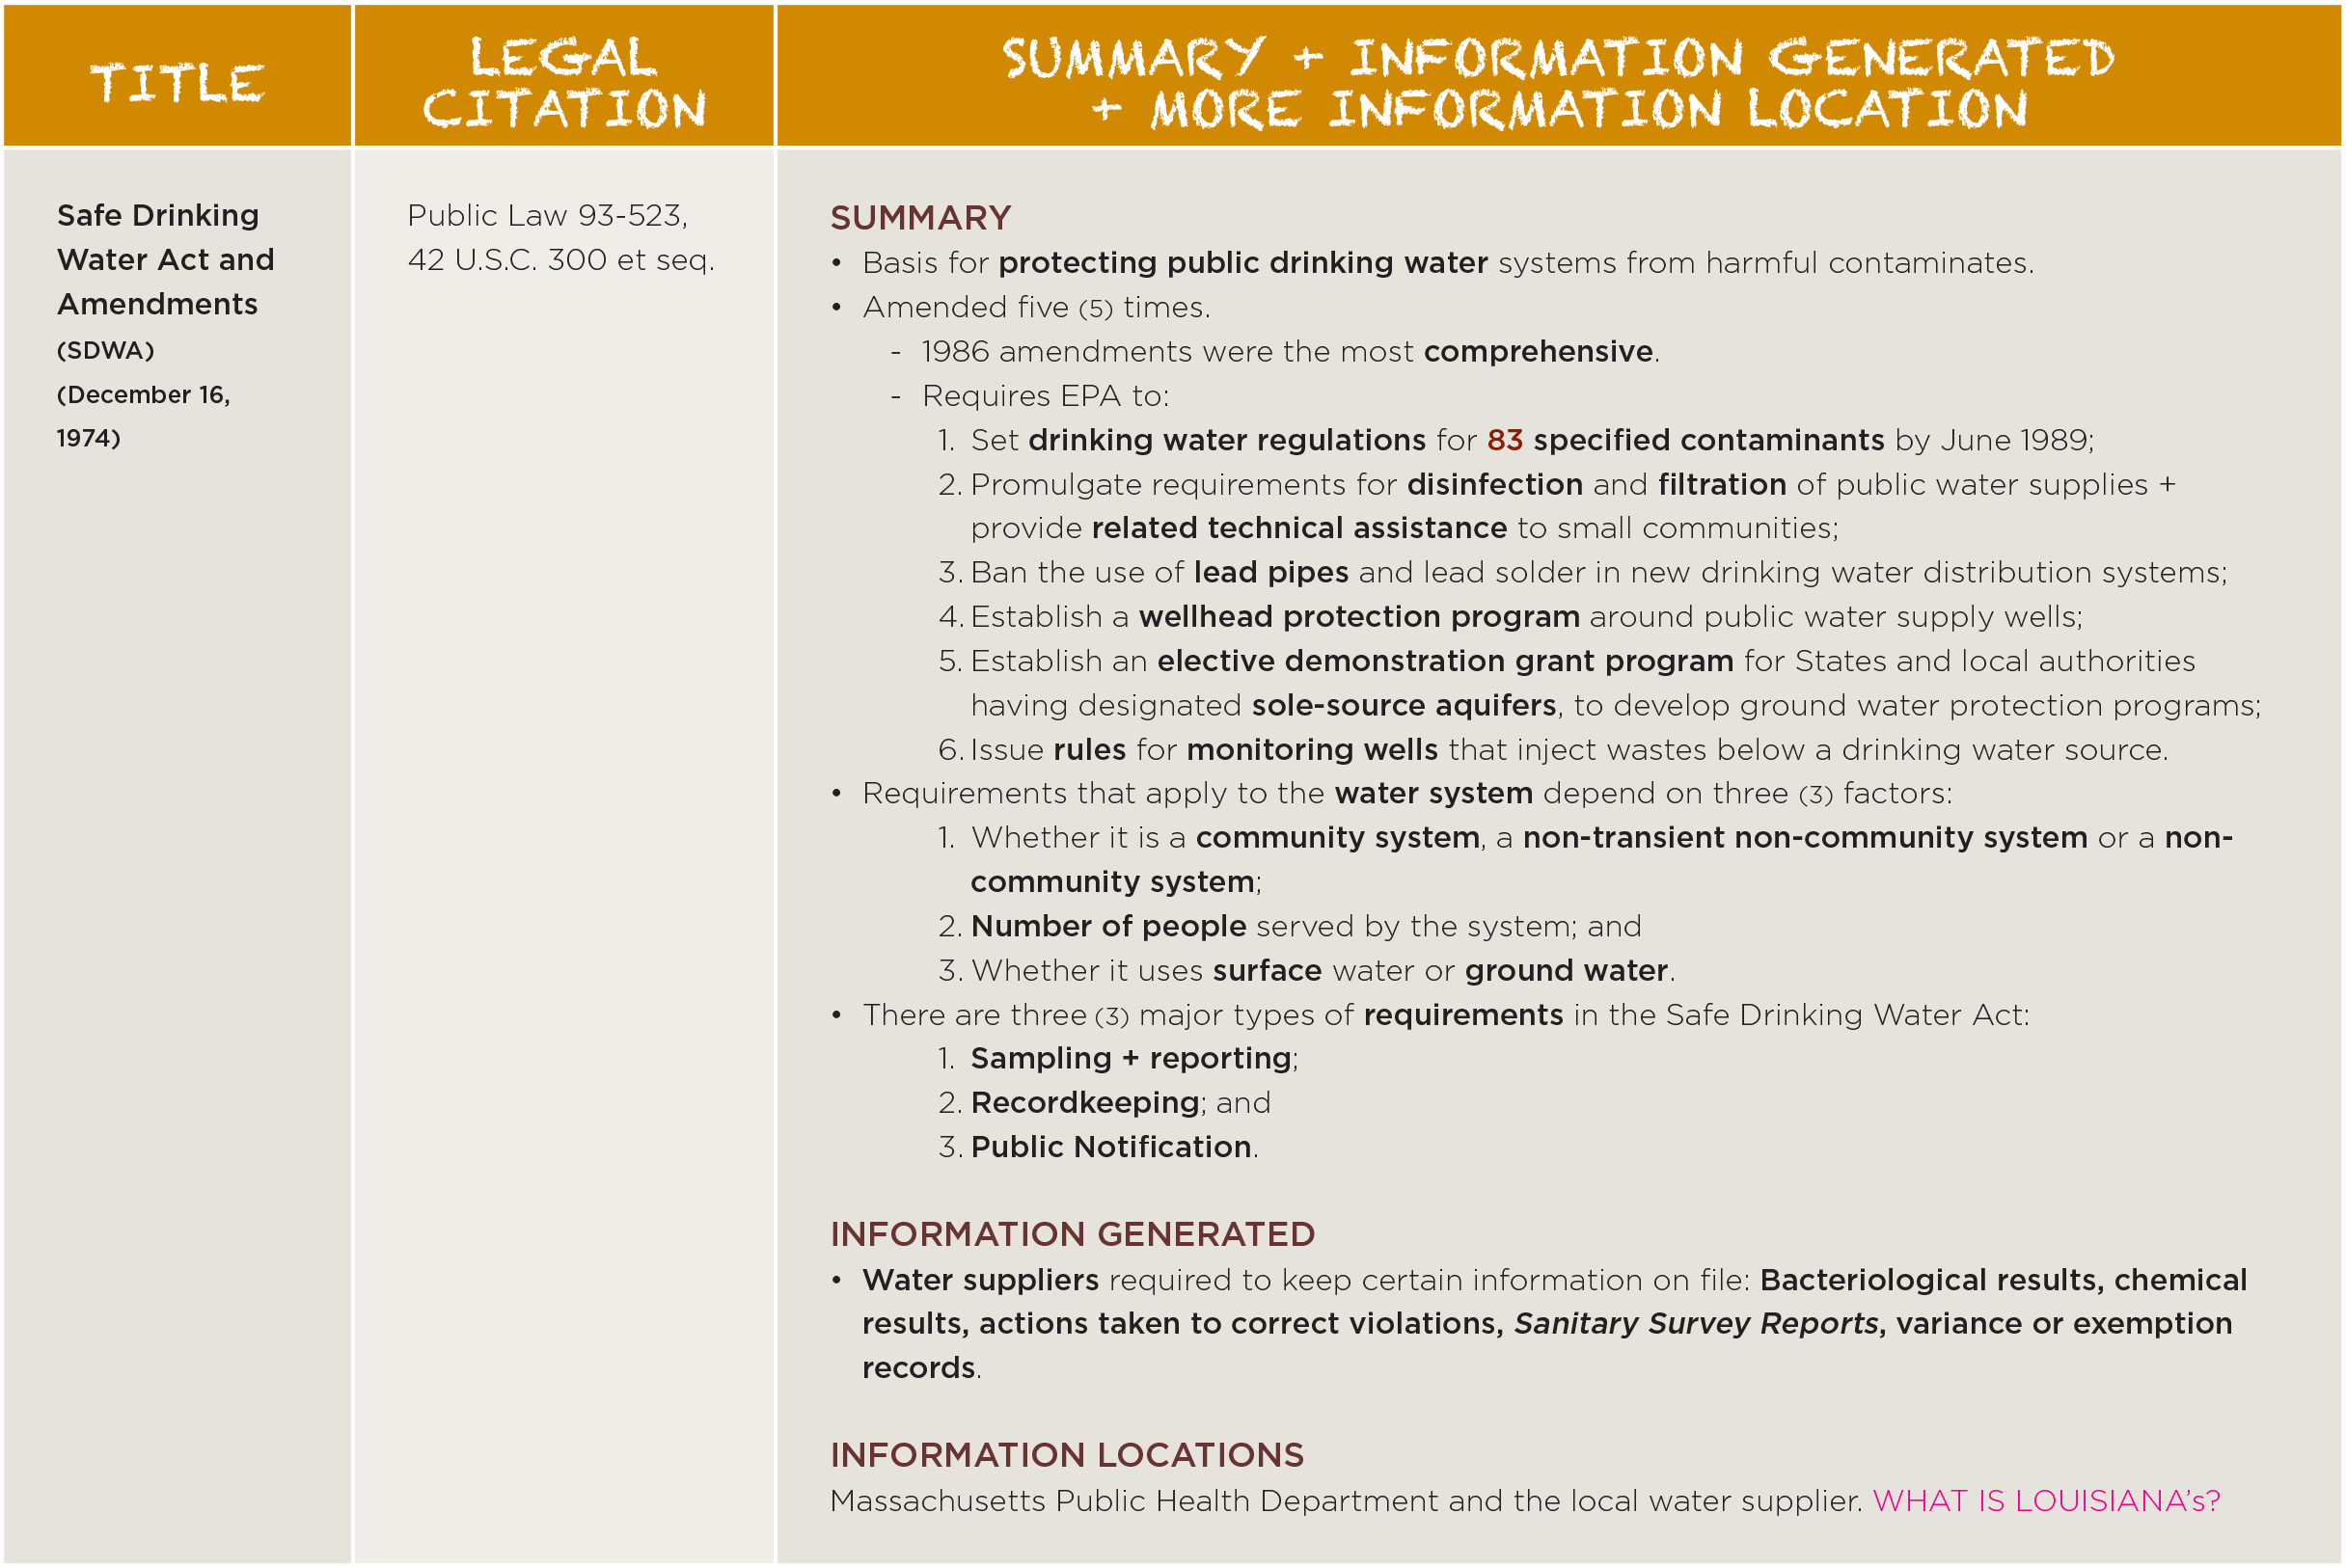
Federal + State + EPA

Slide 9
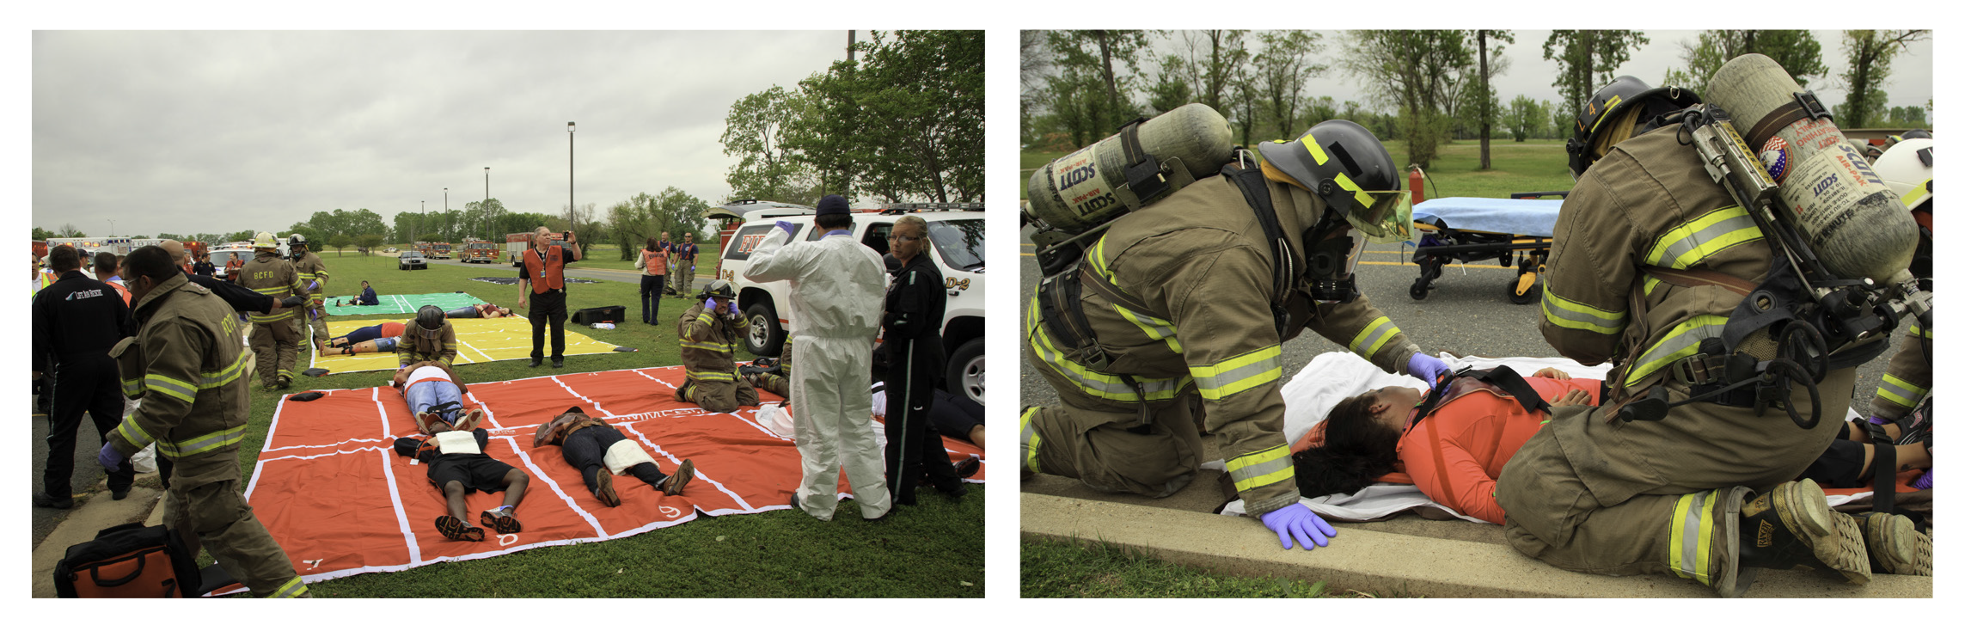
Roles + Responsibilities
Louisiana Department of Public Safety +
Corrections (LDPS&C)
Louisiana Emergency Response Commission (LERC)
Owners/Operators
Local Emergency
Planning Committees (LEPCs)
Notes:
It identifies roles + responsibilities for the:
• Louisiana Department of Public Safety + Corrections.
• Louisiana Emergency Response Commission
• Owners/Operators
• Local Emergency Planning Committees

Slide 10
Nuts + Bolts
The Handbook discusses the nuts + bolts of reporting requirements, running an LEPC from identifying its membership, to tips on how to call and run meetings, elect leadership, appoint subcommittees and establish meeting protocols.
Importantly, the Handbook identifies potential funding sources for its activities.

Slide 11
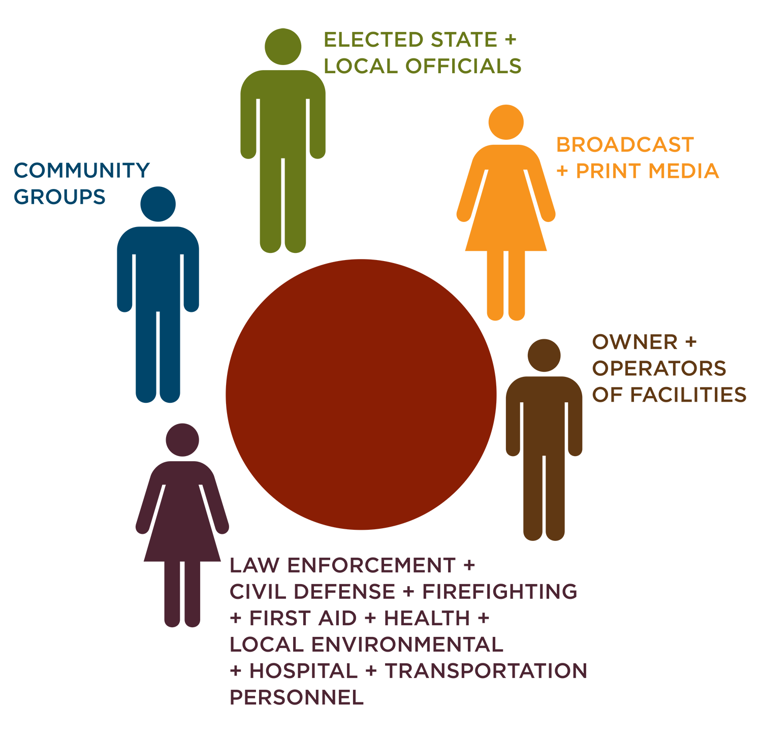
Nuts + Bolts
Identifies training + outreach activities a LEPC might want to engage in – and who needs what kind of training plus how to build a training plan.

Slide 12
Nuts + Bolts
Provides tips for how to develop + exercise a plan, and how a hazardous substance plan MUST integrate into other local planning initiatives to be effective.
Touches on clean up + the cost of recovery.
Details how to protect the population; from planning to response to an incident, including when and how to evacuate or shelter in place.

Slide 13

Nuts + Bolts
Articulates penalties for failure to report.
Speaks to HAZMAT response activities.
Explains what the Incident Command System (ICS) is and why it must be used.

Slide 14

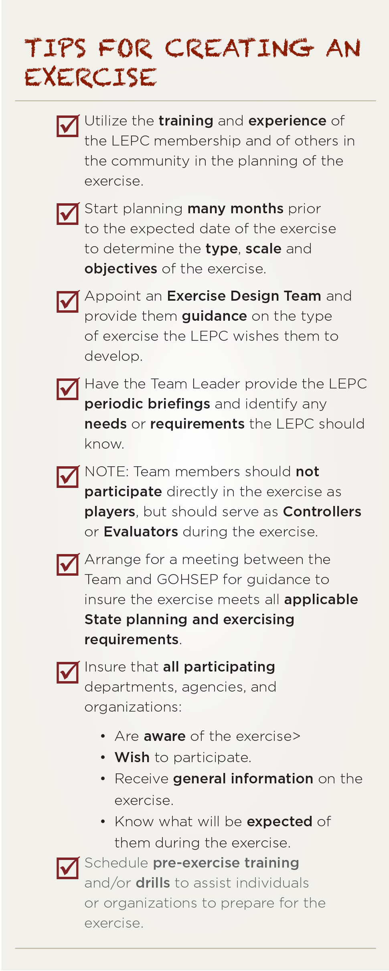
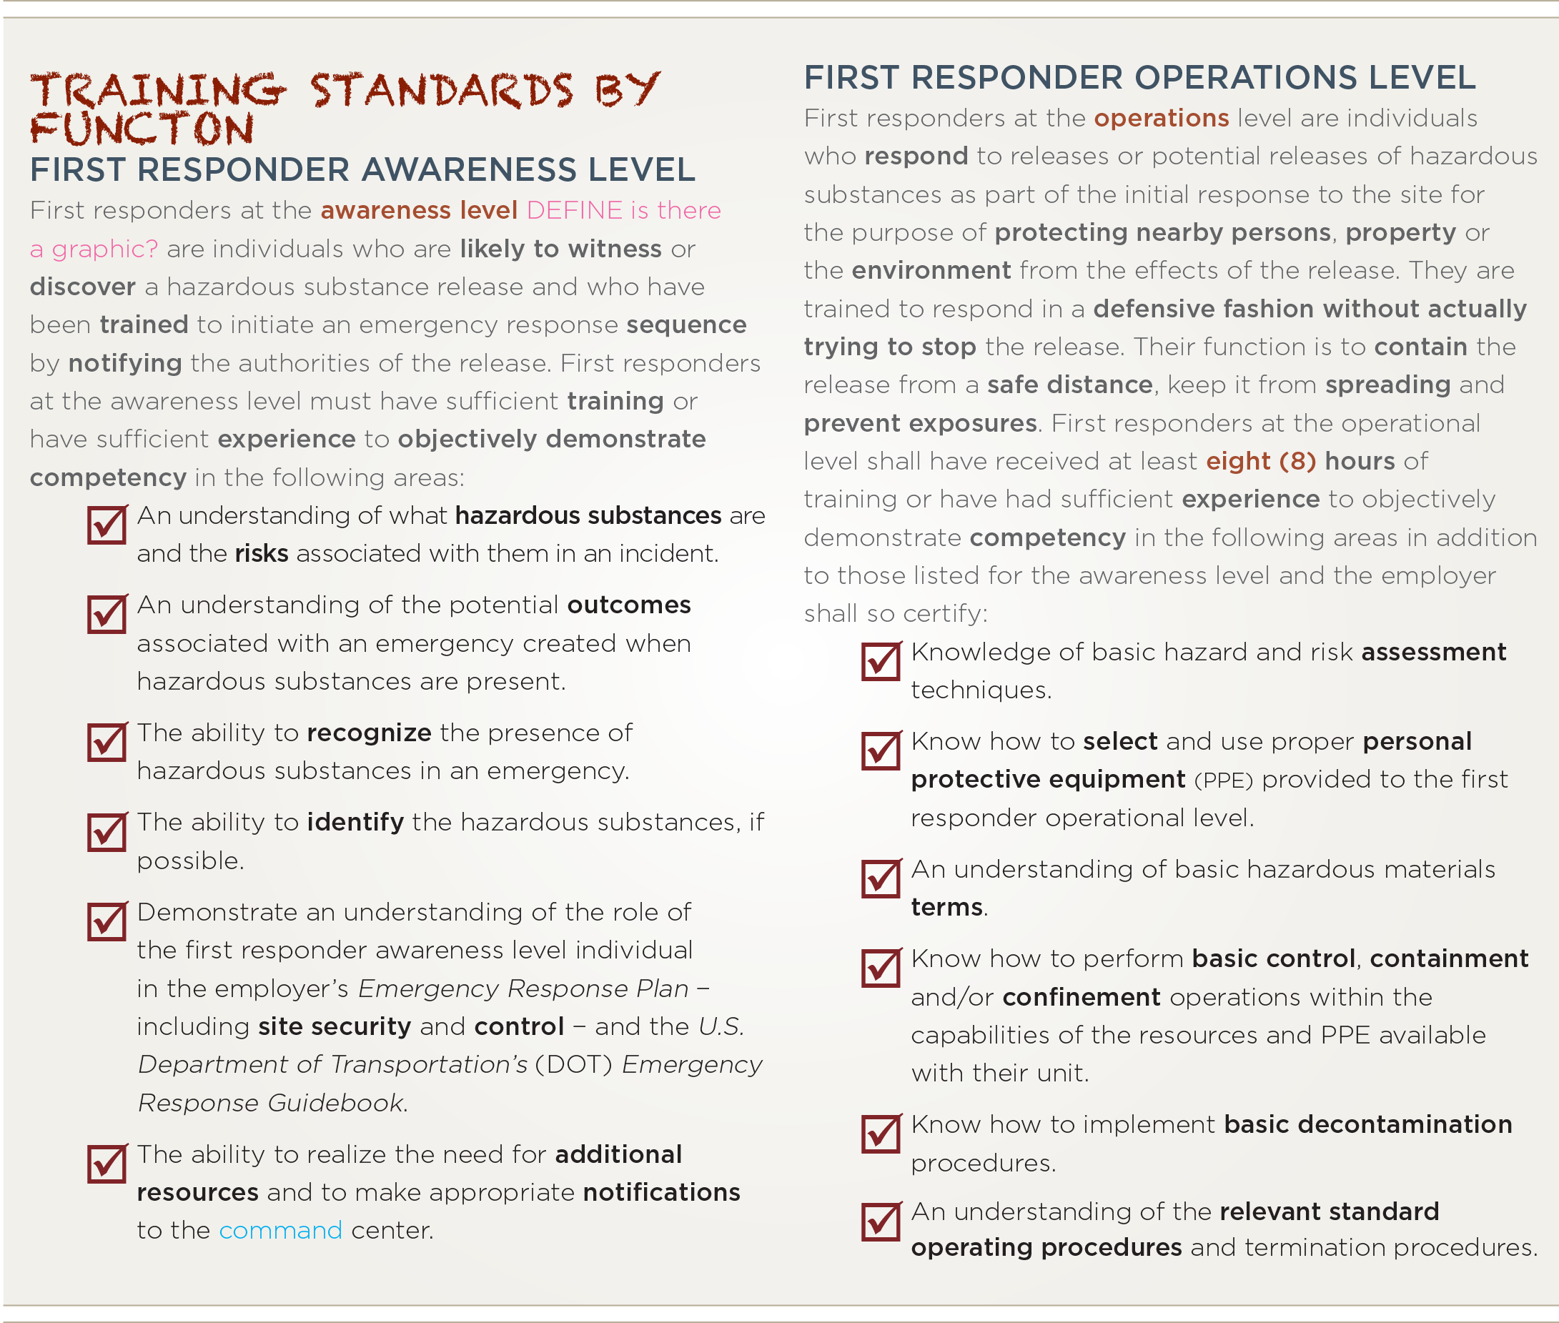
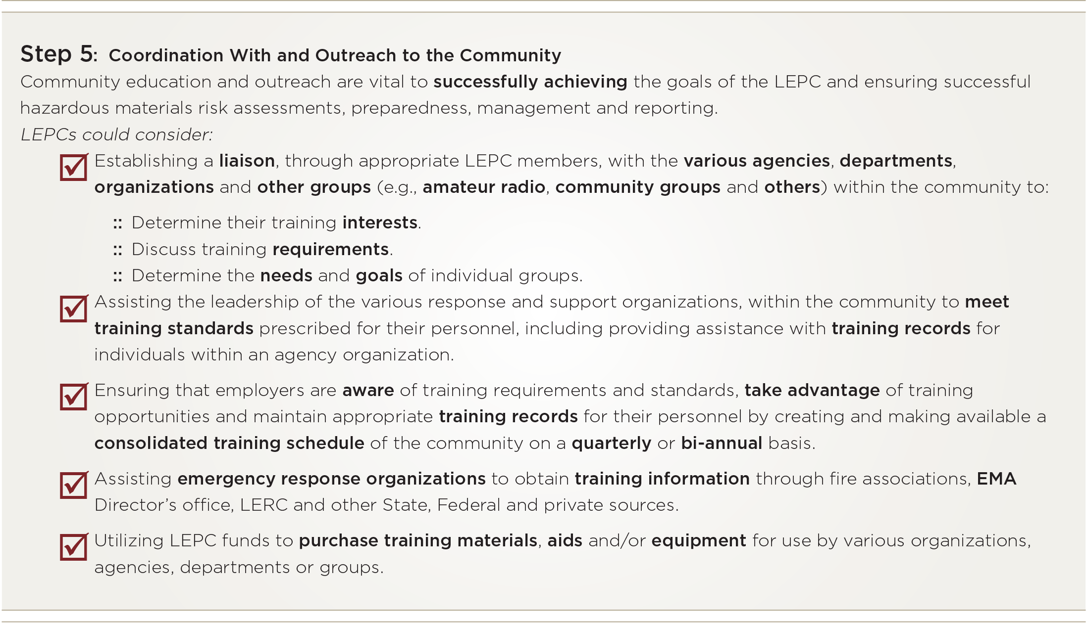
Notes:
The Handbook also includes handy checklists for everything from how to develop a plan to training protocols to tips for creating an exercise and MORE.

Slide 15
REMEMBER!
The Handbook is NOT regulation.
It represents current thinking and policy.
Notes:
The Handbook is not regulation. It does represent current thinking and policy and we hope it is helpful to you in making decision, determining priorities and guiding your day-to-day activities. Safe guarding the public health and our environment is a significant responsibility. We hope this Handbook helps.

