Slide 1
Getting and Keeping Your FEMA Grant Dollars!
Louisiana GFOA
31st Annual Fall Conference
October 8, 2014

Slide 2
Agenda
GOHSEP Overview
Federal Authorities
Common Grant Considerations
Specific Grant Programs
  Public Assistance Grants
  Hazard Mitigation Grants
  Preparedness Grants
Wrap Up

Slide 3
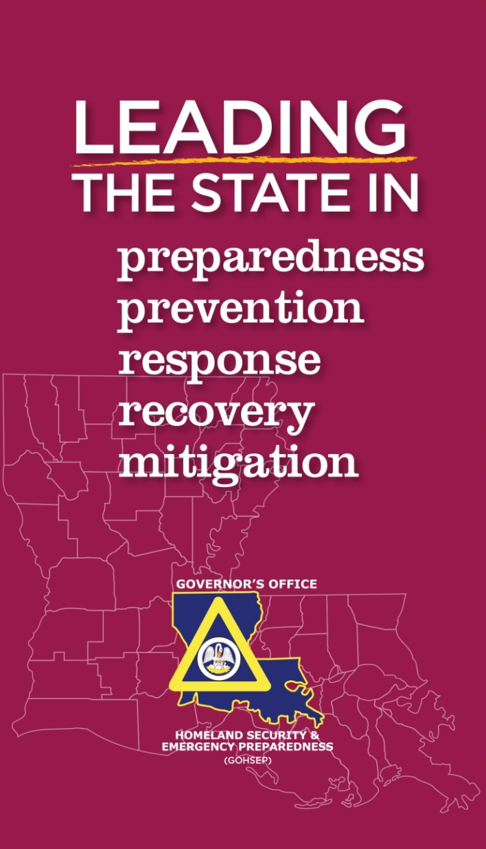
GOHSEP Overview

Slide 4
GOHSEP Organization
Kevin Davis
Director
Chris Guilbeaux
Deputy Director
Preparedness, Response
& Interoperability
Christina Dayries
Chief of Staff
Deputy Director
Grants & Administration
Mark Riley
Deputy Director
Disaster Recovery
Preparedness
Training
Exercise
CI/KR
Planning
Recovery Grants Administration
Facility Management
Public Assistant
Grants
Hazard Mitigation
Grants
Sub Recipient Monitoring
James Smith
Executive Officer
Operations
EOC
Logistics
Mapping
Vernie McNamee
Executive Assistant
Fusion Center
Radiological/Nuclear
Regional Support
Interoperability
Legal
Appeals
Document Services
Homeland Security Grants Admin
Administrative
Services
Mike Steele
Communications Director

Slide 5
The Louisiana Homeland Security &
Emergency Assistance & Disaster Act
Louisiana Revised Statutes, Title 29, Chapter 6
To create and provide for designation of
GOHSEP and to authorize the creation of local organizations for emergency preparedness.
To confer upon the governor and upon the parish presidents the emergency powers provided in this Chapter.

Slide 6
Overview
Disaster Act…
  Provides guidance related to:
    Shelters
    Evacuations
    Curfews
    Financing
    Assistance Identification
    Interstate Cooperation
    Liability Limitations
    Responder Immunities

Slide 7
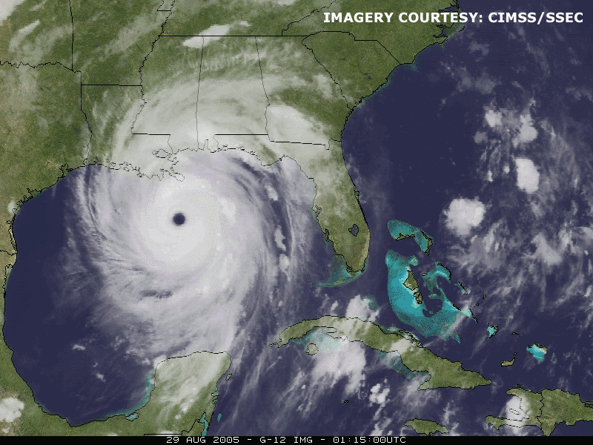
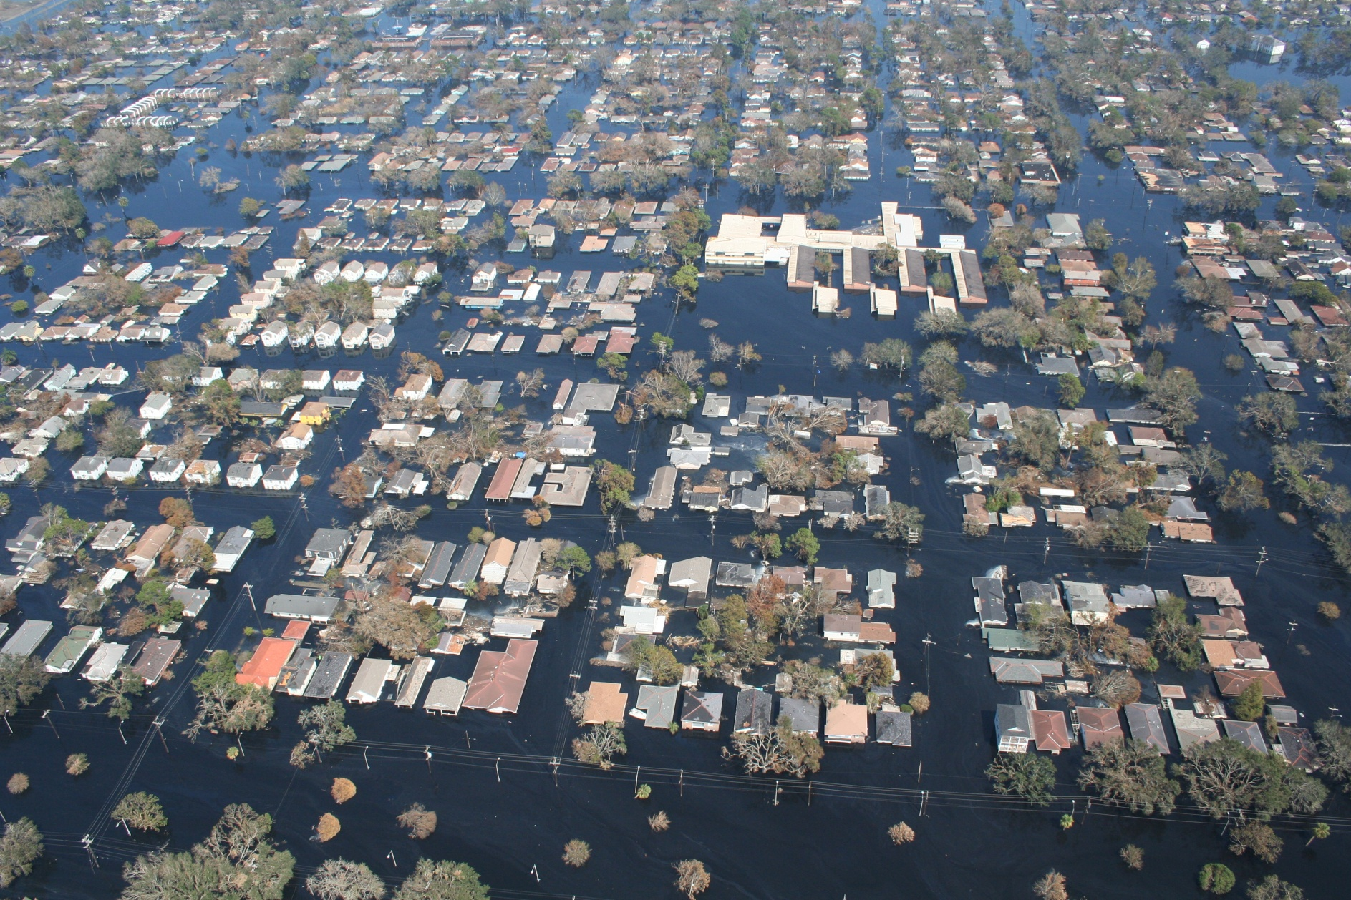
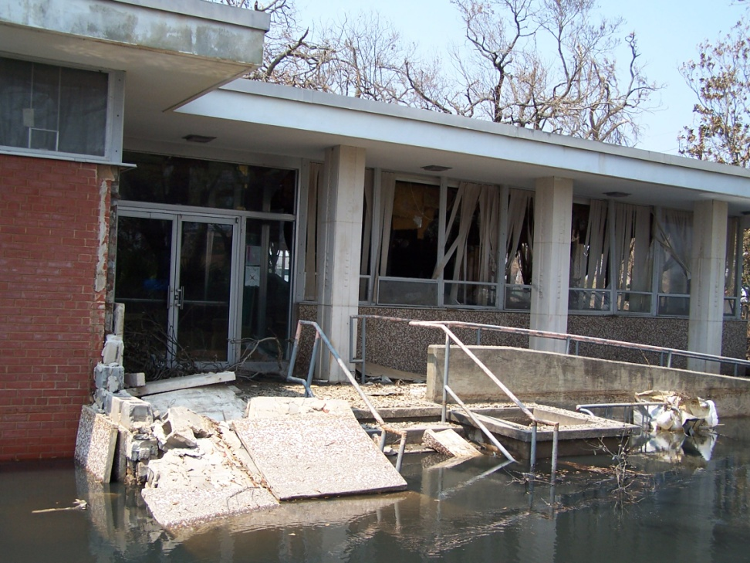
Risk
Louisiana is a high-risk State for emergency events + disasters.
Notes:
Louisiana is a high-risk State for emergency events and disasters. . . Whether from the threat of:
-Accidental hazardous materials release;
-Cyber attack, or threat of explosion;
-Weather related threats like drought, floods, fires, hurricanes, heat, thunderstorms or tornadoes;
-OR man-made threats such as dam or levee failures, or acts of terrorism . . .
NO Parish in the State is without risk for some type of emergency or disaster.

Slide 8

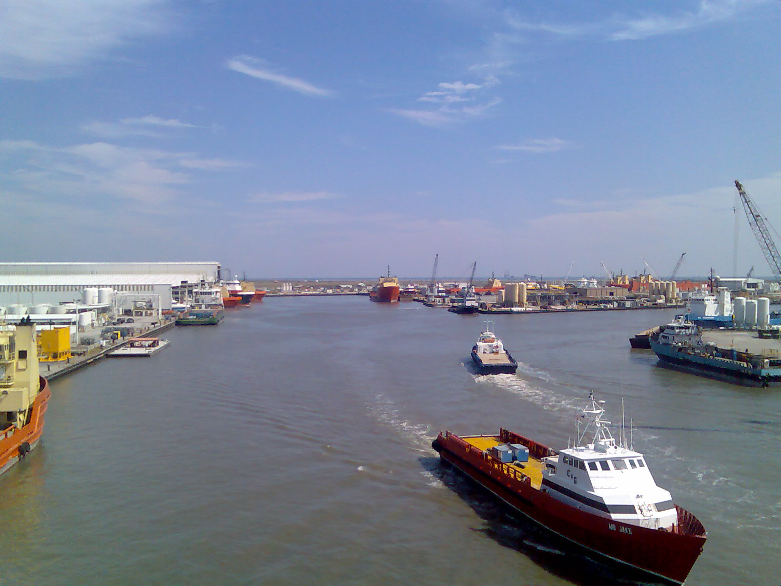

Risk
  We are home to critical supply routes + energy production resources.
Notes:
Additionally, we are home to critical supply routes and energy production resources that are attractive targets for man-made disruptions.

Slide 9
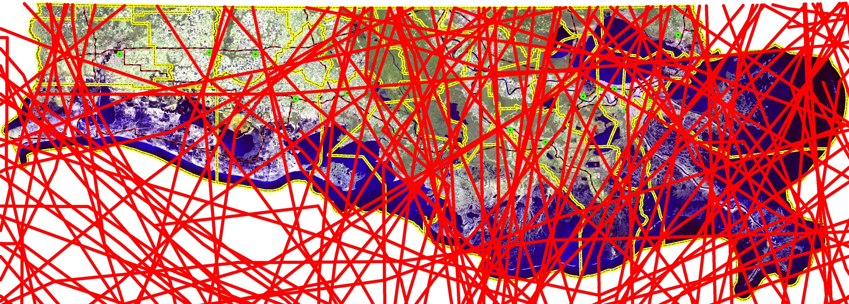
Louisiana coast -
A vulnerable area for storm surge
Jeff
Davis
Acadia
St
Martin
Livingston
Saint
Tammany
Calcasieu
Iberville
Ascension
St
John
Iberia
Lafayette
St
James
Cameron
Jefferson
St Bernard
Vermilion
Assumption
St Charles
St Mary
Lafourche
Terrebonne
Plaquemines
All Atlantic Basin Tropical Systems
National Hurricane Center 1850 - 2007
Notes:
. . . showing hurricanes and other tropical-force wind events, that have struck the Louisiana coastline over the last 150 years. This does NOT include tornadoes, flooding from heavy rains in the Midwest which makes its way down the Mississippi river to Louisiana, or man-made disasters like the BP Oil Spill.

Slide 10
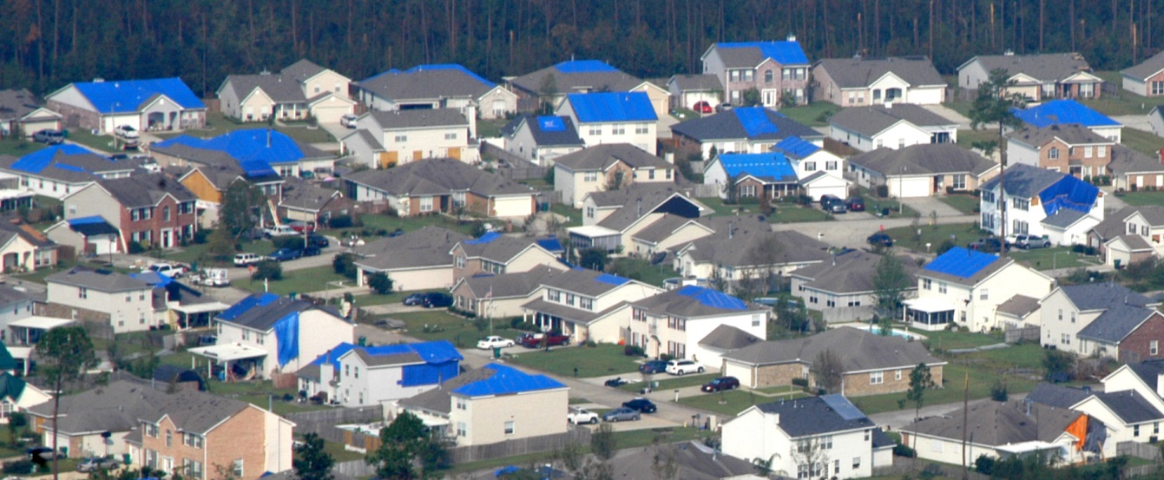
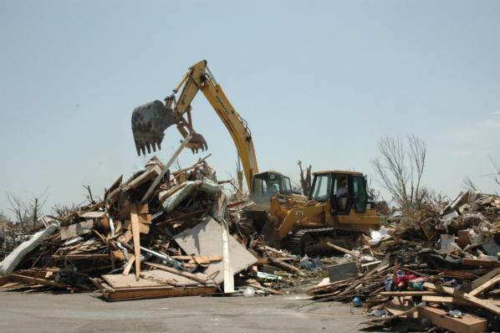
Responsibility
The State - through GOHSEP - has a significant responsibility to protect communities + citizens + property + assets in the event of an incident.
Notes:
The State — through GOHSEP — has a significant responsibility to protect communities, citizens, property and assets in the event of an incident.

Slide 11
Mission
To lead + support Louisiana and
its citizens in the preparation for, response to + recovery from all emergencies + disasters.
Notes:
Our mission is to lead and support Louisiana and its citizens in the preparation for, response to and recovery from ALL emergencies and disasters.

Slide 12
Structure
GOHSEP’s FIVE (5) FOCUS AREAS:
prepare // prevent // respond // recover // mitigate
Notes:
To deliver on our mission, GOHSEP is organized around 5 focus areas: PREPARE. PREVENT. RESPOND. RECOVER. MITIGATE.

Slide 13

Emergency Management Cycle
Preparedness
Emergency managers develop plans of action to manage & counter their risks & take action to build the necessary capabilities needed to implement such plans
MITIGATION
Prevention
Prevention happens when property and lives are
protected by those that identify, deter or stop an
incident from occurring
PREPARATION
Response
Response includes the mobilization of necessary emergency services & first responders in the disaster area
Event
RECOVERY
Recovery
Recovery efforts are primarily concerned with actions
that involve rebuilding destroyed property,
re-employment & the repair of other essential infrastructure
PREVENTION
RESPONSE
Mitigation
Mitigation efforts are attempts to prevent hazards from developing into disasters or to reduce the effects of disasters

Slide 14
Declaration Process
Presidential
Authorizes
use of
Federal Resources
State
Authorizes
use of
State Resources
Parish
Authorizes
use of
Local Resources

Slide 15
Emergency Management Process
LEGEND
State
Agency
Assets
ESF
Contracts
Rents
etc.
Status Feedback
Business
EOC
Request for Support
Parish
EOC
State
Operations
Federal
Assistance
Parish
Assets
Intrastate
Mutual
Aid
EMAC
State
To State
Assets
Contracts
Rents
etc.

Slide 16
Federal Funding Authorities

Slide 17
Federal Funding Authorities
Rules
Regulations
Policy
Specific Program Guidance
Federal or State Grantee Special Conditions

Slide 18
Federal + State + Local Relationship
  Grantee + Subgrantee Relationship
  The State is represented by GOHSEP.
  GOHSEP is the grantee.
  Federal assistance from FEMA will come to GOHSEP.
  Local authorities receiving FEMA funding (grants) are subgrantees/applicants.

Slide 19
Common Grant Considerations

Slide 20
Common Grant Considerations
Procurement
Documentation
Reimbursement
Cost Share
Program Compliance

Slide 21
Procurement Authorities
Law
  Robert T. Stafford Disaster Relief and Emergency Assistance Act
  Disaster Operations Legal Reference, Version 2.0
  State Procurement Law
Regulations
  44 CFR 13.36 (Common Rule)
  2 CFR 215, 220, 225,230
Policy and Procedures
  Agency specific procurement processes
MUST FOLLOW MOST STRINGENT REQUIREMENT

Slide 22
Procurement
FY 2011: OIG recommended $131,739,350 be de-obligated for improper procurement.
  FEMA agreed with OIG: $4,956,690 < 4%
FY 2012: OIG recommended $21,746,755 be de-obligated for improper procurement.
  FEMA agreed with OIG: $119,055 < 0.5%
SOURCE: Capping report DHS-OIG 13-90 May 2013

Slide 23
Procurement
FEMA’s willingness to exercise its discretion pursuant to 44 CFR 13.43(a) and 2 CFR 215.62(a) and mitigate improper procurement by cost analysis.
BUT . . .

Slide 24

Proper procurement is necessary
OIG says . . .
  “ . . . Clearly, OMB’s intent was not for Federal agencies to make exceptions to the procurement standards in the administrative requirements for grants a routine practice. Accordingly, we do not believe that it is prudent to waive Federal procurement standards unless lives and property are at stake, because the goals of proper contracting relate to more than just reasonable costs. Once the roads are clear, power is restored, and the danger is over, cities, counties, and other entities should follow regulations or risk losing Federal funding . . . ”
SOURCE: Capping report DHS-OIG 13-90 May 2013, page 7

Slide 25
Proper procurement is necessary
Insight from GOHSEP:
  FEMA is under increased pressure from DHS Headquarters, DHS-OIG and OMB to apply procurement standards in accordance with the regulations,
  AND . . .

Slide 26
Proper procurement is necessary
State responsibility:
  “To assure that subgrantees are aware of requirements imposed upon them by Federal statue and regulation.”
    SOURCE: 44 CFR 13.37
  “Grantees must monitor grant and subgrant supported activities to assure compliance with applicable Federal requirements . . .”
  SOURCE: 44 CFR 13.40(a)
  AND . . .

Slide 27
Proper procurement is necessary
Subgrantee responsibility:
  “To comply with all of the procurement requirements as stated in 44 CFR 13.36 and 2 CFR 215.”
  SOURCE: Memorandum of Understanding or Grant Award Package between GOHSEP + subgrantee

Slide 28
Procurement
Conclusion:
  Subgrantees have the responsibility to be compliant.
  GOHSEP has the responsibility to assure subgrantee compliance.
  It is uncertain how long FEMA will continue to liberally apply its discretion.

Slide 29
Procurement
There are few objective criteria.
2 CFR 215.40-48 + 44 CFR 13.36 are open to different interpretations + vague + sometimes is contradictory.

Slide 30
GOHSEP’s Procurement Tools
Procurement Guide
Procurement Checklist
Procurement Desk Reference

Slide 31
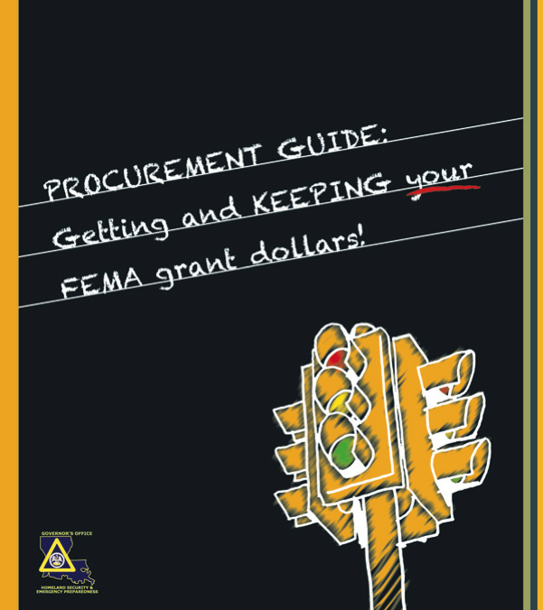
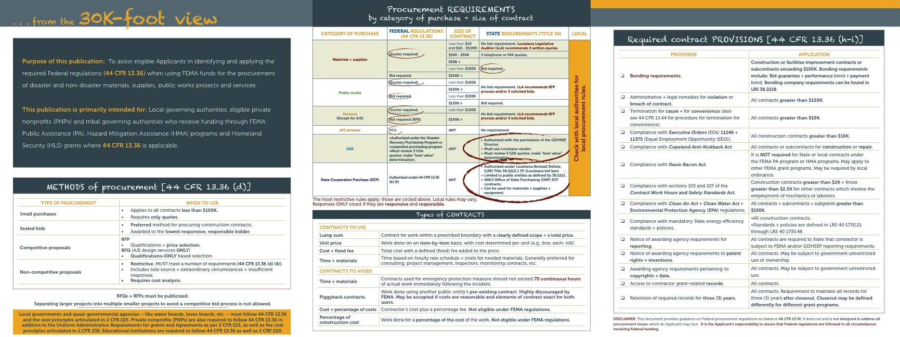
Procurement Guide

Slide 32
Procurement Checklist
Solicitation
Method of Procurement
Types of contracts (good and bad)
Bonding requirements
Contract provisions
Cost analysis

Slide 33
Procurement Desk Reference
Relevant CFR requirements
Best available interpretation using
  DHS OIG audits
  Citations from FEMA policy
  GOHSEP experience based “tips”

Slide 34
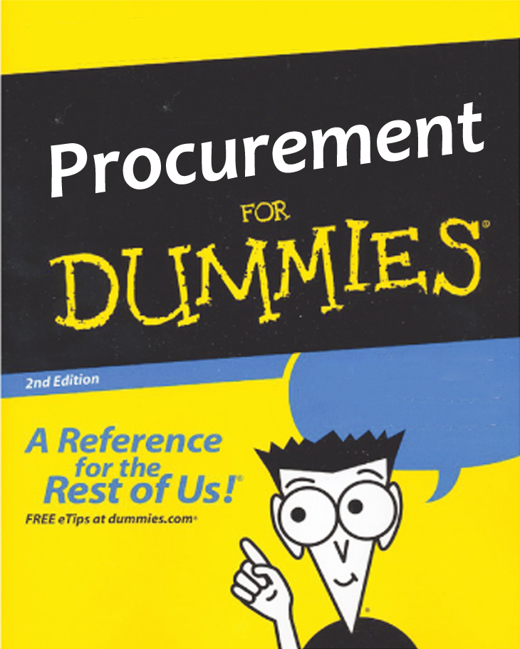
Procurement Tools
Not “for dummies” books.
Must have some knowledge of Federal (FEMA) procurement regulations and State and Local laws and policies.
Developed with 80/20 rule in mind.

Slide 35
Federal Procurement Best Practices
The Applicant is ultimately responsible.
GOHSEP provides “technical support” ONLY.
So . . . always act like a good risk manager, as if it was your money.

Slide 36

Current issue
NEW 2 Code of Federal Regulations (CFR) 200
Uniform Guidance (super circular)
Effective December 26, 2014

Slide 37
Procurement Key takeaways
Always have a competitive process.
  Publicize v. Advertise
Follow MOST Stringent Procurement Requirement
  Federal, State or Local
Avoid prohibited contracts and be very careful with Time + Materials contracts.
Include all required clauses.
Affirmative steps for minority, small, women-owned businesses. (44CFR 13.6e)
Process to monitor contractors.
Local contractor preference (Stafford Act Section 307)
Most conservative approach.

Slide 38

Reimbursement Required Documentation
Items required during the reimbursement process include the following:
  Reimbursement Request Form (RRF)
    Obtained from grant program website (www.gohsep.la.gov)
  Summary Records
  Invoices
  Contracts
  Demonstration of Proper Procurement
Progressive Closeout
Undocumented eligible expenses are
very difficult to get reimbursed
Notes:
Explain what the reimbursement request form is and that the RRF in addition to all summary records can be found under the resources tab in LouisianaPA.com which will be discussed with later slides. Stress to the audience that this is a REIMBURSEMENT Program. It is up to you to keep good records and submit your documentation to us. You have to submit all required documentation to GOHSEP for reimbursement and retain additional documents for closeout and audits. We like to see complete and accurate packages with no returns because returns can delay reimbursements.

Slide 39

Records Retention
Applicants must retain documentation for at least 3 years from the date they receive official notification from GOHSEP that all projects have been closed (44 CFR Part 13.42).
All documentation pertaining to a specific project should be filed with the grant package and its related projects.
Notes:
Closeout could take years so that means the documentation will need to be retained for years (Katrina, Andrew)
Records should describe in detail the who, what, when, where, why, and how much for each item related to a project
Everything that pertains to a project should be filed with the corresponding PW: photos, new insurance or insurance settlement info, cancelled checks, payroll records, purchase orders, maintenance records, reimbursement documents (RRF, summary records, invoices, contracts, procurement info)
Retention period starts after you as an applicant receive notification that all projects have been closed. The period does not start after a project is closed. Your account must be closed and you’ll be notified in writing. Put this letter with date highlighted on the outside of each box or file that pertains to that disaster. Start your 3 year countdown then.

Slide 40
Cost Share

Slide 41
Cost Share
Federal Funding is typically awarded with a state/local cost share.
Disaster Grants
  25% state/local cost share
  Some rare exceptions are granted
Non Disaster Mitigation Grants
  Vary from 25% to 10% dependent on program
Preparedness Grants (homeland security)
  50% for Emergency Management (currently covered by GOHSEP)
  Zero (0%) for State Homeland Security Program
Notes:
Closeout could take years so that means the documentation will need to be retained for years (Katrina, Andrew)
Records should describe in detail the who, what, when, where, why, and how much for each item related to a project
Everything that pertains to a project should be filed with the corresponding PW: photos, new insurance or insurance settlement info, cancelled checks, payroll records, purchase orders, maintenance records, reimbursement documents (RRF, summary records, invoices, contracts, procurement info)
Retention period starts after you as an applicant receive notification that all projects have been closed. The period does not start after a project is closed. Your account must be closed and you’ll be notified in writing. Put this letter with date highlighted on the outside of each box or file that pertains to that disaster. Start your 3 year countdown then.

Slide 42
Interim Emergency Board (IEB)
Available to state or local government that does not have the ability to fund recovery for its cost share from a presidentially declared emergency or other emergency event
Requests for emergency appropriations include:
  State agencies or State sponsored programs
  Political subdivisions generated as a result of disaster situations (i.e., hurricane, flood, severe freezing, tornado, etc.)
  Requests Submitted on the Board's official application form by:
  Head of a State department or educational management board
  State legislator for a disaster situation application on behalf of a political subdivision

Slide 43
Questions?

Slide 44
Break

Slide 45
Program Compliance

Slide 46
Prepare

Slide 47
Prepare
GOHSEP is designated as the State Administrative Agent (SAA) manages $21.3 million in Preparedness Grant Programs.
Notes:
GOHSEP administers a host of Federal preparedness grant programs for first responders and emergency managers. Today we are managing $21.3 million in Homeland Security grants and Emergency Management Performance Grants.

Slide 48
Prepare
Preparedness (Non-Disaster) Grants
  Federal preparedness grants provide assistance to State + local + tribal authorities to enhance homeland security + emergency management.
  Grants are awarded directly the local Parish President/Equivalent
  Types of preparedness (non-disaster) grants:
    Emergency Management Performance Grant (EMPG) Program
    Homeland Security Grant Program (HSGP)
    Other grant opportunities

Slide 49
Prepare
Emergency Management Performance Grant (EMPG)
  Provides for a comprehensive system of emergency preparedness for the protection of life + property from all hazards.
  This program is the main source of funding for many local emergency management operations.

Slide 50
Prepare
  Homeland Security Grant Program (HSGP)
  Funds a range of preparedness activities, including planning + training + planning + exercises + operations + equipment.
  Is comprised of three (3) main grant programs:
  State Homeland Security Program (SHSP)
  Urban Areas Security Initiative (UASI)
  Operation Stonegarden (OPSG)

Slide 51
Prepare
Other Grant Opportunities
  Grants are awarded directly to local fire departments to enhance abilities to protect the public + fire service personnel.
  Assistance to Firefighters Grants (AFG)
  Staffing for Adequate Fire & Emergency
  Response (SAFER) Grants
  Assistance to Firefighters Station Construction Grants (SCG)

Slide 52
Grant Requirements
Federal Regulation/Guidance
  Environmental Historical Preservation (EHP) approval required for all grant items (some exceptions authorized)
  25% of all SHSP & UASI grant expenditures must be allocated towards Law Enforcement Terrorism Prevention Activities
State Law
  Formation of Parish Emergency Management Advisory Committee (PEMAC) - La R.S. 29:727(I)
  PEMAC advisory committee review for all EMPG & HSGP projects

Slide 53
Grant Workflow
STEP 1
Acceptance of Grant Award Sheet
(Special Conditions & Federal Grant Agreement Articles)
STEP 2
Completion of Grant Project Application
STEP 3
Approval from SAA
STEP 4
Subgrantee Begins Procurement on Approved Items
STEP 5
Subgrantee Submits Request for Reimbursement to SAA
STEP 6
SAA Reimburses Subgrantee
STEP 7
SAA Closes Grant File
with Subgrantee

Slide 54
Recover

Slide 55
Recover
GOHSEP administers Federally funded subgrants in a highly regulated environment . . .
  Helping to ensure compliance with complex + sometimes confusing Federal grant requirements to protect against
  de-obligation of funds.
Notes:
Recovery – and mitigation – Federally funded subgrants are administered in a highly regulated environment . . .
GOHSEP helps Subgrantees to ensure compliance with complex and sometimes confusing Federal grant requirements, so that Subgrantees get and keep all of the assistance for which they are eligible and to protect against de-obligation of funds.

Slide 56
Recover
  A Presidential declaration opens the door for Federal assistance:
  FEMA Public Assistance (PA)
  FEMA Individual Assistance (IA)
  Direct Federal Assistance (DFA) for other Federal support

Slide 57
Recover
  Local authorities play a significant role in the declaration process.
  The accuracy and quality of the information provided at the local level regarding damage assessments + their economic impact is critical to obtaining a Presidential declaration.

Slide 58
Lifecycle of a
Public Assistance (PA) Grant

Slide 59
Public Assistance Process
Disaster
Event
PDA
Governor’s
Request
Declaration
Kick-off
Meeting
Request for
Public Assistance
Applicants’
Briefing
Formulation
of Projects
Project
Review
Approval
reimbursement
implementation
Closeout

Slide 60
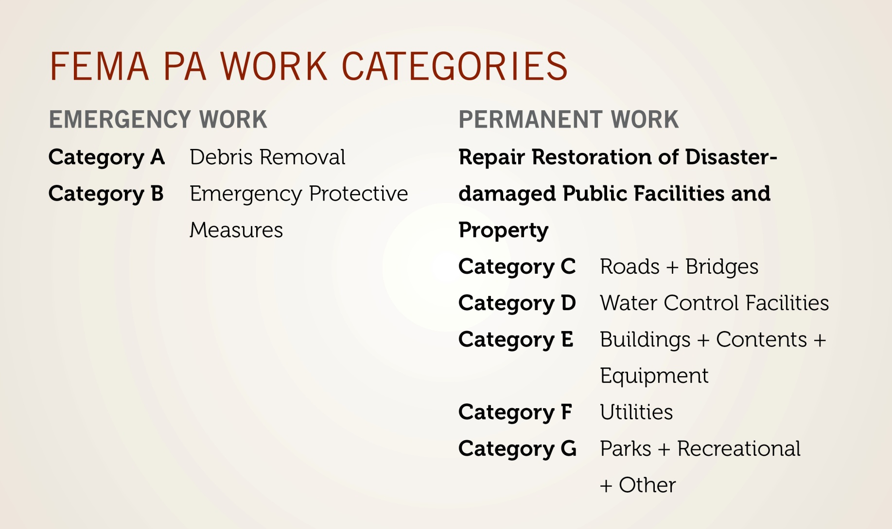
Public Assistance

Slide 61
Request for Public Assistance (Application)
Within 30 days from a Disaster Declaration Date, applicants MUST complete a submission package to GOHSEP
Methods of Submission:
  Fax
  Mail
  Email
  LouisianaPA.com (preferred method)
ALL proper documentation must be included
  Will ensure that GOHSEP can forward your submission to FEMA in a timely manner.

Slide 62
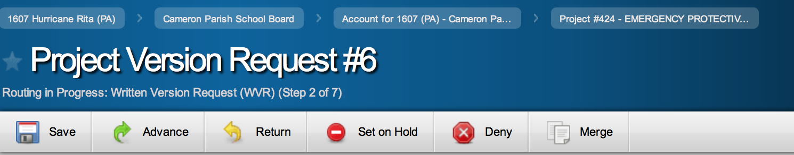
Public Assistance
LouisianaPA.com web platform provides online management assistance for PA Subgrantees . . .
  And handles more than 78,500 Project Worksheets (PWs) + amendments from application to Closeout.
Notes:
The recoveries from Hurricanes Katrina and Rita and the other declarations GOHSEP is currently managing is huge – larger than any other recovery effort in the country.
Grants management at the magnitude of assistance received through GOHSEP for the 10 Presidentially declared disasters we are currently managing requires a business model that efficiently and effectively pushes grants from application and amendments to obligation of funds through close out. GOHSEP uses a unique web-based operating portal called Louisiana PA.com to provide online grants management assistance to PA Subgrantees.
The system handles more than 78,500 Project Worksheets (PWs) and amendments from application through Closeout. . .

Slide 63
Request individual Project Grant (PW)
63
GOHSEP – Joint Version Tracking Tool (JVTT)
  Scope of work
  Cost estimate

Slide 64
Grant Approval Process
64

Slide 65
Implement Grant
Procure services and construction contracts
Perform emergency work, debris removal and or facilities repair
Request reimbursement
  Advance funding is available (special circumstances)
Maintain documentation

Slide 66
Reimbursement Process
Review the project worksheet (PW)
  Note line items that have been deemed eligible and ineligible.
Prepare a Request for Reimbursement Form (RRF).
  Attach summary records and supporting documentation.
  Force Account Labor
  Force Account Equipment
  Materials
  Rented Equipment
  Contract Work
    Ensure invoices are included for contract work
    Attach procurement documentation (Initial RRF)

Slide 67
Reimbursement Documentation
Standard GOHSEP Forms:
RRF
Force Account Labor (FAL) Summary
Force Account Equipment (FAE) Summary
Materials Summary
Rented Equipment Summary
Contract Work Summary
Typical Supporting Documentation:
Invoices
Purchase orders
Cancelled checks
Contracts
Emails
Narratives
Evidence of proper procurement
Fringe benefits

Slide 68
Force Account Labor Summary
  Work performed by Applicant’s own staff that is directly related to the disaster.
  Documentation required for reimbursement:
  Accurately completed Force Account Labor Summary Forms.
  Pre-disaster Overtime Policy.
  Fringe Benefits Calculation Sheet.
  Timesheets/Time Records.

Slide 69
69
Force Account Equipment Summary
  Equipment Owned by the Applicant and used for disaster-related work.
  Documentation required for reimbursement:
  Accurately completed Force Account Equipment Summary Forms.
  Payroll records and usage logs to support expenses.
  Proof of equipment ownership.

Slide 70
70
Materials Summary
  Items purchased or pulled from inventory that are related to the disaster.
  Documentation required for reimbursement:
  Accurately completed Material Summary Record Forms.
  Itemized invoices and receipts.
  Procurement information.

Slide 71
Public Assistance
Closeout
Final check of all documentation
Cost share validation
Canceled checks
Insurance validation

Slide 72


Types of Closeout
72
Small Project Closeout
Small PWs are grouped and closed by disaster.
All small projects must be certified complete by applicant.
A subgrantee may request small project netting if they have incurred additional costs to complete the eligible scope of work.
Large Project Closeout
Each project is closed on a project by project basis following State review.

Slide 73
GOHSEP Progressive Closeout
73
PW Initiation
Expense
Submission
Document
Review
Payment
Processing
Road to Closed
Closeout

Slide 74
Insurance
Duplication of Benefits
Obtain and Maintain Requirements

Slide 75
Insurance
Duplication of Benefits: “First disaster”
  Facilities damaged by flood & located in a special flood hazard zone
  Mandatory Reductions (up to max amount available)
    $500,000 structure
    $500,000 contents
  Facilities not located in a special flood hazard zone
  Grant eligibility reduced by the amount of actual insurance proceeds

Slide 76
Insurance
Obtain & Maintain (O&M) Insurance Requirement
  Obtain insurance in the amount at least equal to the damages and for the peril that caused the damage
  Maintain insurance coverage in perpetuity

Slide 77
Insurance
Duplication of Benefits - “Second disaster”
  Facilities damaged by flood & located in a special flood hazard zone
  Mandatory Reductions (up to max amount available)
    $500,000 structure
    $500,000 contents
  Facilities not located in a special flood hazard zone
  If full Insurance O&M requirements met:
  Grant eligibility reduced by the amount of actual insurance proceeds
  If full Insurance O&M requirements not met:
  Grant assistance is denied

Slide 78
Insurance
Obtain & Maintain (O&M) Insurance Requirement
  Obtain and Maintain FULL insurance requirements or apply for an Insurance Commissioner’s Certification (ICC).
  “(FEMA)… shall not require greater types and amounts of insurance than are certified as reasonable by the State Insurance Commissioner” 44 CFR 206.252 & 253

Slide 79
Public Assistance
Debris Removal
  Event-related debris.
  Property + right of-ways that are the responsibility of the Applicant.
  It is an Applicant’s responsibility to understand and follow all local, State & Federal regulations for debris removal + management + monitoring + operations.

Slide 80
Public Assistance
Individual Assistance (IA)
  FEMA Individuals + Households Program (IHP) provides financial assistance needed as a direct result of a Presidentially declared disaster or emergency.
  Grants provide for special + personal needs. For example:
  Currently the grant amount is $31,900 (updated annually).
    Temporary housing
    Medical bills
    Dental
    Personal property (e.g. computers)
    Funeral expenses
    And more

Slide 81
Recover: Other Funding
Other Funding Opportunities
  Small Business Administration (SBA) Disaster Loans
    Provides loans to homeowners + renters + businesses + organizations to repair or replace real estate + personal property + equipment + business assets damaged in a disaster.
  Community Development Block Grants (CDBG)
    Is a part of the Department of Housing & Urban Development (HUD), administered through the Louisiana Division of Administration’s Office of Community Development (OCD).

Slide 82
Key Takeaways – Public Assistance
Competitive procurement
Reimbursement program
Documentation driven program
Insurance requirements O&M

Slide 83
Mitigate

Slide 84
Mitigate
Hazard Mitigation
  Reduces vulnerabilities so that communities are better protected from disaster impacts, more resilient and better prepared to face future disasters.
  Hazard mitigation guidance & technical assistance is provided by the State Hazard Mitigation Plan (SHMP).
  Local plans provide prioritization of mitigation projects.

Slide 85
Mitigate
GOHSEP helps eligible entities reduce risk through mitigation.
  Oversees + administers Federal Hazard Mitigation (HM) grant funding.
Notes:
GOHSEP helps eligible entities reduce risk through mitigation efforts funded through Federal grants to eligible entities which include – local communities, State agencies, Federally recognized Tribal governments and certain private nonprofits.
Just like our grants management activities in support of the FEMA Homeland Security, the Emergency Management Performance Grants and Public Assistance programs, GOHSEP oversees and administers Federal Hazard Mitigation grant funding.
Mitigation is an important strategy to help us build and rebuild communities and facilities that are stronger, safer, more resilient and better able to withstand the next threat.

Slide 86
Mitigate
GOHSEP . . .
Creates + maintains the State Hazard Mitigation Plan (SHMP).
Provides leadership + technical assistance + oversight to local governments in the preparation of local HM plans.
Notes:
To do that. . .
GOHSEP . . .
Creates and maintains the State Hazard Mitigation Plan.
We provide leadership, technical assistance and oversight to local governments in the preparation of their local Hazard Mitigation plans.

Slide 87
Mitigate
NON-Disaster (available on annual funding cycles) | POST-Disaster
Pre-Disaster Mitigation (PDM) Flood Mitigation Assistance (FMA) | Hazard Mitigation Grant Program (HMGP)
Notes:
There are 3 Hazard Mitigation Assistance Grant programs – also known as HMA programs.
-2 grant programs – Pre-Disaster Mitigation – also called PDM – and the Flood Mitigation Assistance program – also called FMA – are available on annual grant cycles and are NOT dependent upon a disaster to trigger funding.
-The 3rd is the Hazard Mitigation Grant Program – also called HMGP – which is available after a Presidentially declared disaster.

Slide 88
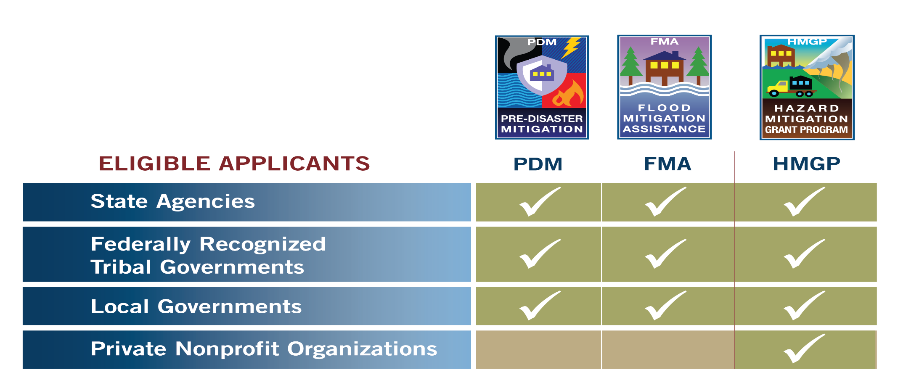
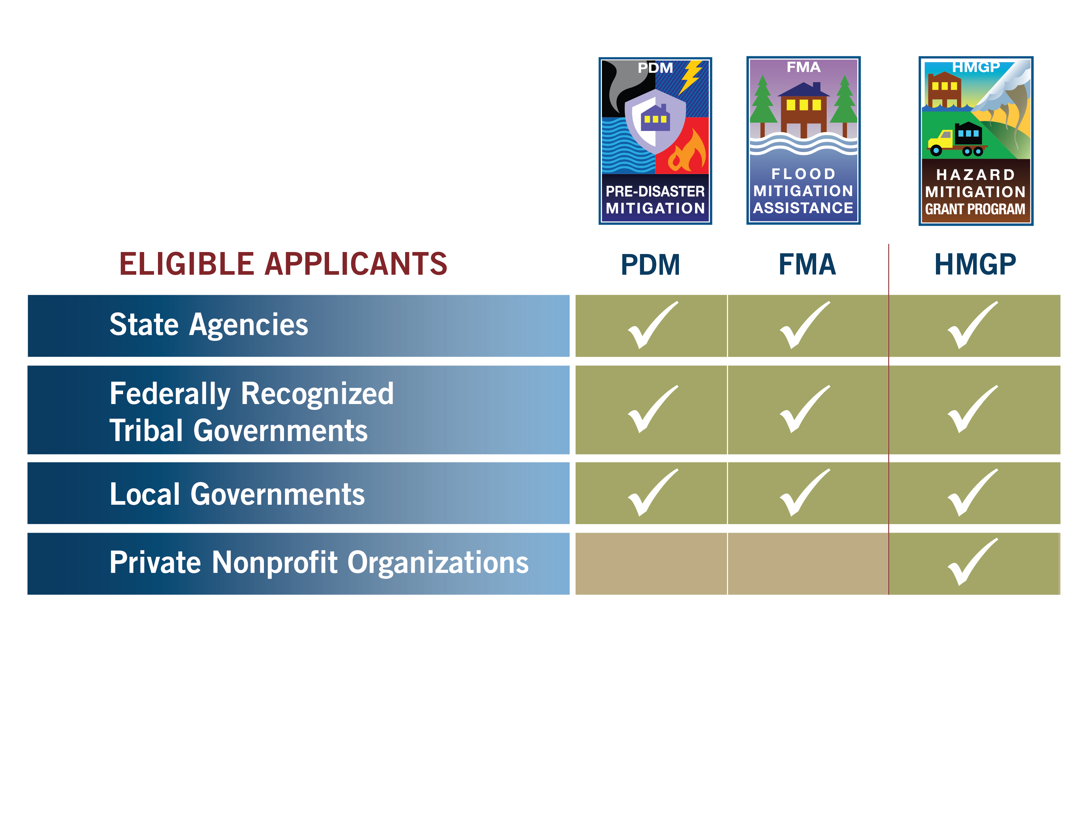
*
* Apply through local jurisdictions

Slide 89
Mitigate
GOHSEP is currently managing more than $2 billion in Stafford Act HM funding
Notes:
GOHSEP is currently managing more than $2 BILLION in Stafford Act Hazard Mitigation funding — representing 607 approved projects — across all 64 Louisiana Parishes.
Projects include:
-Hardening/retrofitting of critical facilities.
-Improved drainage.
-and flood control.

Slide 90
Mitigate
9,571 elevations
144 retrofits, including 566 structures
77 drainage projects
132 plan development projects
48 flood control projects, representing 91 structures
600 generators
and MORE!
Notes:
We have:
9,571 elevations
144 retrofits, including 566 structures
132 plan development projects
And 48 flood control projects, representing 91 structures
Plus 600 generators have been funded through the program.
AND MORE.

Slide 91
Mitigate
For every $1 spent on mitigation, $4 is saved in future reduced losses.
Source: United States Congressional Budget Office, Potential Cost Savings from the Pre-Disaster Mitigation Program.
Notes:
Mitigation initiatives offer a significant return on investment. According to the U.S. Congressional Budget Office, for every $1 spent on mitigation, $4 are saved in future REDUCED losses.

Slide 92
5 minimum project criteria
Activities must be included in current approved State + local hazard mitigation plans.
Provide a beneficial impact and reduce loss of life + property.
Comply with ALL applicable environmental + historical + other regulations.
Independently solve a problem – not a partial solution
Demonstrate cost-effectiveness with a Benefit-Cost Analysis

Slide 93
HMGP application process

Slide 94

HMGP application process
DISASTER EVENT
Step 1
State notifies potential Applicants of the availability of funds.
Applicants submit Letters of Intent (LOIs)/Request for Assistance to the State.

Slide 95
HMGP application process
DISASTER EVENT
Step 2
Applicants submit projects to the State - Application cycle closes.

Slide 96
HMGP application process
Step 3
State begins review of submitted applications, which includes:
  Program eligibility
  Budget
  Environmental coordination + compliance
  BCA
  Metrics + milestones

Slide 97
HMGP application process
Step 4
State submits applications to FEMA.
FEMA reviews the application; either sends an RFI, approves or denies.

Slide 98
HMGP application process
Step 5
If the application is approved
by FEMA,
  The State informs the Applicant of approval.
  Sets up a kickoff meeting.
  Begins the project/grant management process.

Slide 99
Outreach

Slide 100

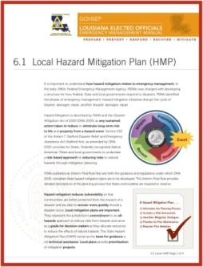
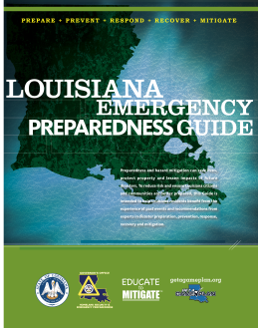
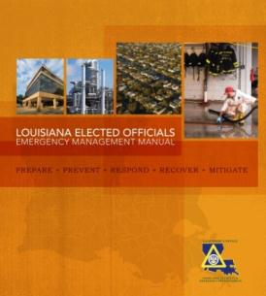
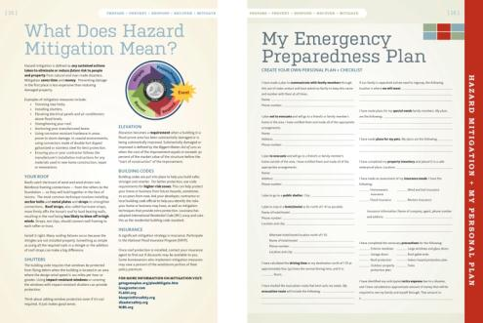
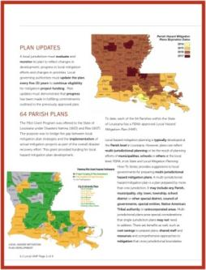
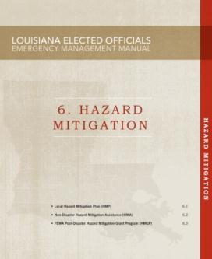
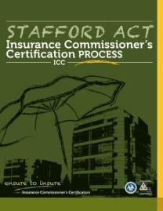
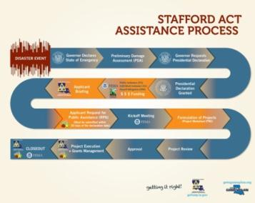
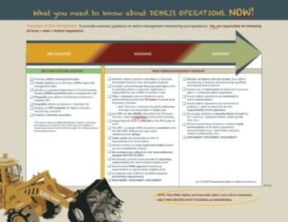
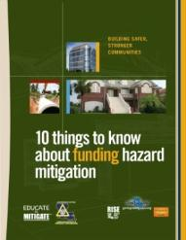
Outreach: Literature
This year, GOHSEP . . .
Produced + distributed 67 different public information + training tools.
x
Notes:
Stakeholder outreach and education is an important PREPAREDNESS component, helping local, Tribal, State and nonprofits (also called PNPs) and other entities to know what will happen; what is expected; and how to respond in the event of an emergency or disaster.
Education and outreach initiatives also help Applicants and Subgrantees to know and understand the disaster-recovery process, and how to mitigate against future events.
Importantly a significant portion of GOHSEP outreach and stakeholder education helps Applicants and subgrantees know how to manage Federal preparedness grants and Federal grants that support response, recovery and mitigation.
GOHSEP implements an aggressive outreach and education strategy. In FY 12-13, those efforts were supported by:
-Production and distribution of 67 different public information and training tools . . . . Including:
-Louisiana Emergency Preparedness Guide.
-What you need to know about DEBRIS OPERTIONS. NOW!
-PROCUREMENT GUIDE: Getting and KEEPING your FEMA grant dollars!
-STAFFORD ACT Insurance Commissioner’s Certification PROCESS
-10 things to know about funding hazard mitigation
-STAFFORD ACT ASSISTANCE PROCESS
-Louisiana Elected Officials Emergency Management Manual . . .

Slide 101
Outreach: Training
This past year, at minimal cost to the State, provided training for:
  1,802 elected officials + emergency + recovery stakeholders.
Notes:
This past year, at minimal cost to the State, GOHSEP provided training for:
1,722 first responders in ICS 300/400 courses.
43,152 first responders and preparedness stakeholders.
1,802 elected officials and emergency management and recovery stakeholders.

Slide 102
GOHSEP Website
Home Page
  http://gohsep.la.gov
Outreach
  http://gohsep.la.gov/outreach.aspx
Publications
  http://gohsep.la.gov/publications.aspx
Training Classes
  http://gohsep.la.gov/Registrations.aspx

Slide 103
GOHSEP Information
Christina Dayries
Chief of Staff
225.358.5599
Christina.Dayries@la.gov
Mark DeBosier
Assistant Deputy Director
Public Assistance
225.338.6782
Mark.DeBosier@la.gov
Jeffrey Giering
State Hazard Mitigation Officer
Hazard Mitigation
225.267.2516
Jeffrey.Giering@la.gov

Slide 104
Questions?

