Slide 1
Closeout

Slide 2
Purpose
Prepare for Closeout.
Explain why Closeout matters.
Discuss the benefits of closing.
Review Closeout process.

Slide 3
What is closeout?
Last administrative task.
Requirement.
Also assures you are fully reimbursed.

Slide 4
Purpose of project closeout
To ensure:
All physical work is complete.
Final claim of all eligible costs are documented.
Insurance proceeds are reconciled.
Obtain and maintain requirements are met.
Actual costs have been reimbursed.

Slide 5
GOHSEP’s role in closeout
Protect reimbursement now and tomorrow
OIG Audit

Slide 6
Why closeout matters?
There are 3,598 large projects reporting as 100% complete.
Since work is done, FEMA requires projects to be closed.

Slide 7
Required closeout metrics
DISASTERS | 2014-15 LARGE PWS | 2014-15 SMALL PWS
Katrina/Rita | 1,200 | 10,072
Gustav/Ike | 648 | 1,704
Other Disasters | 119 | 193
Totals | 1,967 | 11,969

Slide 8
Why closeout matters?
If GOHSEP does not meet closeout metrics:
State Management Costs may not be extended.
GOHSEP is advocate for you and the citizens.
Closeout Incentive will not be extended.

Slide 9
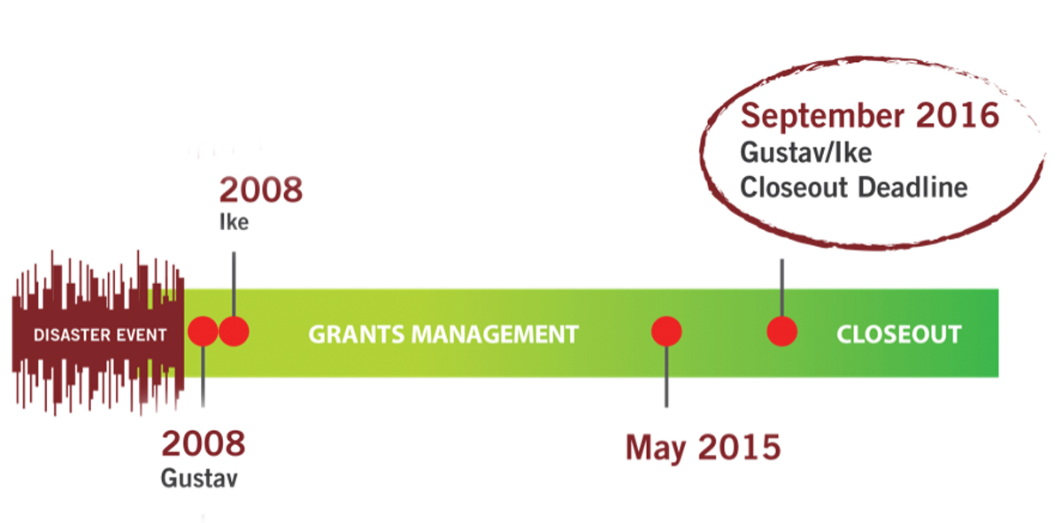
Gustav/Ike closeout deadline
September 2016
Gustav/Ike
Closeout Deadline

Slide 10
Benefits of closing a project
Subrecipient (Applicants) may receive additional payments.
Subrecipient (Applicants) do not have to complete a Quarterly Report for closed projects.
You can go back to your day job.

Slide 11
When is project ready to close?
Work has been completed.
No versions currently in process.
No outstanding appeals or arbitrations.
No pending reimbursement requests.

Slide 12
Types of closeouts
Grouped (Preferred)
Large
Insurance
Actual Cost
Certification
Certification
Single
Estimates
Small

Slide 13
Small projects: Closeout exceptions
Small project “netting”
Request additional funding for all small projects.
Supporting documentation for netted small projects reviewed same as large projects.

Slide 14
Small project netting
Project Number | Current Obligation | Actual Costs | Variance
Project 1 | $10,000.00 | $5,000.00 | ($5,000.00)
Project 2 | $10,000.00 | $20,000.00 | $10,000.00
Totals | $20,000.00 | $25,000.00 | $5000.00
Net is $5,000.00

Slide 15
Large project closeout
Submit Closeout Request

Slide 16
Large project closeout
Submit Closeout Request
State Preliminary Review

Slide 17
Large project closeout
Submit Closeout Request
State Preliminary Review
Missing Documents

Slide 18
Large project closeout
Submit Closeout Request
Final Reconciliation Completed
State Preliminary Review
Missing Documents

Slide 19
Large project closeout
Submit Closeout Request
Final Reconciliation Completed
FEMA Reviews Closeout Packet
State Preliminary Review
Missing Documents

Slide 20
Large project closeout
Submit Closeout Request
Final Reconciliation Completed
FEMA Reviews Closeout Packet
Final Financial Transactions Completed
State Preliminary Review
Missing Documents

Slide 21
Additional documentations during closeout
Proof of payment (Vendors)
Insurance Statement of Loss
Proof of insurance O + M requirements

Slide 22
Additional documentations during closeout
Proof of compliance with EHP requirements
Site Inspections Reports

Slide 23
Additional documentations during closeout (Closeout . . . )
TIP: Banks have a limited retention requirement of your records.
It is important that you request copies of bank statements.

Slide 24
Documentation retention
Once closed, still subject to audit.
Recommendation to maintain electronic files.

Slide 25
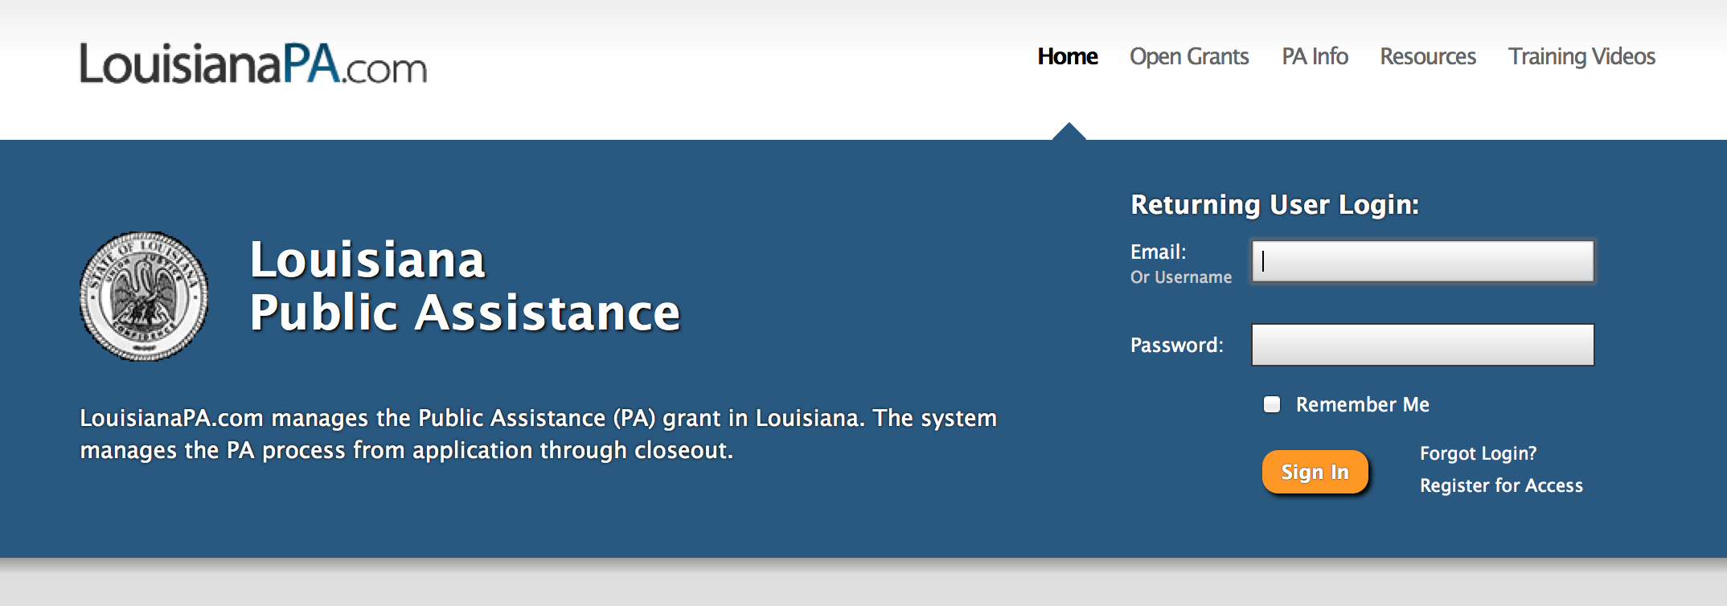
Documentation retention (Continued . . . )
LouisianaPA.com is a useful storage platform.

Slide 26
Closeout funding
Closeout Incentives (COI) for Katrina/Rita
Subgrantees may claim up-to 3% of eligible project costs.
Hours tracked to eligible tasks for specific project.
Reasonable cost.

Slide 27
Closeout funding (Continued . . . )
Direct Administrative Costs (DAC) disasters post November 13, 2007 for Closeout.
Hours tracked to eligible tasks for specific project.
Reasonable cost.

Slide 28
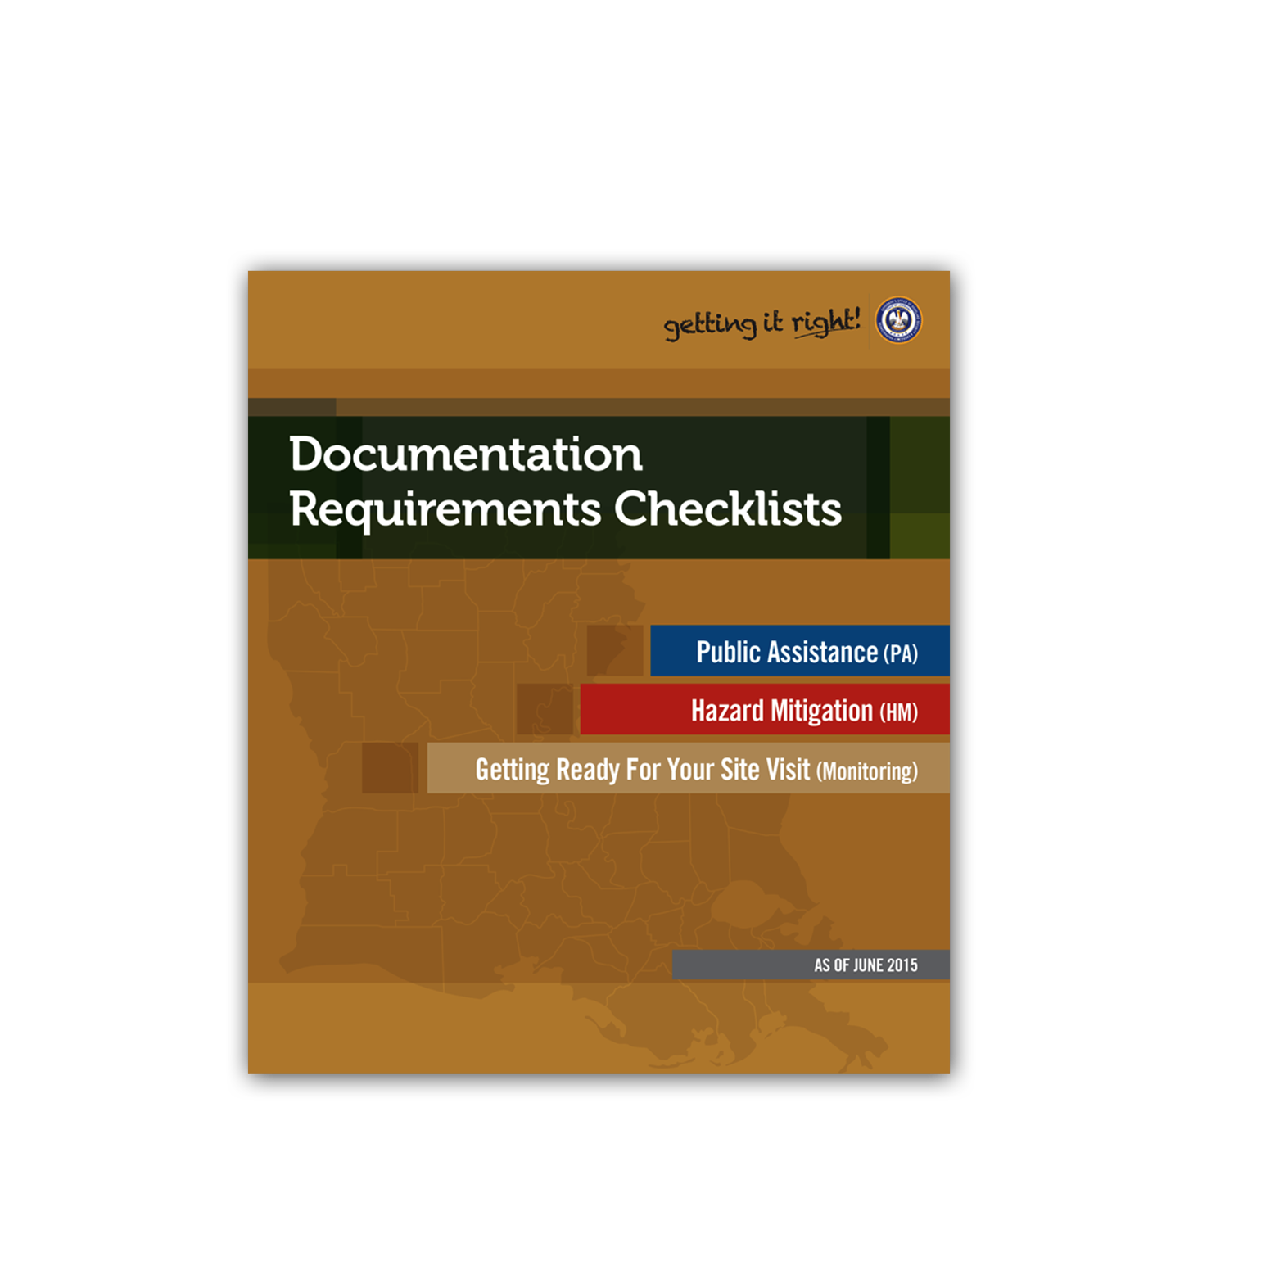
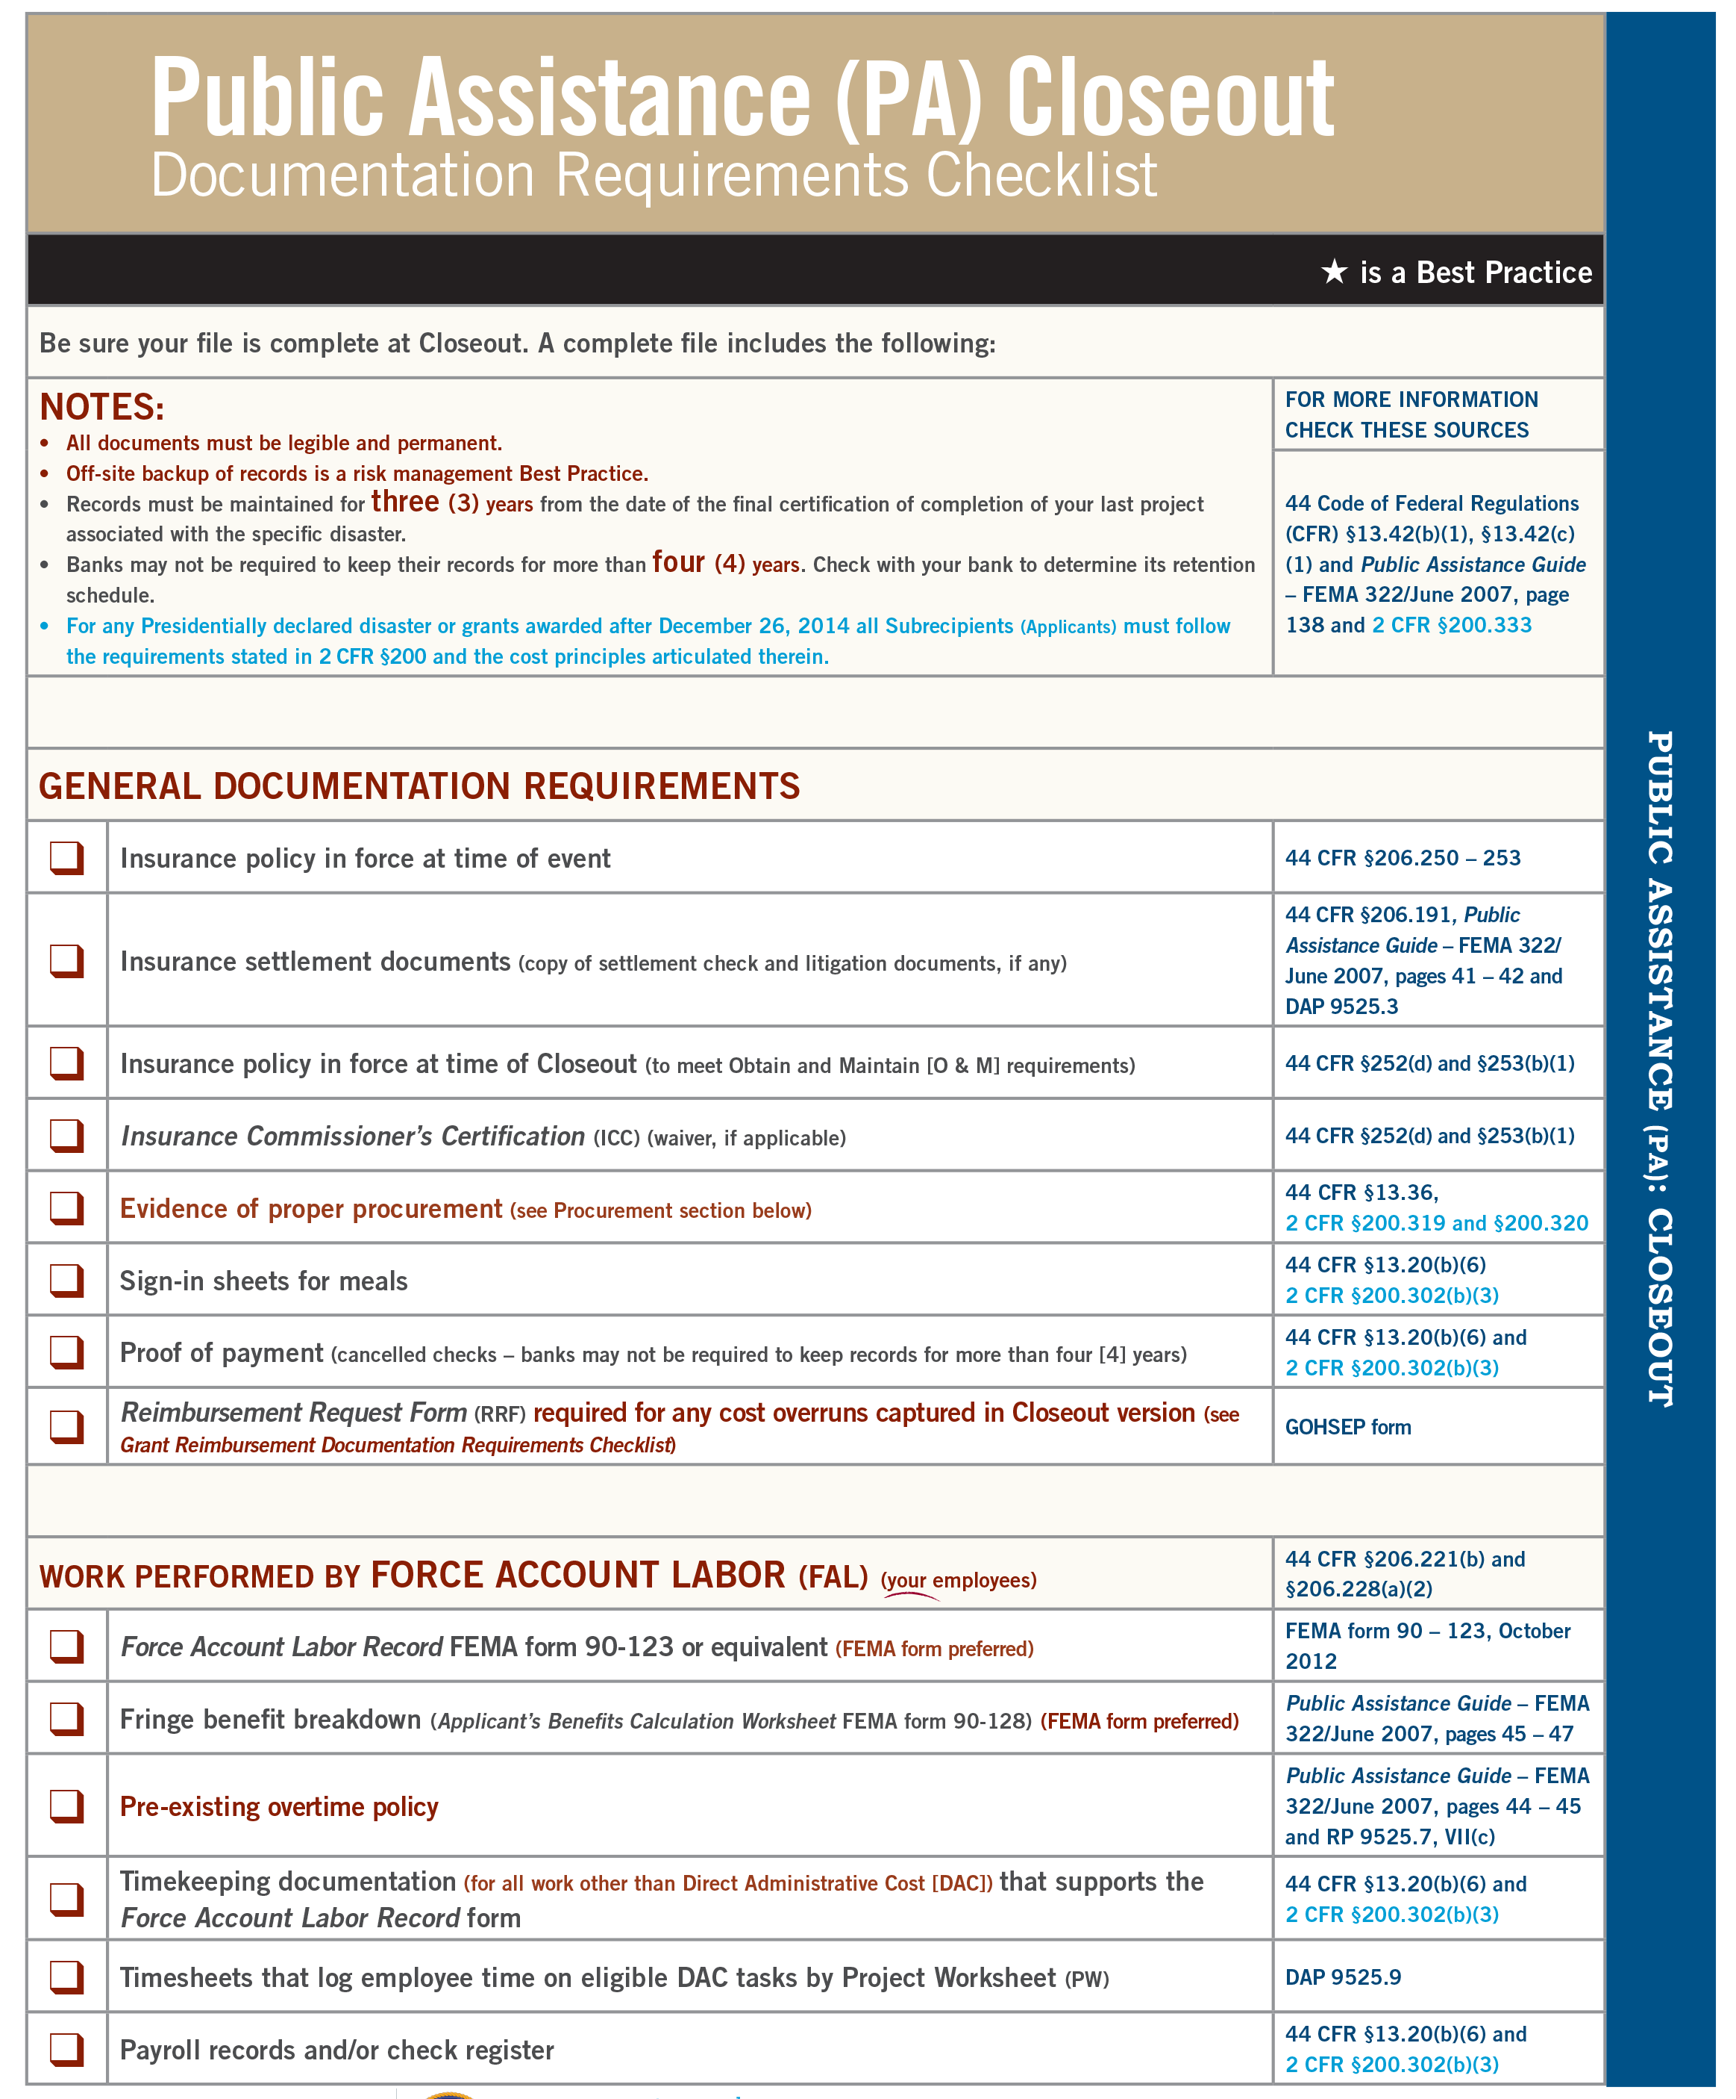

Slide 29
Closeout contacts
Public Assistance Main Line
(225) 346-4112
Christina Knighten
Section Chief
(225) 338-6763
christina.knighten@la.gov
Nathan Elkins
Group Lead – Katrina/Rita
(225) 339-3723
nathan.elkins@la.gov
Kennon Clayton
Group Lead – All Other Disasters
(225) 242-6014
kennon.clayton@la.gov

Slide 30
Questions?

