Slide 1
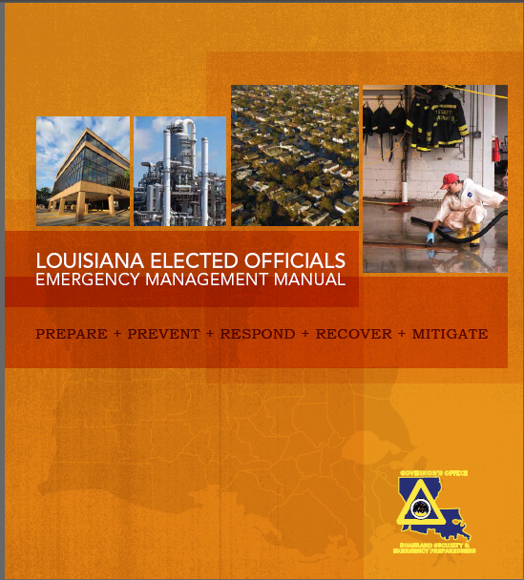
Individual Assistance (IA)

Slide 2
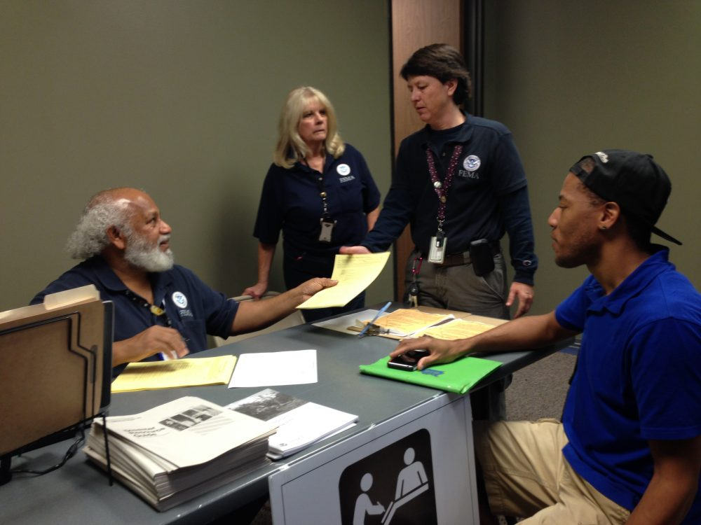
FEMA provides a variety of programs that help individuals + families recovering from the impacts of a disaster.
FEMA IA grant program is managed through FEMA and assisted by GOHSEP.
Notes:
The FEMA Individual Assistance Program, the Disaster Recovery Center and site location of a Disaster Recovery Center are essential components to helping citizens restore basic, life-living needs post disaster.
In your Toolkit, you will find the sequence of delivery Handout for the Individual Assistance Program.
(hold up the flow chart here)

Slide 3
Decoding Acronyms. . .
DRC: Disaster Recovery Center
OFA: Other Federal Agencies
ONA: Other Needs Assistance
POD: Points of Distribution
SBA: Small Business Administration
Notes:
You will hear some of these acronyms throughout the presentation and they are:
DRC:
OFA:
ONA: Program to help individuals that are in a serious disaster related needs
POD: Site where essentials are given out to individuals
SBA:

Slide 4
What does FEMA IA provide?
Financial | Direct | Other needs assistance (ONA) | Blue Roof Program
Lodging expenses + rental assistance. | Temporary housing. | Medical, dental, funeral expenses and other personal expenses. | At the request of the parish with a 75%/25% parish cost share.
Notes:
IA provides these types of assistance:
Financial: will be lodging expenses and rental assistance. Which is Hotels or Motels.
Direct: Is temporary housing that, which is setup by FEMA. Example is a mobile home or FEMA trailer.
Other Needs Assistance: is you medical, dental, funeral expenses, and other personal expenses, that is not covered by insurance or any other programs.
Blue Roof Program: The Blue Roof Program is at the parishes request. This Program is a 75/25 cost share with the 25% being the parishes responsibility. Once again I want to stress that 25% is the Parishes responsibility.
This is very important point, individuals can only obtain these types of assistance or programs if they have been directly impacted by the disaster.

Slide 5
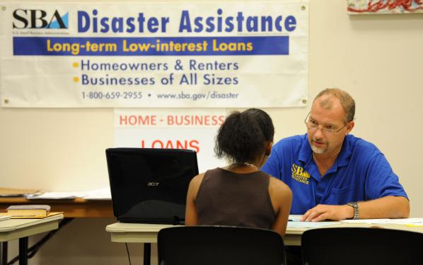
Disaster Recovery Centers (DRCs)
Key component of Individual Assistance (IA)
Hub of other assistance
Notes:
Who has had a DRC in there location?
For those who have not, what are Disaster Recovery Centers?
The DRC is a key component of the IA program and the hub of activity post disaster.

Slide 6
The FEMA Individual Assistance (IA) Program, the Disaster Recovery Center (DRC), and site location of a DRC are essential components to helping citizens restore basic, life-living needs post disaster.
Notes:
The FEMA Individual Assistance Program, the Disaster Recovery Center and site location of a Disaster Recovery Center are essential components to helping citizens restore basic, life-living needs post disaster.
In your Toolkit, you will find the sequence of delivery Handout for the Individual Assistance Program.
(hold up the flow chart here)

Slide 7
DRCs + Applicant
Readily accessible facility or mobile office . . .
Face-to-face time.
Individuals go for information.
Resources to assist with disaster recovery.
Notes:
So how can your Citizens take advantage of these programs in addition to applying on online or via telephone?
They may visit a DRC should one be set up in your parish.
This is where your individuals can go to get face to face time with the agencies, to apply or to check status of their applications, and also to receive other types of assistance.

Slide 8
DRCs may include . . .
FEMA + State + Local Government Agencies + Voluntary Agencies +
Other Federal Agencies (OFA)
Notes:
Within the DRC you may a find combination of ….

Slide 9
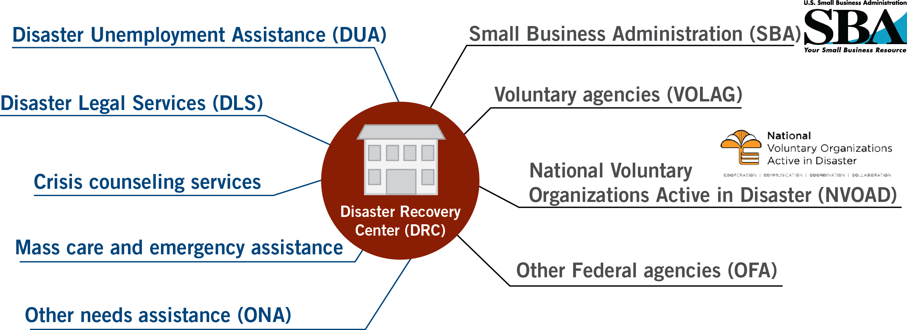
Individual Assistance (IA)
Program
Other Agencies
Notes:
Some of the other IA programs within the DRC could be:
As well as a few of these other agencies which might include:
Depending on the Disaster the DRC could have a combination of programs and

Slide 10
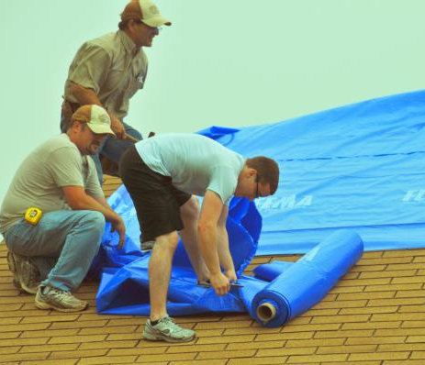
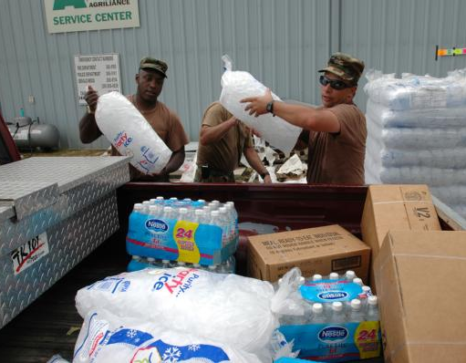
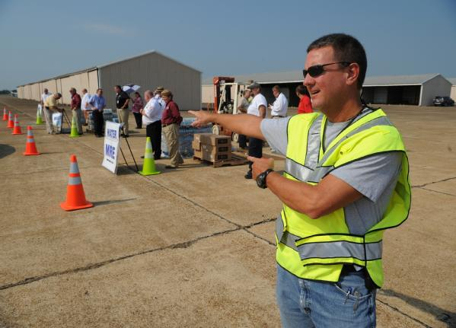
Bottom line . . .
Programs provide a safety net for those without essential basics.
Notes:
In summary I want to recap:
IA programs are a safety net for those without essential basics.
It is not meant to make them whole but rather restore them to basic life-living environment and the basic life-living environment are Temporary Housing, Shelters, Food, Water and Clothing.
So how can your parish be prepared?
You can go ahead and make those DRC locations, better yet make multiple DRC locations!
This will help your citizens and parish to recover as quickly and efficiently as possible should a disaster occur in your area.

Slide 11
How to Apply
Individuals can apply online at DisasterAssistance.gov.
Or by phone: 800-621-3362
Notes:
In summary I want to recap:
IA programs are a safety net for those without essential basics.
It is not meant to make them whole but rather restore them to basic life-living environment and the basic life-living environment are Temporary Housing, Shelters, Food, Water and Clothing.
So how can your parish be prepared?
You can go ahead and make those DRC locations, better yet make multiple DRC locations!
This will help your citizens and parish to recover as quickly and efficiently as possible should a disaster occur in your area.

Slide 12
To learn more . . .
http://www.fema.gov
http://www.disasterassistance.gov
http://www.sba.gov
http://www.getagameplan.org
Notes:
To learn more about these programs you can visit the following websites:
To check the status of a presidential declaration at fema.gov
To file for assistance at disaster assistance.gov
to apply for a loan at sba.gov
I encourage all of you to go to GOHSEP’s getagameplan.org to further think through your post disaster action plans.

Slide 13
…or contact GOHSEP
Individual Assistance
Connie Mincey
225.572.4176
connie.mincey@la.gov
Notes:
For more information you can contact Ms. Mincey with GOHSEP and they can further assist you with any questions which you may have.
Thank you again for your time and we appreciate your coming out today. Thank you

