Slide 2
LA BEOC Floor Plan

Slide 3
LABEOC.ORG

Slide 4
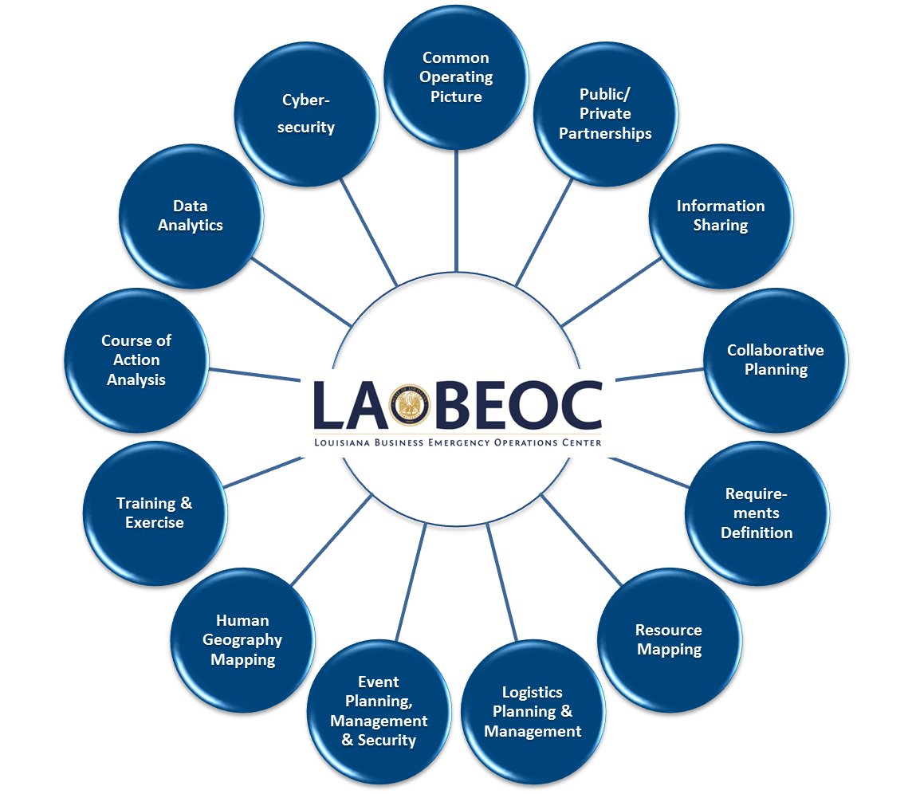
Research on/with LA BEOC

Slide 5
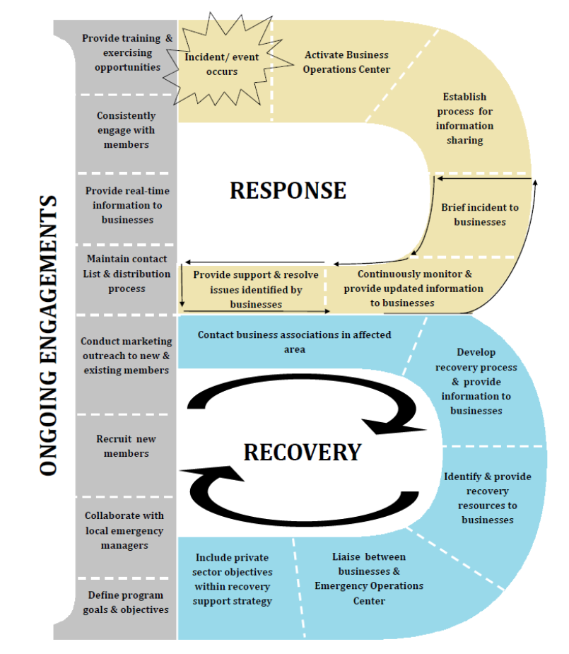
Business B
Source: Maryland Emergency Management Agency
Private Sector Integration Program (PSIP)
www.mema.maryland.gov

Slide 6
Public-private partnership . . .
An outlet for the private sector to:
PROVIDE information
OBTAIN information
Identify REQUIREMENTS
Provide RESOURCES

Slide 7
…Public-private partnership
An opportunity for businesses to:
Support State disaster recovery when traditional resources are exhausted.
Help prepare and recover local economies through a network of associations.
Assume a leadership role in building resilience in Louisiana communities

Slide 8
Industry Organizations, Associations & Registered Businesses
Stakeholder Associations:
Association of Contingency Planners
Associated Wholesale Grocers
Associated Grocers
Baton Rouge Area Foundation
Louisiana Credit Union League
Louisiana Hotel and Lodging Association
Louisiana Motor Transport Association
Louisiana Office of Financial Institutions
Louisiana Oil Marketers and Convenience Store Association
Louisiana Pulp and Paper Association
Louisiana Restaurant Association
Louisiana Retailers Association
Louisiana Telecommunications Association
Louisiana Mid-Continent Oil & Gas Association (LMOGA)
Louisiana Association of Business and Industry
Louisiana Bankers Association
Louisiana Chemical Association
Louisiana Hospital Association
Louisiana Technology Council
National Federation of Independent Business
Ports Association of Louisiana
LA VOAD
Economic Development Organizations (EDO):
Greater New Orleans, Inc.
South Louisiana Economic Council (SLEC)
Baton Rouge Area Chamber
One Acadiana
Acadiana Economic Development
Lafayette Economic Development Authority
Southwest Louisiana Economic Development Alliance
Central Louisiana Economic Development Alliance
Central Louisiana Chamber of Commerce
Northeast Louisiana Economic Alliance
North Louisiana Economic Partnership
Utility Allies
Entergy Louisiana Economic Dev. Office
AEP-Southwest
CLECO
U.S. Department of Homeland Security
Protective Security Advisor
Registered Businesses (VBEOC Portal): 2,242*
(13,100 contacts representing 4,923,508 employees)
* November 2015

Slide 9
LEGEND
Status Feedback
Request for Support
State
Agency
Assets
State
Associations
ESF
Contracts
Rentals
etc.
Business
EOC
Private Sector
Virtual BEOC
State
Emergency
Operations
Center
Federal
Assistance
Local EOC
Local
Assets
EMAC State
to State Assets
Contracts
Rentals
etc.
Intrastate
Mutual
Aid

Slide 10
Be Prepared

Slide 11
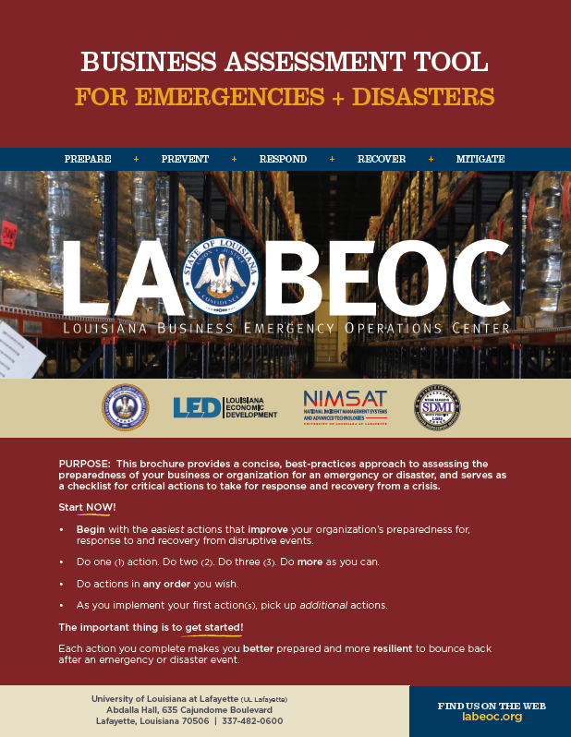
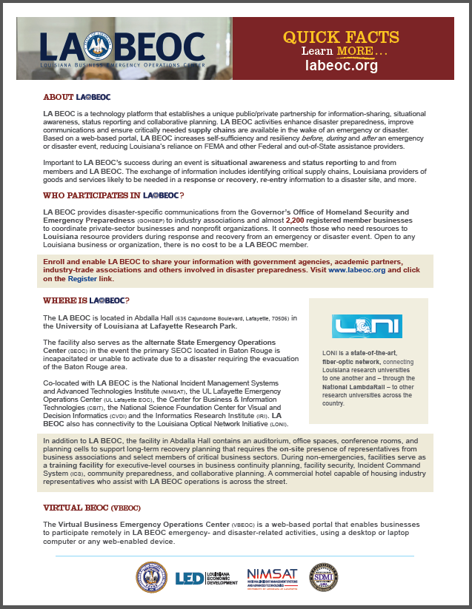
LA BEOC Products

Slide 12
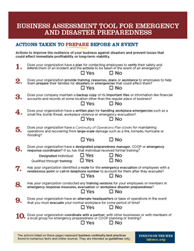
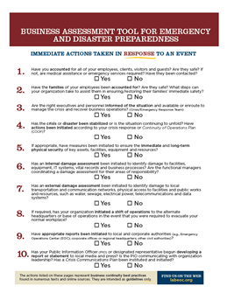
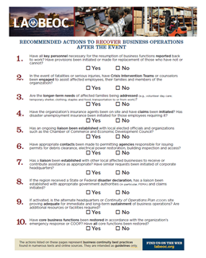
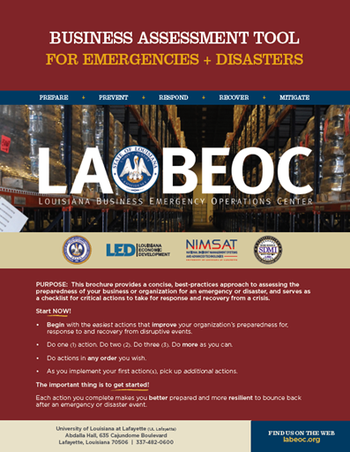
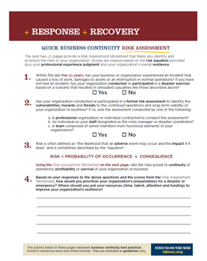
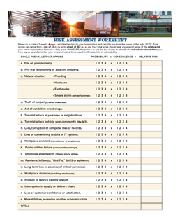
Risk Assessment

