Slide 1
CDR
The Texas General Land Office
Community Development and Revitalization Program (GLO-CDR)
“We work to rebuild communities, to put Texans back in their homes, and to help businesses recover after the trauma of disaster.”
George P. Bush
Texas General Land Office Commissioner

Slide 2
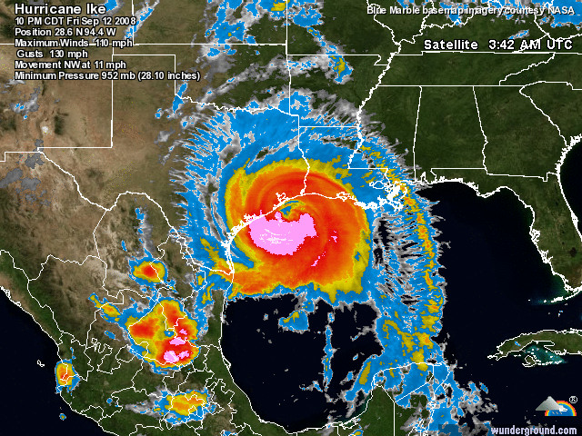
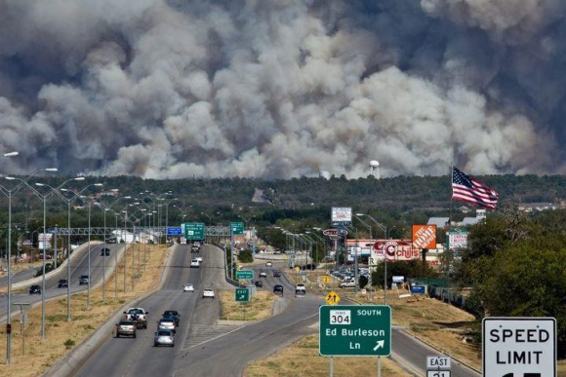
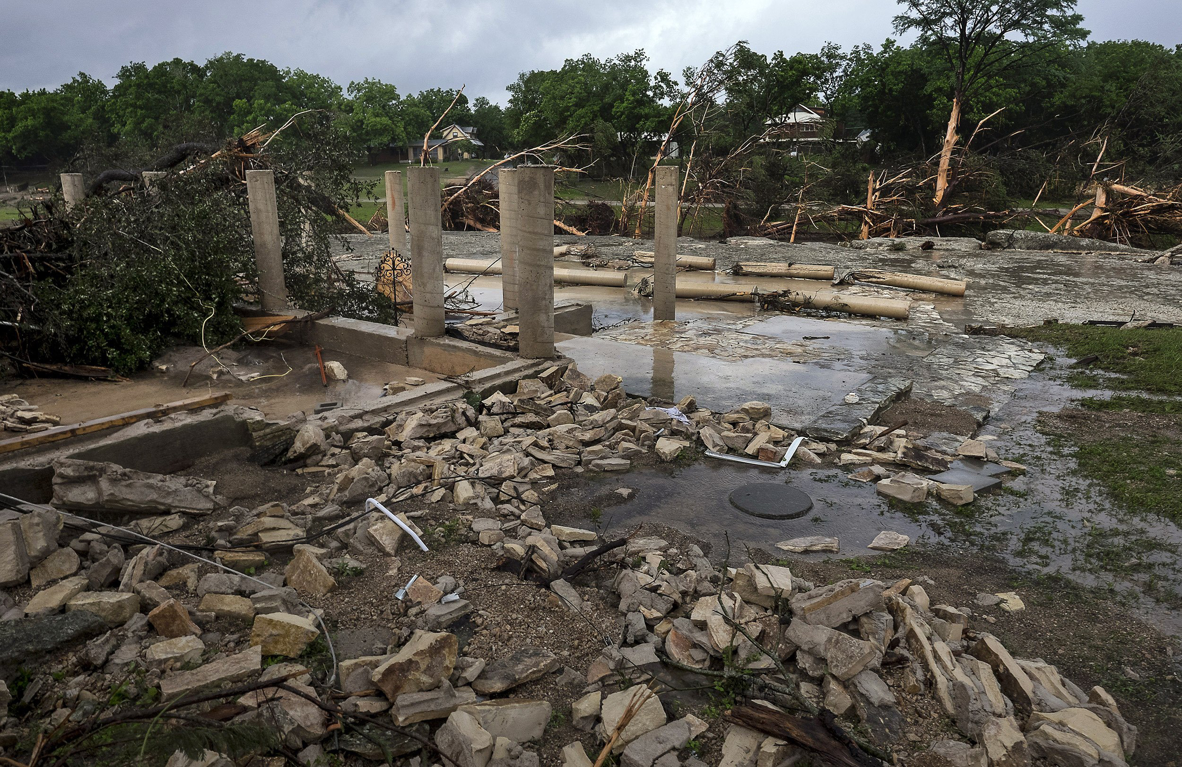
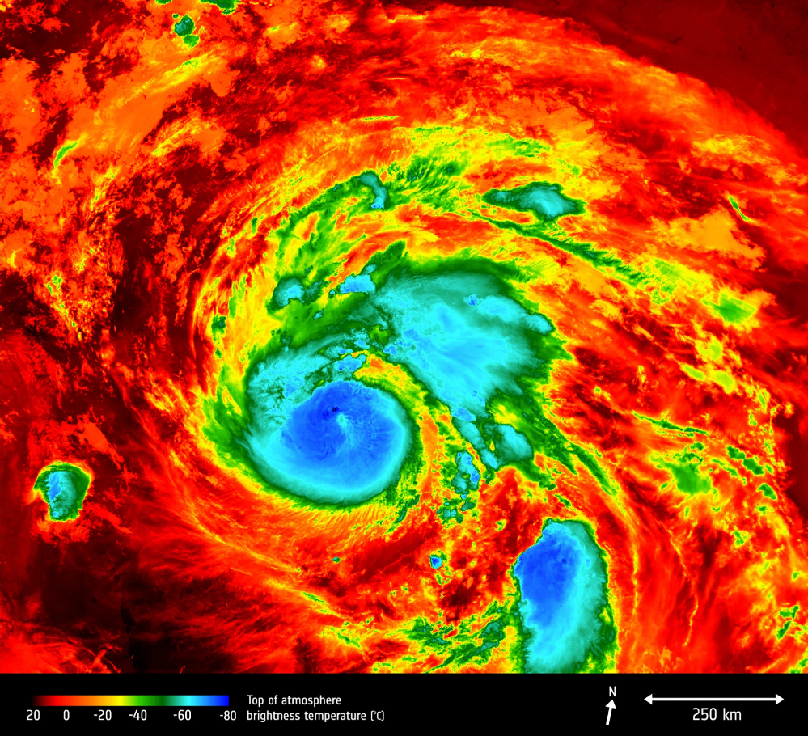
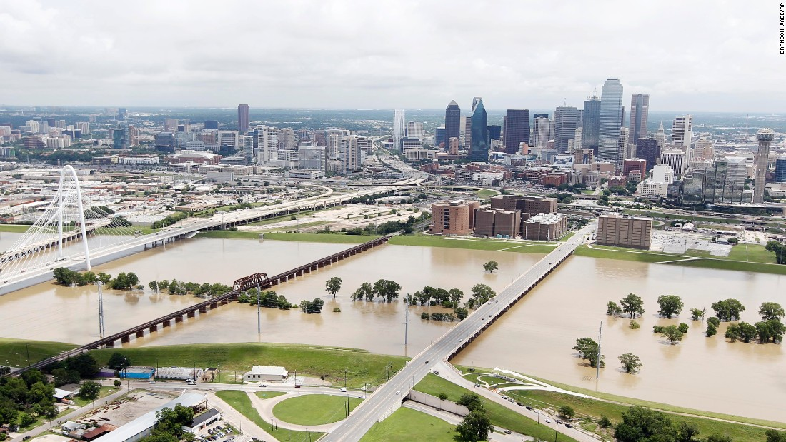
GLO and Long-Term Disaster Recovery
CDR

Slide 3
Response vs. Recovery
CDR
Disaster Response - performed by the Federal Emergency Management Agency (FEMA) and Texas Department of Emergency Management (TDEM) during and immediately following a disaster under the Stafford Act for FEMA and Governor Disaster Declaration for TDEM. Short-term Housing executed jointly by FEMA and the Texas General Land Office (GLO)
Disaster Recovery – conducted by the United States Department of Housing and Urban Development (HUD) and the Texas General Land Office’s Community Development and Revitalization Program Office (GLO-CDR), via Special US Congressional Appropriation for Community Development Block Grant – Disaster Recovery (CDBG-DR)

Slide 4
GLO and Short-Term Recovery
CDR
On 14 Sep 2017, Governor Abbott designated the Texas General Land Office with responsibility for administering short-term housing disaster recovery for the State of Texas, through the administration of all FEMA housing funds.
FEMA short-term housing programs:
Direct Assistance Limited Home Repair (DAHLR)
Multi-Family Lease and Repair
Direct Lease
Manufactured Housing Units (MHUs)
Travel Trailers/Recreational Vehicles (TT/RV)
Partial Repair Essential Power for Sheltering (PREPS)
Sec 403 Public Assistance Sheltering Program
Required local match 10% for Harvey DR-4332-TX

Slide 5
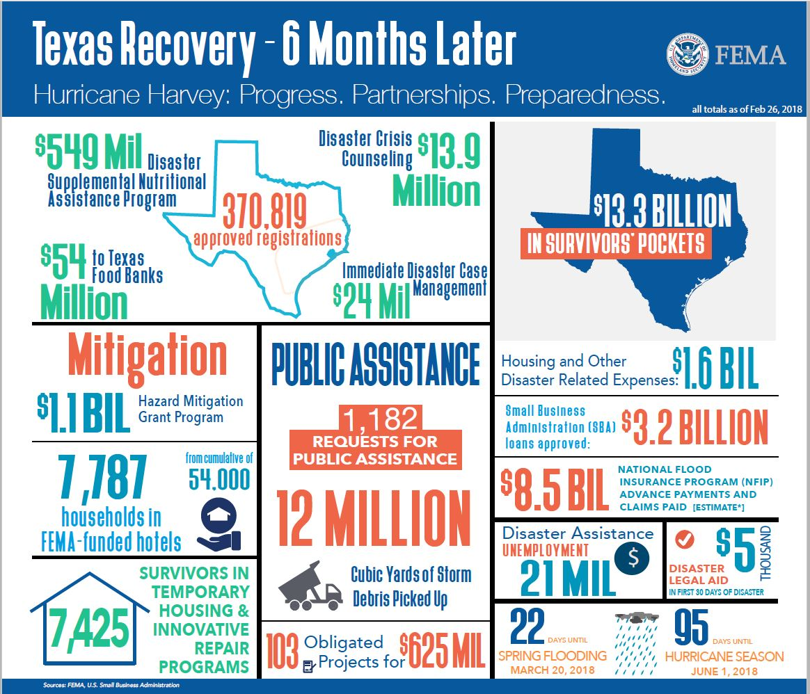
Hurricane Harvey Recovery
CDR

Slide 6
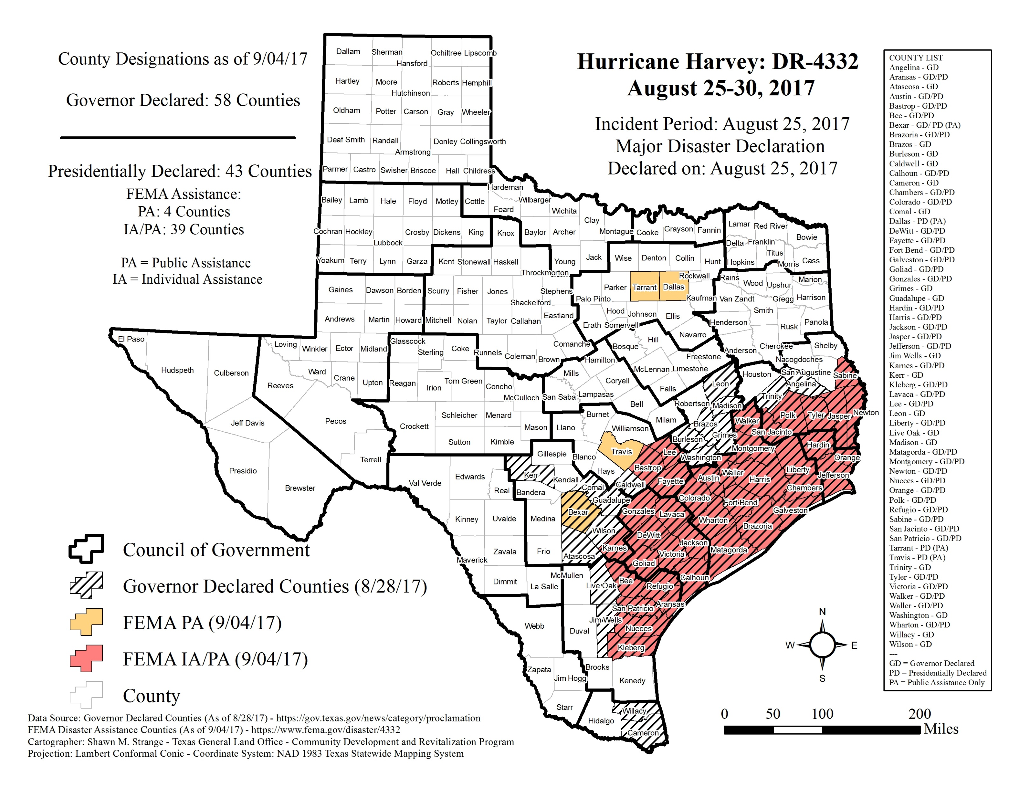
Hurricane Harvey Impacted Area
CDR

Slide 7
Hurricane Harvey Programs
CDR
Single Family Homeowner Assistance: Provides funding for rehabilitation and reconstruction of owner-occupied single family homes damaged by Hurricane Harvey.
Buyouts and Acquisitions: Eligible homeowners are able to sell their home to a local government at a pre-storm or post-storm fair market value and move out of harm’s way by relocating outside of a floodplain to a lower-risk area.
Homeowner Reimbursement: Allows homeowners to be reimbursed for certain out-of-pocket expenses incurred for repairs to their home including reconstruction, rehabilitation or mitigation up to $50,000.
Homelessness Prevention: Provides programs such as short-term mortgage, utility payment and tenant-based rental assistance in an effort to prevent homelessness in the region following Hurricane Harvey.

Slide 8
CDBG-DR Funded Programs (Cont.)
CDR
Affordable Rental: Provides funding for rehabilitation, reconstruction and new construction of affordable multi-family housing projects in areas impacted by Hurricane Harvey.
Local Infrastructure: Repairs, enhances and restores infrastructure for local communities impacted by Hurricane Harvey as part of a comprehensive long-term recovery program.
Economic Revitalization: Allows for interim assistance to businesses impacted by Hurricane Harvey through deferred forgivable loans and loans in exchange for job creation or retention.
Local, Regional and State Planning: In coordination Texas public universities, the GLO will conduct planning studies in the impacted areas with the purpose of promoting sound long term recovery.

Slide 9
Issues & Challenges
CDR
New Mission (Short-Term Housing)
First time FEMA/State Partnership
New Housing Options
Lack of Documentation
IGSA vs. Grant
100% Federally Funded Staff (HUD)
Procurement (2 CFR Part 200)
Legal Authorities
1972 Privacy Act
Background Checks (Federal/State)
IT Systems
Federal/State

Slide 10
Thank you!
CDR
CONTACT:
Pete Phillips or Heather Lagrone
512.475.5000
cdr@glo.texas.gov

