Slide 1
HMA Review Process
John Washington
HMA Specialist
Louisiana HMGP Liaison
FEMA Region VI

Slide 2
Application review criteria
Application eligibility.
Eligible activity but not eligible.
Cost-effectiveness.
Documentation to validate accuracy and credibility of data.

Slide 3
Application review criteria (Continued . . . )
Feasibility + effectiveness.
FEMA will accept cost estimates.
Grantee certifies: nationally published or local cost guides.
Detailed documentation must be provided.
Contractor bid.
Historic costs from another activity.

Slide 4
Application review criteria (Continued . . . )
EHP compliance.

Slide 5
Emphasis on application detail
Application should paint a picture.
State + FEMA expect a good faith effort by the local government and are available to answer questions during the process and provide technical assistance.

Slide 6
Emphasis on application detail (Continued . . . )
State + FEMA will need the required information to make an eligibility determination.

Slide 7
HMA efficiencies
FEMA will accept engineering design for mitigation efficiency:
Safe Room projects.
Wind Retrofit projects.
Certain Flood Mitigation projects.

Slide 8
HMA efficiencies (Continued . . . )
FEMA provides opportunities to streamline application requirements by allowing Applicants to use:
FEMA technical publications.
National standards and codes.
Design criteria such as ASCE criteria.
Pre-calculated benefits.

Slide 9
Quality control (QC) applications
FEMA will no longer accept incomplete project applications.

Slide 10
QC applications (Continued . . . )
Complete application contains (at least):
Scope of Work (SOW)
Cost breakdown
Benefit Cost Analysis (BCA)
Work schedule
Environmental letters

Slide 11
Streamlining timeframes
Application is submitted to FEMA; FEMA has 60 days to review.
FEMA requests additional information (email) – 30 days.
2nd request for information (email) – 14 days.
3rd request for information (letter) – 30 days.
Formal denial.

Slide 12
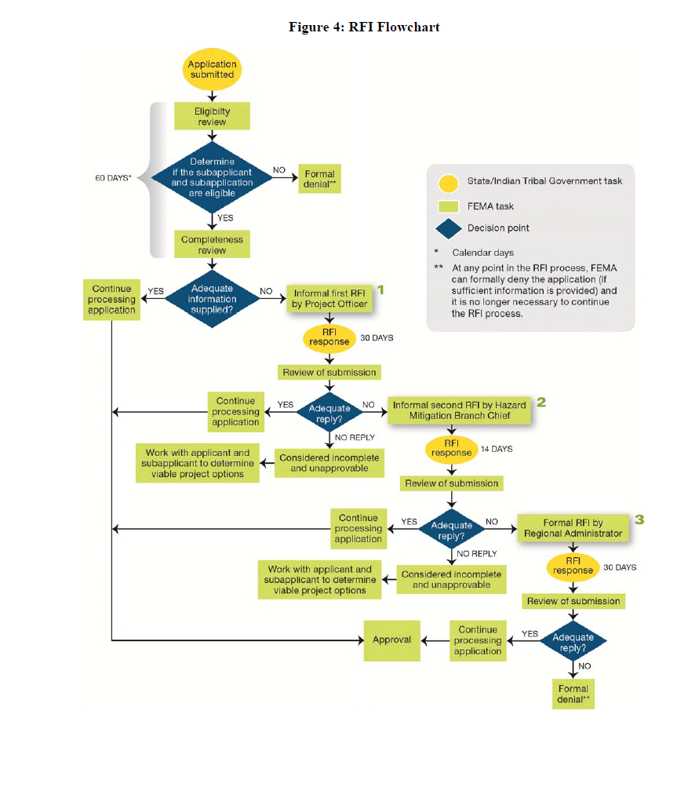
Application review flow

Slide 13
Phasing project
For complex projects requiring additional technical and financial resources.
Must be requested in initial application.

Slide 14
Phasing project (Continued . . . )
Hydrologic and Hydraulic (H + H) or Other Relevant Technical Data.
Preliminary engineering design.
EO 11988 – demonstrate compliance with floodplain management requirements.
Refinement of the cost-effectiveness Assessment.
Environmental assessment.
Phase II approval

Slide 15
Contact
John Washington
HMA Specialist
Louisiana HMGP Liaison
FEMA Region VI

Slide 16
Questions?

