Slide 1
Procurement

Slide 2
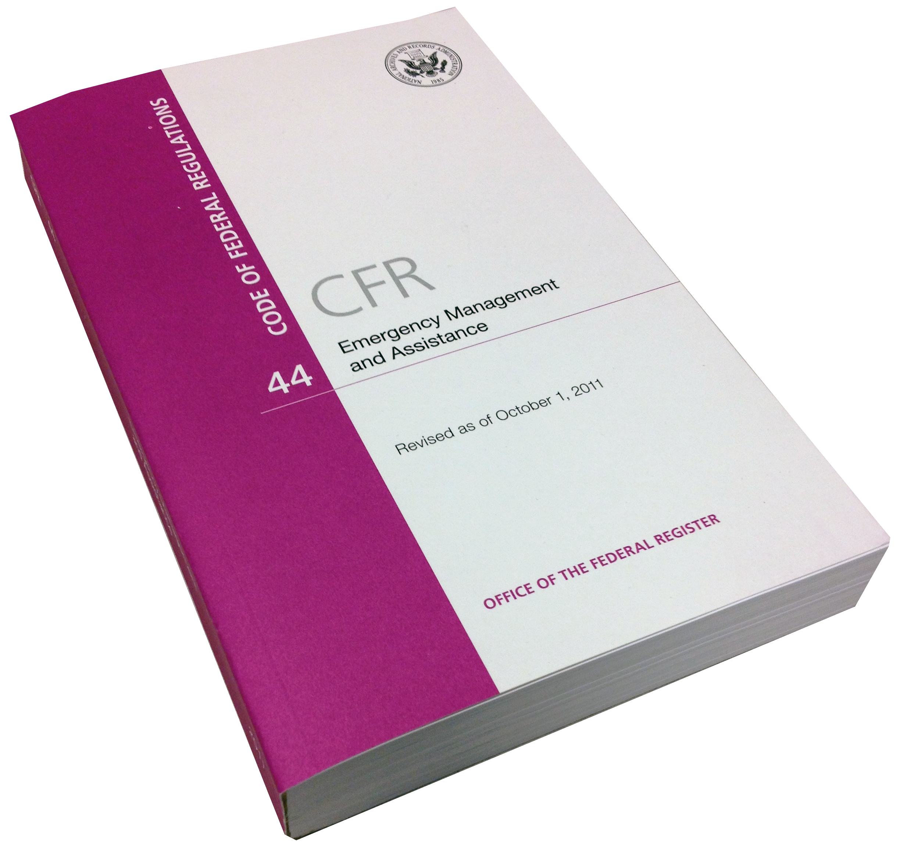
Purpose
OVERVIEW

Slide 3

Why is this important?
COST ANALYSIS
DE-OBLIGATION

Slide 4
Agenda
How to develop a Request for Proposal (RFP)/Qualifications (RFQ).
  Review of Procurement Checklist.
Procurement requirements.
  Review of Procurement Guide.
Current issue.

Slide 5
How to develop a RFP/RFQ
Do you need a contract?
If YES . . .
  Form a contracts committee.
  Develop accurate scope of work (SOW).

Slide 6
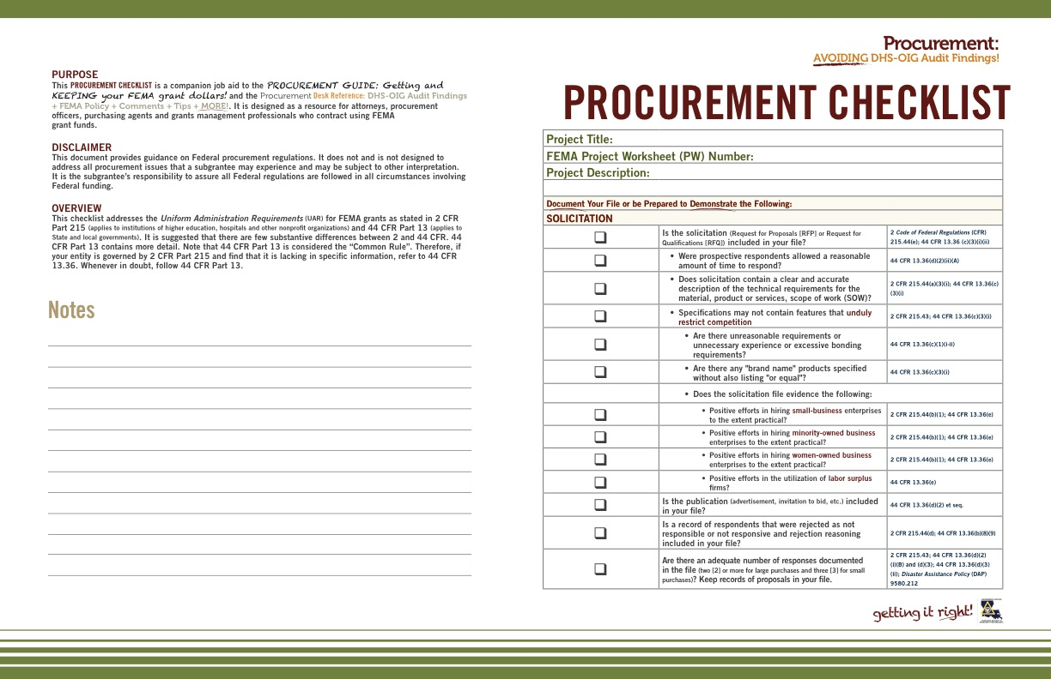
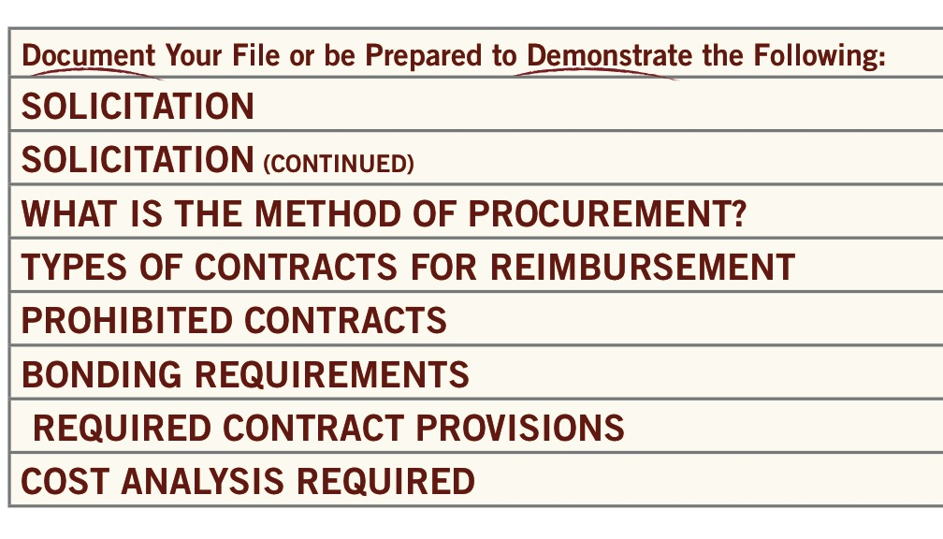
Procurement
Checklist

Slide 7

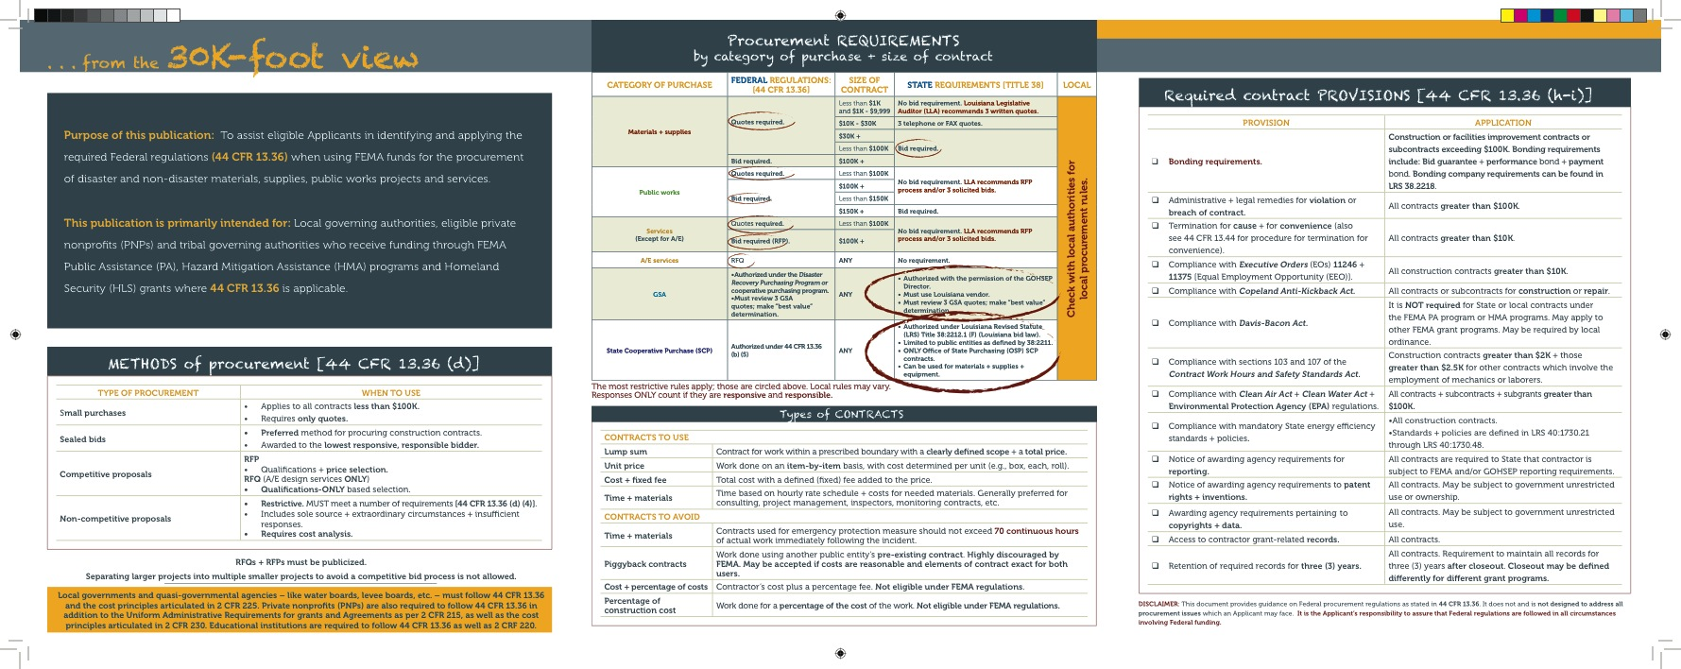
Procurement Guide

Slide 8

Current issue
NEW 2 Code of Federal Regulations (CFR) 200
Super circular

Slide 9
Key takeaways
Always have a competitive process.
Avoid prohibited contracts and be very careful with Time + Materials contracts.
Include all required clauses.
Affirmative steps for minority, small, women-owned businesses.
Process to monitor contractors.
Most conservative approach.

Slide 10
Contact
LaShaunté Martin
Deputy Legal Counsel
lashaunte.martin@la.gov
Ben Plaia
Legal Counsel Disaster Recovery Division
ben.plaia@la.gov
Shontae Davis
Legal Assistant
shontae.davis@la.gov

Slide 11
Questions?

Slide 12
For more information + to download materials from today’s seminar:
gohsep.la.gov/outreach.aspx

