Slide 1
Panel Discussion
Louisiana Shelter At Home Program

Slide 2
Presenters
Danielle Aymond, Executive Counsel Louisiana GOHSEP (225) 925-7541 Office (337) 515-4127 Cell Danielle.Aymond@la.gov | Eddie Williams, FEMA Infrastructure Branch Director, DR 4277 (225) 389-7282 BR Office (225) 678-7800 Cell Eddie.Williams@fema.dhs.gov

Slide 3

Background
AUGUST 12, 2016
Up to 31 Inches of Rainfall within hours
  7 trillion gallons of water
FEMA verified losses
  More than 91,000 households
Notes:
DANIELLE : On August 12, 2016, Louisiana declared a State of Emergency for one of the worst natural disaster in the country since Hurricane Sandy. A slow moving system produced up to 20 inches of rainfall in some areas of the state, providing more than 7 trillion gallons of new surface water.
Rivers rose rapidly and inundated homes, roads and businesses within hours. More than a half dozen river gauges set new record highs, in some cases by as much as 6 feet. FEMA verified losses at more than 91,000 households.
The State lacked available rentals or hotels as those structures has flooded as well.

Slide 4

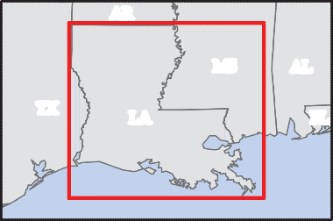
FEMA-4277-DR, Louisiana Disaster Declaration as of 09/02/2016
AR
West Carroll
East Carroll
AR
Claiborne
Union
Morehouse
MS
AL
Bossier
TX
LA
FL
Caddo
Lincoln
Webster
Ouachita
Richland
Bienville
Jackson
Madison
Data Layer/Map Description: The types of assistance that have been designated for selected areas in the State of Louisiana.
De Soto
Red River
Caldwell
Franklin
Tensas
Winn
MS
All designated areas in the State of Louisiana are eligible to apply for assistance under the Hazard Mitigation Grant Program.
Catahoula
Natchitoches
Grant
La Salle
Concordia
Sabine
Rapides
Designated Counties
Vernon
Avoyelles
No Designation Individual Assistance and
Public Assistance (Categories A - G)
Public Assistance (Categories A - G)
TX
West Feliciana
East Feliciana
St. Helena
Washington
Beauregard
Evangeline
Pointe Coupee
Allen
St. Landry
East Baton Rouge
Tangipahoa
West Baton Rouge
Livingston
St. Tammany
Calcasieu
Jefferson Davis
Acadia
Lafayette St. Martin
Iberville
Ascension
St. James
St. John the Baptist
St. Charles
Orleans
Cameron
Iberia
Assumption
Jefferson
St. Bernard
Vermilion
St. Mary
Lafourche
Plaquemines
Miles
Terrebonne
Data Sources:
FEMA, ESRI;
Initial Declaration: 08/14/2016 Disaster Federal Registry Notice: Amendment #5 - 09/02/2016 Datum: North American 1983
Projection: Lambert Conformal Conic
MapID e6e73fe5bc80902161712hqprod

Slide 5
Four Most Impacted Parishes
County/Parish | Status | # Applicants
East Baton Rouge Parish | Ineligible | 934
 | Withdrawn | 4,041
 | Complete | 6,533
East Baton Rouge Parish Total |  | 11,508
Livingston Parish | Ineligible | 447
 | Withdrawn | 2,278
 | Complete | 2,169
Livingston Parish Total |  | 4,894
Ascension Parish | Ineligible | 151
 | Withdrawn | 926
 | Complete | 898
Ascension Parish Total |  | 1,975
Lafayette Parish | Ineligible | 37
 | Withdrawn | 501
 | Complete | 478
Lafayette Parish Total |  | 1,016

Slide 6
Goals of the STEP/SAH Program
Reduce demand for congregate and transitional sheltering assistance
Ensure SAH applicants are able to remain in their community
Keep the fabric of the existing community intact
Help schools re-open quickly
Speed up the pace of recovery

Slide 7
Process for Policy Approval
State assess need for STEP program
  Large scale displacement of residents
  Limited hotel availability
  Limited rental availability
State makes a formal request and confirms authority to undertake proposed actions (Executive Order)
FEMA and State jointly work to develop program parameters
FEMA approves policy guidance for implementation of the program

Slide 8
FEMA Policy
State accepts responsibility for program implementation
Disaster declared parishes only
Single family owner-occupied residential properties only
Property must be structurally sound such that authorized temporary repairs can be safely made with no impediments blocking access to the dwelling

Slide 9
FEMA Policy cont’d.
Property must be able to serve as a suitable shelter upon completion of the emergency repairs authorized under the program
Rights of Entry must be obtained to hold harmless the Federal Government
Daily and weekly reporting required
FEMA makes no warranties of any sort for any assessments or temporary work performed

Slide 10
FEMA Policy cont’d.
Cap provisions for eligible work (FEMA 4277-DR-LA was $15,000)
Any inspections for code compliance or safety necessary to accomplish eligible work is reimbursable and not part of cap provisions
Program Management and oversight activities not part of cap provisions
Limitations of continued Individual Assistance

Slide 11
Implementation of STEP Program
State may hire Program Manager to help deliver the program
State develops process and procedures for implementation of program
State hires contractors to execute repairs
State provides regular reporting to FEMA
State requests project closure within 120 days of final payment to all vendors

Slide 12
Process
OIG Briefed
Development of RFEI by GOHSEP and multiple State and Federal agencies
Separation of Project Manager (PM) and construction contract
Selection Panel consisted of multiple agency representatives
GOHSEP advertised repair RFEI twice
GOHSEP staggered the repair contracts
Allowed for the State and/or PM to re-assign
RFEI reviewed and advised by attorneys from GOHSEP, FEMA, OSP and DOA
FEMA invited to every development meeting
Notes:
KIMBERLY

Slide 13

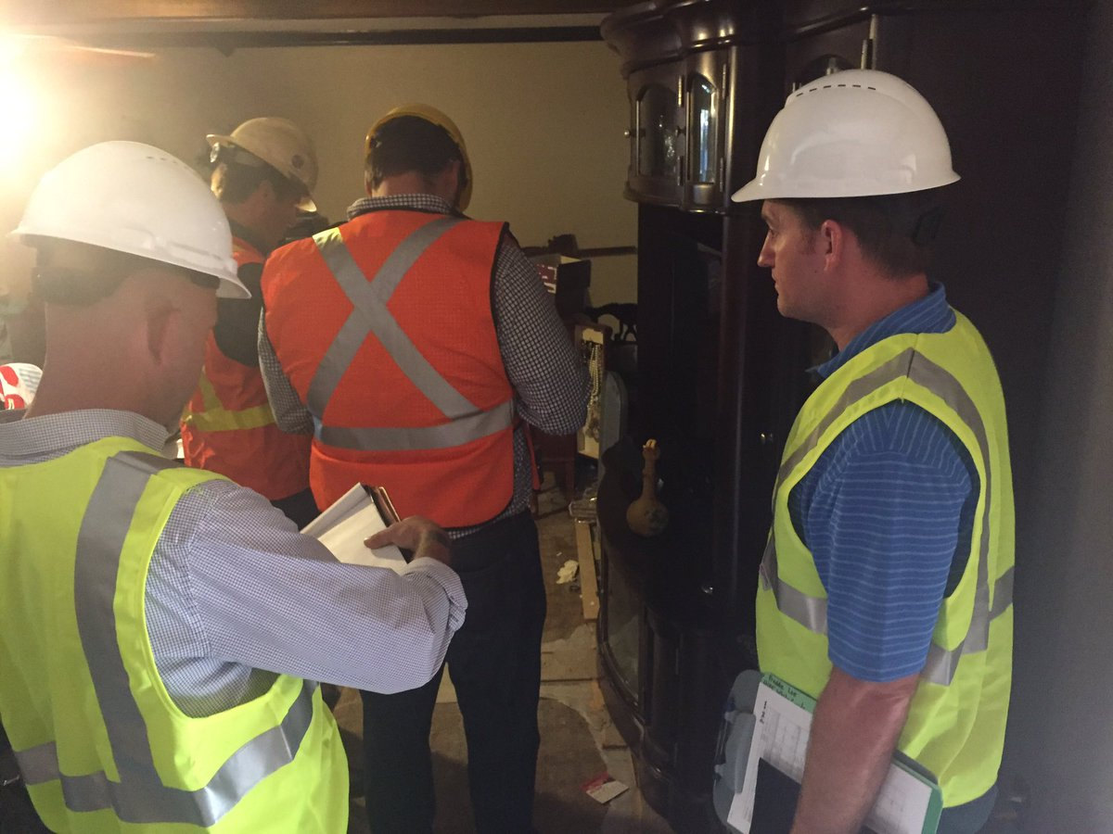
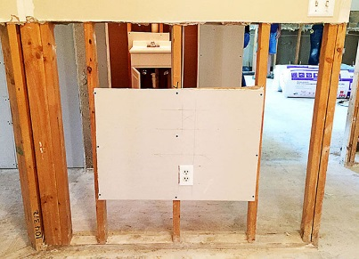
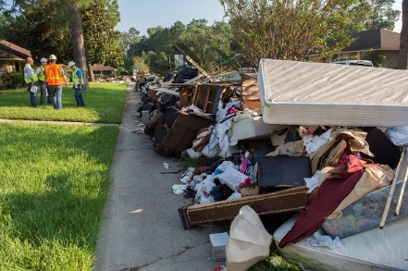
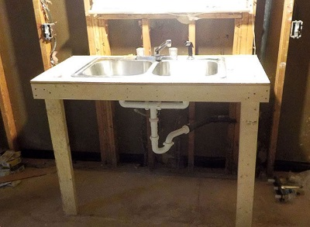
GOHSEP’s Response: Shelter at Home
An Innovative Disaster Recovery Tool
Completed Homes - 10,990
96% of homes completed by December 24, 2016: 3 months after implementation
$11,854 was the average repair cost per home
Overview:
      This program did not exist at the time of the historic, August 2016 flood. The SAH was developed, executed, crews and resources mobilized, and repairs underway within just a few weeks.
      SAH provided a bridge between emergency sheltering efforts and long term recovery.
      No other program offered immediate, transitional help.
      Direct payments are not allowed (PA). There are federal limitations for what can be done and how.
      We worked with FEMA, LLA, OIG, Constituent Services, the Compliance Board, VOAD, and other non-profits.
      The emergency repairs enabled families to return home quicker and communities to recover faster.
      SAH offered support to make homes secure and habitable, with working heating, air and electrical outlets, while long term repairs were made.
      Many of the people who benefitted from this program did not have the means or support to get this critical, initial work done.
PROGRAM APPLICATION METHODS
Notes:
KIMBERLY
Now…we move on to the massive recovery process currently underway.
Shelter at Home is something we helped develop with the Governor and FEMA. The program is meant to fill the void between the emergency sheltering phase and the long term housing programs tied to Congressional aid.
Temporary repairs were made to nearly 11-thousand homes…in order to make them safe and habitable while the homeowner determines their course of action for permanent repairs.
Direct payments to homeowners were not allowed under the Federal regulations.
The goal was to keep our communities and neighborhoods whole during this long recovery process.
Limitations from the Feds did not allow us to include items like sheetrock and other permanent repairs. This program was developed and executed within days of the flood.
It is much more efficient and cost effective than some of the other temporary housing programs…plus it actually includes steps to make the homeowner complete.

Slide 14
State Law Required
The Louisiana Disaster Act LA RS 29:721
The Governor has a legal responsibility to “make provisions for the availability and use of temporary emergency housing.”
The Governor also signed a Public Health Emergency related to the wet materials from homes.
The GOHSEP director under state law may “decontaminate or cause to be decontaminated, or destroy any material there is reasonable cause to believe that it may endanger to public health.”
Notes:
DANIELLE: In conjunction with a letter from our State Health officials Louisiana Department of Health

Slide 15
State Law Required
The general power and responsibility of the Governor to shelter citizens in a time of emergency, in conjunction with the special powers conferred upon me during a time of public health emergency, gives Louisiana the legal right and responsibility to implement the Rapid Repair Program to include work on flood damaged dwellings to provide basic sheltering conditions for the health and safety of residents.
Notes:
DANIELLE

Slide 16
Legal Protective Measures
The Right of Entry (ROE)
State law limitation of liability incorporated into the ROE.
  The Owner agrees that the State of Louisiana, along with its contractors, in accordance with LA RS 29:735, are indemnified and will be held harmless from any death of or any injury to persons or damage to property as a result of actions taken pursuant to the Louisiana Shelter at Home Program/FEMA STEP Assistance Program.
Notes:
DANIELLE

Slide 17
Types of Temporary, Emergency Repairs
The temporary repairs covered in the Shelter at Home Program include:
Mucking out the house and applying anti-microbial spray.
Removing wet wall insulation.
Basic electrical restoration with replacement outlets and protection.
HVAC repair or window unit installation.
Replacement of a water heater.
Ensuring one bathroom has an operating sink, toilet, and tub.
Installing a temporary kitchen sink and basic cooking appliances.
PROGRAM APPLICATION METHODS
Notes:
KIMBERLY Now…we move on to the massive recovery process currently underway.
Shelter at Home is something we helped develop with the Governor and FEMA. The program is meant to fill the void between the emergency sheltering phase and the long term housing programs tied to Congressional aid.
Temporary repairs were made to nearly 11-thousand homes…in order to make them safe and habitable while the homeowner determines their course of action for permanent repairs.
Direct payments to homeowners were not allowed under the Federal regulations.
The goal was to keep our communities and neighborhoods whole during this long recovery process.
Limitations from the Feds did not allow us to include items like sheetrock and other permanent repairs. This program was developed and executed within days of the flood.
It is much more efficient and cost effective than some of the other temporary housing programs…plus it actually includes steps to make the homeowner complete.

Slide 18

The Nine General Contractors
Citadel Builders – Metairie, LA
Core Construction – Metairie, LA
DSW Homes – Galveston, TX
JWTC – Tomball, TX
Lamar Contracting – Luling, LA
Lemoine Company – Lafayette, LA
Roy Anderson – Gulfport, MS
SLS – Houston, TX
TKTMJ – Natchitoches, LA
Shelter at Home allowed local Louisiana residents, contractors, builders, and tradespeople to have a stake in the recovery of their homes, communities, and state.
Notes:
KIMBERLY Now…we move on to the massive recovery process currently underway.
Shelter at Home is something we helped develop with the Governor and FEMA. The program is meant to fill the void between the emergency sheltering phase and the long term housing programs tied to Congressional aid.
Temporary repairs were made to nearly 11-thousand homes…in order to make them safe and habitable while the homeowner determines their course of action for permanent repairs.
Direct payments to homeowners were not allowed under the Federal regulations.
The goal was to keep our communities and neighborhoods whole during this long recovery process.
Limitations from the Feds did not allow us to include items like sheetrock and other permanent repairs. This program was developed and executed within days of the flood.
It is much more efficient and cost effective than some of the other temporary housing programs…plus it actually includes steps to make the homeowner complete.

Slide 19
Program Management Process
PROGRAM APPLICATION METHODS
Notes:
KIMBERLY Now…we move on to the massive recovery process currently underway.
Shelter at Home is something we helped develop with the Governor and FEMA. The program is meant to fill the void between the emergency sheltering phase and the long term housing programs tied to Congressional aid.
Temporary repairs were made to nearly 11-thousand homes…in order to make them safe and habitable while the homeowner determines their course of action for permanent repairs.
Direct payments to homeowners were not allowed under the Federal regulations.
The goal was to keep our communities and neighborhoods whole during this long recovery process.
Limitations from the Feds did not allow us to include items like sheetrock and other permanent repairs. This program was developed and executed within days of the flood.
It is much more efficient and cost effective than some of the other temporary housing programs…plus it actually includes steps to make the homeowner complete.

Slide 20
Shelter-at-Home Process Pipeline

Slide 21
SAH Applications – FEMA Registrations
 | Complete | Ineligible | Withdrawn | Grand Total
FEMA Registered | 10,097 | 1,213 | 7,462 | 18,772
Not FEMA Registered | 893 | 662 | 1,188 | 2,743
Grand Total | 10,990 | 1,875 | 8,650 | 21,515

Slide 22
SAH Program - Ineligible Applicants
Specific Detail | Ineligible
FEMA Trailer | 513
Ownership | 458
Over Program Cap | 383
Unsafe to Enter | 290
Not Primary Residence | 84
No Damage | 50
Other | 49
Ineligible Parish | 17
Declined Right of Entry | 15
Home Destroyed | 12
Withdraw ROE | 4
Grand Total | 1,875

Slide 23
SAH Program - Withdrawn Applicants
Specific Detail | Withdrawn
Applicant request | 4,700
HO Completed Work | 1,287
Other | 841
DD Case Management | 476
DD Inspection | 467
Not Interested | 432
Want Alternative Assistance | 206
Notification from Contractor | 193
DD Construction | 43
Unsafe to Enter | 3
No Damage | 2
Grand Total | 8,650

Slide 24
Shelter at Home: Event Timeline
2016 - 2017
August 10
August 12
August 24
August 29
September 2
September 7
September 13
September 15
September 19
September 22
October 4
Flooding Begins
State of Emergency Declared
Release of Shelter At Home (SAH) Program Management RFEI & Repair Services RFEI
SAH call center activated @ 7a.m.
SAH Repairs Begin
Release of second Repair Services RFEI
First home completed under the Shelter at Home Program
Repair Service Contract #2 executed
Mobile Home Inclusion Policy
Small Appliances Inclusion Policy
1,000 homes completed under Shelter at Home
October 7
October 11
October 26
October 27
November 23
November 30
December 1
December 27
January 12
March 10
April 12-13
GOHSEP’s Oral Request to expand SAH denied by FEMA
Request to increase cap limit for AFN, and for unforeseen, reasonable conditions
9,558 homes completed under Shelter at Home
Lessons Learned Meeting (GOHSEP, AECOM, the General Contractors
Shelter at Home construction complete with 10,990 homes repaired
After Action Review for the Shelter at Home Program (FEMA, GOHSEP, AECOM)
Shelter at Home application deadline
5,000 homes completed under Shelter at Home
Initial Site Visits Complete
30 Day Maintenance Warranty Policy
10,601 homes completed under Shelter at Home
Initial Site Visits Complete

Slide 25
Construction Completion Timeline
Completion Milestone | # Applicants | Date Achieved
25% | 2,748 | 10/14/2016
50% | 5,495 | 10/27/2016
75% | 8,243 | 11/12/2016
100% | 10,990 | 3/10/2017

Slide 26
Overall Time Range
Compare overall timeframe to over/under 60 days
Time Range of Completed Properties | Application to Construction Complete Date | % of Completed Applications
Less than or equal to 60 days | 7,423 | 68%
61 to 90 days | 2,469 | 22%
91 to 120 days | 735 | 7%
Over 120 days | 224 | 2%
Missing Data | 139 | 1%

Slide 27
90 Day Comparative Analysis
Type of Assistance | Number of Homes Repaired or Households Utilizing Assistance | Associated Costs
Shelter at Home | 10,307 | $149,564,877
MHU | 2,027 | $126,687,500
TSA | 4,262 | $78,847,000
Shelter at Home was the most responsive, timely, and cost effective option.
This program does not impact Individual Assistance.
Shelter at Home built resiliency. This program saved homes and restored communities at a record setting pace.
Notes:
KIMBERLY Historically, FEMA has only utilized TSA (hotels), rental assistance (RA), and MHUs as sheltering alternatives for disaster survivors, none of which are investments in housing solutions or neighborhood restoration:
* In large scale events, hotels and rental properties are often unavailable, in short supply, or overpriced.
* Assuming a family of four (4) was in one (1) hotel room for six (6) months at an average rate of $108 per night, the estimated TSA cost would be $19,440 per household.
* MHUs are cost an average of $129,198 to place on a survivor’s property and take weeks/months before they are available to residents.
* The N.Y. Rapid Repair Program cost a total of $637,139,504. This program repaired only 11,786 buildings and cost an average of $30,720 per unit.
Shelter at Home was an innovative solution to disaster housing issues:
* This program was the most responsive and timely. Repairs were completed within an average of 24 days. This time frame includes issuing the work order, conducting the initial site visit (ISV), performing the repair work, passing the final site visit, and largely depended on the homeowner’s availability and schedule.
* Shelter at Home was the most cost effective option. The program touched 10,853 homes at an average construction cost of $11,854 per home.
* This program built resiliency. It provided an intrinsic and tangible value in furthering the long term recovery of communities and homeowners.
* This program saved homes and restored communities at a record setting pace when no other options were available.

Slide 28
SAH and MHU
Status | Not Licensed In (MHU) | Licensed In (MHU) | Grand Total
Ineligible | 1,248 | 627 | 1,875
Withdrawn | 8,072 | 578 | 8,650
Complete | 10,080 | 910 | 10,990
Grand Total | 19,400 | 2,115 | 21,515

Slide 29

Questions

Slide 30
Lunch

Slide 31
Panel Discussion
Louisiana Shelter At Home Program
PART II

Slide 32
Overall Cost Range
Cost Range Per Completed Property | # Applicants | Total Scope Cost (less General Conditions)
$0 - $3,000 | 395 | $729,821.11
$3,001 - $6,000 | 1,096 | $5,169,366.47
$6,001 - $9,000 | 1,936 | $14,795,544.47
$9,001 - $12,000 | 2,522 | $26,610,334.64
$12,001 - $15,000 | 5,041 | $70,430,830.17
Grand Total | 10,990 | $117,735,896.86

Slide 33
Total Shelter at Home Program Costs
Notes:
KIMBERLY Now…we move on to the massive recovery process currently underway.
Shelter at Home is something we helped develop with the Governor and FEMA. The program is meant to fill the void between the emergency sheltering phase and the long term housing programs tied to Congressional aid.
Temporary repairs were made to nearly 11-thousand homes…in order to make them safe and habitable while the homeowner determines their course of action for permanent repairs.
Direct payments to homeowners were not allowed under the Federal regulations.
The goal was to keep our communities and neighborhoods whole during this long recovery process.
Limitations from the Feds did not allow us to include items like sheetrock and other permanent repairs. This program was developed and executed within days of the flood.
It is much more efficient and cost effective than some of the other temporary housing programs…plus it actually includes steps to make the homeowner complete.

Slide 34
Average Per Home Program Costs
Notes:
KIMBERLY Now…we move on to the massive recovery process currently underway.
Shelter at Home is something we helped develop with the Governor and FEMA. The program is meant to fill the void between the emergency sheltering phase and the long term housing programs tied to Congressional aid.
Temporary repairs were made to nearly 11-thousand homes…in order to make them safe and habitable while the homeowner determines their course of action for permanent repairs.
Direct payments to homeowners were not allowed under the Federal regulations.
The goal was to keep our communities and neighborhoods whole during this long recovery process.
Limitations from the Feds did not allow us to include items like sheetrock and other permanent repairs. This program was developed and executed within days of the flood.
It is much more efficient and cost effective than some of the other temporary housing programs…plus it actually includes steps to make the homeowner complete.

Slide 35
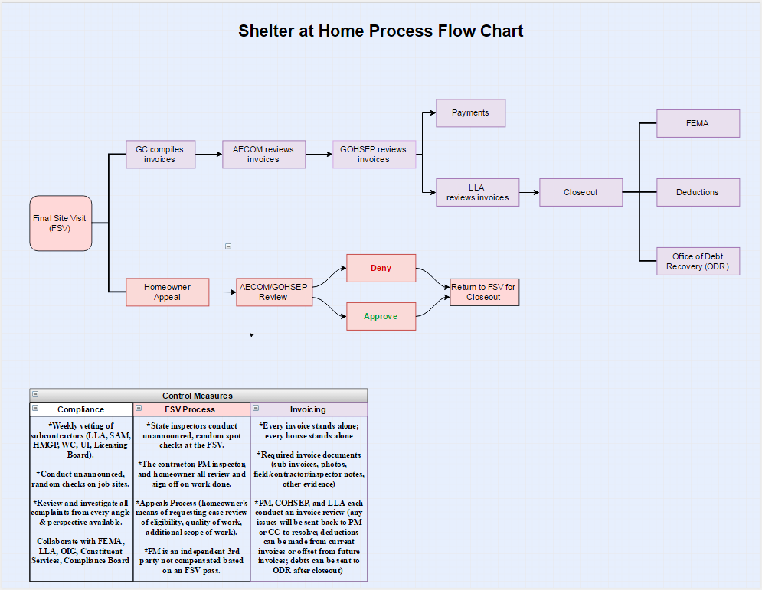
Louisiana Shelter at Home Quality Control Process
Notes:
KIMBERLY Now…we move on to the massive recovery process currently underway.
Shelter at Home is something we helped develop with the Governor and FEMA. The program is meant to fill the void between the emergency sheltering phase and the long term housing programs tied to Congressional aid.
Temporary repairs were made to nearly 11-thousand homes…in order to make them safe and habitable while the homeowner determines their course of action for permanent repairs.
Direct payments to homeowners were not allowed under the Federal regulations.
The goal was to keep our communities and neighborhoods whole during this long recovery process.
Limitations from the Feds did not allow us to include items like sheetrock and other permanent repairs. This program was developed and executed within days of the flood.
It is much more efficient and cost effective than some of the other temporary housing programs…plus it actually includes steps to make the homeowner complete.

Slide 36
Lessons Learned From Previous STEP
FEMA and Louisiana restructured the Sheltering and Temporary Essential Power Pilot Program based on lessons learned from New York:
A $15,000 financial cap was placed on each home.
Program eligibility was limited to single family owner occupied residences (no commercial properties).
A specific scope of work for the RFP was developed in close coordination with FEMA legal in order to clearly identify temporary work vs. permanent work.
A multiple contract system was used by developing two separate RFPs: one for a Program Manager and one for Repair Contractors. This allowed the State to manage repair contractors directly, and allowed the Program Manager to oversee work, conduct inspections, and determine eligibility without a financial benefit (or detriment) regarding construction work.
PROGRAM APPLICATION METHODS
Notes:
KIMBERLY: Now…we move on to the massive recovery process currently underway.
Shelter at Home is something we helped develop with the Governor and FEMA. The program is meant to fill the void between the emergency sheltering phase and the long term housing programs tied to Congressional aid.
Temporary repairs were made to nearly 11-thousand homes…in order to make them safe and habitable while the homeowner determines their course of action for permanent repairs.
Direct payments to homeowners were not allowed under the Federal regulations.
The goal was to keep our communities and neighborhoods whole during this long recovery process.
Limitations from the Feds did not allow us to include items like sheetrock and other permanent repairs. This program was developed and executed within days of the flood.
It is much more efficient and cost effective than some of the other temporary housing programs…plus it actually includes steps to make the homeowner complete.

Slide 37

Shelter At Home: Contracting Best Practices
Financial Cap
  $15k per home
Line item pricing
Temporary vs. Permanent Work
  Developed scope of work for RFP
Multi-Contract System
  Develop (2) separate RFP’s
    Program Manager
    Repair Contractors
Notes:
DANIELLE -Putting a financial cap on each home. $15k per home, including $500 toward appliances, but not including a $1500 general conditions (total cap $16500 per home).
-Identifying temporary work vs permanent work by developing a specific scope of work for the RFP in close coordination with FEMA legal.
-Used a multiple contract system by developing two separate RFPs: one for a Program Manager and one for Repair Contractors. This allows the State to manage repair contractors directly and control invoicing, scope of work, and oversee quality. It also allowed the Program Manager to oversee work and conduct inspections and determine eligibility without a financial benefit (or detriment) regarding construction work.
- Negotiated the General Conditions separate from the cap

Slide 38
Shelter At Home
State of LA
New York
Shelter at Home
OIG
FEMA
BEST PRACTICES
Financial Cap
Temp vs. Perm work
Multi-Contract System
Hiring Contractors
Hiring Employees
Notes:
DANIELLE :
Our State (several different agencies) worked with FEMA, OIG, and our counterparts in New York that managed the Rapid Repair Program, to implement only the best practices to make this program a success.

Slide 39
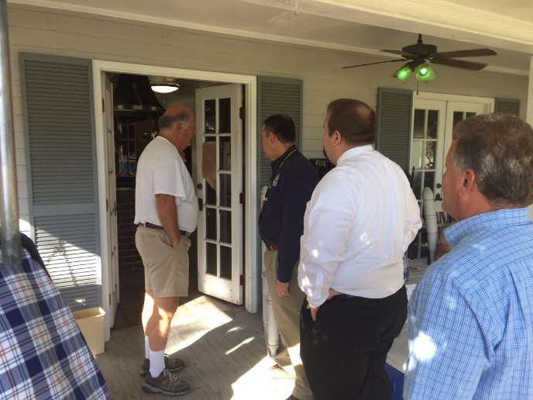
Shelter At Home: Best Practices
Hiring a Pool of Repair Contractors
  Re-assignment of contractors
  Re-assignment of homes
  Competitive Work
Hiring and Embedding State Employees
  Ensure compliance and oversight
Notes:
DANIELLE
-Hiring a Pool of Repair Contractors. Our repair contracts allowed the State to do contractor re-assignment based on productivity and complaints. This also allowed the State to re-assign homes individually if homeowners had unresolvable differences with a particular contractor. It also kept the work competitive- contractors knew they could easily be replaced by others if they failed to produce quick and quality work.
-Hiring and embedding State Employees into the process to ensure compliance and oversight.
Recommendations for the future: Pre-contract to drive down prices and prepare outreach
Picture of the Director of GOHSEP doing random unannounced inspections of contractors while working… The Governor also did the same.

Slide 40
Areas for Improvement
While the State was successful in expanding the program in a few areas (including appliances, the inclusion of mobile homes, and an increase in the cap for Access and Functional Needs homes), there were issues in which the State lost its requests to expand SAH.
The State asked FEMA to add additional protective measures, such as sheetrock. This request also included a request to raise the $15,000 cap to $22,000 and include all eligible homes. The request to expand was denied by FEMA.
Moving forward, the SAH program should not be limited to temporary work, and should include a disaster and locale specific cap.
PROGRAM APPLICATION METHODS
Notes:
Now…we move on to the massive recovery process currently underway.
Shelter at Home is something we helped develop with the Governor and FEMA. The program is meant to fill the void between the emergency sheltering phase and the long term housing programs tied to Congressional aid.
Temporary repairs were made to nearly 11-thousand homes…in order to make them safe and habitable while the homeowner determines their course of action for permanent repairs.
Direct payments to homeowners were not allowed under the Federal regulations.
The goal was to keep our communities and neighborhoods whole during this long recovery process.
Limitations from the Feds did not allow us to include items like sheetrock and other permanent repairs. This program was developed and executed within days of the flood.
It is much more efficient and cost effective than some of the other temporary housing programs…plus it actually includes steps to make the homeowner complete.

Slide 41
Solutions for the Future
Shelter at Home bridged the gap between emergency sheltering needs and long-term recovery by creating a program that does not currently exist within the confines of the Stafford Act or subsequent Federal Regulations.
Moving forward, the SAH program should not be limited to temporary work, and should include a disaster and locale specific cap.
The Duplication of Benefits language in 42 U.S.C. § 5155 needs to be changed to allow interim housing solutions (such as SAH) to maintain some flexibility in order to meet the specific needs of the disaster and the local community.
This “pilot program” must also be codified into 44 CFR in order for all States to implement a pre-disaster plan and contract to ensure better prices and a better response.
In the alternative, other interim housing solution concepts are:
A block grant to the state
A state managed program that issues non-transferable vouchers to homeowners for home improvements or mobile home / camper trailers.
PROGRAM APPLICATION METHODS
Notes:
Now…we move on to the massive recovery process currently underway.
Shelter at Home is something we helped develop with the Governor and FEMA. The program is meant to fill the void between the emergency sheltering phase and the long term housing programs tied to Congressional aid.
Temporary repairs were made to nearly 11-thousand homes…in order to make them safe and habitable while the homeowner determines their course of action for permanent repairs.
Direct payments to homeowners were not allowed under the Federal regulations.
The goal was to keep our communities and neighborhoods whole during this long recovery process.
Limitations from the Feds did not allow us to include items like sheetrock and other permanent repairs. This program was developed and executed within days of the flood.
It is much more efficient and cost effective than some of the other temporary housing programs…plus it actually includes steps to make the homeowner complete.

Slide 42
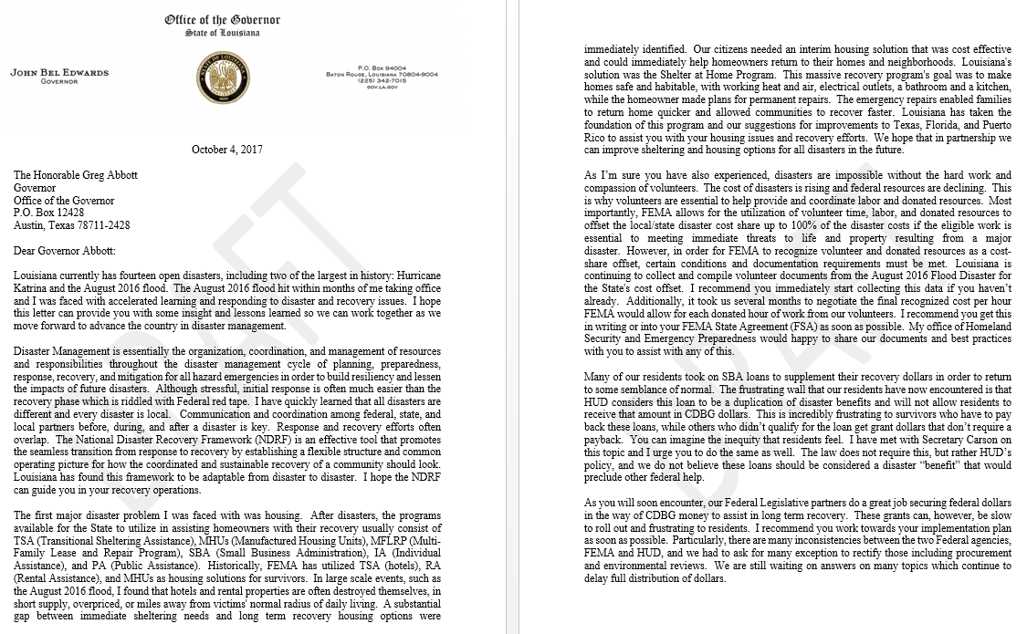
Sharing SAH with Texas, Florida, Puerto Rico, and the Virgin Islands

Slide 43

SAH Project Worksheet (PW)

Slide 44
Questions

Slide 45


