Slide 1
Benefit Cost Analysis (BCA)

Slide 2
Basics
What is it?
Why is it important?
Understanding BCA fundamentals.

Slide 3
What is a BCA?
A methodology to compare the value of the lifetime benefits of a project to the cost of the project.

Slide 4

Why is it important?
BCA is a way of determining if funding a project is a wise use of taxpayers’

Slide 5
BCA fundamentals
Start early in the project evaluation process.
Every BCA needs to be credible and defensible to FEMA.

Slide 6
6 things to remember
Before-mitigation vs. after-mitigation conditions.
Benefits = avoided future damages.
Damages reduced after mitigation = benefits to count.

Slide 7
6 things to remember (Continued . . . )
Benefits (avoided future damages in dollar value) > costs = cost-effective.
Some mitigation projects are more cost-effective than others.
Benefit Cost Ratio (BCR) is used to compare cost-effectiveness.

Slide 8
Benefit cost ratio (BCR)
A project is cost-effective if:
Project Benefit (in $$$)
  Total Project Cost
≥
1

Slide 9
Project costs
Costs should be . . .
  Appropriate for the project.
  In present-day dollars.
  Well documented + from a credible source.
Project costs occur up front and are determined by cost estimates.

Slide 10

What is a benefit?
A benefit is an avoided loss.
Damages are reduced or eliminated due to the project.
Consistent approach to determine value of avoided loss.

Slide 11
What is a benefit? (Continued . . . )
Benefits have historically considered the value of avoided loss expressed in $$$:
Damages to buildings + contents + infrastructure.
Deaths + injuries in certain circumstances.
Loss of function for economic impacts.

Slide 12
What is a benefit? (Continued . . . )
Deaths + injuries
When they are a primary impact of disasters: Earthquakes + tornadoes.
Do not count except for flash floods or dam/levee failures.
Benefits of reducing casualties are always counted for safe room projects.

Slide 13
Benefits count (Continued . . . )
FEMA uses statistical values of:
  $5.8 – $6.6 million per person for deaths.
  $1.08 million for major injuries.
  $90 thousand for minor injuries.

Slide 14
What is a benefit? (Continued . . . )
Loss of function
Non-residential
Occurs when a government facility, road, utility or business is interrupted by a natural hazard event.
Usually the largest single benefit for projects that protect buildings or infrastructure.
Often overlooked by analysts.

Slide 15
What is a benefit? (Continued . . . )
Loss of function
Examples (as a result of a hazard):
Damage to a hospital’s electrical or gas connections.
Road washing out.
EOC losing the roof.
Utility line breaking.

Slide 16
What is a benefit? (Continued . . . )
Loss of function
Residential
For residential buildings, a loss of function impact results in a “displacement” to temporary quarters and includes:
  Temporary rental costs.
  Other monthly costs.
  One-time costs.
  Per diem.

Slide 17

What is a benefit? (Continued . . . )
NEW considerations
$$$ Value of benefits to society
Mental stress + anxiety:
  Treatment cost $2,443 per person.
  Lost productivity cost:
    $8,743 per worker.

Slide 18
What is a benefit? (Continued . . . )
NEW considerations
$$$ Value of volunteer labor
Based of prevailing labor rate per State.
  Louisiana = $22.13 per hour.
Per diem + lodging can be included.

Slide 19
Concept of risk
“Risk” is a simple term for the monetary value of future damages.
  Based on vulnerability + frequency.
Risk is the single most important concept in mitigation planning + BCAs.

Slide 20
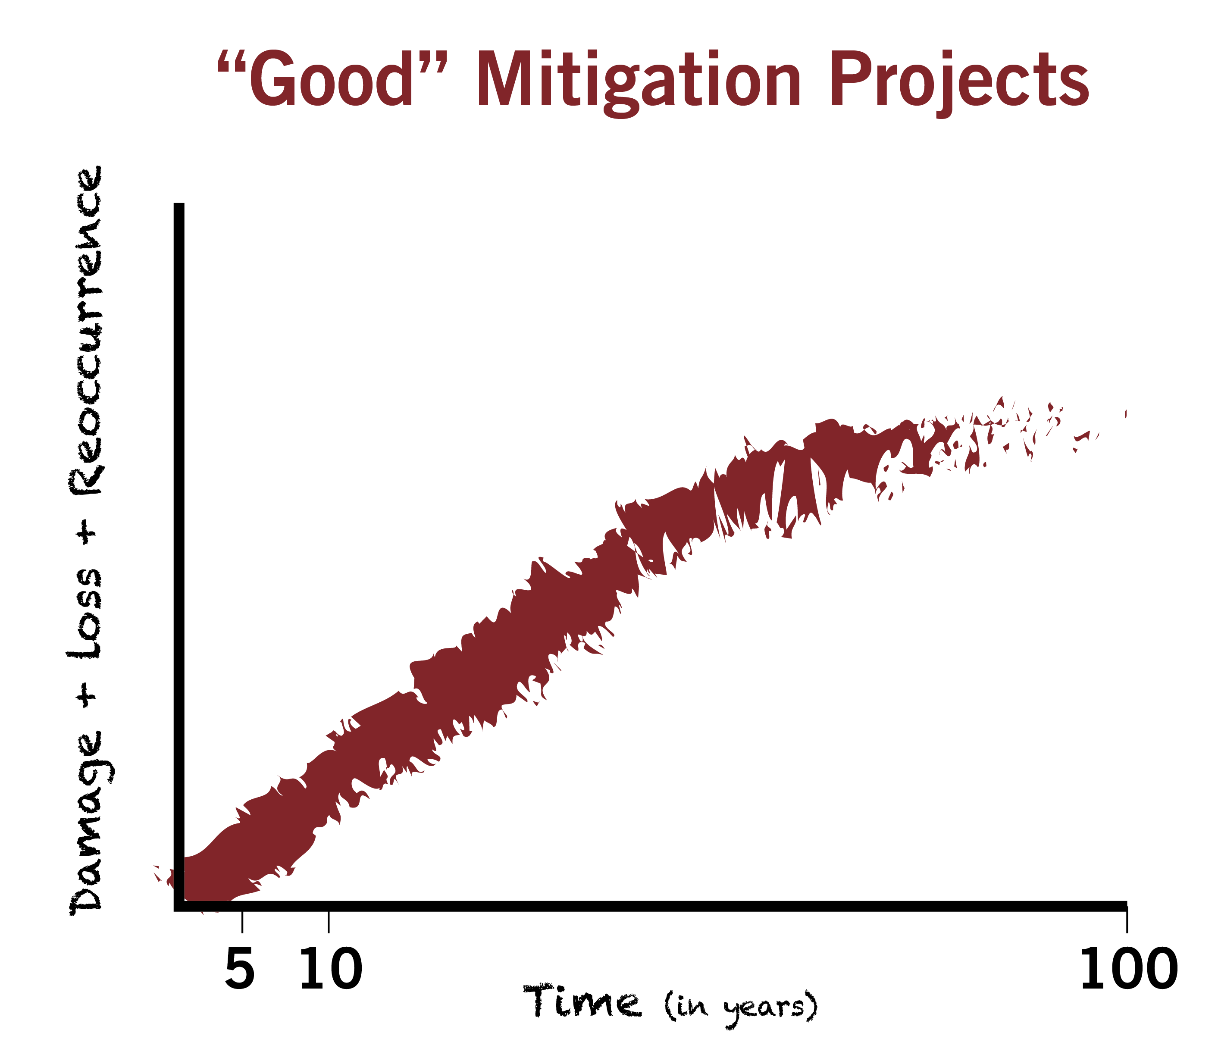

Slide 21
Is it worth $1 million to protect . . .
Probably | Probably Not
1 doghouse or 1 outhouse?
1 house that floods infrequently?
A flood-prone hospital + city hall + school + other important buildings?
150 flood-prone houses?

Slide 22
Frequency
All reoccurring events can be assigned a frequency.

Slide 23
Frequency + severity
100-year flood = 510’
10-year flood = 502’
FFE = 500’

Slide 24
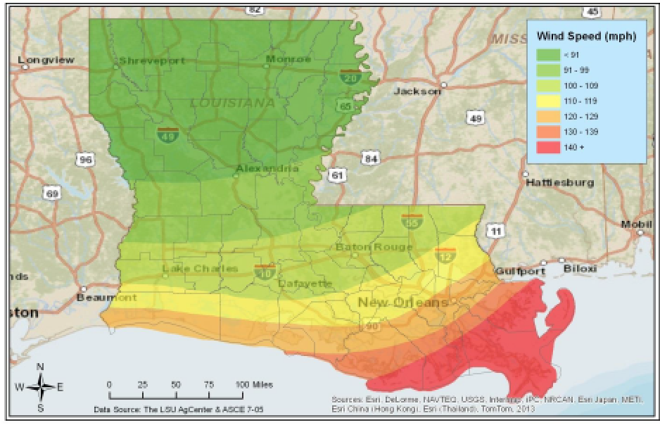
Frequency + severity (Continued . . . )

Slide 25
Documentation
Document! Document! Document!
It is important to track + record + include in the application:
  Data sources
  Dates
  Assumptions
  Analysis procedures

Slide 26
Documentation (Continued . . . )
Data Documentation Template (DDT).
Acceptable forms of documentation:
  Project Useful Life
  Loss of Function
  Frequency
  Building Replacement
  Values

Slide 27
Damage frequency assessment
Calculated using either:
  Various FEMA BCA full data modules OR . . .
    Use if you have specific data.
  Damage-Frequency Assessment module.
    Use if you have to estimate.

Slide 28
BCA modules
Damage-Frequency Assessment
  Formerly known as Limited Data module.
  Requires detailed documentation.
  Full explanation of damage scenarios before- and after-mitigation.

Slide 29
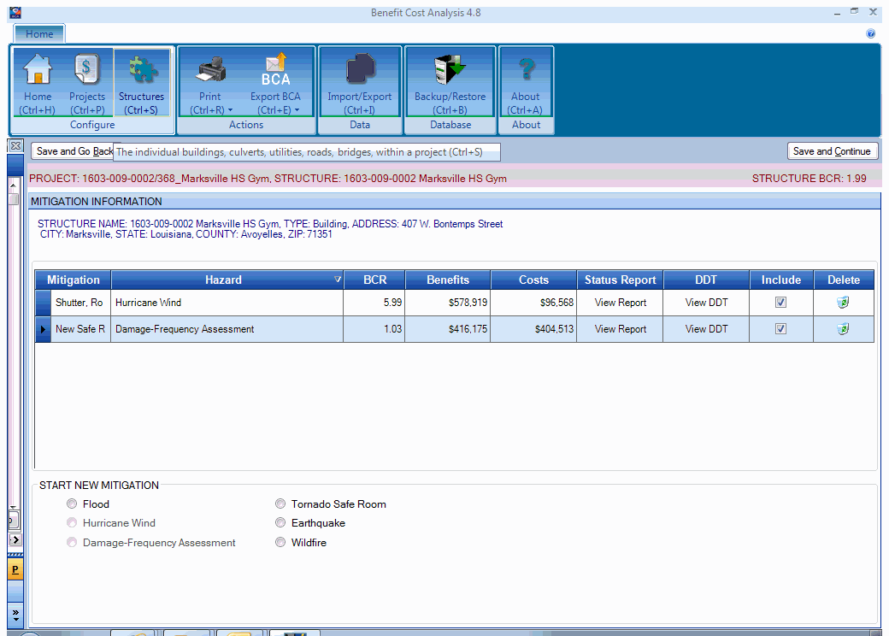
Add image of modules

Slide 30
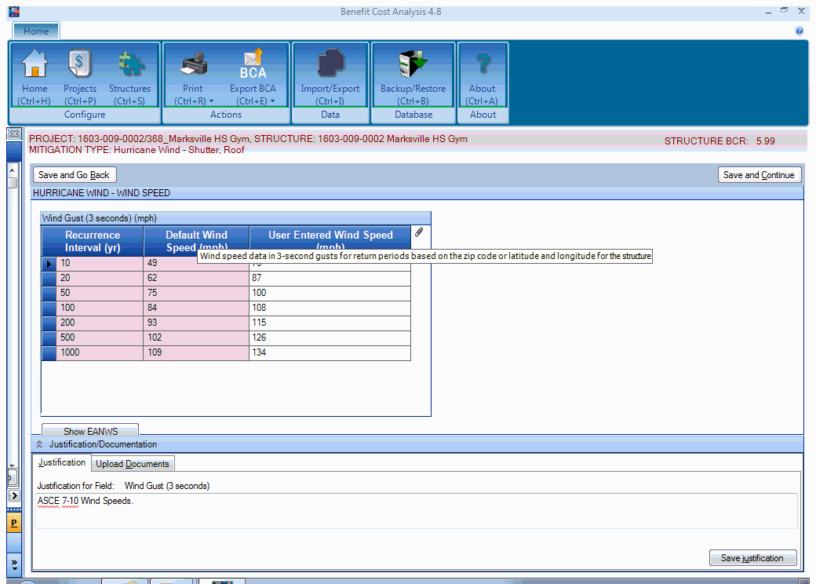

Slide 31
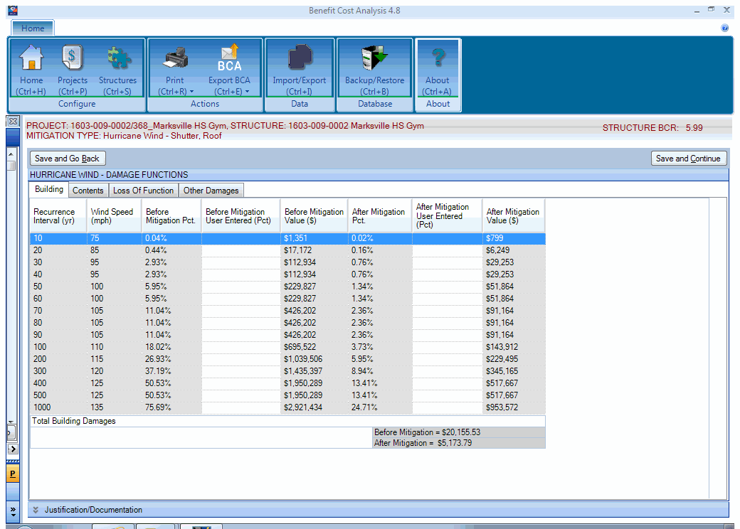

Slide 32
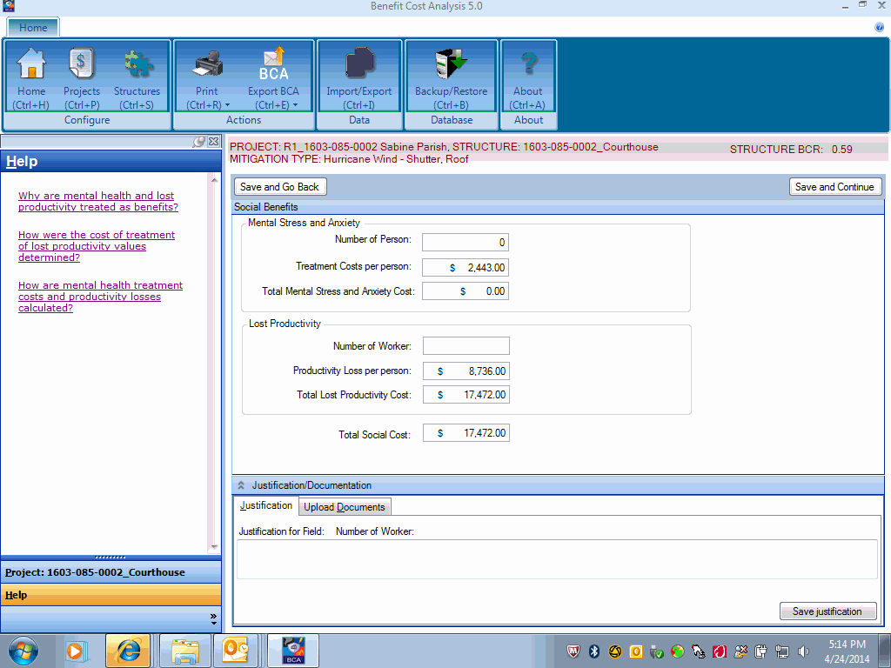

Slide 33
BCA full data modules
FEMA has BCA modules for various hazards:
  Two (2) for riverine flooding.
  One (1) for coastal A-zone flooding.
  One (1) for coastal V-zone flooding.
  Two (2) for earthquakes.
  One (1) for tornado/hurricane shelters.
  One (1) for hurricane wind.
  One (1) for wildfire/urban fires.

Slide 34
FEMA BCA 5.0 module
Most recent release.
Incorporates several hazard modules.
Provides guidance or help button.
Wind Speed Data.
Wind Damage Functions.
Flood Damage Functions.
Upload Capability.

Slide 35
For more information
Benefit Cost Analysis Toolkit version 5.0
https://www.fema.gov/media-library/ assets/documents/92923
1-855-540-6744
www.bchelpline.com

Slide 36
2 keys to BCA success . . .
Start early in the project evaluation process and provide reasonable and defensible data.
Ensure that someone other than the original BCA analyst can easily verify and re-create the data inputs and conclusions of the BCA.

Slide 37
Questions?

Slide 38
For more information + to download materials from today’s seminar:
gohsep.la.gov/outreach.aspx

