Slide 1
L.W.I.N.
Louisiana Wireless
Information Network
System Management & Maintenance July 31, 2024
Department of Public Safety
Office of State Police
Mobility and Communication Services
(225) 925-6036

Slide 2

Infrastructure Update

Slide 3
SYSTEM SUMMARY
149* Total Tower Sites in Operation
6 Operational Mobile Sites

Slide 4
Zone 1:
42 Sites in Full Operation
Pan Am
Bridge City
Livonia
Laplace
St. Tammany Simulcast
Lacombe
Abita Springs
Waldheim
Pearl River
Covington
Slidell
Talisheek
Blond
Sheridan
Geismar
St. James
Larose
Gibson
BR Simulcast
BR
Central
LSU
WBR
Hammond
Gray
Berwick
Baywood
Ramah
Sage Hill
Parker Road
Iberville
Livingston
Jackson
Greensburg
Superdome
South Baton Rouge
Baldwin
Pointe Coupee
Theriot
Paincourtville
Boothville
Mobile Units
94
96
97
98
99
100
Denham Springs
Clinton
St. George

Slide 5
Zone 2:
18 Sites in Full Operation
N. Simulcast
Gretna
Galleria
NO East
Houma
Lafitte
Bayou Gauche
Hahnville
St. Rosalie
Kenner
Airport
Port Fourchon
Reggio
Montegut
Bourg
Buras
Wilmer
Grand Isle
Thibodeaux

Slide 6
Zone 3:
55 Sites in Full Operation
Clearwater
Monroe
Winnfield
Delhi
Chopin
Dry Prong
Hagewood
Bossier(City)
Farmerville
Minden
Natchitoches
Bastrop
Greenwood
Ruston
Hineston
Ashland
Vivian
Newellton
Noble
Transylvania
Alexandria
Avoyelles
Bellevue
Bernice
Calhoun
Columbia
Ferriday
Homer
Jena
Jonesboro
Mansfield
Many
Marion
Oak Grove
Plain Dealing
Ringgold
Sentell
Tallulah
Wheeling
Shreveport
West Monroe
Chase
Keachi
Coushatta
Shongaloo
Sibley
Vick
Calvin
Arcadia
Enterprise
Holloway
Chatham
Cypress
Logansport
Pelican

Slide 7
Zone 4:
34 Sites in Full Operation
Abbeville
Acadia
Arsene LeBleu
DeQuincy
Dry Creek
Jeanerette
Jennings
Johnson Bayou
Lafayette
Lake Charles
Leesville
Merryville
Opelousas
Parks
Rockefeller
Rosepine
Scott
Sulphur
Vermillion
Ville Platte
Vinton
Craven
Hicks
Hornbeck
Oakdale
Roseland
E. Jennings
Anacoco
Oberlin
Moss Bluff
New Iberia
Eunice
Starks
Bell City

Slide 8
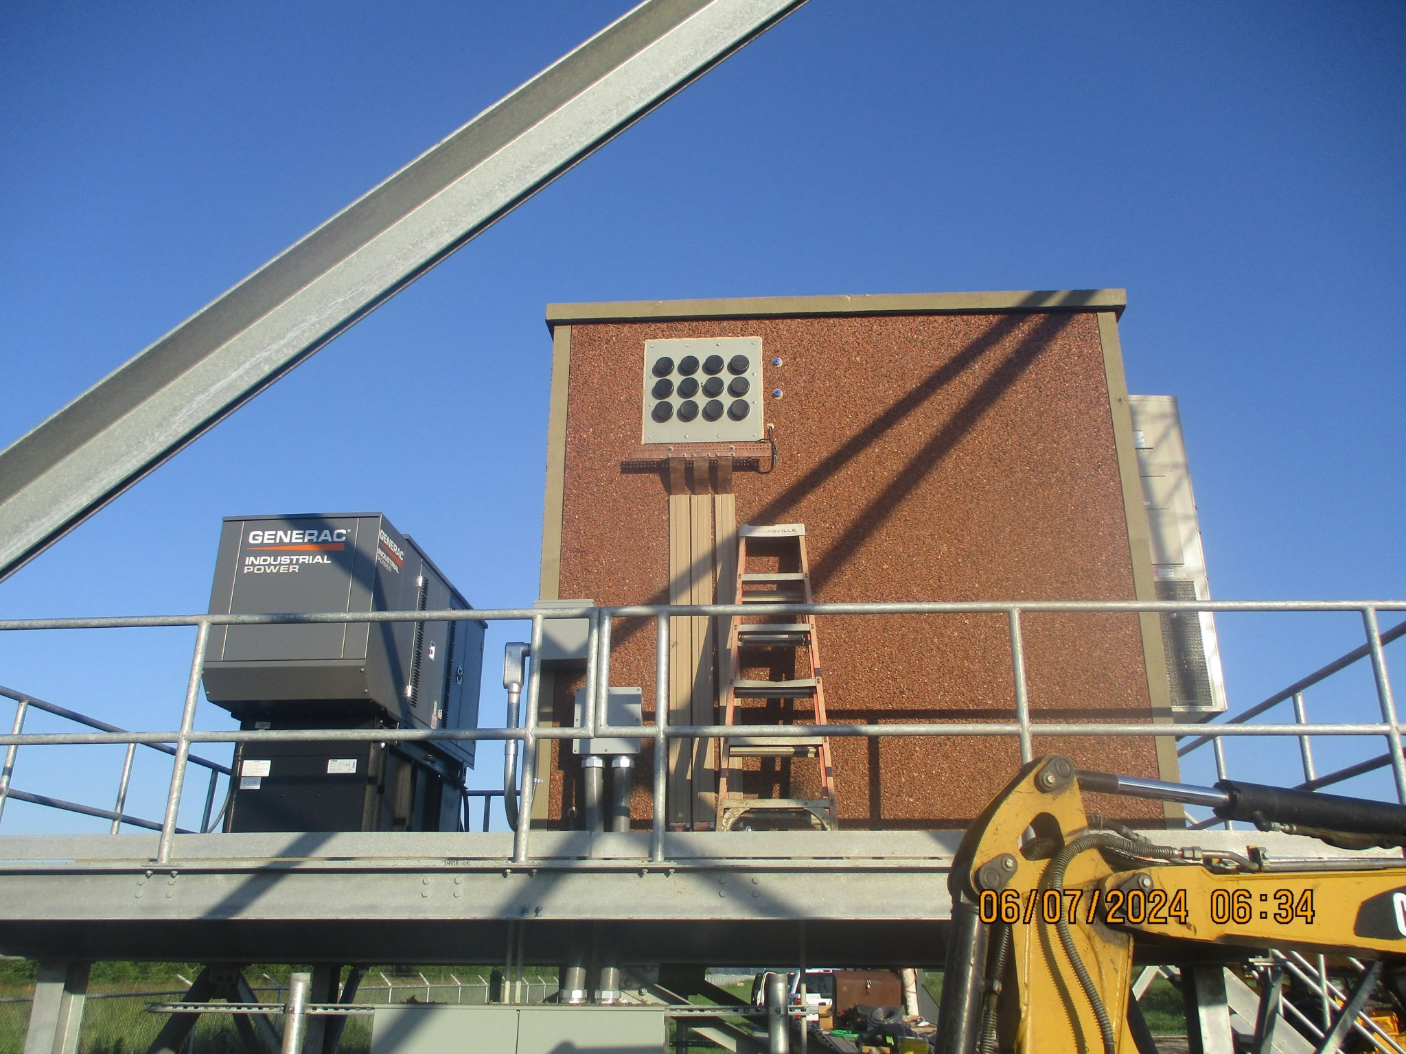
New Thibodeaux Site Building

Slide 9
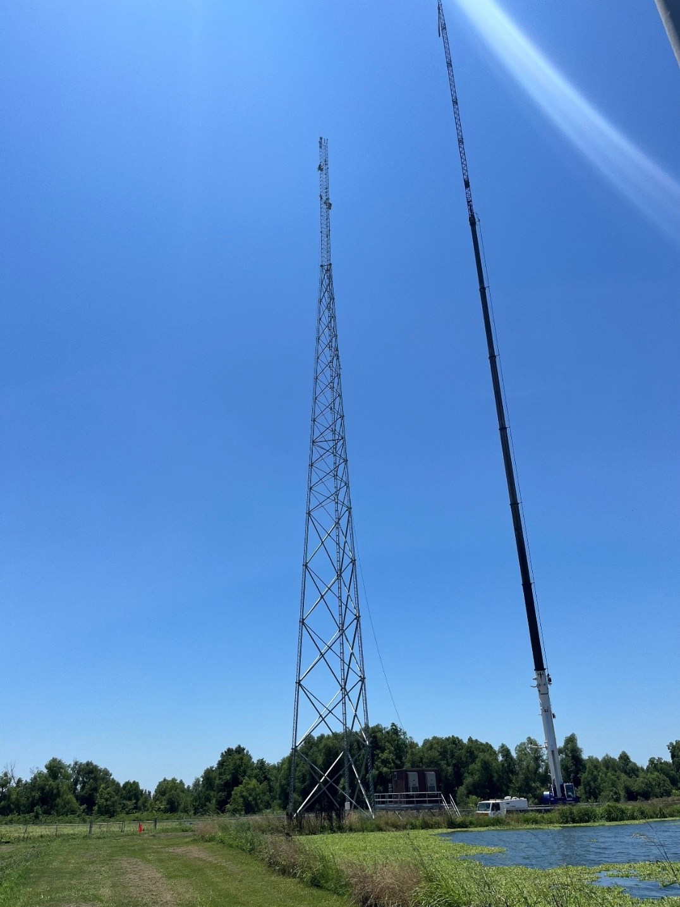
New Thibodeaux Tower

Slide 10
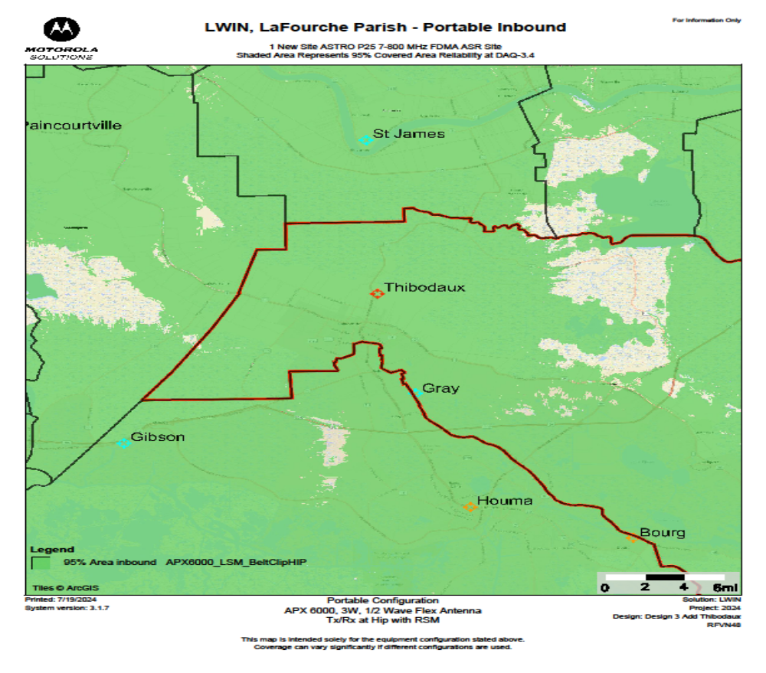
New Thibodeaux Tower-INBOUND Coverage

Slide 11
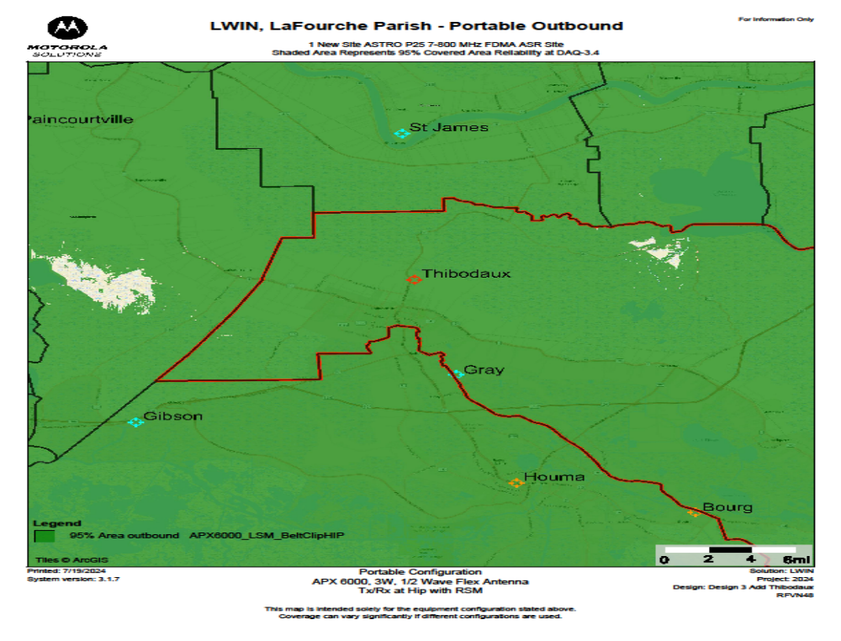
New Thibodeaux Tower-OUTBOUND Coverage

Slide 12
Channel Summary
Total Channels 1343
1292 Channels on 149 Sites
51 Channels on 6 Mobile Sites

Slide 13
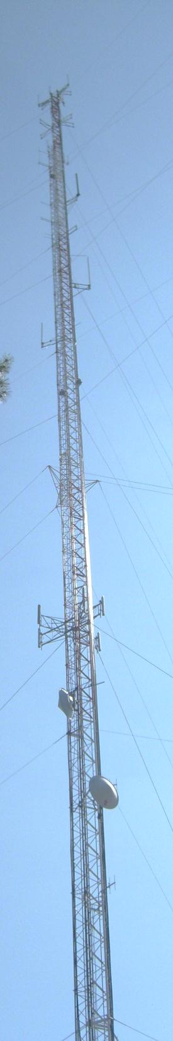
System
Statistics

Slide 14
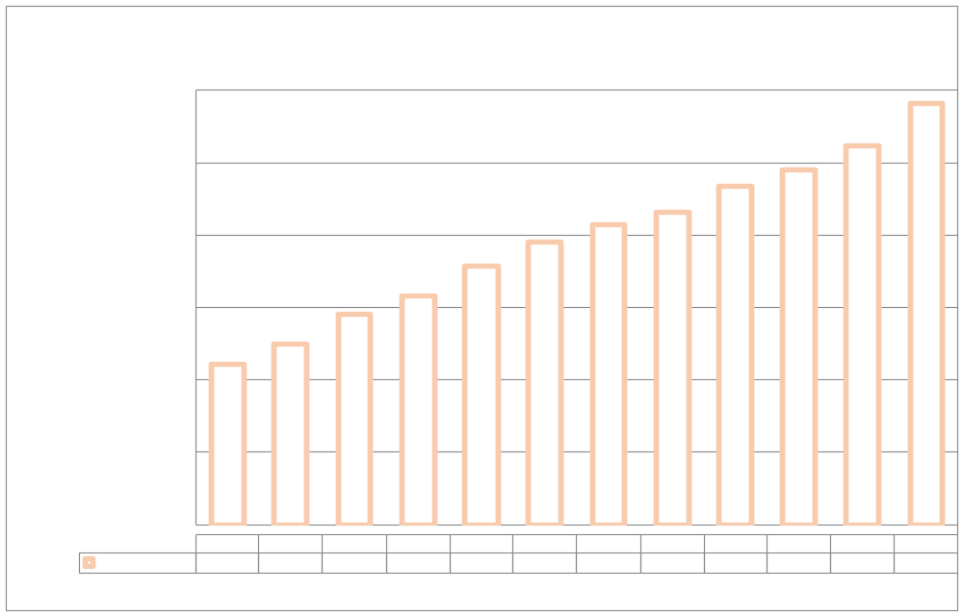
SUBSCRIBERS

Slide 15
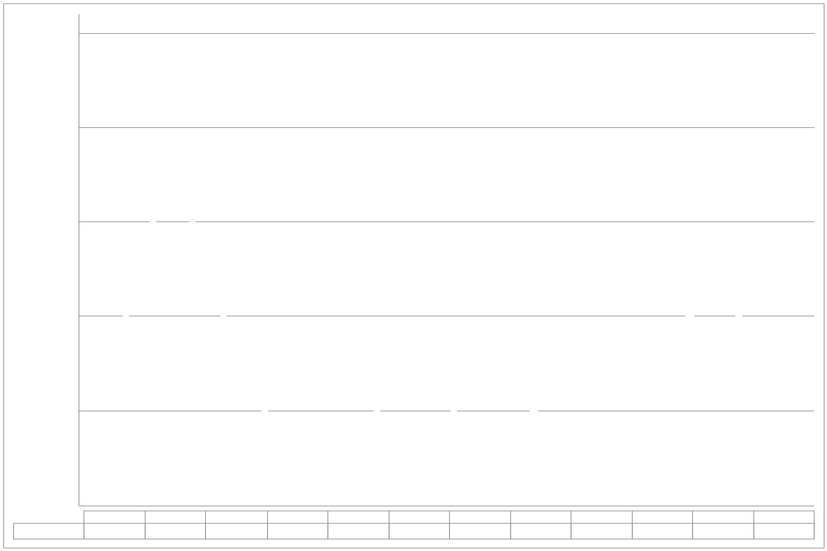
PUSH TO TALK

Slide 16
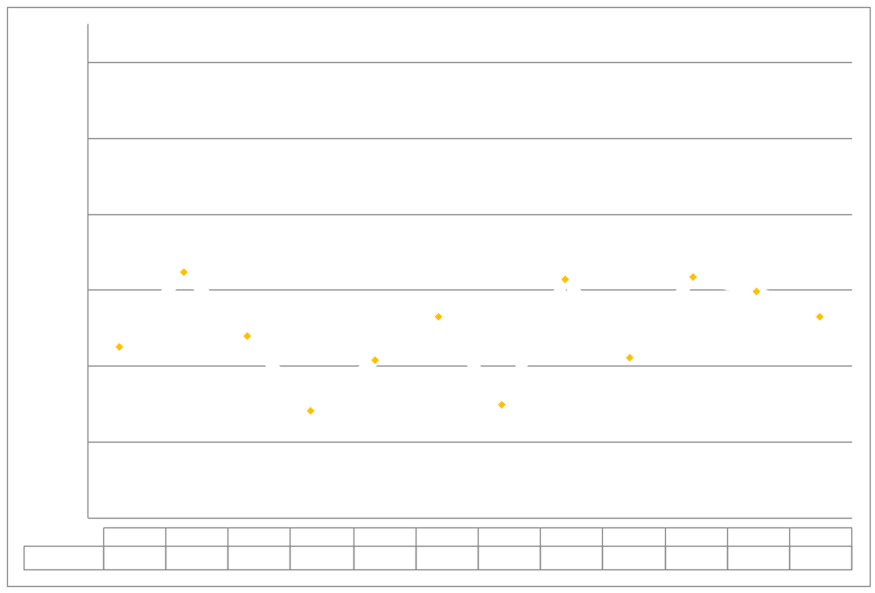
PUSH TO TALK PER DAY

Slide 17
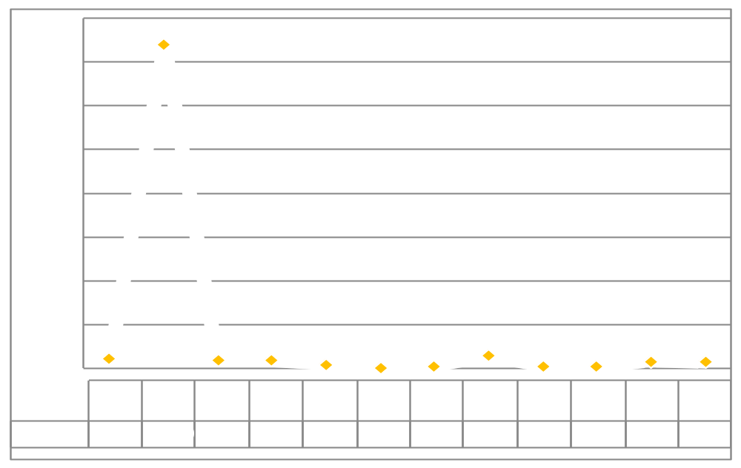
BUSIES

Slide 18

Top Busy Sites
Opelousas 89
Calhoun 57
Moss Bluff 54

Slide 19
SITE OUTAGES
Airport | Alexandria | Arcadia | Arsene Lebleu | Ashland
Avoyelles | Bayou Gauche | Baywood | Bellevue | Berwick
Boothville | Buras | Calhoun | Calvin | Chase
Chopin | Clearwater | Clinton | Coushatta | Cravens
Delhi | Denham Springs | Dequincy | Drycreek | Enterprise
Farmerville | Ferriday | Greensburg | Hagewood | Hicks
Hineston | Holloway | Homer | Iberville | Jackson
Jeanerette | Jena | Jennings | Johnson Bayou | Keachi
Total Downtime: 2632 Hours

Slide 20
SITE OUTAGES
Laplace | Leesville | Livingston | Livonia | Mansfield
Many | Marion | Merryville | Minden | Moss Bluff
Noble | Oak Grove | Oberlin | Opelousas | Paincourtville
Parker Road | Port Fouchon | Ramah | Reggio | Ringgold
Rockefeller | Roseland | Sentel | Shreveport | Sibley
St. George | St. James | Tallulah | Theriot | Trailer 98
Trailer 99 | Trailer 100 | Transylvania | Vermillion | Ville Platte
Vinton | West Monroe | Wheeling | Wilmer
Total Downtime: 2632 Hours

Slide 21
SITE OUTAGE DATA
69%

Slide 22
SYSTEM STATISTICS

Slide 23
Subscriber Statistics
Security Groups
192
Agencies
612
Talkgroups
6,546

Slide 24

Agencies Added Last 3 Months
Louisiana capitol security.

Slide 25
System Coverage

Slide 26
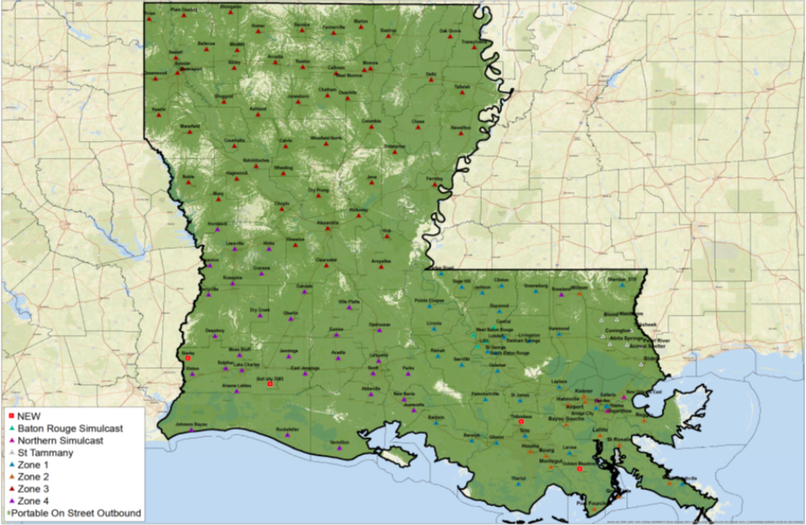
Present Coverage

Slide 27
Questions?

Slide 28
Ethernet Update

Slide 29
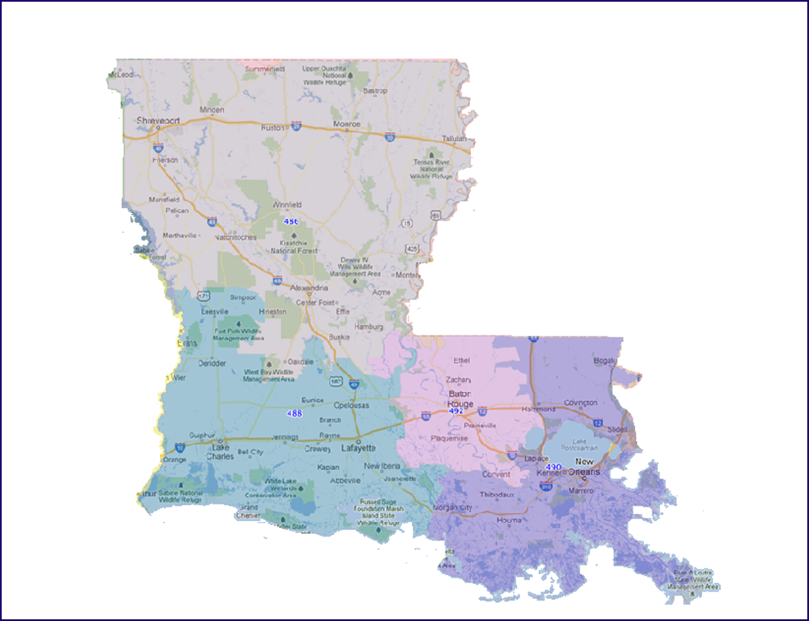
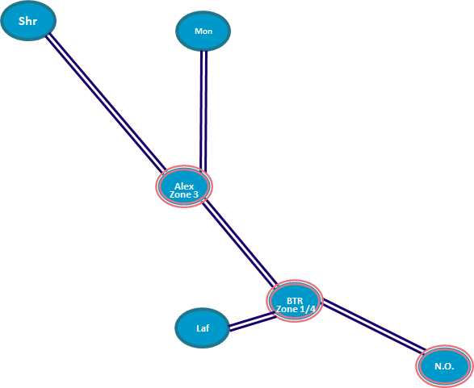
Existing Network

Slide 30
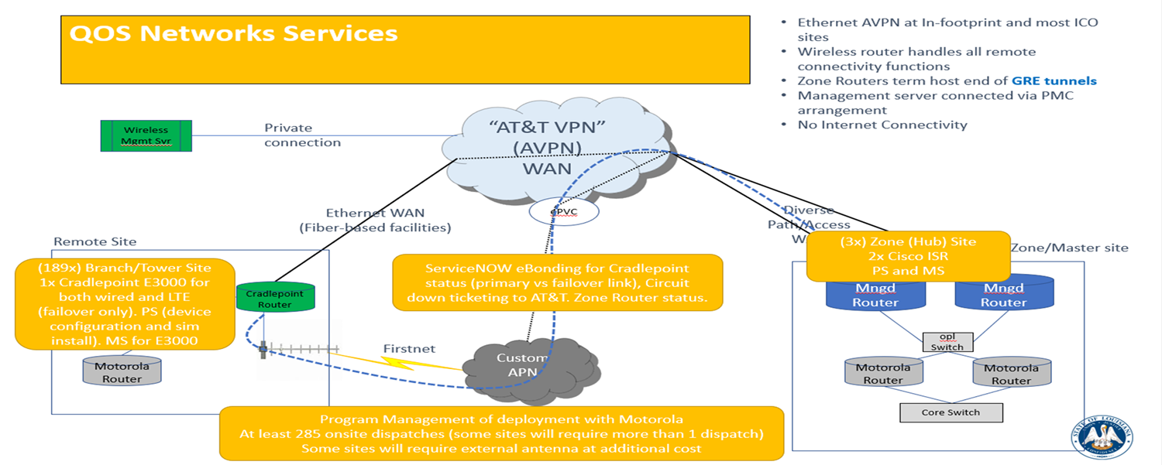
New LWIN Network

Slide 31
Completed Sites
Deployment Status Schedule
Deployment Date(s) | Phase | Site | Progress | Zayo Status | Motorola Cutover Completed | Cradlepoint Installed | Antenna Installed
5/10/2023 | HUB | Zone 1 - Baton Rouge | 100% | Complete | Yes | N/A | N/A
6/1/2023 | HUB | Zone 2 - Gretna | 100% | Complete | Yes | N/A | N/A
5/30/2023 | HUB | Zone 3 - Alexandria | 100% | Complete | Yes | N/A | N/A
5/11/2023 | HUB | Zone 4 - Baton Rouge | 100% | Complete | Yes | N/A | N/A
7/21/2023 | Pilot | Denham Springs | 100% | Complete | Yes | Yes | Yes
10/27/2023 | Pilot | Baywood | 100% | Complete | Yes | Yes | Yes
11/2/2023 | Pilot | Jackson | 100% | Complete | Yes | Yes | Yes
02/26/24 and 02/29/24 | Deployment | Sage Hill - Tower | 100% | Complete | Yes | Yes | Yes
02/28/24 and 03/15/24 | Deployment | Eunice - Tower | 100% | Complete | Yes | Yes | Yes
3/12/2024 | Deployment | Kenner Dispatch - Console | 100% | Complete | Yes | Yes | Yes
2/26/2024 | Deployment | Vernon EOP - Console (CP Only) | 100% | Complete | Yes | Yes | No - No Antenna Needed
03/05/24 and 04/02/24 | Deployment | Delhi - Tower | 100% | Complete | Yes | Yes | Yes
4/30/2024 | Deployment | Ponchatoula PD (Console) | 100% | Complete | Yes | Yes | Yes
03/05/24 | Deployment | LWIN - TRANSYLVANIA (MON) - Tower | 100% | Complete | Yes | Yes | Yes
03/07/24 03/26/24 | Deployment | LWIN - SENTELL (Tower) | 100% | Complete | Yes | Yes | Yes
03/26/24 | Deployment | LWIN - SIBLEY (SHRV) - Tower | 100% | Complete | Yes | Yes
03/27/24 | Deployment | LWIN - NEW IBERIA - Tower | 100% | Complete | Yes | Yes | Yes
03/27/24 | Deployment | LWIN - NEW IBERIA - Console | 100% | Complete | Yes | Yes
04/02/24 | Deployment | LWIN - MANY (PTP) - Tower | 100% | Complete | Yes | Yes | Yes
06/11/24 | Deployment | LWIN - Troop I - Console | 100% | Complete | Yes | Yes | No - No Antenna Needed
06/11/24 | Deployment | LWIN - VICK - Tower | 100% | Complete | Yes | Yes | No - No Antenna Needed

Slide 32
Completed Sites
Deployment Status Schedule
Deployment Date(s) | Phase | Site | Progress | Zayo Status | Motorola Cutover Completed | Cradlepoint Installed | Antenna Installed
06/12/24 | Deployment | LWIN - POINTE COUPEE SO - Tower | 100% | Complete | No Need to confirm if a circuit is in place at the tower and console site in order to proceed with the migration. | Yes | No - No Antenna Needed
06/13/24 | Deployment | LWIN - HAGEWOOD (PTP) - Tower | 100% | Complete | Yes | Yes | Yes
06/13/24 | Deployment | LWIN GREENWOOD (SHRV) - Tower | 100% | Complete | Yes | Yes | No - No Antenna Needed
02/28/24 | Deployment | LWIN - St. Landry Sheriff Office (Console) | 100% | Complete | Yes | Yes | Yes
06/18/24 | Deployment | LWIN - HICKS (PTP DHDC) - Tower | 100% | Complete | Yes | Yes | Yes
06/18/24 | Deployment | LWIN - Jefferson Davis SO - Console | 100% | Complete | Yes | Yes | No - No Antenna Needed
06/20/24 | Deployment | LWIN - CALHOUN (MON) - Tower | 100% | Complete | Yes | Yes | Yes
06/20/24 | Deployment | LWIN - ARCADIA (SHRV) - Tower | 100% | Complete | Yes | Yes | No - No Antenna Needed
07/02/24 | Deployment | WEST MONROE (MON) - Tower | 100% | Complete | Completed on Fiber - #INC1312656 | Yes | No
07/02/24 | Deployment | LWIN - BERNICE (MON) - Tower | 100% | Complete | Yes | Yes | Yes

Slide 33
Completed Sites
Deployment Status Schedule
Pending Motorola Cutover Date
06/25/24 | Deployment | LWIN - BELLEVUE (SHRV) - Tower | 100% | Complete | Yes | Yes | No
06/26/24 | Deployment | LWIN - PAINCOURTVILLE (NO) - Tower | 90% | Pending | Activation Scheduled on August 5 | Yes | No
07/09/24 | Deployment | LWIN - HORNBECK (PTP) - Tower | 50% | Pending | Yes | Yes | No
07/09/24 | Deployment | LWIN - NOBLE (SHRV) - Tower | 100% | Complete | Yes | Yes | No
07/10/24 | Deployment | LWIN - COUSHATTA (SHRV) - Tower | 100% | Complete | Yes | Yes | Yes
07/10/24 | Deployment | LWIN - KEACHI - Tower | 100% | Complete | Yes | Yes | Yes
07/11/24 | Deployment | LWIN - Union 911 - Console | 100% | Complete | Yes | Yes | No

Slide 34
Completed Sites
Deployment Status Schedule
Deployment Date(s) | Phase | Site | Progress | Status | Risks, Issues, Dependences or Concerns | Motorola Cutover Completed | Cradlepoint Installed | Antenna Installed | Alternate Antenna Solution Needed
TBD | Deployment | ST. James | 0% | On-Hold | ** CP SHIPPED TO ATT/BLAINE FOR TESTING PURPOSES. PENDING CIRCUIT DELIVERY CONFIRMATION AND ANTENNA INSTALLATION | No | No | No
TBD | Deployment | Troop E Dispatch - Console | 0% | On-Hold | ATT circuit released to the customer on 01/22/24, Zayo pending customer to advise when site will be ready to deploy. | No | No | No

Slide 35
BATCH 3 SITES AND SITE TYPES
TROOP I DISPATCH CONSOLE
POINTE COUPEE SO CONSOLE
JEFFERSON DAVIS SO CONSOLE
BERWICK TOWER
WINNFIELD TOWER
CHOPIN TOWER
HAGEWOOD TOWER
MINDEN TOWER
GREENWOOD TOWER
ASHLAND TOWER
NEWELLTON TOWER
BELLEVUE TOWER
CALHOUN TOWER
WHEELING TOWER
CALVIN TOWER
ARCADIA TOWER
HICKS/LEESVILLE TOWER
HORNNBECK TOWER
OAKDALE TOWER
ROSELAND TOWER

Slide 36
BATCH 4 SITES AND SITE TYPES
BOSSIER CITY PD CONSOLE
BOSSIER CITY FD CONSOLE
UNION PARISH 911 CONSOLE
TANGIPAHOA EOC TBD
POINTE COUPEE TOWER
MONROE TOWER
BOSSIER CITY TOWER
FARMERVILLE TOWER
BASTROP TOWER
VIVIAN TOWER
NOBLE TOWER
BERNICE TOWER
COLUMBIA TOWER
HOMER TOWER
JONESBORO TOWER
MANSFIELD TOWER
MARION TOWER
OAK GROVE TOWER
PLAIN DEALING TOWER
RINGGOLD TOWER
WEST MONROE TOWER
CHASE TOWER
COUSHATTA TOWER
SHONGALOO TOWER
CHATHAM TOWER
KEACHI TOWER

Slide 37
Thank You!

Slide 38
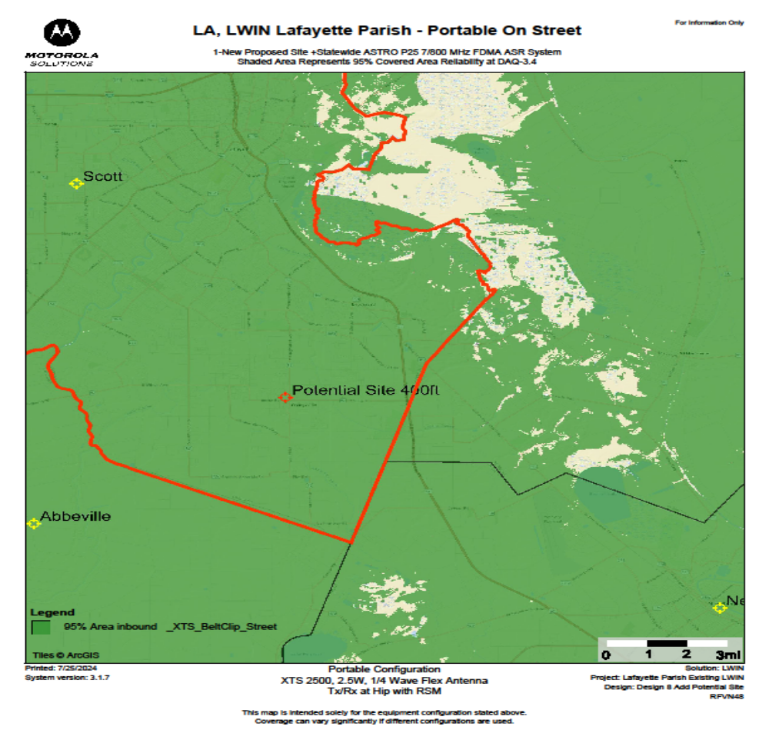
Lafayette Parish LWIN Coverage

Slide 39
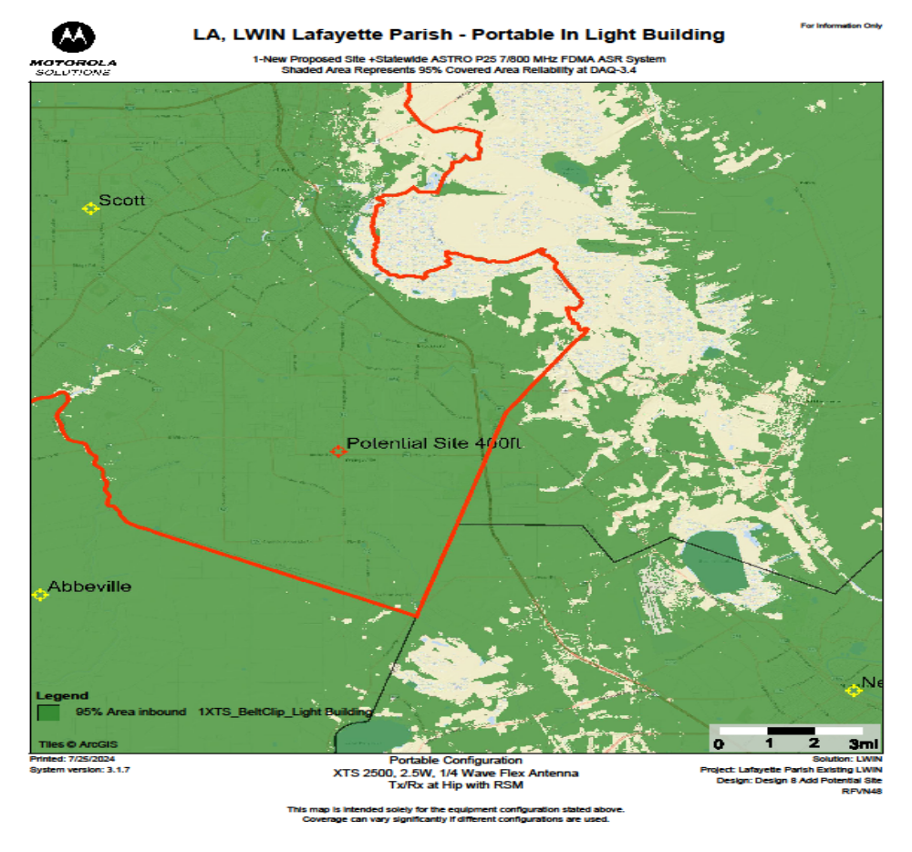
Lafayette Parish

Slide 40
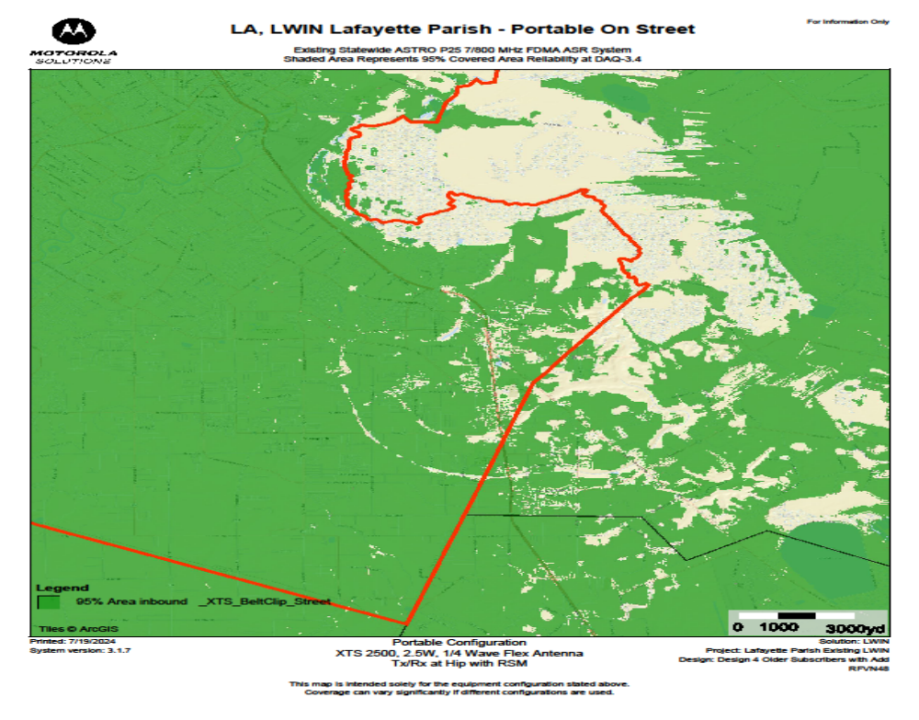

Slide 41
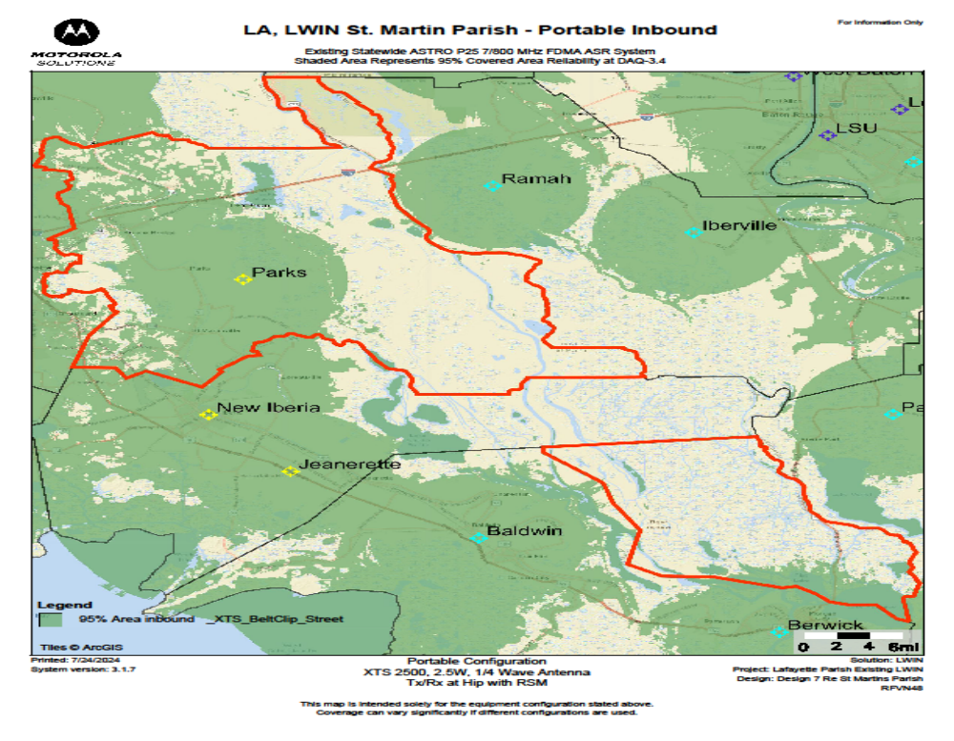

Slide 42
