Slide 1
Subrecipient (Applicant)
Monitoring

Slide 2
Not auditors.
Purpose: to assist the
Subrecipient

Slide 3
Federal regulations . . .
Require GOHSEP to monitor grant-supported activities to:
  Ensure Subrecipients are in compliance with Federal laws + regulations + specific program requirements (MOU).

Slide 4
Federal requirements
A-102
44 CFR Part 13
Uniform Grant Administrative Requirements
Circulars Consolidated into 2 CFR
Grants Management
A-89, Federal Domestic Assistance Program Information
A-102, Grant Awards and Cooperative Agreements with State and Local Governments (44 C.F.R. Part 13)
A-110, Uniform Administrative Requirements for Awards and Other Agreements with Institutions of Higher Education, Hospitals, and Other Nonprofit Organizations (2 CFR 215)
Cost Principles
A-21, Cost Principles for Educational Institutions (2 CFR part 220)
A-87, Cost Principles for State, Local and Indian Tribal Governments (2 CFR part 225)
A-122, Cost Principles for Non-Profit Organizations (2 CFR part 230)
Audit
A-133, Audits of States, Local Governments and Non-Profit Organizations
Sections of A-50 related to audits performed under Subpart F—Audit Requirements
Single Audit Requirements
Notes:
These two areas apply to conducting SVs and monitoring DRs.

Slide 5
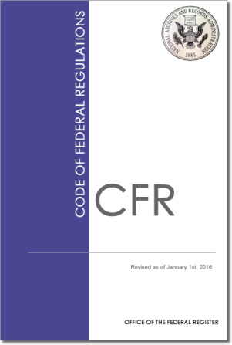
Federal requirements
2 CFR Part 200 (Uniform Guidance/Super Circular)
Applies to Awards made on or after December 26, 2014
2 CFR 200.51
(Grant Agreement)
2 CFR 200.328
(Monitoring and Reporting Program Performance)
www.ecfr.gov
www.whitehouse.gov
Notes:
The sections of 2 CFR that gives GOHSEP the authority to monitor federal grants.

Slide 6
Federal requirements
2 CFR 200
Applies to all Federal Awards, not just FEMA
2 CFR 200 will not apply retroactively to existing awards, EXCEPT: Non-federal entities will follow the Audit Requirements in Subpart F for existing awards in some circumstances.
  A non-Federal entity that expends $750,000 or more during the non-Federal entity’s fiscal year in Federal awards must have a single or program-specific audit conducted for that year.
Notes:
Therefore: 44 CFR and the individual circular guidance will apply to grants awarded prior to December 26, 2014 except for the threshold for a single audit.

Slide 7

Monitoring assists by . . .
Reduce risk of de-obligation in current disasters.
Assist with compliance deficiencies so future audits and closeouts are a smooth process.
Prepare for future events.

Slide 8
How is an Subrecipient chosen for a site visit?
Annual Risk Assessment
  Risk Indicators:
    Financial + Operational + Compliance
  Rated as low, moderate, or high risk to GOHSEP.

Slide 9
How is a Subrecipient chosen for a site visit?
Risk Analysis Results
GOHSEP Grant Managers
GOHSEP Management Request
      Director
      Chief of Staff
      Assistant Deputy Director

Slide 10
Prior to a site visit
Contact the Subrecipient to schedule
(most visits lasts up to three [3] days).
  The Subrecipient Monitoring Section Chief will contact the Subrecipients Via Email and/or Telephone.

Slide 11
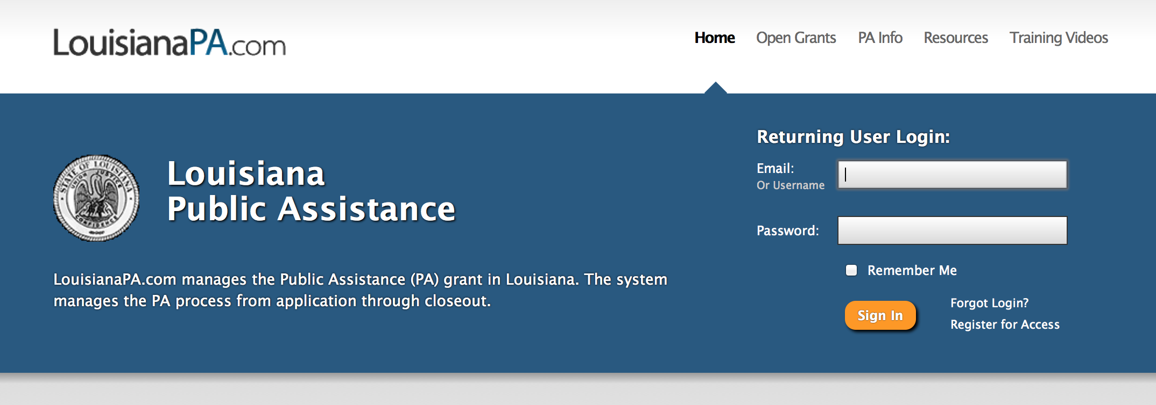
Prior to a site visit
  Louisiana Public Assistance (LAPA) LouisianaPA.com

Slide 12
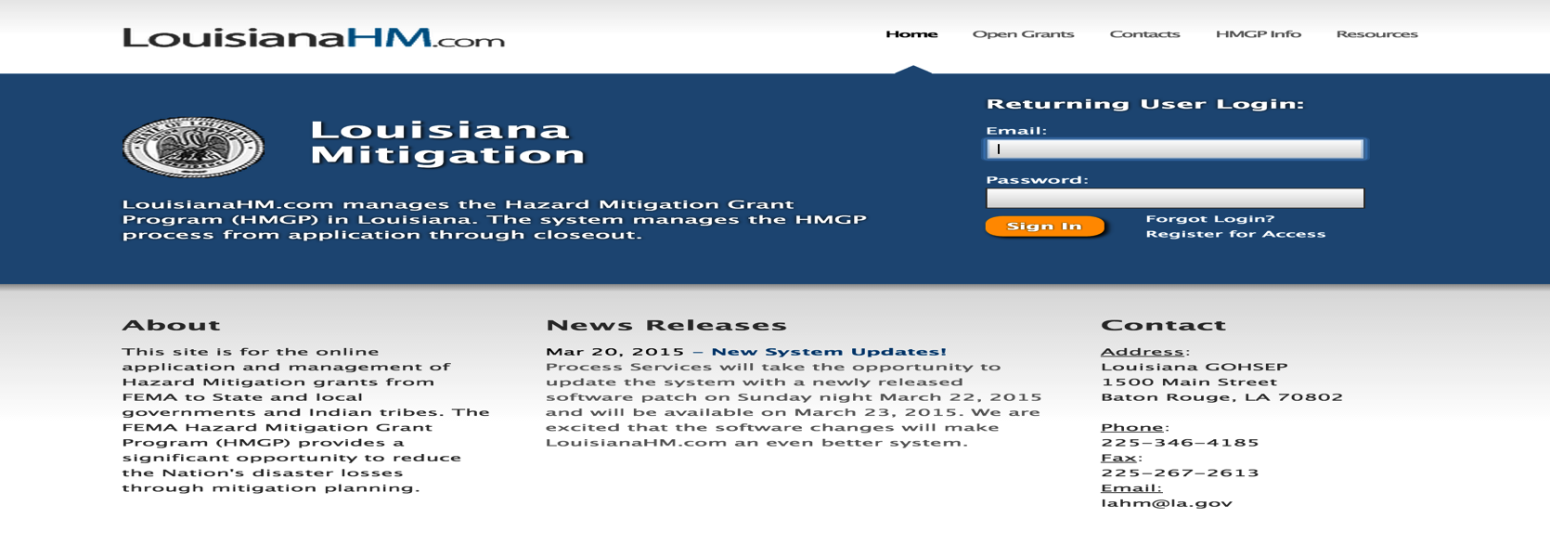
Prior to a site visit
  Louisiana Hazard Mitigation (LAHM) LouisianaHM.com

Slide 13
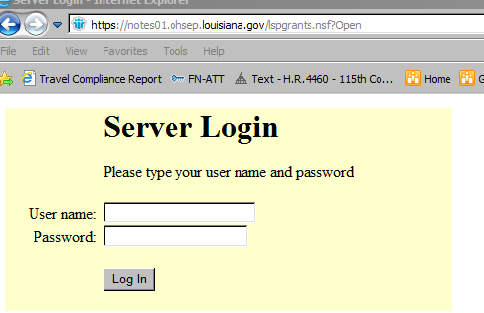
Prior to a site visit
  Louisiana Preparedness Grant Login
    https://notes01.ohsep.louisiana.gov/lspgrants.nsf?Open

Slide 14
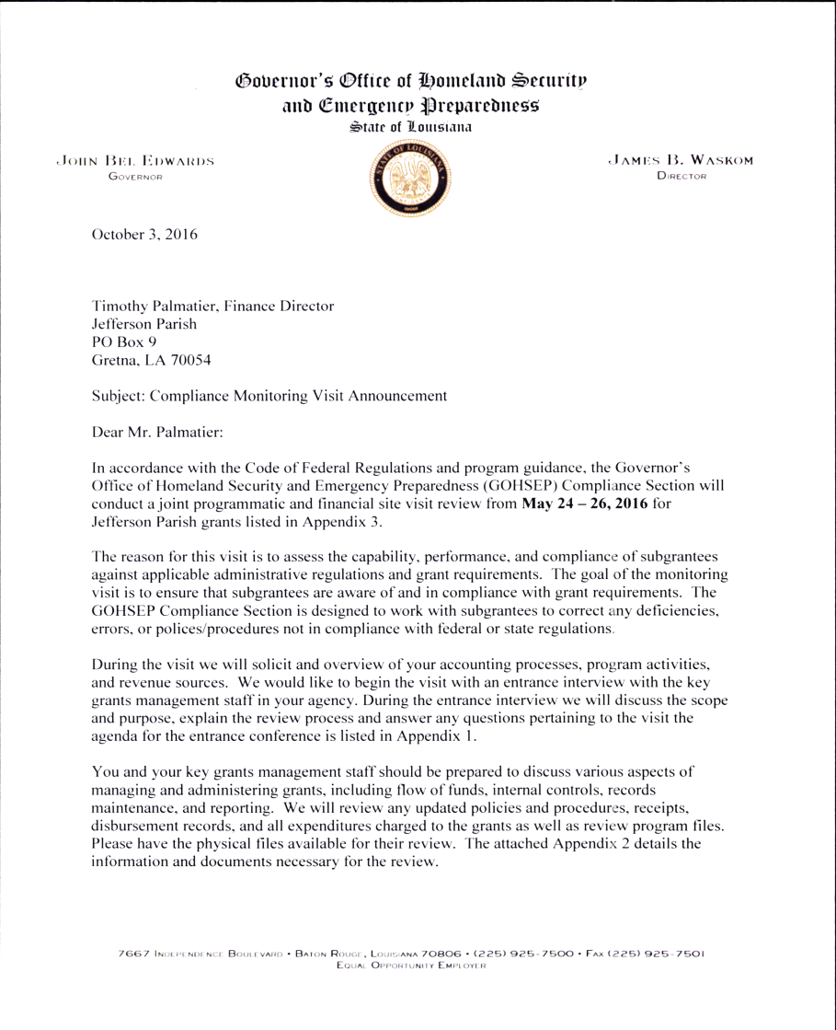
Prior to a site visit
Site Visit Announcement letter
Parish President Name
Parish Name
Address
City, LA Zip
Subject: Compliance Monitoring Visit Announcement
Dear Mr./Ms. President:

Slide 15
Announcement letter
Subrecipient’s are encouraged to contact our office with questions or concerns. The analyst name and contact information will be listed in the letter.

Slide 16
Preliminary General Document Request List
  Policies + Procedures for areas related to the Public Assistance (PA), Hazard Mitigation (HM), and Homeland Security (HLS) grant programs.
  Organizational Charts for all administrative functions
  Job profiles/descriptions for all administrative functions
  Single Audit Reports and Management Letters
  Code of Ethics
  Quarterly Reports and Project Progress Reports
  Listing of all vendors related to the PA/ HM
  Bidding process documentation
  Listing of all project sites (related to the PA, HM Grant Program)

Slide 17
Preliminary Sample Document Request List
  Invoices for PA, HM related expenses
  Purchase Orders for PA, HM related purchases
  Contracts for any goods/services related to the PA, HM Program transactions
  Bank Statements for accounts with PA, HM Program transactions
  Internal Reports used to account for transactions relevant to the PA, HM Program (e.g. trial balances, system reports, treasury reports)
  Payroll reports, time cards, and employee certification forms for employees supporting PA, HM Program functions
  Travel + per diem reports, invoices, and reimbursement documentation for administrative expenses related to the PA, HM Program

Slide 18
Project Worksheet/Project Sample Selected
Sample Selection
PW/ Project | RRF# | Type | Doc. No. | Amount | Approval Status | Submitted Date | Approved Date
EMPG 2014 | Grant | N/A |  | 85,000 | Normal | 5/4/2014 | 5/5/2014
PW 2239 | 1 | Contract Work Summary | N/A | $626,420 | Normal | 11/23/2009 | 6/23/2010
 | 2 | Force Account Payroll | Multiple | $4,073 |  | 2/15/2011 | 5/31/2011
HMGP 1603-0412 | 1 | Structural + Non-structural Retrofit | N/A | $8,394,305 | Normal | 10/2/2008 | 1/15/2009
PW 2239 | 1 | Contract Work Summary | N/A

Slide 19
Preparing for site visit
Review the Site Visit Checklist
  Be Organized
  Has implemented and updated written policies + procedures.
  Is familiar with grant requirements + follows requirements.

Slide 20
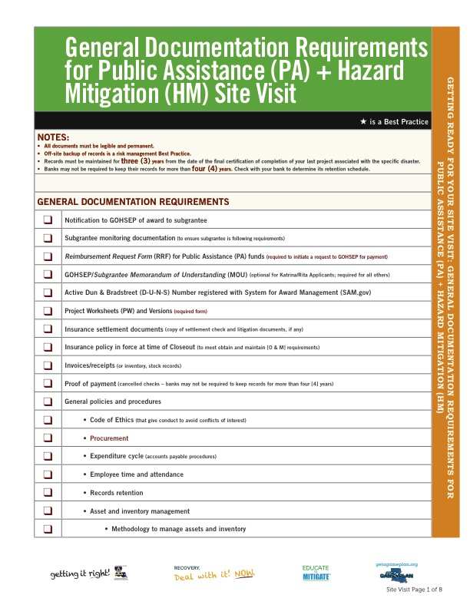
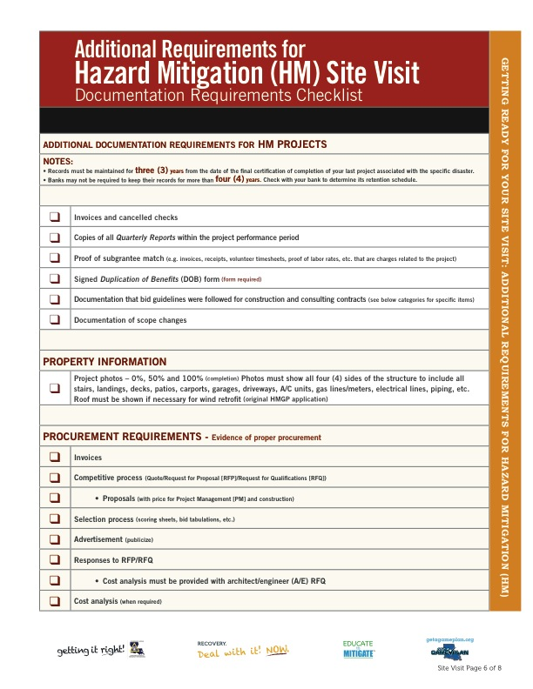
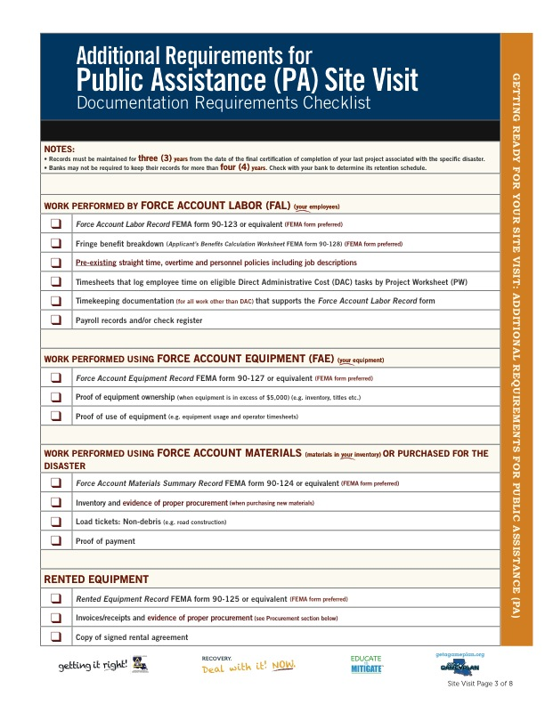

Slide 21
Need help?
What happens if I can’t or don’t fulfill documentation requirements?
  Call us. We can help . . .
  Don’t create backup documents.

Slide 22

Site visit – Day 1
Entrance meeting:
  Discuss why we are there.
  Ask our procedural questions
  Request documents.

Slide 23
Site visit – Day 1
2 to 3 Compliance Analysts
Subrecipient’s staff
Place to work
Reviewing requested documents

Slide 24
Site Visit Entrance Meeting Agenda
Introductions
Overview of the Subrecipient Monitoring Program
Sub-recipient Monitoring Components
A-133 Single Audit Desk Reviews
Site Visit Reviews
Ongoing Communication
Why are we here today?
Site visits are a monitoring activity implemented by the Grant Programs to assess compliance and administration of Federal funds.
Site Visit Objectives
Timing and Logistics
Benefits to applicants
  Assistance with preparation to the close-out process
  Increased understanding of your unique situation
  Improved insight into the Expense Review process
  Exercise for your administrative function
Overview of the Subrecipient Monitoring Program
Timing and Logistics
Benefits to Subrecipients

Slide 25
Site Visit Areas of Review
Area of Review |  | Monitoring Visit Objectives
A | General Control Environment | To assess whether the Subrecipient has a defined organizational structure and assignment of authority and responsibility to promote a sound control environment within the organization.
B | Expenditures | To assess the expenditure approval process by the Subrecipient and determine if approvals are performed by individuals with the knowledge and background of program and federal requirements.
C | Accounting | To assess the accounting system of the organization and understand how transactions are processed and how the organization maintains a budget for each project/grant.
D | Reporting and Project Progress | To review the overall project progress of the Subrecipient for all in-scope grant programs and to select a recent sample of quarterly reports to assess the accuracy of the project status as indicated in the report.
E | Cash Management & Advances | To assess whether the program funds are managed appropriately and that advances are in progress of being supported by approved expenditures.
F | Equipment & Inventory | To determine if controls are in place to protect assets acquired with federal funds.
G | Force Account Labor & Administration Costs | To assess how employee time and administration costs that are charged to the project is accounted for and segregated from non-project related activities and responsibilities.
H | Procurement / Contracts | To review the procurement process used for a sample of contracts for compliance with federal, state, and local procurement requirements.
I | Sub-grantee Monitoring | If the Subrecipient has passed-through funds to additional sub-grantees, to assess the approach and methodology used to monitor those sub-grantees for compliance with federal program requirements.
J | Records Retention | To review the Subrecipient's record retention policy for financial records, supporting documents, statistical records, and all other records pertinent to the grant programs.
K | Insurance | To review the Subrecipient's insurance documentation and assess if they are in compliance with program requirements.
L | Duplication of Benefits | To determine the status of duplicated benefits and assess whether the proceeds overlap with project activities funded by GOHSEP.
M | DUNS Validity / CCR Registration | To assess whether the Subrecipient has maintained an active Data Universal Numbering System (DUNS) number and also registered with the Federal Government Central Contractor Registry, this is required to receive federal grant funds.
General Control Environment
Expenditures
Accounting
Reporting and Project Progress
Cash Management & Advances
Equipment and Inventory
Records Retention
FAL and Admin Costs
Procurement and Contracts
Duplication of Benefits
Sub Grantee Monitoring
DUNS Registration
Insurance

Slide 26
Site visit – Day 2
Compliance analysts can work by themselves.
Pull samples from selected grants.
Review requested documents.
Ask follow-up questions.
Identify compliance deficiencies (if any).

Slide 27
Site visit – Day 3
Exit meeting
  Reiterate why we are here.
  Discuss observed deficiencies and best practices.
  Provide preliminary recommendations.
  Gather any feedback.

Slide 28
What to expect after site visit
30 days
No actions required/no compliance deficiencies OR
30 days
Corrective Action Plan
Non-acceptance
Acceptance
Closeout
Written recommendations + required courses of action within 30 days

Slide 29
Consequences of non-compliance
Negative impact for future grants.
De-obligation of funds.
Stricter scrutiny at a minimum.

Slide 30

Points of Contact
Lisa E. Tucker, CFE
Section Chief,
Subrecipient Monitoring (225) 358-5704
  lisa.tucker@la.gov
Takisha Ross
Supervisor, Subrecipient Monitoring
  (225) 922-2664
  takisha.ross@la.gov
Lekeesha Jordan
Supervisor, Subrecipient Monitoring
  (225) 358-5525
  lekeesha.jordan@la.gov

Slide 31
Questions?

