Slide 1
GOHSEP IPAWS Update
Annual GOHSEP Conference
January 20-22, 2015

Slide 2
Agenda
We will cover the what, who, and how…
What is IPAWS?
Who can sign up?
How much does it cost?
What are the benefits?
Which parishes have completed the process?

Slide 3
What is Integrated Public Alert & Warning System (IPAWS)?
Modernization and integration of the nation’s alert and warning infrastructure
Emergency Alert System (EAS)
Wireless Emergency Alerts (WEA)*
NOAA Weather Radio
Other public alerting systems as available
Alert Studio Specific - Facebook/Twitter (Social Media)
Alert Studio Specific - Alert FM App and/or Alert FM Receivers
*IPAWS is the only way emergency managers can send Wireless Emergency Alerts

Slide 4
IPAWS Overview
IPAWS is accessed through software that meets specific IPAWS system requirements
IPAWS does not replace existing methods of alerting, but instead complements existing systems & offers additional capabilities
IPAWS improves alert & warning capabilities by allowing delivery of alerts simultaneously through multiple communications devices reaching as many people as possible to save lives & protect property

Slide 5
Who can sign up for IPAWS?
Federal, State, and local laws determine which public safety officials are granted authority to alert the public of emergency situations
+ Federal Agencies + State Governments + Territorial Governments + Tribal Governments
+ Local Governments

Slide 6
Local
Emergency Alert System (EAS)
State
Wireless Emergency Alerts (WEA)
Territorial
Tribal
Internet Services
Federal
NOAA
HazCollect
State/Local Unique Alerting Systems
Future Technologies

Slide 7
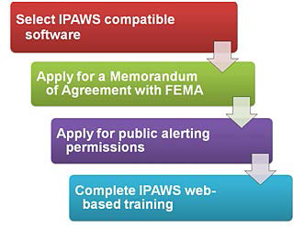
How can I sign up for IPAWS?
Any qualifying public safety organization may apply for authorization to use IPAWS to send alerts
4 step process…

Slide 8
IPAWS Signup Process
1. Select an IPAWS-compatible Alert Origination Software
To send a message using IPAWS, an organization must procure its own alert origination software
The developer of the software must have an MOA with FEMA
A list of developers can be found at: http://www.fema.gov/alert-origination-service-providers

Slide 9
IPAWS Signup Process
2. Apply for a Memorandum of Agreement (MOA) with FEMA
Once submitted to FEMA, the MOA will be prepared & returned to the applicant for signature
Once executed, a Collaborative Operating Group (COG) ID & digital certificate will be generated
A copy of the executed MOA, COG ID, & digital certificate will be returned to the Primary Point of Contact

Slide 10
IPAWS Signup Process
3. Apply for public alerting permissions
Complete the application defining the types of alerts & the applicable geographic warning areas
Reviewed & signed by GOHSEP
4. Complete the IPAWS web-based training
IS-247.A: “Integrated Public Alert & Warning System”
Course web address:
http://training.fema.gov/is/courseoverview.aspx?code=is-247.a

Slide 11
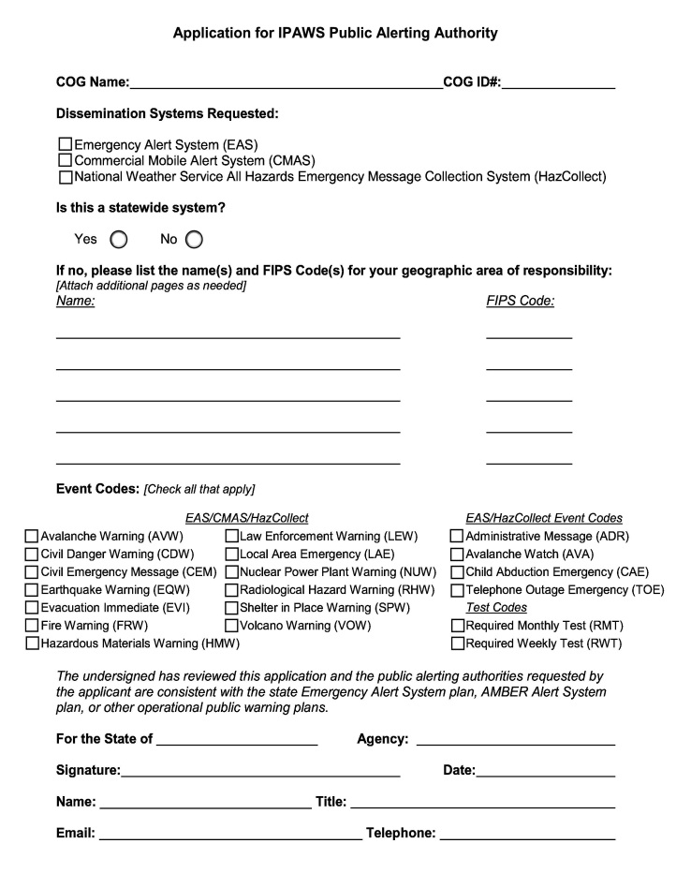
IPAWS Signup Process
COG Name and ID # provided by FEMA through MOA process
FIPS Code can be found in the State EAS plan on GOHSEP’s website
Select the event codes and submit to GOHSEP to complete the bottom portion
Once form is returned to you, send to FEMA with proof of course IS-247 completion
STOP HERE
http://training.fema.gov/is/courseoverview.aspx?code=is-247.a

Slide 12
How does IPAWS benefit my agency?
Internet-based system that Federal, State, territorial, tribal & local authorities can use to issue critical public alerts & warnings; portability of access (24/7 and home, road, office)
IPAWS improves alert & warning capabilities by allowing delivery of alerts simultaneously through multiple communications pathways; reaches as many people as possible (residents & tourists)
Provides emergency managers access to send Wireless Emergency Alerts; adds to the emergency notification “toolbox”
Geo targeted alerts limited to 90 characters
For “alerts” only and not notification-type messages
Free to alerters and alertees; not subscription based

Slide 13
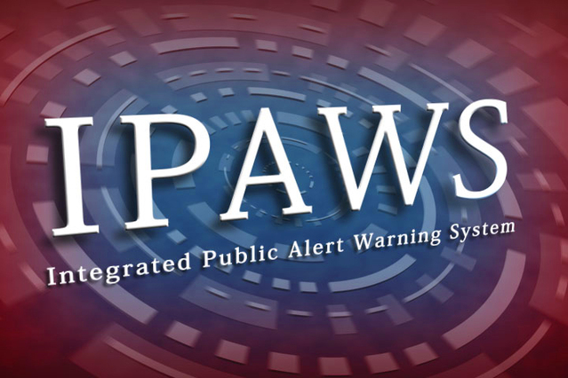
Who in Louisiana is IPAWS accredited?
Applications Approved
GOHSEP
17 Parishes
Applications in Process
5 Parishes

Slide 14
Louisiana IPAWS Certification Status
GOHSEP Region | Parish | IPAWS Status w/ FEMA | Application for IPAWS Public Alerting Authority Approved
5 | Allen Parish | approved | 3/25/2014
5 | Calcasieu Parish | approved | 10/24/2013
5 | Cameron Parish | pending | not submitted
2 | East Baton Rouge | pending | not submitted
4 | Iberia Parish | approved | 4/29/2014
2 | Iberville Parish | pending | 9/4/2014
1 | Jefferson Parish | approved | 10/25/2013
Statewide | LA GOHSEP | approved | 8/5/2013
3 | Lafourche Parish | approved | 10/25/2013
8 | Lincoln Parish | approved | 4/24/2014
6 | Natchitoches Parish | approved | 9/3/2014 & 1/6/2015
1 | Orleans Parish | pending | 3/25/2014
1 | Plaquemines Parish | approved | 11/8/2013
1 | St. Bernard Parish | approved | 11/1/2013
3 | St. Charles Parish | approved | 6/10/2014
3 | St. James Parish | pending | 9/4/2014
4 | St. Landry Parish | approved | 6/24/2014
9 | St. Tammany Parish | approved | 8/6/2014
9 | Tangipahoa Parish | approved | 10/23/2013
9 | Washington Parish | approved | 6/16/2014
2 | West Baton Rouge Parish | approved | 8/6/2014
2 | West Feliciana Parish | approved | 3/26/2014
6 | Winn Parish | approved | 8/27/2014

Slide 15
What are the associated costs?
There is no cost to send messages through IPAWS, although there may be costs associated with acquiring compatible alert origination software
GOHSEP contracted with GSS Net (Alert FM and Alert Studio) through 2022 to provide IPAWS origination software; no cost to parishes

Slide 16
Alerting/Notification Best Practices
Raise awareness around or during holidays and festivals
Relay road closure information during construction and/or traffic accidents
Provide evacuation and re-entry notifications during hurricanes or tropical storms
Announce ferry closures and re-openings
Announce school closings during winter weather

Slide 17
Effective Warning Messages
Specific Hazard/Threat – what is the hazard?
Location – where are impacts likely to occur?
Timeframe – when will it arrive?
Source of Warning – who is issuing the warning?
Magnitude – how bad is it expected to get?
Likelihood – what is the probability that it will occur?
Protective Action/Behavior – what and when should actions be taken?

Slide 18
Contact Information
Operations Section:
Email: GOHSEP-Operations@la.gov
Sean Wyatt
Phone: (225) 358-5412
Email: Sean.Wyatt@la.gov
Steve Burr – Technical POC
Phone: (225) 925-7423
Email: Steve.Burr@la.gov

Slide 19
Questions?

