Slide 1
Louisiana FirstNet
Christina Dayries
Christina.Dayries@la.gov
225.358.5599

Slide 2
What is FirstNet?
FirstNet Goal
Provide emergency responders with the first nationwide, high-speed broadband network dedicated to public safety.
Built and managed by the Federal Government
Use of a Contractor through an RFP Process for buildout of network
Notes:
. . . to provide emergency responders with the first nationwide, high-speed, broadband network dedicated to public safety.

Slide 3
RFP Status
Contract selection was made in November 2016
FirstNet intended to award to AT&T
Rivada Mercury submitted protest as they were excluded from evaluation
Earliest an award could be made is March 2017
Contract award is subject to further protest
Delay in delivery of State Plans
Earliest delivery of State Plans, Fall of 2017
Governor has 90 days to Opt In or Opt Out or Do Nothing

Slide 4
Education + Outreach
Presentations continue for the following:
Updates on FirstNet Plans
Review of Louisiana’s State Plan (if received)
Target Audience
Parish First Responder Meetings
Member Associations
Group Conferences
Tribal Meetings
Website + Twitter + Newsletter

Slide 5
SLIGP(FirstNet) Grant 1.0
80% Federal / 20% State match
Federal Share: $1.9 million
State Share: $480,000
Total Project: $2.4 million
Project End Date: February 2018
Projected Balance: Roughly $800K

Slide 6
Unspent SLIGP 1.0 Grant Funds
The following factors contributed to the potentially large unspent balance:
*NTIA anticipates slightly more than 20% of SLIGP recipients will spend all of the grant funds by the end date.

Slide 7
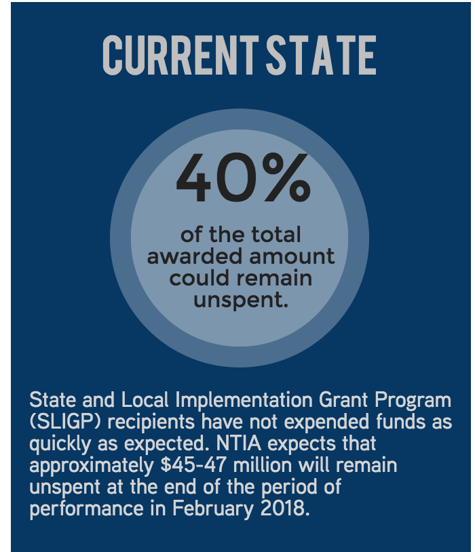
SLIGP 2.0 Overview
NTIA intends to award SLIGP 2.0 grants that will leverage SLIGP unspent balances to support activities in states where FirstNet is deploying the Radio Access Network (RAN), subject to the availability of funding.
Eligible grant recipients: States that “OPT IN”

Slide 8
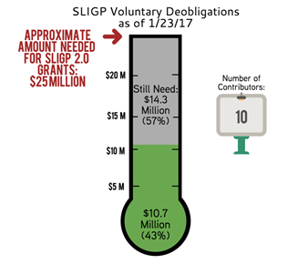
SLIGP 2.0 Overview
NTIA estimated that $25 million is the approximate amount of voluntarily deobligated funds necessary to make SLIGP 2.0 awards.
To date, 10 recipients are in the process of voluntarily deobligating $10.7 million in support of SLIGP 2.0, meaning that NTIA must recover another $14 million in order to make SLIGP 2.0 grants possible.

Slide 9
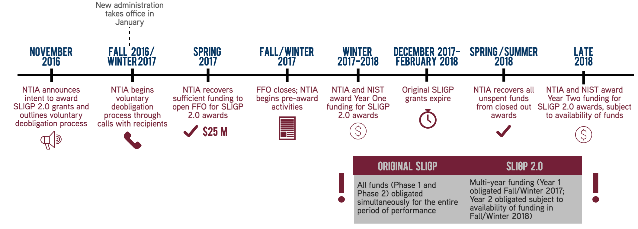
Potential Scenario 1: NTIA Voluntarily Recovers Sufficient Funds

Slide 10
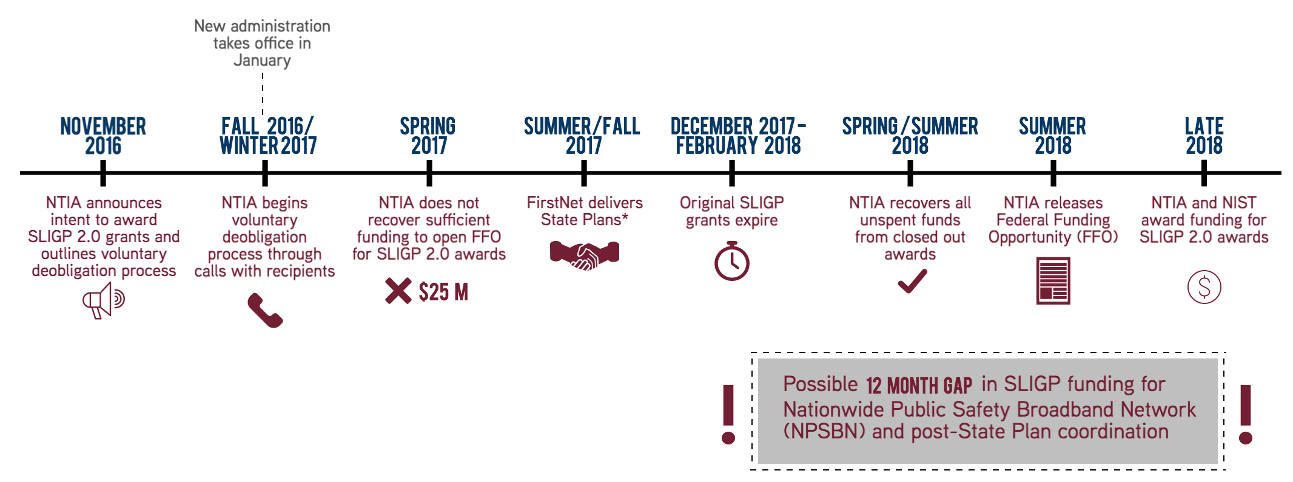
Potential Scenario 2: NTIA Does Not Voluntarily Recover Sufficient Funds
*According to notional timeline discussed during FirstNet Governing Board meeting

Slide 11
Contact Louisiana FirstNet
Brad Smith
Email: FirstNet@la.gov
Twitter: @LAFirstNet
Website: firstnet.louisiana.gov
Phone: (225) 925-7500

Slide 12
Questions?

