Slide 1



FirstNet Louisiana Updates
©2018 AT&T Intellectual Property. FirstNet, First Responder Network Authority, and FirstNet logo are registered trademarks and service marks of FirstNet, an independent authority within the U.S. Department of Commerce. All other marks are the property of their respective owners.

Slide 2
First responders, AT&T and the first responder network authority have come together to build FirstNet, a dedicated communications tool created for and
by public safety.

Slide 3

6 KEY FACTS
1. HIGHLY RELIABLE NETWORK COVERAGE
This network gets a head start by launching on the nation’s best data
network* — featuring more than 99% population coverage.
No throttling on the network. Prioritization with no speed limits on voice, text or data.
2. PRIORITY
When disaster strikes and networks can be congested, first responders remain first in line. Primary users (Law Enforcement, Fire, and EMS) have priority and preemption across our network at no additional charge. First responders get the access they need to keep the lines of communication open … when it matters most.
3. TRUSTED SECURITY AND RESILIENCY
Designed with superior security in mind to help resist physical and cyber threats. Ruggedized to help withstand power outages, and backed by a dynamic, highly trained disaster recovery organization.
4. PUBLIC SAFETY APPS
A dedicated public safety app store offers highly secure and relevant first responder applications, delivering critical interoperability and the ability to talk with team members from other agencies, states, or local rescue teams. All apps pass a rigorous vetting process that focuses on meeting superior standards, enhancing safety and situational awareness.
5. DEDICATED SUPPORT
Your dedicated technical support is available 24/7/365 and is staffed with highly trained professionals who have experience in emergency communications and understand the demands of public safety.
6. AFFORDABLE PLANS WITH ADVANCED FEATURES
So much more than a competitive rate plan — this world-class broadband network comes with unique public safety capabilities.
*Claim based on the Nielsen Certified Data Network Score for AT&T. Score includes data reports by wireless consumers in the Nielsen Mobile Insights survey,
network measurements from Nielsen Mobile Performance and Nielsen Drive Test Benchmark. *Wireless reliability based on 3rd party data as of April 2017.

Slide 4






User Type + Availability of Service
PRIMARY USERS | EXTENDED PRIMARY USERS | CERTAIN INDIVIDUAL PAID USERS
Fire Police EMS Emergency Management Emergency Communications (9-1-1) | Hospitals Utilities Transportation Education | Primary or Extended Users Users that Pay Personally For Service
Notes:
There are three (3) categories of priority users:
Primary Users.
Extended Primary Users.
Certain Individual Paid Users.
More specifically…

Slide 5
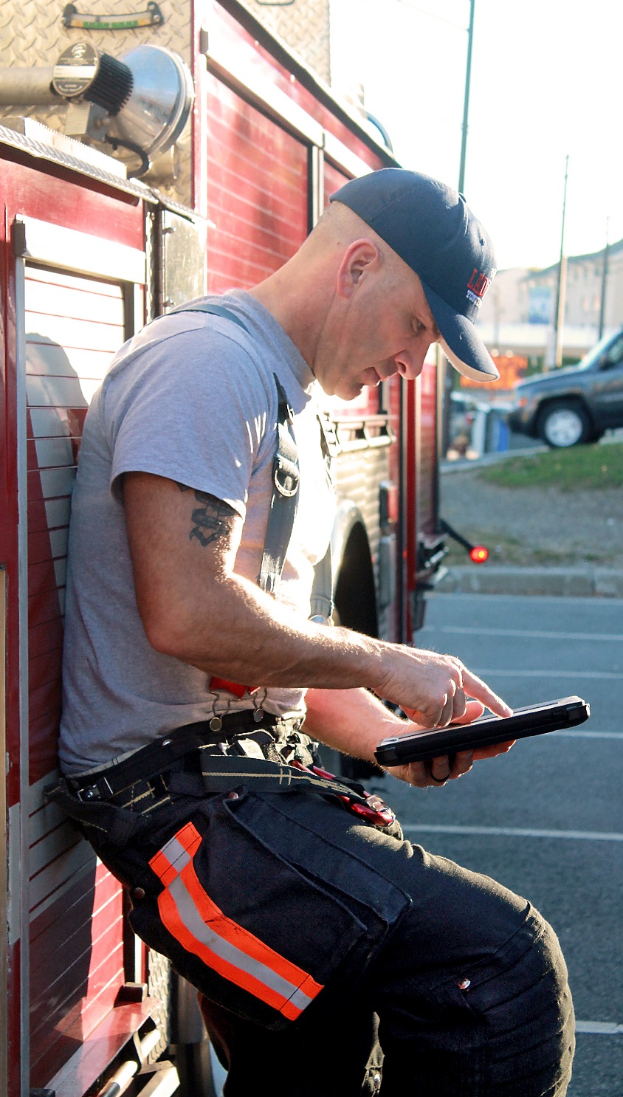
  Updates
All States and Territories have Opted-In to FirstNet
2,551 total agency paid subscribers in Louisiana
109 total individual paid subscribers in Louisiana (BYOD)
FirstNet’s Core Launched 03/29/2018.
  The FirstNet Core is the first-ever nationwide LTE core infrastructure built specifically for our nation’s first responder community. It separates public safety traffic from commercial traffic.
  The FirstNet Core will support future mission-critical services to be offered by FirstNet, like Mission Critical push-to-talk and location based services.
26 new cell sites have been activated since Louisiana’s Opt-in
FirstNet Satellite Colts will begin staging in June 2018. Louisiana will have 1 Sat-Colt. Delivery date TBD.

Slide 6

Louisiana Price Plans
Unlimited for Smartphones | Unlimited Talk, Text, Data & EPTT | $47.99
Unlimited Enhanced for Smartphones | Unlimited Talk, Text, Data, EPTT, hotspot/Tethering | $57.99
Unlimited for Data only Devices | Unlimited Data, Hotspot/Tethering | $37.99

Slide 7

  New Towers in Louisiana

Slide 8
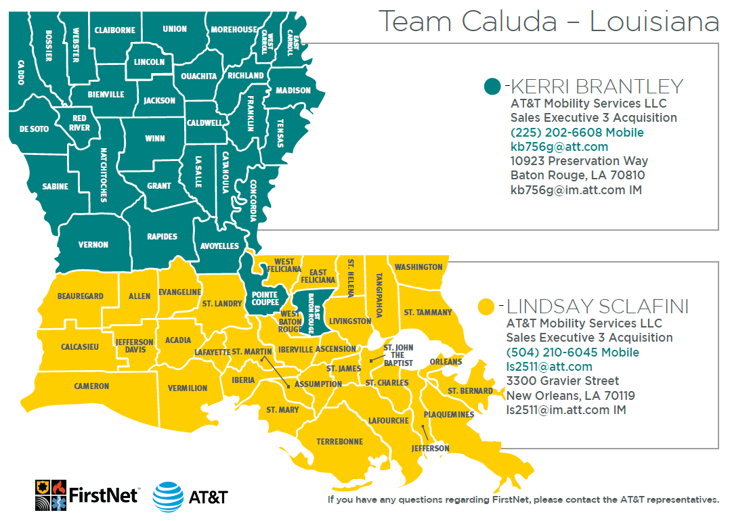


Slide 9
QUESTIONS?
©2018 AT&T Intellectual Property. FirstNet, First Responder Network Authority, and FirstNet logo are registered trademarks and service marks of FirstNet, an independent authority within the U.S. Department of Commerce. All other marks are the property of their respective owners.

