Slide 1
L.W.I.N.
Louisiana Wireless
Information Network
System Management & Maintenance April 24, 2024
Department of Public Safety
Office of State Police
Mobility and Communication Services
(225) 925-6036

Slide 2

Infrastructure Update

Slide 3
SYSTEM SUMMARY
148* Total Tower Sites in Operation
6 Operational Mobile Sites

Slide 4
Zone 1:
42 Sites in Full Operation
Pan Am
Bridge City
Livonia
Laplace
St. Tammany Simulcast
Lacombe
Abita Springs
Waldheim
Pearl River
Covington
Slidell
Talisheek
Blond
Sheridan
Geismar
St. James
Larose
Gibson
BR Simulcast
BR
Central
LSU
WBR
Hammond
Gray
Berwick
Baywood
Ramah
Sage Hill
Parker Road
Iberville
Livingston
Jackson
Greensburg
Superdome
South Baton Rouge
Baldwin
Pointe Coupee
Theriot
Paincourtville
Boothville
Mobile Units
94
96
97
98
99
100
Denham Springs
Clinton
St. George

Slide 5
Zone 2:
17 Sites in Full Operation
N. Simulcast
Gretna
Galleria
NO East
Houma
Lafitte
Bayou Gauche
Hahnville
St. Rosalie
Kenner
Airport
Port Fourchon
Reggio
Montegut
Bourg
Buras
Wilmer
Grand Isle

Slide 6
Zone 3:
55 Sites in Full Operation
Clearwater
Monroe
Winnfield
Delhi
Chopin
Dry Prong
Hagewood
Bossier(City)
Farmerville
Minden
Natchitoches
Bastrop
Greenwood
Ruston
Hineston
Ashland
Vivian
Newellton
Noble
Transylvania
Alexandria
Avoyelles
Bellevue
Bernice
Calhoun
Columbia
Ferriday
Homer
Jena
Jonesboro
Mansfield
Many
Marion
Oak Grove
Plain Dealing
Ringgold
Sentell
Tallulah
Wheeling
Shreveport
West Monroe
Chase
Keachi
Coushatta
Shongaloo
Sibley
Vick
Calvin
Arcadia
Enterprise
Holloway
Chatham
Cypress
Logansport
Pelican

Slide 7
Zone 4:
34 Sites in Full Operation
Abbeville
Acadia
Arsene LeBleu
DeQuincy
Dry Creek
Jeanerette
Jennings
Johnson Bayou
Lafayette
Lake Charles
Leesville
Merryville
Opelousas
Parks
Rockefeller
Rosepine
Scott
Sulphur
Vermillion
Ville Platte
Vinton
Craven
Hicks
Hornbeck
Oakdale
Roseland
E. Jennings
Anacoco
Oberlin
Moss Bluff
New Iberia
Eunice
Starks
Bell City

Slide 8
Channel Summary
Total Channels 1334
1283 Channels on 148 Sites
51 Channels on 6 Mobile Sites

Slide 9
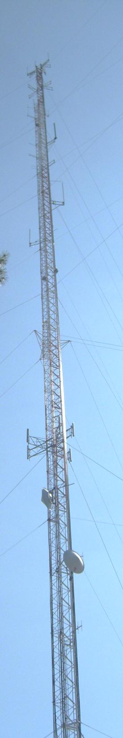
System
Statistics

Slide 10
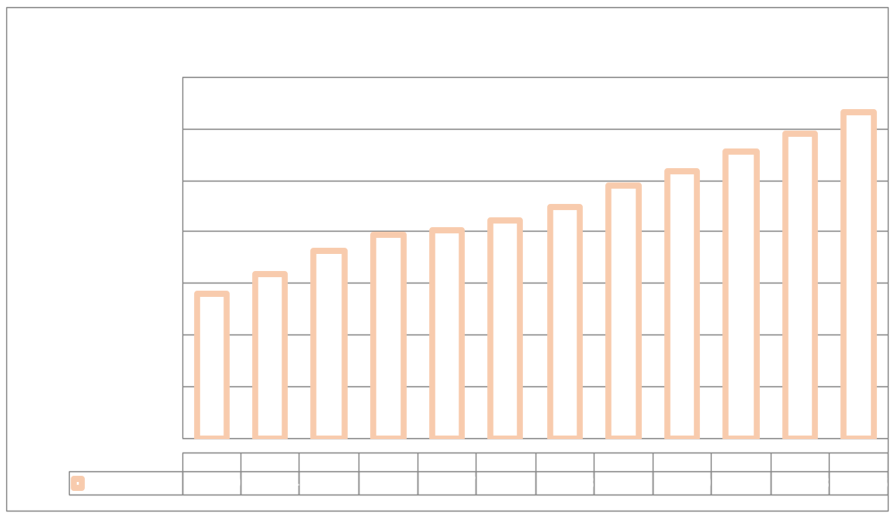
SUBSCRIBERS

Slide 11

PUSH TO TALK

Slide 12
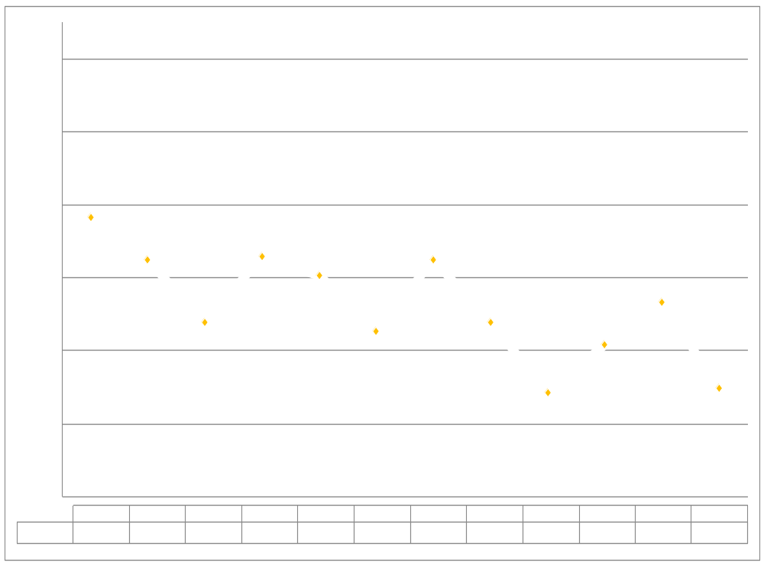
PUSH TO TALK PER DAY

Slide 13
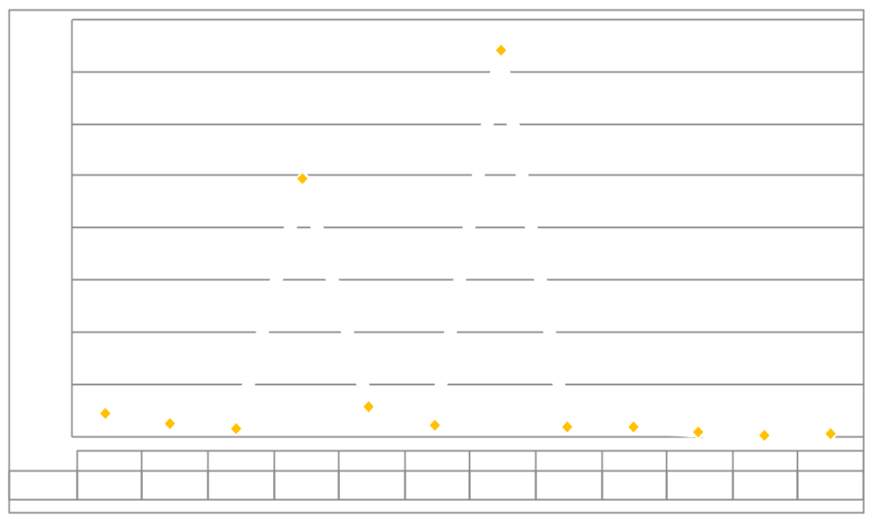
BUSIES

Slide 14

Top Busy Sites
Avoyelles 43
Hammond 24
Farmerville 11

Slide 15
SITE OUTAGES
Abbeville | Acadia | Anacoco | Arcadia | Arsene Lebleu
Ashland | Avoyelles | Baldwin | Baywood | Bell City
Bellevue | Berwick | Boothville | Bossier | Buras
Calvin | Chatham | Chopin | Coushatta | Cravens
Cypress | Delhi | Denham Springs | Dequincy | Dry Creek
East Jennings | Enterprise | Ferriday | Gibson | Greenwood
Hagewood | Hahnville | Hammond | Hicks | Holloway
Homer | Houma | Iberville | Jeanerette | Jena
Total Downtime: 1,911 Hours

Slide 16
SITE OUTAGES
Jennigs | Johnson Bayou | Jonesboro | Keachi | Lafayette
Lake Charles | Laplace | Leesville | Merryville | Oberlin
Opelousas | Paincourtville | Parks | Plain Dealing | Port Fourchon
Ramah | Rockefeller | Rosepine | Sage Hill | Scott
Sentell | Shongaloo | Shreveport | Sibley | St. James
Starks | Sulphur | Superdome | Tallulah | Theriot
Trailer 99 | Trailer 100 | Transylvania | Vermilllion | Vick
Ville Platte | Vinton | Wilmer
Total Downtime: 1,911 Hours

Slide 17
SITE OUTAGE DATA
69%

Slide 18
SYSTEM STATISTICS

Slide 19
Subscriber Statistics
Security Groups
192
Agencies
610
Talkgroups
6,528

Slide 20

Agencies Added Last 2 Months
1st Priority EMS

Slide 21
System Coverage

Slide 22
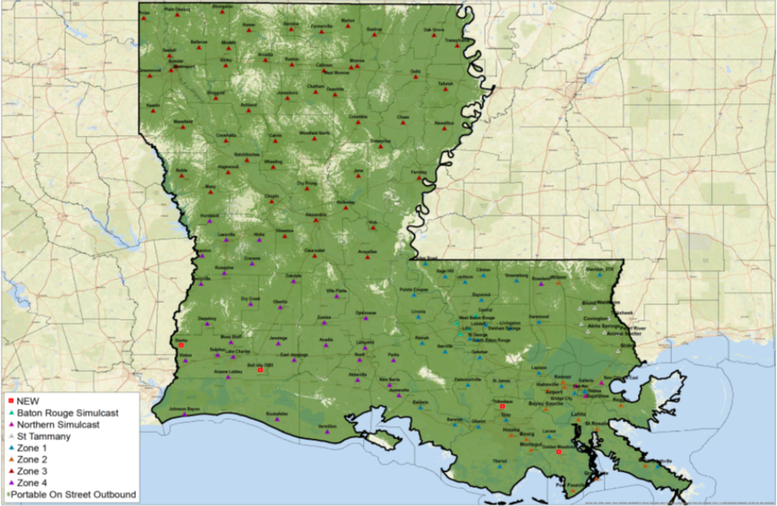
Present Coverage

Slide 23
Questions?

Slide 24
Ethernet Update

Slide 25
Implementation
ATT and Motorola completed all Zones and all zones are now operating on the new fiber Inter-zone link since June 7, 23.
Microwave simulcast upgrade for Baton Rouge and St. Tammany has been completed.
The 3 pilot sites: Denham Spring and Baywood were cut over to the new Ethernet system on January 4, 2024. Jackson is completed, but not yet online, waiting on antenna installation for LTE backup. ETA: Week of Jan. 29-2024.
Fiber for 27 challenge sites and priority sites has been ordered. ETA as of today, a week to 40 dates out.
The rest of the tower sites and dispatch centers will be scheduled soon after we complete the pilot and challenge sites. ETA late 2024 or early 2025.

Slide 26
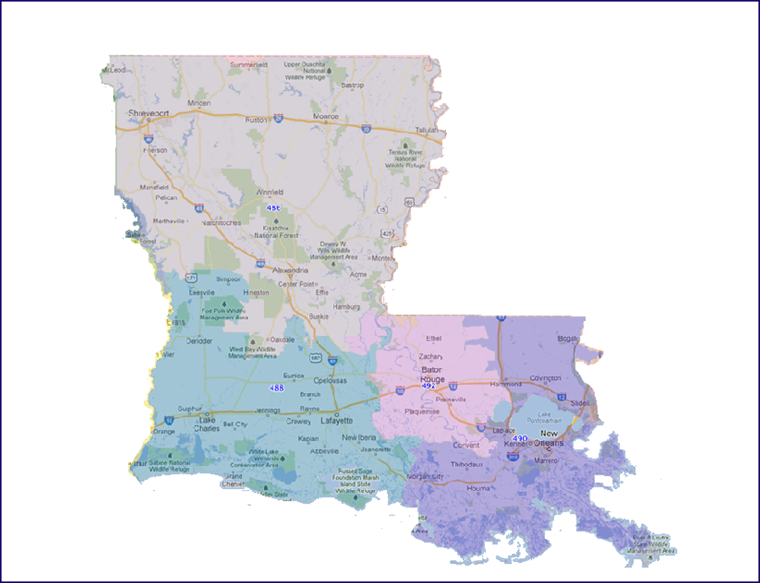
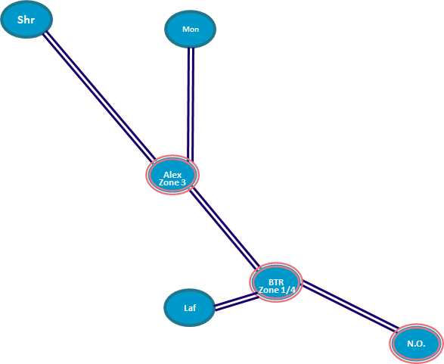
Existing Network

Slide 27
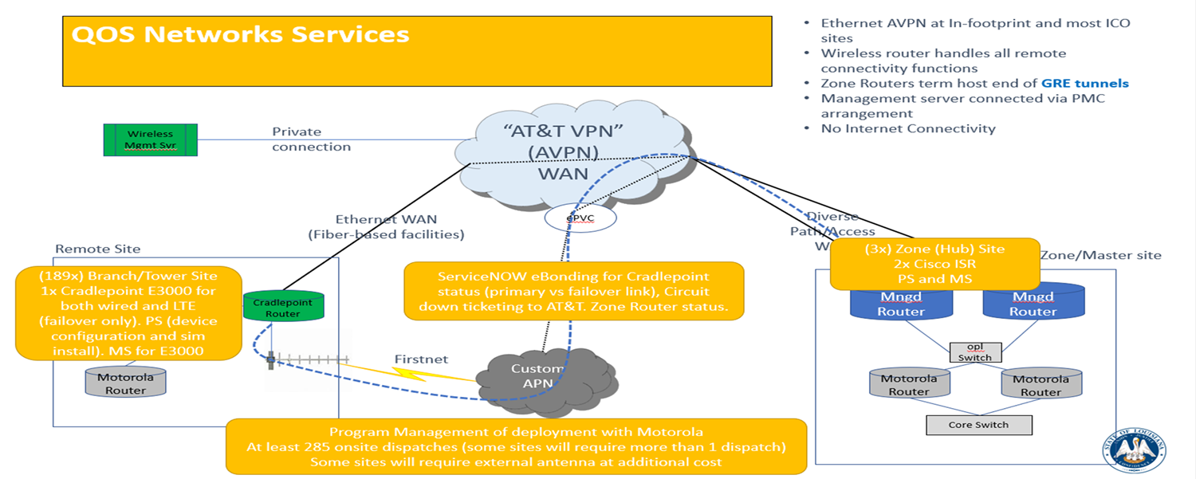
LWIN Topology

Slide 28
Questions?

Slide 29
Thank You!

