Slide 1
Statewide Interoperability Executive Committee
Christopher Guilbeaux
SIEC Chairman
Christopher.Guilbeaux@la.gov
(225) 925-7345

Slide 2
Louisiana Wireless Information Network (LWIN) Update
Statewide Interoperability Executive Committee

Slide 4
Statewide Interoperability Executive Committee
LWIN System Statistics
135 tower sites
Four (4) mobile tower sites
Two (2) mobile repeater sites
Four (4) mobile satellite dishes
Six (6) generators on wheels
Four (4) masters sites
Monthly average of over 12 million Push To Talks (PTTs)
90,994 user devices

Slide 5
Statewide Interoperability Executive Committee
SIEC / LWIN Ongoing Projects
As funding becomes available, the SIEC authorized the following priorities:
Addressing LWIN coverage gaps
Increasing capacity
Redundant/Backup communications
Ethernet / Fiber
Currently reviewing options for master sites with OTM/vendors as contract expires in August 2017
Further review required for tower site connections with OTM/vendors

Slide 6
Statewide Interoperability Executive Committee
LWIN System Budget Update
Upgrade of LWIN Software, Consoles and STR repeaters
$15.8 million total project costs
FUNDED: $11.4 million for software and console replacement
FUNDING REQUESTED for FY 17/18: $4.4 million for STR repeater replacement
LWIN System Maintenance
No anticipated reductions or increases for FY 17/18

Slide 7
Statewide Interoperability Executive Committee
LWIN Software/Equipment Project Update:
GPIOM/Console/Workstation swap out: completed 12/14/16
7.15 software upgrade: completed 1/17/17 – 1/27/17
NICE voice recorder upgrade: 1/24/17 start for the 19 loggers
Genesis upgrade: 1/30/17 start
7.17 software upgrade: 4/24/17 start (approximately two weeks)
Console/NICE upgrade: 5/1/17 start
Estimated Total Project Completion: 6/30/17

Slide 8
Statewide Interoperability Executive Committee
Interoperability and LWIN System Training
New GOHSEP Position
Travis Johnson, Interoperability Program Manager
Travis.Johnson@la.gov
225.573.0300
On site trainings for the following:
Radio or Device Operation
LWIN System Overview / Policies
Operational Communications Plan Development

Slide 9
Emergency Request for Deployable Assets and Training Opportunities
Emergency Support Function (ESF) – 2

Slide 10
Emergency Support Function (ESF) – 2
Co-lead or Primary Agencies
Governor’s Office of Homeland Security and Emergency Preparedness (GOHSEP)
Louisiana State Police
Louisiana National Guard
Agencies request support through WebEOC during emergencies or disasters

Slide 11
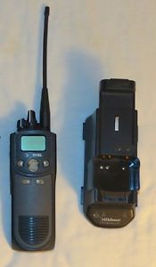
Radio Cache
Available through ESF – 2, Communications
182, Louisiana State Police
303, GOHSEP

Slide 12
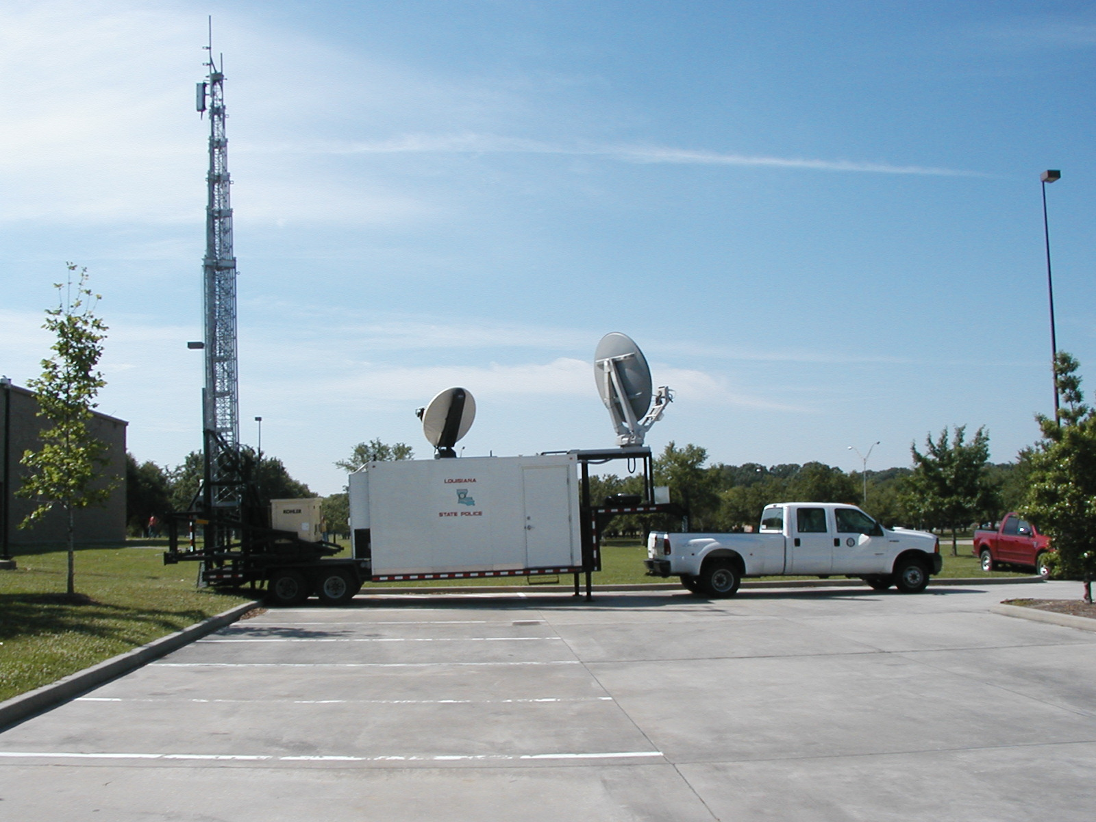
3 – LSP Mobile Communications Trailers
100’ Extendable Tower
Internet / Intranet
Satellite Connectivity
P25 System
Satellite Connectivity
700 / 800 MHz P25 TRUNKED SITE
800 MHz MUTUAL AID REPEATERS
VHF / UHF MUTUAL AID BASE STATIONS
INTEROPERABILITY GATEWAY
INTERNET & VOIP ACCESS
LOCATED REGIONALLY

Slide 13
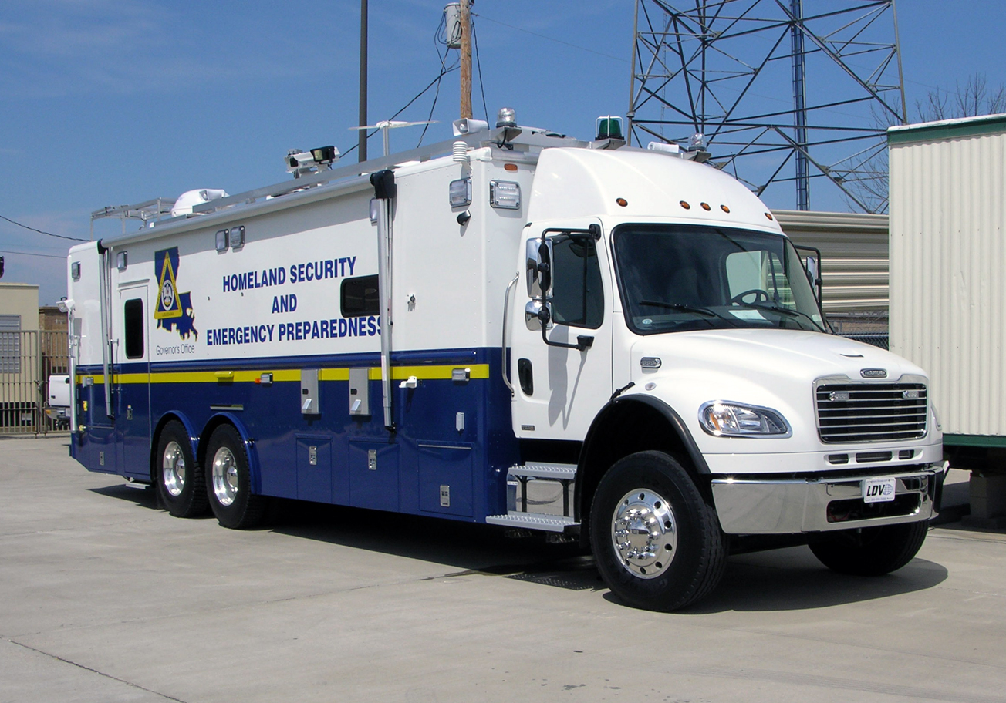
GOHSEP Mobile Command Post
700/800, VHF, UHF, aviation & HF
ACU1000 unit
Satellite Comms data/voice
Video Teleconferencing
Weather Station with plume modeling software
Telephone System
Conference Room
Audio Visual capabilities
Computer Systems
Direct TV

Slide 14
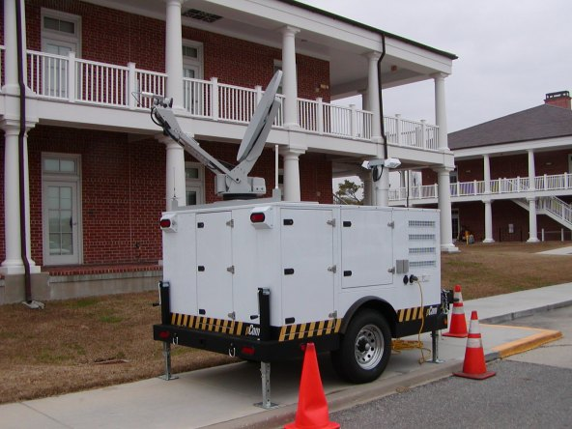
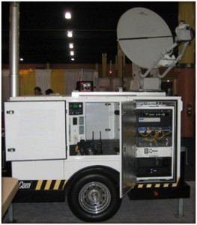
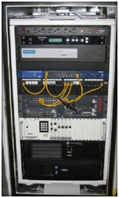
GOHSEP P-Comm
Rapid re-establishment or enhancement of on-site communications.
3 units available
Capabilities include:
Radio communications
Satellite connectivity
Voice Over Internet Protocol (VOIP) telephones
Wireless network & Internet connectivity
Onboard generator

Slide 15
Questions?

