Slide 1

Preliminary Damage Assessments / Disaster Assistance Programs
E. Carroll W. Carroll Tensas Jackson Sabine Winn Natchitoches Grant LaSalle Vernon Rapides Avoyelles Catahoula Terrebonne LaFourche

Slide 2

PRELIMINARY DAMAGE ASSESSMENTS (PDAs)
Documenting Disaster Impacts To Obtain Federal Disaster Assistance

Slide 3
What is a Preliminary Damage Assessment?
An essential element of the response and recovery process. A PDA is a joint assessment between FEMA, GOHSEP and the Parish.

Slide 4
What is a Preliminary Damage Assessment?
The PDA process is a mechanism used to determine the impact and magnitude of damage, the resulting unmet needs of individuals, businesses, the public sector and the community as a whole.
Information collected is used:
  By the State as a basis for the Governor's request, and
  By FEMA to document the recommendation made to the President.
It is in the best interest of all parties to combine State and Federal personnel resources by performing a joint PDA prior to the initiation of a Governor's request, as follows.
PDA’s are performed on FEMA’s two main type of assistance programs:
  Public Assistance
  Individual Assistance
Notes:
This is the FEMA definition from The Code of Federal Regulations

Slide 5
Before the Public Assistance (PA)
PDA Occurs You Should:
Build a list of potential applicants within the parish.
Educate each applicant on the PDA process.
Take an inventory of all property.
Make sure maintenance records are updated and available.
Assign qualified personnel to assess damages and costs following the event.
Gather damages/costs for each potential applicant inside the parish.
Once the PDA is scheduled, make sure each entity that will be seen during the PDA has an available insurance policy that is ready to submit.
ONE CRITICAL TIP IS TO ENSURE THAT THE PROCESS IS NOT MOVED TOO QUICKLY IN THE LOCAL ASSESSMENT STAGE. A COMMON MISTAKE MADE IN THE DAMAGE ASSESSMENT PROCESS IS RUSHING LOCAL ASSESSMENTS BEFORE THE PARISH IS READY!
Notes:
These are the things that need to occur before a PDA Occurs.

Slide 6
FEMA Damage Categories for PA
Category A - B: Emergency Work
Category C - G: Permanent Work
CATEGORY A DEBRIS REMOVAL
CATEGORY B PROTECTIVE MEASURES
CATEGORY C ROADS AND BRIDGES
CATEGORY D WATER CONTROL FACIL.
CATEGORY E BUILDINGS, EQUIPMENT
CATEGORY F PUBLIC UTILITIES
CATEGORY G PARKS, REC. AND OTHER
Notes:
FEMA has divided disaster-related work into two broad Categories of Work, Emergency Work and Permanent Work. These categories are further divided into the seven categories shown above.

Slide 7
The two phases of a PDA for both Public Assistance and Individual Assistance
Pre-assessment - by local officials
Joint Preliminary Damage Assessment - with Federal government (FEMA & other Federal agencies) and State Agency Reps - guided by local officials
Notes:
After necessary preparations have occurred, you are now ready to begin the PDA. Here listed above are the two phases of a PDA, which are necessary for not only Public Assistance but for Individual as well. We will elaborate a little bit more on Individual Assistance further into the presentation.

Slide 8
Pre-Assessment by Local PDA Team Member/Representative
Locate damaged areas.
Assist the State Representative in providing required information.
Serve as an expert on local issues.
Ensure that all damaged areas are identified.
Provide an overview of the disaster for team members.
Provide maps of damages areas.
Pre-disaster photos are necessary and extremely helpful when documenting damages.
Don’t overlook PNP’s!
Notes:
Above are the roles and responsibilities required of that individual that has been assigned to perform the Pre-Assessment.
*The person assigned from your agency should be responsible for the information listed above*

Slide 9
Joint Preliminary Damage Assessments
The Joint PDA validates the damage information and evaluates the impact.
Gathers information about the community in the Presidential declaration.
Notes:
The second phase is the Joint Preliminary Damage Assessment.
*Joint PDAs are intended for validation, not findings, of damage and impact information.* Listed above are a few main points of the purpose of a Joint PDA.

Slide 10
Damage Assessments Threshold
Every state has a threshold of dollar value for FEMA to review for eligibility.
FEMA statewide declaration “indicator” for FY 2018
FY 2018 State Declaration Threshold @ $1.43/Capita = $6,618,723

Slide 11
PA PDA Success
Compile Master Applicant Lists with contact names and numbers.
Notification of entities is vital.
Make sure to take photos.
Capturing every estimate matters.
PNP’s in your parish need to understand the importance of contacting you for event related damages/costs.
Be prepared for multiple site visits.
Ensure that correct staffing ( Finance, Facility Managers, Road Supervisors, etc.) are available to provide estimates and a detailed description of the damages at each site that is visited.
Don’t overlook Private Non-Profit Organizations (PNPs)!
* DO NOT REQUEST A PDA BEFORE YOU ARE READY. *

Slide 12
Individual Assistance (IA) Preliminary Damage Assessments
IA PDA teams are deployed to disaster sites immediately after a disaster to evaluate damages, specifically to homes and businesses.
Depending on the size of the event, state team members may be joined by a FEMA PDA team member, SBA team member and/or local team member.
Locals should have performed at least a windshield assessment, if not, a detailed survey of residential and business structures in the area.
Notes:
Now that you have an idea of the PDA process for Public Assistance, we will go into the process for Individual Assistance.

Slide 13
Based on the assessments, local governments should perform the following:
Prepare maps locating damages.
Secure large capacity vehicles that should be able to accommodate at least six passengers for Damage Assessment Teams.
Assign a local representative to each team who is familiar with the damages.
Notes:
So once the local PDA has been performed, listed above are the steps that the local government should perform.

Slide 14
Based on the assessments, local governments should perform the following:
A parish representative will need to accompany the assessment teams throughout the parish and cities, serving as a liaison with each jurisdiction.
Determine the percent of insurance coverage for the impacted homes and businesses.
Assist the assessment teams with communication and planning throughout the preliminary assessment.

Slide 15
Field Team Assessment Methods
The way in which PDA information is gathered
Windshield Survey
Door to Door
The Windshield Survey is the most common approach to conducting a PDA. Generally, the local representative will take the teams by car to the affected areas. The teams will record the observed damages while driving through these areas, periodically stopping to conduct interviews to establish benchmarks for insurance coverage; and the degree of damages and a socioeconomic profile. This process is repeated street-by-street for teams assigned to the area.
The Door to Door approach may be used when very detailed information is needed to document a recommendation or to declare or not to declare a minor event. The teams are created and dispatched in the usual manner, but once in the affected areas they knock on nearly every door and record specific income, the degree of damages, and ‘etc.’. This level of verification is labor intensive but highly accurate. It is useful for ensuring that all previously surveyed damaged dwellings are verified, if a second PDA is needed.
Notes:
Now there are a few different ways that IA PDA’s can be conducted. Please see above a few of the different ways that field teams conduct their assessments.

Slide 16
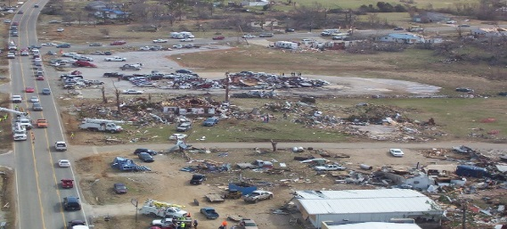
Field Assessment Methods Continued
Fly Overs
A “Fly Over” may be required during large operations or to assess remote areas. This method is the fastest way to assess large areas, but it is also the least accurate. The “best guess” damage determination is made while flying over populated areas. Usually homes are counted in clusters (e.g., clusters may equal 5 to 100 homes depending on the multitude of the disaster, speed of the flight, and the density if the dwellings). As with the other PDA methods, the PDA teams are responsible for determining the degree of damage, insurance coverage, income levels, and ‘etc.’

Slide 17
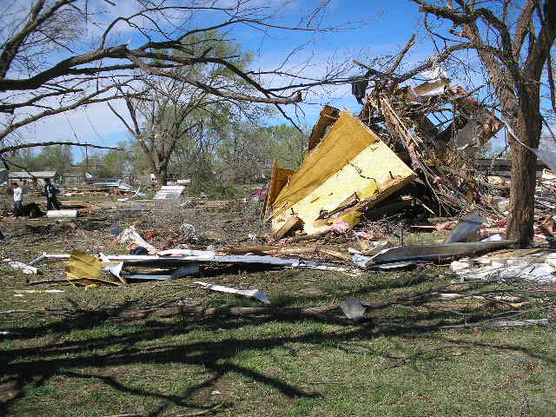
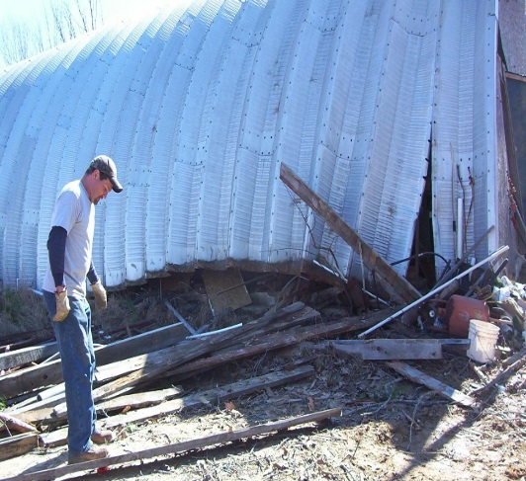
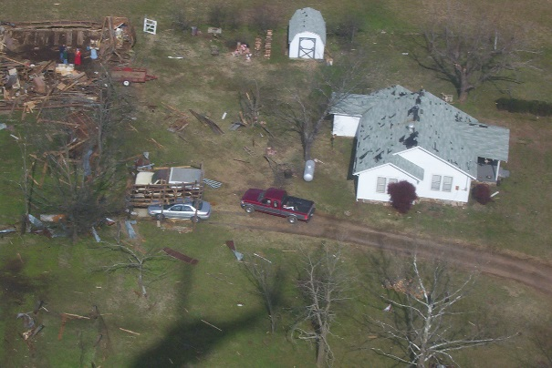
Degree of Damages
When determining the degree of damages, the focus for Individual Assistance Preliminary Damage Assessments is HABITABILITY, meaning whether or not the survivor can safely continue to live in the structure. Damages to homes and businesses are broken down into five categories for an IA PDA: destroyed, major, minor, inaccessible and affected.
DESTROYED
MAJOR
MINOR
Structure is not feasible to repair.
Structure is permanently uninhabitable.
Complete failure of major structural components (collapsed basement walls, foundation, walls or roof).
Substantial failure to structure elements of residence (walls, floors, foundation).
Damages that will take more than 30 days to repair.
Can be repaired within 30 days.
Has more than $100 (or more than program minimum) of eligible habitability items through the Disaster Housing Program, Other Needs Assistance Program, and has less than $10,000 of eligible habitability items through the Disaster Housing Program.
Notes:
Once the necessary information from the PDA has been collected, the level of damage is determined. Listed above is an outline of how FEMA categorizes level of damages as a result of a disaster.

Slide 18
Degree of Damages
AFFECTED
INACCESSIBLE
This category includes dwellings with some damage to structure and contents but which are habitable without repairs and damage to habitability items is less than Disaster Housing Program, Individual and Household/Other Needs Assistance minimum.
The residence is inaccessible by normal means. Generally, this is due to road closures as a result of the disaster (e.g., the bridge is out, the road is covered by water, the road is impassable due to landslide or some other type if soil erosion).

Slide 19
IA requirements for a
Presidential Declaration
No pre-determined formula.
FEMA counts number of houses destroyed or heavily damaged; others have little or no significance.
Number of uninsured/under insured houses.
Demographics of the area affected.
Economic Impact.
Notes:
Once the level of damage is determined, based on the results, a President Declaration may be necessary. If so, listed above are the requirements that will determine a Presidential Declaration.

Slide 20
SBA DECLARATIONS
Four ways disaster declarations are issued for SBA Loans
If the damages are less extensive the Governor can ask for an SBA declaration.
SBA will make a physical disaster declaration when:
SBA will make an economic injury disaster declaration when:
At least 25 homes (primary residences) and/or businesses in a county have uninsured losses of 40% or more of their estimated fair replacement value.
OR
At least three businesses have uninsured loss of 40% or more of their estimated fair replacement value and, as a direct result of damages, 25% of the work force in the community would be unemployed for at least 90 days.
The Governor certifies that at least five small businesses in a disaster have suffered substantial economic injury as a result of the disaster and are in need of financial assistance, not otherwise available on reasonable terms.
OR
The Secretary of Agriculture designates an area as an agricultural disaster area.
Notes:
Individual PDAs also include U.S. Small Business Administration (SBA) PDA. The Governor can ask for a Presidential disaster declaration or a SBA declaration, depending on the severity of the disaster. Listed above are four ways that disaster declarations are issued for SBA Loans.

Slide 21
The information that the Small Business Administration (SBA) Collects:
Number and types of damaged businesses
Number of damaged homes
Degree of damage
Physical property losses
Economic injuries to small businesses
Notes:
The information that the SBA will collect in order to make a declaration is listed above.

Slide 22
Summary of Presentation
Key Points
Identify potential PA applicants and train them to collect necessary information and supporting documentation defined by FEMA.
Collect documentation necessary to support estimates.
Accompany Joint PDA field teams when necessary.
Document the location of and level of damage to homes and businesses according to criteria defined by FEMA.
Document trauma, disruption of normal community functions, areas of concentrated damage, and areas where there is a high numbers of residents from defined special populations observed in the field.
Notes:
Recovery is composed of the core capabilities necessary to assist communities affected by an incident to recover effectively. Listed above are a few key points to ensure a smooth, effective and efficient recovery process.

Slide 23
Disaster Assistance Programs
Overview of Recovery Resources

Slide 24


Types of Federal Assistance
A Presidential declaration opens the door for Federal Assistance:
FEMA Public Assistance (PA)
FEMA Individual Assistance (IA)
Small Business Administration (SBA)
Community Disaster Loan (CDL)
Assistance is supplemental, insurance is always the primary source for assistance.

Slide 25
Who is Eligible for Federal Assistance
Small Business Administration (SBA) – provides low-interest loans to homeowners, renters, businesses, and organizations.
Community Disaster Loan (CDL) – provides operational funding loans to local governments.

Slide 26
Who is Eligible for Federal Assistance
FEMA Public Assistance (PA) – grant assistance for state, tribal , and local governments, and certain Private Nonprofit (PNP) organizations.
FEMA Individual Assistance (IA) – grant assistance for individuals and households affected by disasters.

Slide 27
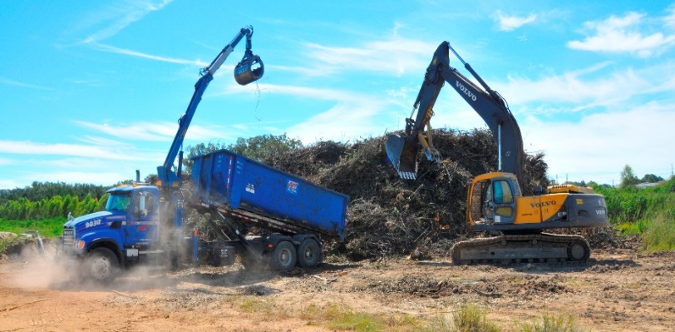
FEMA Public Assistance (PA)
The FEMA Public Assistance (PA) program provides grant funding to eligible applicants for disaster related activities such as:
Debris Removal
Emergency Protective Measures
Permanent Repairs or replacement of applicant owned infrastructure

Slide 28
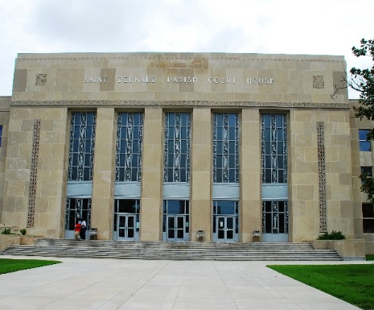
FEMA Public Assistance (PA)
Eligible applicants typically include:
Municipalities
State Agencies
Certain Private Nonprofits
Government Organizations
Tribal Organizations

Slide 29
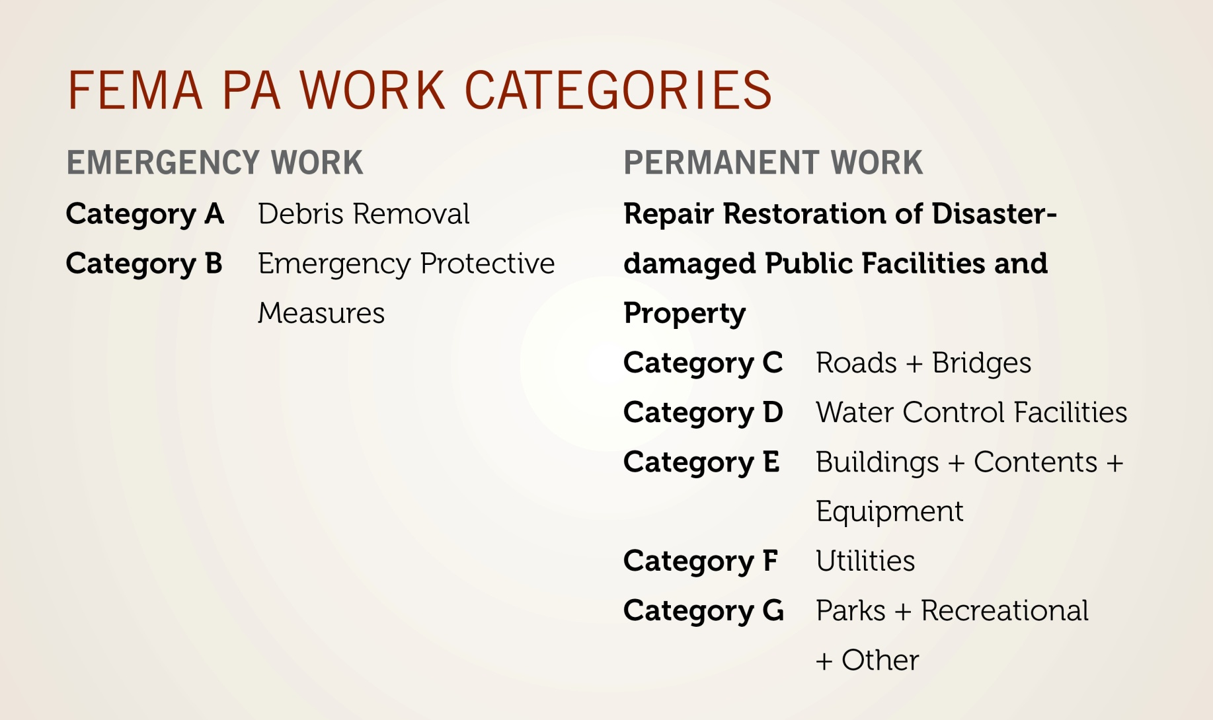
FEMA Public Assistance (PA)
PA Project Thresholds for Fiscal Year 2018
Small Project Minimum - $3,140
Large Project Minimum - $125,500

Slide 30
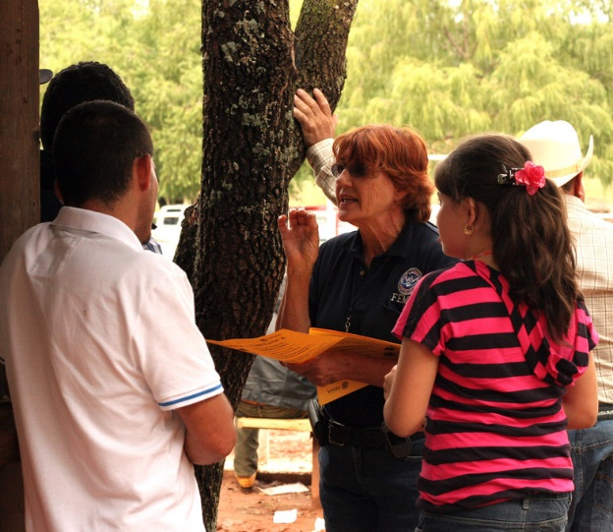
FEMA Individual Assistance (IA)
The FEMA Individual Assistance (IA) program may provide financial help or direct services to eligible individuals and households whose property was directly affected as a result of the federally-declared disaster, and whose losses are not covered by insurance.

Slide 31
FEMA Individual Assistance (IA)
Forms of help available:
Housing Assistance (HA) – may include temporary housing, repair, replacement, and semi-permanent or permanent housing.
Other Needs Assistance (ONA) – may include repair, cleaning or replacement of personal property, medical and dental expenses, funeral expenses and other items.

Slide 32
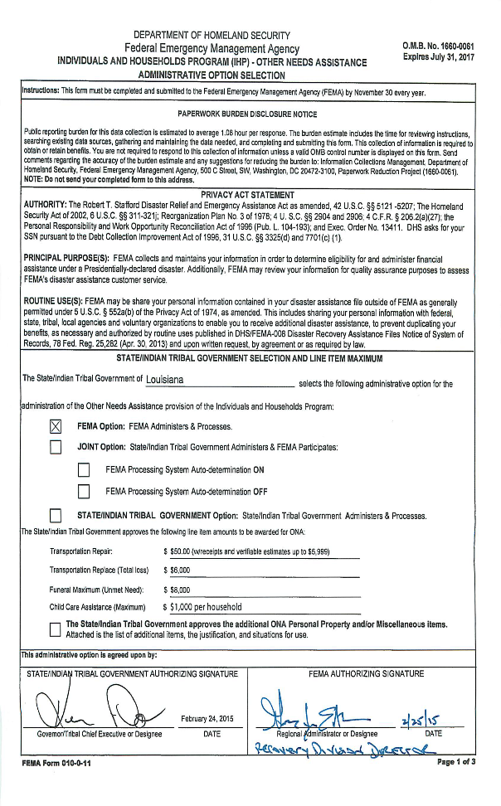
FEMA Individual Assistance (IA)
Congress sets the Individual Assistance grant limit each Fiscal Year (FY)
Current FY limit is up to the max amount of $34,000 for eligible expenses/assistance.

Slide 33
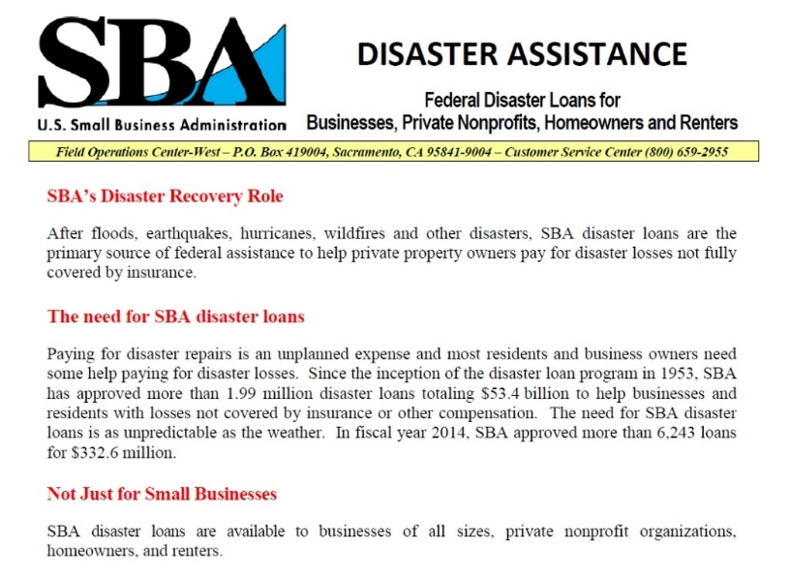
Small Business Administration (SBA)
Small Business Administration (SBA) Disaster Loans
  Provides loans to homeowners + renters + businesses + organizations to repair or replace real estate + personal property + equipment + business assets damaged in a disaster.

Slide 34
Small Business Administration (SBA)
  Types of Disaster Loans
  Business Disaster Loan – loans to business to repair or replace disaster damaged property.
  Economic Injury Disaster Loans (EIDL) – Working capital loans to help small business, small agricultural cooperatives, and most private nonprofit organizations meet their ordinary and necessary financial obligations.
  Home and Property Disaster Loans – Loans to homeowners or renters to repair or replace disaster damaged real estate and personal property.

Slide 35
Small Business Administration (SBA)
Business Disaster Loans
Low-interest, long-term loans for business and certain Private Nonprofit organizations in declared disaster areas for losses not fully covered by insurance or other means.
Loans may be available to repair or replace:
  Damaged or destroyed real estate
  Machinery & Equipment
  Inventory & Other Business Assets

Slide 36
Small Business Administration (SBA)
Economic Injury Disaster Loan (EIDL)
Low-interest, long-term loans to help meet working capital needs caused by the disaster.
EIDL may be available whether the business had any physical property damage or not.

Slide 37
Small Business Administration (SBA)
Home and Property Disaster Loans
Low-interest, long-term loans to homeowners and renters in declared disaster areas for losses not fully covered by insurance or other means.
Loans may be available to:
  Repair or replace your primary residence.
  Replace damaged or destroyed personal property.

Slide 38
Community Disaster Loan (CDL)
The Community Disaster Loan (CDL) program provides a loan to local governments that have incurred a significant loss in revenue, due to a major disaster, that has or will adversely affect their ability to provide essential municipal services provided prior to the disaster.
  Shall not exceed $5 Million
  Will carry an interest rate determined by the Secretary of Treasury
  5 year loan not to normally exceed 10 years

Slide 39
Community Disaster Loan (CDL)
The lesser of…
25% of the applicants Operating Budget for the Fiscal Year of the disaster, or
The cumulative estimated revenue loss for the Fiscal Year of the disaster and the subsequent 3 Fiscal Years, or
50% of the applicant’s Operating Budget for the Fiscal Year of the disaster if estimated revenue loss for the Fiscal Year of the disaster is at least 75% of the applicant’s Operating Budget for the Fiscal Year of the disaster.

Slide 40
Community Disaster Loan (CDL)
Use of Funds
  Must be used to carry on existing local government functions of a municipal operation character or to expand such functions to meet disaster related needs.
  Funds SHALL NOT be used to finance capital improvements, repair or restore damaged facilities, or pay for non-Federal cost shares.

Slide 41
Other Recovery Help
Some additional resources:
  Catalog of Federal Domestic Assistance – search programs offered by type, agency or number
  Grants.gov - Federal grants available from over 26 agencies
  Benefits.gov – “benefit finder” to find programs with federal partners
  National Resource Network - diverse private and public sector organizations providing support, peer networks and online expertise

Slide 42
Questions?
E. Carroll W. Carroll Tensas Jackson Sabine Winn Natchitoches Grant LaSalle Vernon Rapides Avoyelles Catahoula Terrebonne LaFourche

