Slide 1
Changes to the National Flood Insurance Program (NFIP)
Sandy Keefe
Mitigation Division Deputy Director
FEMA Region 6
Feb 11, 2013

Slide 2
Purpose
Provide overview of changes to the National Flood Insurance Program (NFIP)
Review R6 demographics related to NFIP
Highlight potential demographic and Recovery implications
Review actions citizens and government officials can take

Slide 3
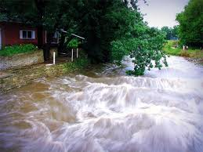
Background
Flooding is a component in 90% of the nation’s disasters

Slide 4
Background
NFIP created in 1968 to reduce flood-related disaster costs
Managed by FEMA
Established quid pro quid: availability of flood insurance in exchange for local floodplain management
At inception, exempted/grandfathered actuarial rate premium pricing for all properties built before FEMA issued its first flood maps
In FEMA Region 6, 42% of all policy holders pay non-actuarial or subsidized insurance premiums
July 2012: Congress passed Biggert-Waters NFIP Reform legislation
Requires the NFIP to use actuarial principles in rating policies
Phases out and removes premium subsidies
Subsidies can account for 40% to 70% of a policy’s premium

Slide 5
NFIP Rating Examples: The Impact of Loss of Subsidies
Rate comparisons
$2,235/yr
$2,235/yr
Non-Actuarial
$2,235/yr
1 foot above BFE
1 foot below BFE
$819/yr
10 feet below BFE
$5,623/yr
$25,000+/yr
Actuarial
Building- $200,000 Contents- $80,000 (2012 Rates)
Notes:
Homes located in a high-risk flood zone that were built before the first flood insurance rate map became effective, and that have not been substantially damaged or improved, may currently be receiving subsidized rates, These subsidized rates for “pre-FIRM” homes will be phased out.

Slide 6
What’s Changing
Phasing:
All categories except mapping: 25% p/yr. until full-risk rate is achieved
Mapping: 20% p/yr. over 5 years
Subsidies to be phased out
Non-primary residences (January 2013)
Business properties (later in 2013)
Severe repetitive loss properties and where
claims payments > fair market value (later in 2013)
Properties affected by map changes (2014)
New policies to be issued at full-risk rates (later in 2013)
After the sale/purchase of a property
After a lapse in insurance coverage
After substantial damage/improvement
For properties uninsured as of the law’s enactment
Notes:
A subsidized premium rate is one that does not reflect the true risk of flood to that property. Homes located in a high-risk flood zone (i.e., zones beginning with an “A” or “V”, for Velocity Zone) that were built before the first flood insurance rate map became effective, and that have not been substantially damaged or improved, may currently be receiving subsidized rates, These subsidized rates for “pre-FIRM” homes will be phased out.
Second, some policies that previously could be issued at lower rates will move to full-risk rates. Let’s look at these changes in more detail.
A primary residence is defined as a building that will be lived in for 80% of the year. If the homeowner or spouse will not be living in the residence for at least 80% of the year, it’s a non-primary residence.

Slide 7
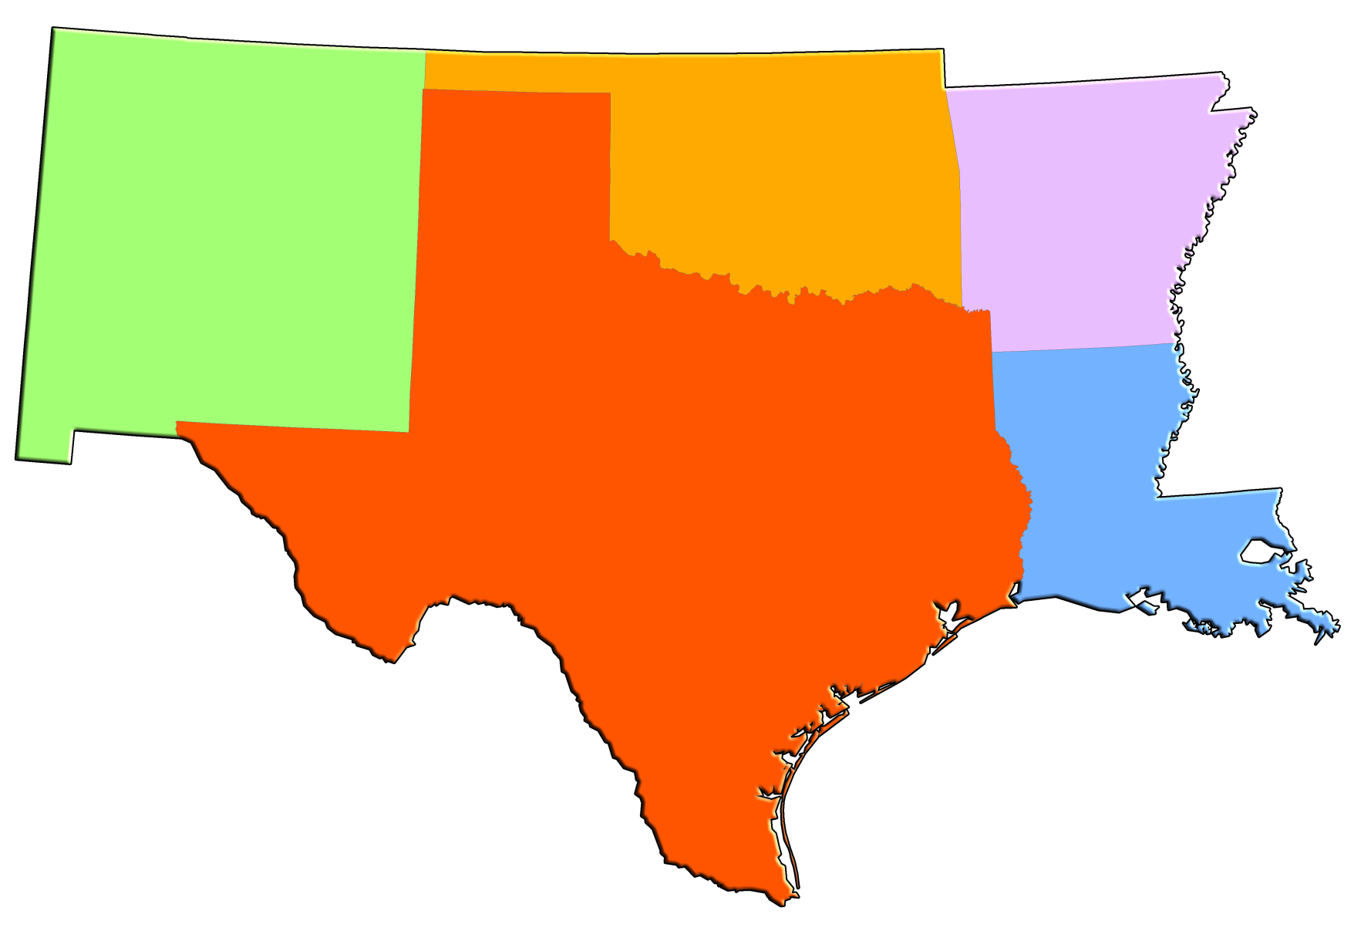
Regional Statistics
R6 has 1.2M NFIP Policyholders
Oklahoma
17,640
NFIP Policyholders
Arkansas
21,303
NFIP Policyholders
New Mexico
16,779
NFIP Policyholders
Texas
645,707
NFIP Policyholders
Louisiana
486,233
NFIP
Policyholders

Slide 8
Regional Statistics
42% of R6 Policyholder Rates are Subsidized (508K)
Oklahoma: 65%
New Mexico: 61%
Arkansas: 57%
Louisiana: 49%
Texas: 38%
Policyholders of Business Properties: 68K
Repetitive Loss Policyholders: 54K

Slide 9
Ramifications to Consider
Does this make living in high-risk areas unaffordable for some citizens?
Does this impact response and recovery operations in a flooding disaster or event?
Individual and Public Assistance – NFIP purchase requirement
Immediately after a disaster:
Do citizens know the impact of their rebuilding decisions?
Is this an opportunity to optimize interest in elevations and buy-outs?
Does this change how states allocate or prioritize mitigation grant dollars?

Slide 10
What Policyholders Can Do:
Take a look at their current, effective flood maps
Talk with the local Floodplain Administrator to learn if there is a preliminary flood insurance rate map available
Know their risk and start planning for mitigation actions
Call their insurance agent for more details on their policy
Look into FEMA Mitigation programs available to them

Slide 11
Mitigation Programs Available
Increased Cost of Compliance (ICC) Program
Up to $30,000 for flood proofing, relocation, elevation, or demolition (FRED) after a flood.
NFIP Community Rating System (CRS) Program
Premium discounts up to 45% are available for policyholders in communities that participate in CRS
FEMA Hazard Mitigation and Severe Repetitive Loss Grant Programs

Slide 12
Regional Approach
Messaging and Education Campaign:
State and local hazard mitigation officers
DEM staff
State and local floodplain administrators
Insurance agents
Congressional offices
Post Disaster: Ensuring citizens have the information they need to make
informed rebuilding and repair decisions
Overarching Message: Rebuilding higher reduces flood risk and insurance costs

Slide 13
Where to Find More Info:
www.fema.gov for numerous mitigation programs
search for -
Hazard Mitigation Assistance
Increased Cost Compliance
Community Rating System
Building Sciences
www.floodsmart.gov for more on flood risks and flood insurance
http://maps.riskmap6.com/ to view online flood maps
Sandra.keefe@dhs.gov
Ph: 940-898-5146

