Slide 1
Avoid Your
Next Disaster

Slide 2


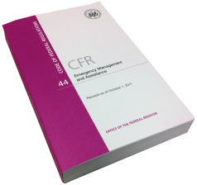

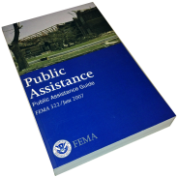
Notes:
Introduction Slide

Slide 3
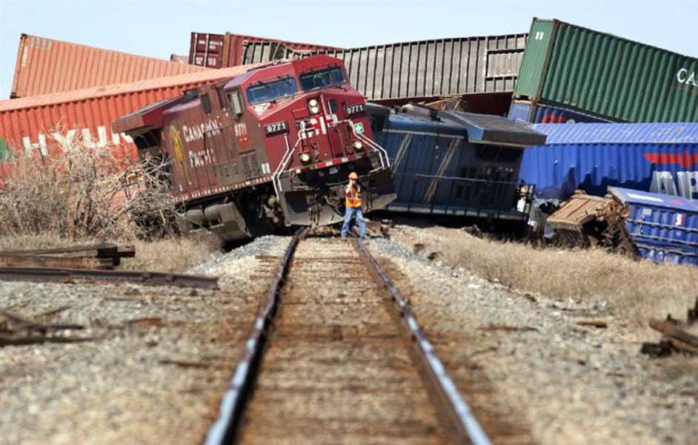
IF NOT . . .

Slide 4
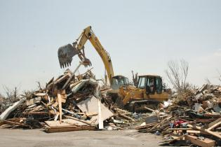
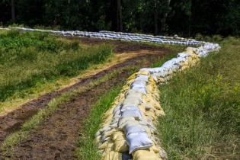

Director’s areas of responsibility
Category A
Category B
Category C - G

Slide 5

Procurement and documentation

Slide 6

Pre-event contracts

Slide 7


Presidential declaration thresholds for public assistance
St. Tammany Parish
State
$818,090
$6.3M

Slide 8
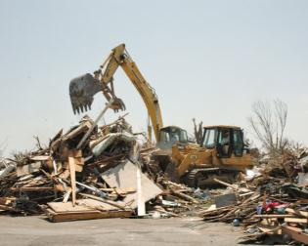
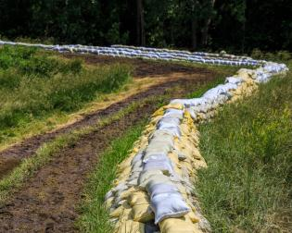
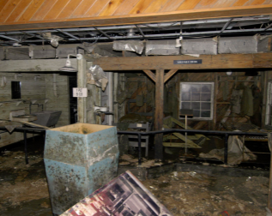
Public assistance criteria for presidential declaration request
Cost of debris operation
Cost of emergency protective measures
Damage to infrastructure

Slide 9

Individual assistance criteria for presidential declaration request
Insurance
Insurance

Slide 10
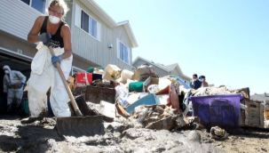
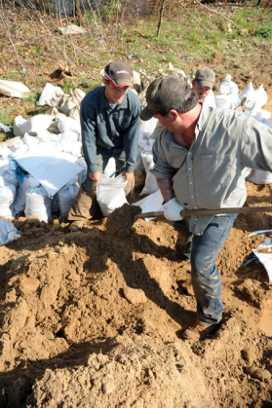
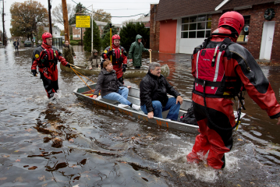

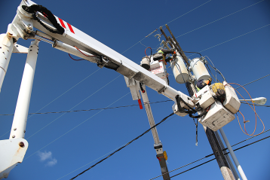
Activity details
for presidential declaration request

Slide 11
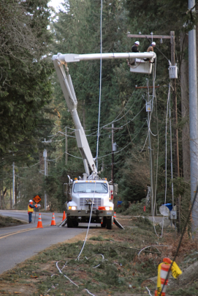

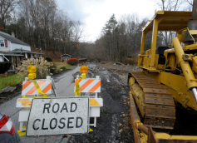

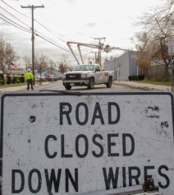
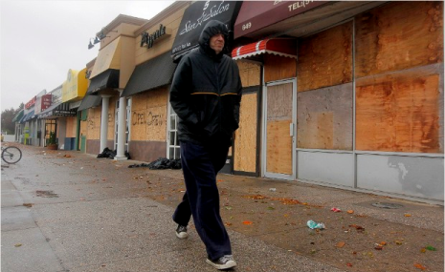
Consequences of event for presidential declaration request

Slide 12




Economic impact statement for presidential declaration request

Slide 13
Disaster Recovery, Legal Section
Questions?
Contact information
Ben Plaia
Legal Counsel
225-456-0374
ben.plaia@la.gov
LaShaunté Martin
Deputy Legal Counsel
225-397-7712
lashaunte.martin@la.gov
Jordan Parker
Attorney
225-334-7756
jordan.parker@la.gov

