Slide 1
LASEMP Regional Exercise

Slide 2
Welcome and Overview
David Schultz
Preparedness Section Chief
GOHSEP
Rachel Schlatre
Administrative Coordinator
GOHSEP
John Callahan
Training and Exercise Branch Manager
GOHSEP
Michael Zaruba
Exercise Officer
GOHSEP
LA Governor’s Office of Homeland Security and Emergency Preparedness

Slide 3
Exercise Overview
Scope: This exercise is a seminar planned for 3 hours at each of the 9 regions within Louisiana. Exercise play is limited to First Responders, key school personnel, and Emergency Management personnel.
Mission area: Response

Slide 4
Objectives and Core Capabilities
Review the current Tornado/Hazardous Weather plan’s ability to address a catastrophic event at a school in your parish in accordance with your district’s Emergency Operation Plan.
Planning
Discuss your plan’s collaboration with First Responders and local NGOs in preparation and response for a crisis in accordance with your district’s Emergency Operation Plan.
Operational Coordination
Review the current notification, accountability and reunification plans and their implementation after a severe weather event in accordance with your district’s Emergency Operation Plan.
Operational Communications

Slide 5
Participants Roles and Responsibilities
Players: Respond to situation presented based on current plans, policies, and procedures
Observers: Support players in developing responses, but do not participate in moderated discussion
Facilitators: Provide situation updates and moderate discussions
Evaluators: Observe and document player discussions

Slide 6
Exercise Structure
This exercise will be a multimedia, facilitated exercise. Players will participate in the following 3 modules:
Module 1: Watch & Warnings
Module 2: Touchdown
Module 3: Aftermath
After each update, we will review the situation and engage in functional group discussions of appropriate response issues. For this exercise, the functional groups are as follows:
Key School Personnel
First Responders

Slide 7
Exercise Guidelines
This is an open, low-stress, no-fault environment. Varying viewpoints, even disagreements, are expected
Base your responses on the current plans and capabilities of your organization
Decisions are not precedent setting; consider different approaches and suggest improvements
Issue identification is not as valuable as suggestions and recommended actions that could improve response efforts; problem-solving efforts should be the focus

Slide 8
Assumptions and Artificialities
The exercise is conducted in a no-fault learning environment wherein capabilities, plans, systems, and processes will be evaluated
The exercise scenario is plausible, and events occur as they are presented
All players receive information at the same time

Slide 9
Exercise Schedule
Registration……………………………………………….. 8:30am
Welcome and Introduction………………………………. 9:00am
Module 1: Watch & Warning…………………………….. 9:15am
Module 1 brief back…………………………………… 9:40am
Module 2: Touchdown…………………………………… 9:50am
Module 2 brief back…………………………………..10:30am
Break………………………………………………………10:40am
Module 3: Aftermath……………………………………..10:50am
Module 3 brief back…………………………………..11:30am
Break………………………………………………………11:40am
Conclusion………………………………………………...11:50am
Closing Comments……………………………………….12:05pm

Slide 10
Module 1: Watch & Warnings
March 31, 2016: 1:00pm
Thursday afternoon and classes are in session. NWS has issued numerous severe weather warnings due to a front moving across our area from the west and that conditions will be favorable for tornadic activity. This weather advisory was forwarded to the school staff along with a link to the EOP this morning.
March 31, 2016: 1:15pm
NWS updates conditions to a tornado watch for our parish.
March 31, 2016: 1:30pm
NWS updates conditions to a tornado warning for our parish. Local media reports that multiple funnel clouds have been spotted 10 miles to the North West.

Slide 11
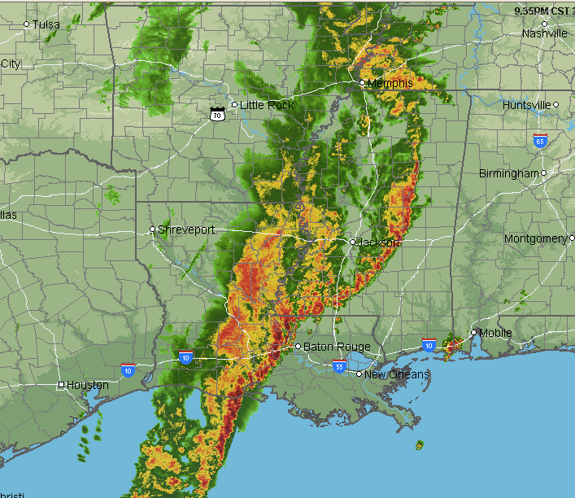
Module 1: Key Issues
Multiple tornadoes have been spotted within 10 miles of the school
The school is fully staffed with employees and students

Slide 12
Module 1: Discussion
Take the next 35 minutes to answer these questions.
Each Functional Group designates someone to scribe and brief
Key School Personnel
What people or agencies would/should receive this information?
Where would you put everyone? Has this been successfully accomplished before during a real world event or exercise?
What supplemental instructions would need to be given?
First Responders
What people or agencies would/should receive this information?
Where would you go until the tornado passed over?
Do you have standing instructions pertaining to tornadoes impacting schools?

Slide 13
Module 1: Discussion
Are there any gaps in your checklist/plan? What redundancies are built into the plan in case of unavailability of key personnel?

Slide 14
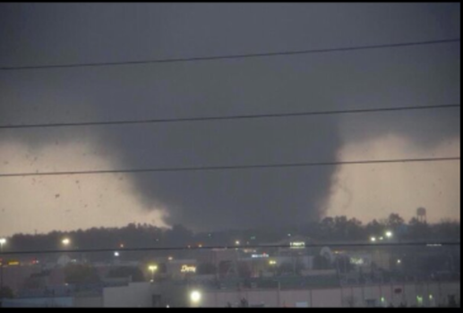
Module 2: Touchdown
March 31, 2016: 1:35pm
Four wind shears converge into one mass and impacts six major areas of the city. At about 1:45 p.m. the tornado touches down at your largest school.
March 31, 2016: 1:50pm
An EF-4 on the Enhanced Fujita Scale with winds of 170 mph has cut a 500 yard path through 10 miles of the parish.

Slide 15
Module 2: Touchdown
March 31, 2016: 2:00pm
Initial damage assessment is difficult. Complex of classrooms, auditorium, gymnasiums, band room, athletic facilities, ROTC building and stadium are damaged.
Additional assessment finds the roof of one school hallway was lifted by the force of the storm, allowing the walls to collapse onto students, stadium clock blown to neighboring town 14 miles away, 330 damaged vehicles scattered in five parking lots, and all classrooms are damaged. Within the parish:
• 374 homes with “major” damage
• 529 homes with “minor” damage
• 251 homes “affected”
• 239 homes destroyed

Slide 16
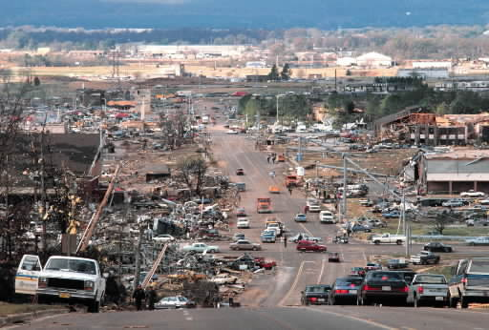
Module 2: Key Issues
Key Issues
• Multiple casualties and some confirmed fatalities
• Some structures have collapsed with possible victims trapped under the rubble

Slide 17
Module 2: Discussion
Take the next 35 minutes to answer these questions.
Each Functional Group designates someone to scribe and brief
Key School Personnel
How do you plan to gain accountability of everyone on campus?
Who are you going to notify?
What message would officials deliver to the general public?

Slide 18
Module 2: Discussion
First Responders
How would your agency prioritize service between a school and other people/facilities in need?
Where would you establish the Casualty Collection Point (CCP)? Has this been practiced?
What message would officials deliver to the general public?
What local/state resources are available for this type of situation?
Do the Concept of Operations (CONOPs) address information/intelligence sharing adequately? If not, how could they be improved?
What other assets do you need and do Memoranda of Understanding/Agreement (MOU/MOA) exist to provide that?

Slide 19
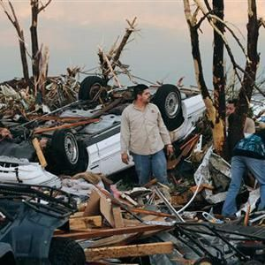
Module 2: Discussion
Where is this in your plan? If you are not there or incapacitated, do others know how to implement this and that they should do so?

Slide 20
Module 3: Aftermath
March 31, 2016: 2:20pm
First Responders are on scene. There is no electricity, water, or phone connectivity in the remaining structures. Cellular service is sporadic and overloaded by high call volume. 2 of 3 VHF repeaters are lost causing police, fire and rescue squad to operate on one frequency.
March 31, 2016: 2:25pm
There is a natural gas line rupture at a nearby business. No fires have been reported but hydrants have little pressure. Extensive debris is blocking access to the scene but parents and media are still beginning to arrive.
March 31, 2016: 3:00pm
Army medical helicopters arrived on scene within minutes of tornado with physicians for field triage. Search and rescue has been called but it will take 2 hours to get their equipment through the debris. 8 students have been confirmed dead.

Slide 21
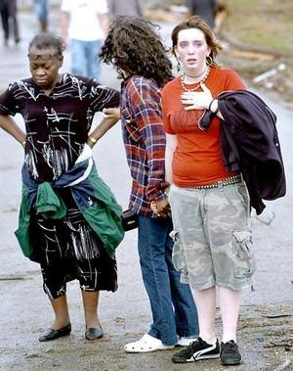
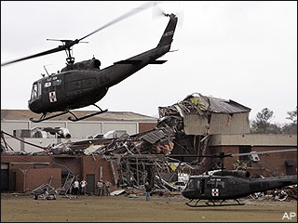
Module 3: Key Issues
Key Issues
Ground access to the school
Parents are anxious, students are dazed/scared, and media are making inquiries
Notes:
TOC is in packets…have them pull it out.

Slide 22
Module 3: Discussion
Take the next 35 minutes to answer these questions.
-Each Functional Group designates someone to scribe and brief
Key School Personnel
Who would you notify and how?
When would you notify them?
What information would you give them?
What is your Plan B (e.g., phone call, text message, e-mail)? Diagram your communication flow.
What assistance will you need?
What are your procedures for missing students or faculty?
What are your other concerns? Do you have the authority to make those decisions?
What changes would you make to your plan and/or training?

Slide 23
Module 3: Discussion
Take the next 35 minutes to answer these questions.
-Each Functional Group designates someone to scribe and brief
First Responders
Who is in charge?
Who would you notify, how, and when?
What information would you give them?
What is your Plan B (e.g., phone call, text message, e-mail)? Diagram your communication flow.
Are there state and/or Federal laws that can be utilized? What are they, and who would advise on these matters?
What changes would you make to your plan and/or training?

Slide 24
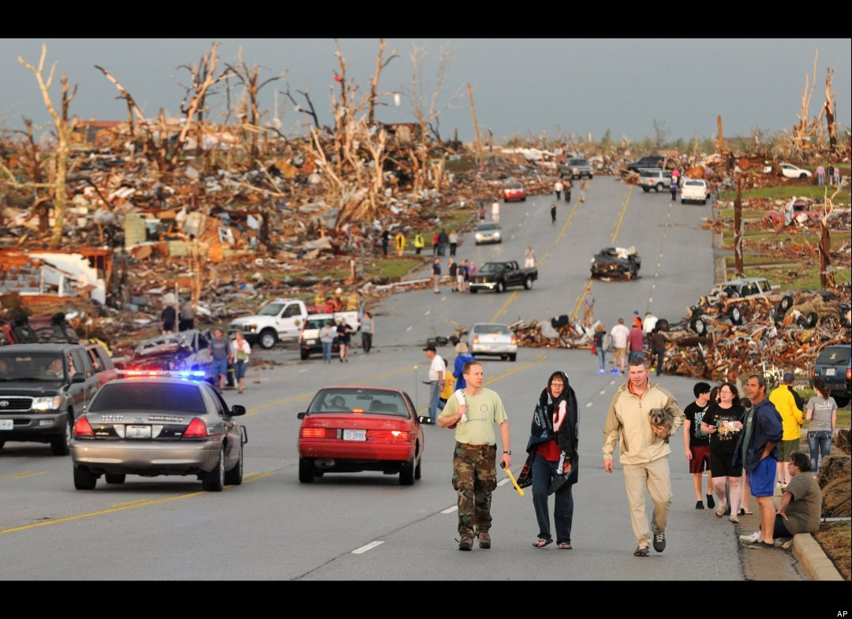
Module 3: Discussion
How do you plan to reunify children with family?
How can you ensure they leave with the proper adult/guardian?
How are you informing school administrators of who has been medivac’d off school grounds?

Slide 25
Conclusion
What aspects of your plan are good and what needs improvement or testing?
What parts of this seminar did you find particularly useful and what should be changed? (PFFs)
Strengths
1.
2.
3.
Areas for Improvement
1.
2.
3.
Notes:
Hold up box.

Slide 26
Moving Forward
Now what?
Determine if your organization’s policies & procedures address this scenario
Perform a TTX to evaluate your school’s specific procedures
Create an Improvement Plan from the evaluation results
Implement solutions and retest

Slide 27
Closing Comments
Sign In sheet (if you missed it)
Participant Feedback Forms
An LASEMP Program After Action Report in the next few months
Final Survey to be distributed in the next few months
Resources: http://gohsep.la.gov/PREPARE/LASEMP
Contact us at: gohsepexercise@la.gov

