Slide 1
Program Overview
Jeff Haley, Office of Community Development
April 5, 2018

Slide 2
Current Program Funding
PROGRAM AREA | TOTAL PROGRAM BUDGETS
HOMEOWNER ASSISTANCE PROGRAM | $1,331,163,919
RENTAL HOUSING PROGRAM | $134,163,422
BUSINESS AND AGRICULTURE | $62,000,000
FEMA NONFEDERAL SHARE MATCH | $105,000,000
INFRASTRUCTURE ENHANCEMENT | $9,800,799
ADMIN AND PLANNING | $66,278,880
TOTALS | $1,708,407,020

Slide 3
Homeowner Assistance Program
Solution 1
PROGRAM MANAGED
Solution 2
HOMEOWNER MANAGED
Solution 3
REIMBURSEMENT

Slide 4
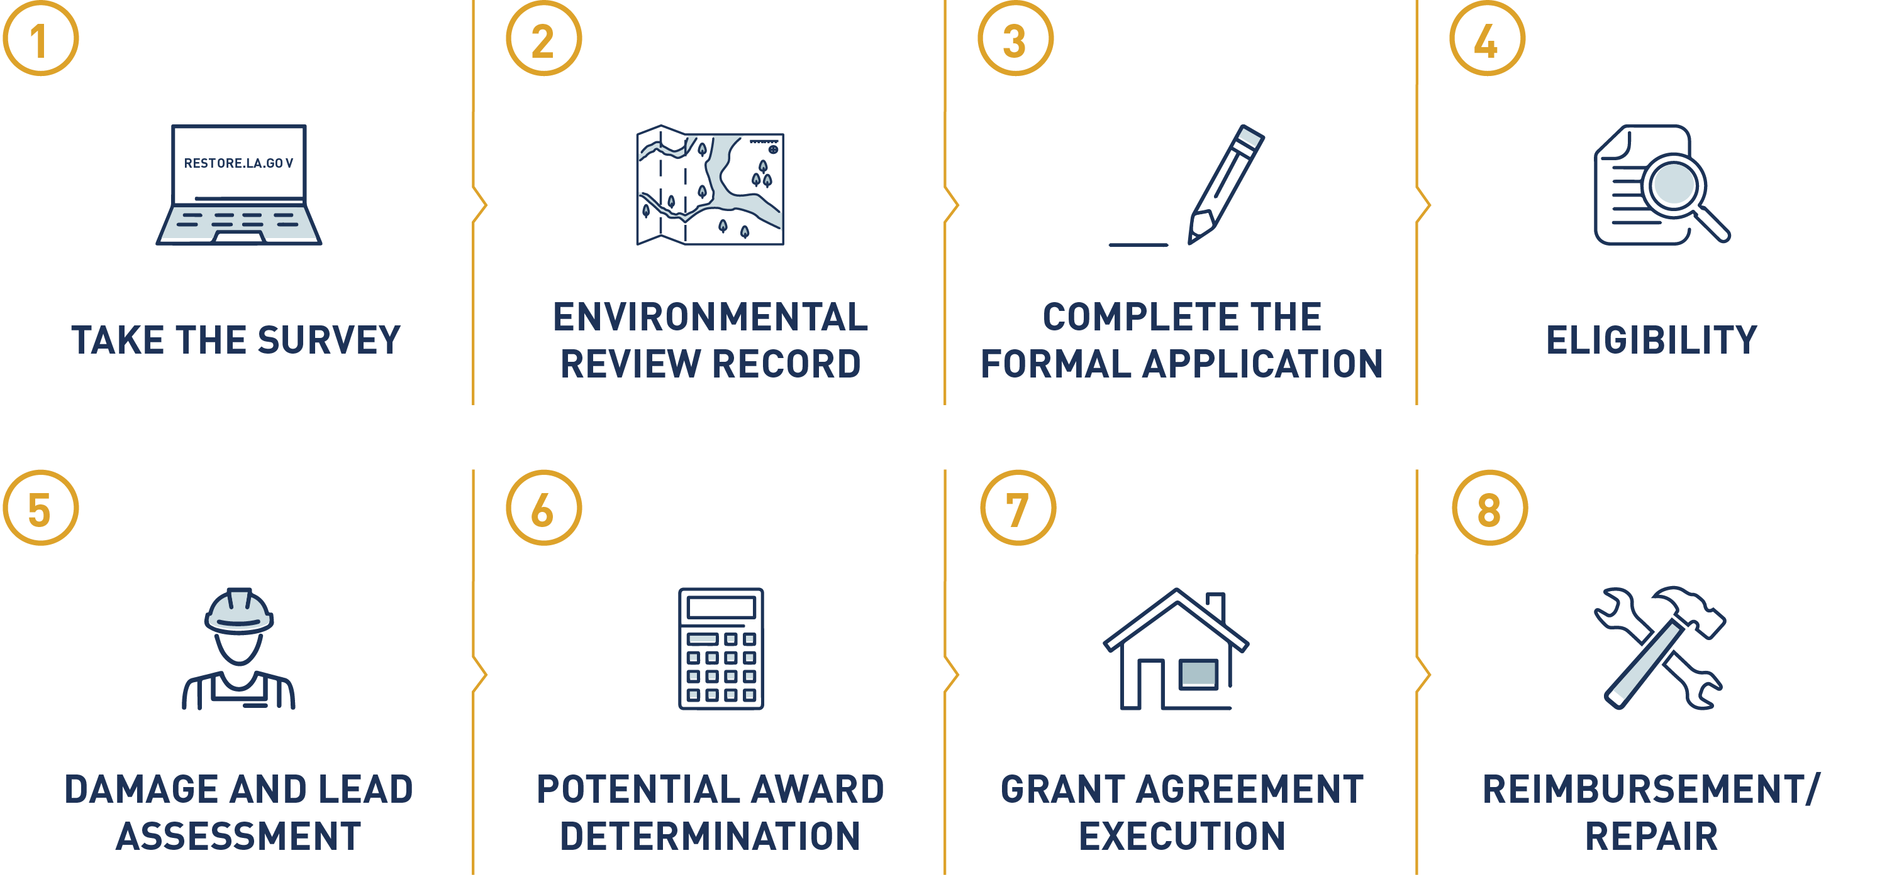
How the program works

Slide 5
Program phases Given Current Funding
ALL PHASES
Must have major/severe home damage.
PHASE I
PHASE II
PHASE III
Low-to-moderate income*
Elderly or persons with disabilities
Outside the floodplain
Low-to-moderate income*
Elderly or persons with disabilities
Inside the floodplain
Reside within one of the 10 most impacted or distressed parishes
Outside the floodplain
No priority due to income
PHASE IV
PHASE V
PHASE VI
Reside within one of the 10 most impacted or distressed parishes
Inside the floodplain
No priority due to income
All other disaster-declared parishes
Inside and outside the floodplain
No priority due to income
Reimbursement for homeowners who do not qualify under Phases I or II, who have completed the rebuilding process at the time they complete the application
No priority due to income
* Household income is at or below 80% of an area’s median income.
Notes:
Income is only a factor in the first two phases. We know there are lots of folks who emptied their savings or retirement accounts to rebuild and are waiting on our reimbursement. It’s important to remember that saving neighborhoods is critical. Getting people back into their homes first helps not only those people we help rebuild, but to their neighbors who have already rebuilt, to protect their neighborhoods and their property values.

Slide 7
PROGRAM STATS
49,080 homeowners have submitted surveys with 40,180 qualifying for the program.
Of the qualifying homeowners, 39,710 have been invited to apply.
28,970 of the invited applicants have submitted their application.
Grant awards have been offered to 8,960 homeowners with a total dollar amount of $242 million⁺.

Slide 8
Jeff Haley | Jeff.Haley@la.gov

