Slide 1
Continuity of Operations Planning (COOP)
Business Continuity Planning (BCP) & Disaster Recovery Planning (DRP)
Skip Breeden

Slide 2
Business Continuity Planning (BCP) & Disaster Recovery Planning (DRP)
How to preserve critical business functions in the face of a disaster.
Notes:
These terms are interchangeable.

Slide 3
Why?
Up to 40% of businesses affected by a natural or human-caused disaster never reopen. (Source: Insurance Information Institute)
Customers expect delivery of products or services on time. If there is a significant delay, customers may go to a competitor.
Failure to implement a preparedness program risks losing business to competitors who can demonstrate they have a BCP.
Notes:
1) Note that “disaster” is defined by the business, and may not include actual destruction of capabilities.

Slide 4
Why?
According to the Small Business Administration, small businesses:
Represent 99.7% of all employer firms
Employ about half of all private sector employees
Have generated 65% of net new jobs over the past 17 years
Made up 97.5% of all identified exporters.
Notes:
1) Note that “disaster” is defined by the business, and may not include actual destruction of capabilities.

Slide 5
The BCP Addresses
Continuation of critical business processes when a disaster destroys data processing capabilities
Preparation, testing and maintenance of specific actions to recover normal operations (the BCP)
Notes:
1) Note that “disaster” is defined by the business, and may not include actual destruction of capabilities.

Slide 6
Disasters – Natural, Man-made
Fire, flood, hurricane, tornado, earthquake, volcanoes
Plane crashes, vandalism, terrorism, riots, sabotage, loss of personnel, etc.
Anything that diminishes or destroys normal data processing capabilities

Slide 7
Disasters are Defined in Terms of the Business
If it harms critical business processes, it may be a disaster
Time-based definition – how long can the business stand the pain?
Probability of occurrence
Notes:
Example: a disaster for a small business that depends on its web presence might be an errant backhoe operator cutting a fiber optic line.
Example: Similarly, if the ISP hosting the web site for that business goes out of business and there is no plan to recover, that might be a disaster.
Example: a plane landing on FREH would be a disaster for Purdue

Slide 8
Broad BCP Objectives - CIA
Confidentiality – important
Integrity – important
Availability – the main focus
Notes:
If you have sensitive or confidential data, your DRP must preserve its confidentiality.
If your DRP doesn’t preserve the integrity of your data, it doesn’t matter if you’ve made it available.

Slide 9
BCP Objective
Create, document, test, and update a plan that will:
Allow timely recovery of critical business operations
Minimize loss
Meet legal and regulatory requirements
Notes:
The first two bullets seem obvious, but what about “regulatory requirements?”
If current business practice must meet regulatory requirements (e.g., FERPA, SOX, HIPPA) then the BCP must preserve that compliance. It’s not enough to say “we’re back up!”

Slide 10
Scope of BCP
Was just the data center
Now includes:
Distributed operations
Personnel
Networks
power
All aspects of the IT environment

Slide 11
Creating a BCP
Is an on-going process, not a project with a beginning and an end
Creating, testing, maintaining, and updating
“Critical” business functions may evolve
The BCP team must include:
Business personnel
IT personnel
Requires the support of senior management
Notes:
Initial creation of the plan is treated like a project, using traditional project management techniques.
However, business needs change, new processes may be added. If they are “critical,” they must become part of the BCP.
Part of the project to create the BCP must build in business processes for plan maintenance.

Slide 12
The Five BCP Phases
Project management & initiation
Business Impact Analysis (BIA)
Recovery strategies
Plan design & development
Testing, maintenance, awareness, training
Notes:
Phases are covered in detail in next slides

Slide 13
1. - Project Management & Initiation
Establish need (risk analysis)
Get management support
Establish team (functional, technical, BCC – Business Continuity Coordinator)
Create work plan (scope, goals, methods, timeline)
Initial report to management
Obtain management approval to proceed
Notes:
If you don’t establish need, how can you get management support? A BCP costs a lot to develop and maintain. No ROI either.
Functional leads are necessary because the IT staff don’t understand the business.
The BCC is the project manager for the BCP creation, the most important person.
The work plan will be like the phases of a traditionally managed project

Slide 14
2. - Business Impact Analysis (BIA)
MTD – Maximum Tolerable Downtime, also known as MAO (Maximum Allowable Outage)
Goal: obtain formal agreement with senior management on the MTD for each time-critical business resource
Notes:
A lot of the BCP creation is driven by the MTDs assigned to various business functions, so the BIA is very important.

Slide 15
2. - Business Impact Analysis (BIA) (continued)
Quantifies loss due to business outage (financial, extra cost of recovery, embarrassment)
Does not estimate the probability of kinds of incidents, only quantifies the consequences
Notes:
On the second bullet, for instance, the question is not “how likely is it we’ll suffer a total loss of our data center from a fire?” The question is “what would be the loss to the business if we suffered the total loss of our data center?”
Some losses may be quantified fairly exactly. Others have to be estimated as carefully as possible. An example of the latter would the cost to the business in loss of consumer confidence from an extended outage.
For instance, what if Purdue were unable to hold classes for four weeks because we couldn’t deliver our electronic instruction? How would parents of potential Purdue students react to that? And how much would it cost?

Slide 16
2. - BIA Phases (continued)
Choose information gathering methods (surveys, interviews, software tools)
Select interviewees
Customize questionnaire
Analyze information
Identify time-critical business functions
Notes:
There are nine phases to the BIA.
Selection of interviewees is very important. These will be the subject matter experts from the business units, and they have to be the people who know the business.
Customize questionnaire: there is no standard set of questions – it varies with each business
Time-criticality – some processes are more critical than others. Printing a payroll is important, but not time-critical usually.
if you’re Amazon.com, keeping your web site up is critical. The business won’t go under if you print paychecks a couple of days late, but they would lose millions in potential revenue if their web site were down for a day. The BIA aims to rank-order business processes in these terms.

Slide 17
2. - BIA Phases (continued)
Assign MTDs
Rank critical business functions by MTDs
Report recovery options
Obtain management approval
Notes:
MTD – maximum tolerable downtime
MAO – maximum allowable downtime
Recovery options will range in price and effort – must match them appropriately with the criticality of business functions

Slide 18
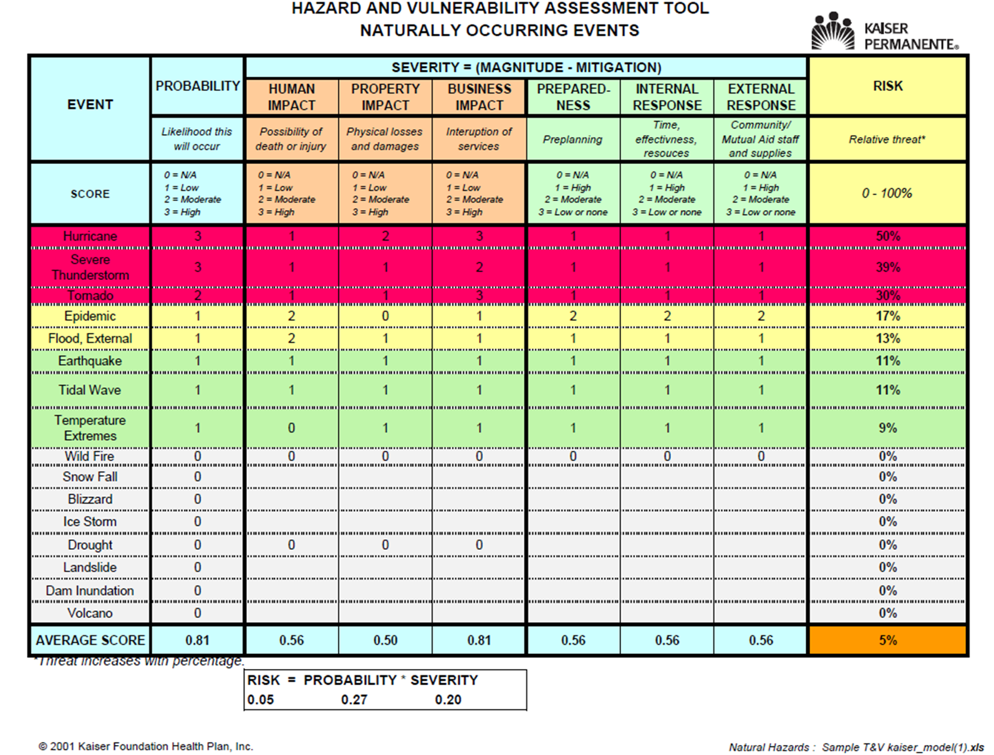

Slide 19
3. – Recovery Strategies
Recovery strategies are based on MTDs
Predefined
Management-approved
Notes:
Predefined means we don’t have to make it up as we go along. We have a documented, tested plan in place.
Management approved means you will get the resources to implement the BCP.

Slide 20
3. – Recovery Strategies (continued)
Different technical strategies
Different costs and benefits
How to choose?
Careful cost-benefit analysis
Driven by business requirements
Notes:
Driven by business requirements means going back to the BIA, which identified critical business processes and ranked them in terms of the MTD/MAO.

Slide 21
3. – Recovery Strategies (continued)
Strategies should address recovery of:
Business operations
Facilities & supplies
Users (workers and end-users)
Network, data center (technical)
Data (off-site backups of data and applications)
Notes:
Business operations were enumerated in the BIA – what IT and other requirements are necessary to support them?
Facilities and supplies – where do I sit at the DR site? Where is my conference room? Do I get a whiteboard? And by the way, I need a pencil.
Users – can manual processes be used as part of DR? If so, how does the manual processing get integrated back into the electronic processing later? Do we need housing, transportation?
Recovery of data centers and networks is an obvious necessity requiring careful planning. There are technical solutions available, though. (Bring money.)
You mean we’ve got all these computers in the DR site and no data? Who forgot the DATA??
I’m only going to go into detail on the last two bullets. The first three are also quite detailed planning processes.

Slide 22
3. – Recovery Strategies (continued)
Technical recovery strategies - scope
Data center
Networks
Telecommunications
Notes:
The data center is obvious.
Network connectivity (loss of) could be defined as a disaster all by itself.
Telecommunications are vital to most businesses. You don’t want to get to the DR site and realize you forgot the need for a PBX or a FAX machine.

Slide 23
3. – Recovery Strategies (continued)
Technical recovery strategies – methods
Subscription services
Mutual aid agreements
Redundant data centers
Service bureaus
Notes:
These four types are covered in subsequent slides

Slide 24
3. – Recovery Strategies (continued)
Technical recovery strategies – subscription service sites
Hot – fully equipped
Warm – missing key components
Cold – empty data center
Mirror – full redundancy
Mobile – trailer full of computers
Notes:
Hot – expensive, testable
Warm – missing key components like computers, hence not testable
Cold – slower to recover, cheaper
Mirror – sounds great if you can afford it
Mobile – the semi tractor-trailer pulls up to your site

Slide 25
3. – Recovery Strategies (continued)
Technical recovery strategies – mutual aid agreements
I’ll help you if you’ll help me!
Inexpensive
Usually not practical
Notes:
Suppose, for instance, that Purdue can’t afford a hot DR site and neither can IU. We agree to help each other in this case.
But we probably don’t have identical hardware and software at both institutions.
Most likely neither institution has excess capacity to make available in a DR scenario
Does this sound like it’s going to work? It is probably better than nothing, though.

Slide 26
3. – Recovery Strategies (continued)
Technical recovery strategies – redundant processing centers
Expensive
Maybe not enough spare capacity for critical operations
Notes:
Think of load balanced redundant sites, for instance. Operations are going OK, but are both sites running at less than 50% capacity? Can site A handle the load if site B goes down?

Slide 27
3. – Recovery Strategies (continued)
Technical recovery strategies –service bureaus
Many clients share facilities
Almost as expensive as a hot site
Must negotiate agreements with other clients
Notes:
The claim in the (ISC)2 book is that service bureaus are shared by many clients and usually run at about 100% capacity. If a client has to transfer operations to the service bureau as part of a DR, the other clients take a hit in diminished processing capacity. Agreements need to be negotiated in advance with the other clients.

Slide 28
3. – Recovery Strategies (continued)
Technical recovery strategies –data
Backups of data and applications
Off-site vs. on-site storage of media
How fast can data be recovered?
How much data can you lose?
Security of off-site backup media
Types of backups (full, incremental, differential, etc.)
Notes:
Full backups are what you think they are – everything.
Incremental backups are files changed since *previous* backup, which might be a full backup or an incremental. Potentially a long recovery period.
Differential backups are all files changed since previous full backup – quicker recovery.
Continuous backups – like a journal file system, or like Oracle’s Dataguard hot spare environment. Geographically separated systems are kept up to date in real time.

Slide 29
4. – BCP Development/Implementation
Detailed plan for recovery
Business & service recovery plans
Maintenance
Awareness & training
Testing
Notes:
Step one above is what you might think of as the BCP, but the next 3 bullets are equally important.

Slide 30
4. – BCP Development/Implementation (continued)
Sample plan phases
Initial disaster response
Resume critical business ops
Resume non-critical business ops
Restoration (return to primary site)
Interacting with external groups (customers, media, emergency responders)
Notes:
Plan phases – i.e., what would happen if a disaster occurred.
The last phase, interacting with external entities, may actually begin immediately, probably with the decision that a disaster has occurred and the business is going to implement the BCP. An initial communication may be out to stakeholders at that point.

Slide 31
5. – BCP Final Phase
Testing
Maintenance
Awareness
Training

Slide 32
5. – BCP Final Phase - TESTING
Until it’s tested, you don’t have a plan
Kinds of testing
Structured walk-through
Checklist
Simulation
Parallel
Full interruption
Notes:
Structured walk-through – step-by-step review of the BCP by functional reps who meet together – no one is actually walking anywhere
Checklist – similar to SWT but checklists are distributed to business units, who review the checklists individually
Simulation – kind of like “war games” – simulation stops at point where equipment would be relocated
Parallel – DR site is put into full operation without taking down the primary – results compared between the two
Full interruption – Full-scale test of BCP by a planned fail-over to the secondary site and fail-back to the primary. Risky.
Note: more than one kind of test may be useful. For instance, a simulation and a parallel test complement each other.

Slide 33
5. – BCP Final Phase - MAINTENANCE
Fix problems found in testing
Implement change management
Audit and address audit findings
Annual review of plan
Build plan into organization

Slide 34
5. – BCP Final Phase - AWARENESS
Internal
Staff
Families
External
Customers
Associations
Investigate changes in the sector
Listen to the market

Slide 35
5. – BCP Final Phase - TRAINING
BCP team is probably the DR team
BCP training must be on-going
BCP training needs to be part of the standard on-boarding and part of the corporate culture
Notes:
How often do disasters occur?
How good are people at executing procedures that they don’t use very often?
How do you ensure something is part of the corporate culture when it’s designed to deal with an event we hope never happens?

Slide 36
Final Comments
Seek advise/help
Charge forward
Plans don’t serve a purpose sitting on a shelf – use them – revise them
Don’t forget your supply chain
Notes:
How often do disasters occur?
How good are people at executing procedures that they don’t use very often?
How do you ensure something is part of the corporate culture when it’s designed to deal with an event we hope never happens?

Slide 37
Questions?
Notes:
How often do disasters occur?
How good are people at executing procedures that they don’t use very often?
How do you ensure something is part of the corporate culture when it’s designed to deal with an event we hope never happens?

