Slide 1
State of Louisiana
SIEC | July 25, 2017
Notes:
It’s great to be here today.
We want to thank XXX. Your efforts have made a tremendous impact and we appreciate your partnership.

Slide 2


Innovative public-private partnership
Customer
experience
20MHz Spectrum
$180B
Infrastructure
Technology
& innovation
FirstNet
AT&T
Program
management
Public
safety
Secured
Network
Telecom
Expertise
Creating an infrastructure dedicated to public safety
Notes:
FirstNet
Program Management
20MHz Spectrum & $6.5B Funding
Customer Experience Innovation
Public Safety Expertise & Relationships
AT&T
Technology Innovation & $40B investment
$180B Infrastructure & Services
Security (Cyber, Application & Network)
Telecommunications Expertise
AVAILABILITY
FirstNet’s powerful broadband LTE network allows first responders to send and receive data, video, images, and text—without concerns about network congestion. FirstNet offers “true priority” and “ruthless preemption” when its needed.
INNOVATIVE
FirstNet fosters an ecosystem of innovation, enabling the delivery of actionable data through public safety applications and devices giving first responders advanced technologies they need to help save lives and keep communities safe.
FirstNet is a nationwide network that provides highly secure, reliable, operable communication between agencies, empowering information sharing across disciplines and jurisdictions, facilitating a dramatic increase in situational awareness.

Slide 3
Important Dates
NLT Aug 4 States Submit Comments
NLT Mid-Sept Official
State Plan Notice
June 19 State Plan Delivery
NLT Mid-Dec
State Decision
OPT IN
OPT OUT
Mid-Sept-Mid-Dec
Governor has up to 90 days to make decision regarding State Plan
June 19-Aug 4
FirstNet and AT&T meet with States for individualized plan discussion
Aug 4-Mid-Sept
FirstNet reviews all comments submitted and makes necessary refinements
Notes:
May 5: State Plan Guidance Package
FirstNet releases State Plan Guidance Package (SPGP) as follow up from May 1 SPOC webinar
May 5-June 7:
FirstNet follows up with state about SPGP
June 19:
State Plan Delivery
FirstNet releases State Plan to SPOCs and Governor offices
Aug 4-Mid-Sept:
FirstNet reviews all comments submitted and makes necessary refinements
Mid-Sept: Official State Plan Notice
FirstNet provides official notice to Governor (and SPOC) of completion of requirements to advance Governor’s decision and begin 90 day review period
June 7-8:
State Plan Meeting
FirstNet and AT&T host in-person State Plan Kickoff Meeting in Dallas, Texas
June 19-Aug 4:
FirstNet and AT&T meet with States for individualized plan discussion
Aug 4:
States Submit Comments
States submit comments and feedback on State Plan
Mid-Sept-Mid-Dec:
Governor has up to 90 days to make decision regarding State Plan
Mid-Dec
Decision
Governor makes decision

Slide 4







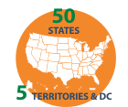


About FirstNet State Plans
States and territories receive a customized, digital State Plan outlining how the FirstNet network will be deployed in the state or territory
Each state’s or territory’s plan includes key information about FirstNet
Based on the State Plan, the state/territory governor can:
OPT-IN
FirstNet and AT&T will deploy, maintain and operate the state/territory Radio Access Network (RAN) at no cost to the state for 25 years. Once a state/territory opts in, FirstNet services will be available to public safety agencies and personnel in that state or territory.
OPT-OUT
Opt-out means the state/territory is responsible for deployment, operation, maintenance, and improvement of a public safety RAN in that state/territory – including costs and risks.
FirstNet Overview
About FirstNet
Value of FirstNet
State Plan Consultation
State/territory consultation
Nationwide outreach
Governor’s Decision
Executive summary
Acceptance and
opt-out guides
FirstNet
AT&T
Coverage
Nationwide coverage
Rural providers
Network Architecture
RAN
Core network
Implementation
Security
Products & Services
Features
Devices
Rate plans
Applications
Program
management
Public
safety
Secured
Network
Telecom
Expertise
To create customized plans, FirstNet consulted with:
Creating an infrastructure dedicated to public safety
AT&T and Globe logo are registered trademarks and service marks of AT&T Intellectual Property. FirstNet, First Responder Network Authority, and FirstNet logo are registered trademarks and service marks of FirstNet, an independent authority within the U.S. Department of Commerce. All other marks are the property of their respective owners.
Notes:
On June 19th, FirstNet and AT&T released our state plans via an online portal. For the past 3 + years, we have been working with public safety in every state and these plans were built with that input, feedback and data.
This is a huge step towards network deployment.
Some of the highlights we will offer are:
Public safety will have priority and preemption across all AT&T LTE bands and Band 14 – dramatically increasing the capacity available to public safety.
Priority service will be available as soon as a governor opts in to the state plans, with preemption on AT&T bands expected by the end of the year.
With a dedicate core infrastructure built just for FirstNet – we now will have a nationwide network, with exclusive public safety features and a larger pipeline then we ever imagined to send real time information.
There is still a lot to do but last week’s release of state plans after less than 3 months into the partnership highlights the urgency in which we are moving forward.

Slide 5






Where to go for FirstNet info
Two sites provide you complete information about this first-of-its-kind initiative:
FirstNet program, activities and
the First Responder Network Authority
FirstNet network products and services
and advantages for public safety
On this site:
FirstNet mission and guiding principles
FirstNet board and leadership
FirstNet Public Safety Advisory Committee
Consultation with public safety, states
and territories
State Plans Process and State Points
of Contact
The law that created FirstNet
FirstNet Innovation and Test Lab
On this site:
Quality of service, priority and preemption
Local control features
Application ecosystem
Devices and accessories for FirstNet
Coverage and rate plans
FirstNet network FAQs
Contact a FirstNet specialist
Notes:
Also launched in June was FirstNet.com which many of you will be interested. This is a public website that highlights FirstNet’s value proposition, features, products and services.
We realized that many folks want access to more information about the FirstNet solution in your state. We heard you and believe FirstNet.com will provide information and answers you’re looking for.

Slide 6



User Types
Primary Users | Extended Primary Users | Individual Paid Users
Fire Police EMS Emergency Management Emergency Communications (9-1-1) | Hospitals Utilities Transportation | Primary or Extended Users Users that pay personally For service
At State Opt-in Agency Paid Services | December 2017 Target | December 2017 Target Individual Paid Services

Slide 7





FirstNet solution overview
COVERAGE
IN-BUILDING
SOLUTIONS
DEPLOYABLES
SERVICE PLANS & PROCUREMENT
Reaches 97+% of
U.S. population
40,000 Wi-Fi hotspots
Satellite and deployable coverage for 99% geographic reach
Access to 6,000+ existing AT&T
in-building assets, including stadiums and transportation facilities
Hundreds of AT&T
units for daily network maintenance
72 deployables for FirstNet customer requests
Customer-deployable asset options
Competitive rate plans at or below existing commercial pricing
Purchase through a variety of contract vehicles
Notes:
I know many of you have followed FirstNet closely but I want to take a few minutes to go through the solutions we are offering.
Walk through solutions

Slide 8

FirstNet solution overview, continued
DEVICES & BYOD
BASIC & FUTURE SERVICES
PRIORITY/
PREEMPTION
CYBERSECURITY
Any AT&T LTE
device can be a FirstNet device
Wide choices, aggressive pricing
Use your personal device on FirstNet
Includes all the voice, data and messaging features of commercial networks
Future roadmap for mission-critical services
Priority and preemption on Band 14 + AT&T commercial LTE bands
Multiple priority levels within agencies
Mutual aid priority management for incident response
Security Operations Center for FirstNet
Uses AT&T’s global cybersecurity assets

Slide 9




FirstNet solution overview, continued
ICAM
FIRSTNET APP
STORE
LOCAL CONTROL
PUBLIC SAFETY
HOME PAGE
Single sign-on capability across
all FirstNet
applications plus agency applications
Shows only security audited apps from trusted vendors
Can integrate with agency MDM/MAM
One-stop web tool
for managing user
rate plans, priority levels, PTT groups, ICAM authorizations
Unprecedented
visibility into network status and more

Slide 10




FirstNet solution overview, continued
APP DEVELOPER PROGRAM
SOLUTIONS
TRAINING
SUPPORT
Foster innovation and interoperability in public safety mobile apps
APIs for FirstNet specific features
First-party options for key services like PTT, mobile VPN, messaging, LBS
Bring your own apps
Public safety solution specialists to educate agencies on how to best use FirstNet services
Dedicated 24/7/365 FirstNet mobility customer care desk based in the U.S.

Slide 11

Q&A

Slide 12
Louisiana
FirstNet

Slide 13
Weekly State Plan Review Meetings
Single Point of Contact (SPOC)
Broadband Subcommittee Chairman
LA FirstNet Staff
LA Office of Technology Services
AT&T
FirstNet
LA Technical Consultant

Slide 14
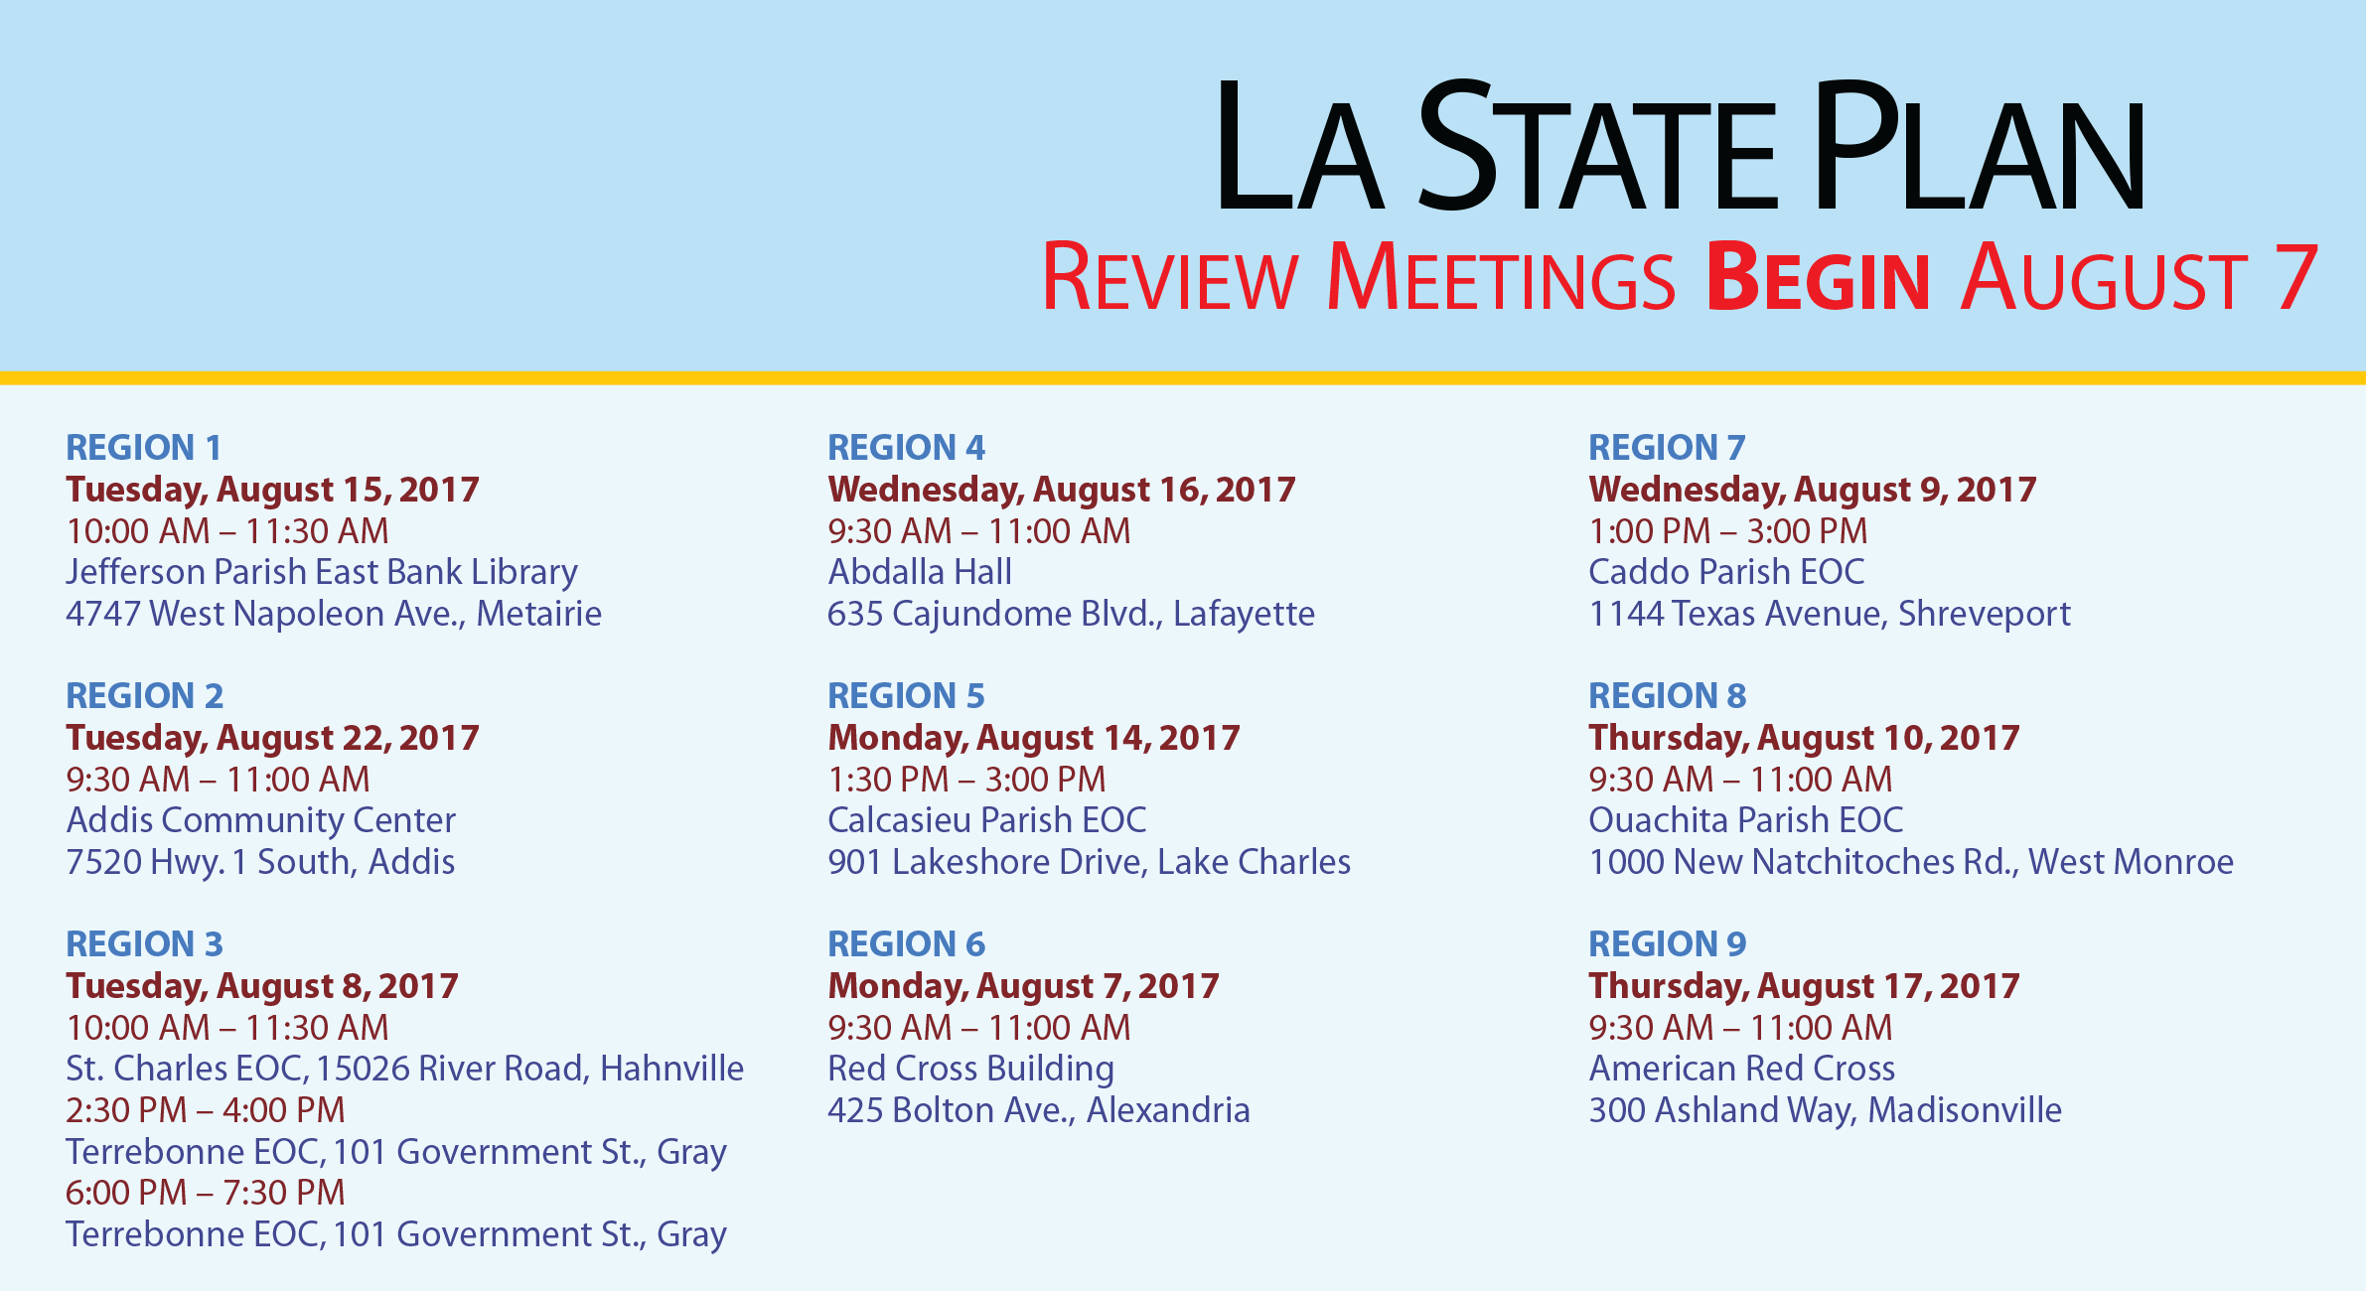
REGION1
Tuesday, August 15, 2017
10:00 AM – 11:30 AM
Jefferson Parish East Bank Library
4747 West Napoleon Ave., Metairie
REGION 2
Tuesday, August 22, 2017
9:30 AM – 11:00 AM
Addis Community Center
7520 Hwy. 1 South, Addis
REGION 3
Tuesday, August 8, 2017
10:00 AM – 11:30 AM
St. Charles EOC, 15026 River Road, Hahnville
2:30 PM – 4:00 PM
Terrebonne EOC, 101 Government St., Gray
6:00 PM – 7:30 PM
Terrebonne EOC, 101 Government St., Gray
REGION 4
Wednesday, August 16, 2017
9:30 AM – 11:00 AM
Abdalla Hall
635 Cajundome Blvd., Lafayette
REGION 5
Monday, August 14, 2017
1:30 PM – 3:00 PM
Calcasieu Parish EOC
901 Lakeshore Drive, Lake Charles
REGION 6
Monday, August 7, 2017
9:30 AM – 11:00 AM
Red Cross Building
425 Bolton Ave., Alexandria
REGION 7
Wednesday, August 9, 2017
1:00 PM – 3:00 PM
Caddo Parish EOC
1144 Texas Avenue, Shreveport
REGION 8
Thursday, August 10, 2017
9:30 AM – 11:00 AM
Ouachita Parish EOC
1000 New Natchitoches Rd., West Monroe
REGION 9
Thursday, August 17, 2017
9:30 AM – 11:00 AM
American Red Cross
300 Ashland Way, Madisonville

Slide 15
Louisiana Single Point
of Contact (SPOC)
James Waskom
Director
Governor’s Office of Homeland Security
and Emergency Preparedness (GOHSEP)
FirstNet@la.gov
Louisiana FirstNet
Outreach Staff Contact
Brad H. Smith
225-358-5625 Office
225-328-9401 Cell
FirstNet@la.gov

