Slide 1
LOUISIANA Ebola Virus Disease (EVD) Preparedness

Slide 2
State Actions
GOHSEP activated our Crisis Action Team for monitoring and coordination
Governor conducted Unified Command Group meeting
GOHSEP conducted state wide informational conference calls with parish officials and state agencies.
Distributed Pre-Incident Action Plan (IAP) to Parish Officials, Sheriffs, Police Chiefs, Fire Chiefs

Slide 3
State Actions
Participated in a conference calls with the U.S. President and his Cabinet Secretaries on various topics.
GOHSEP and Other Agencies Posted Ebola Information on their websites.
GOHSEP provided employees Ebola Educational Information as their required quarterly safety training.
Distributed the safety training to Parish Officials for their use.
Continue to disseminate current DHH and CDC information.

Slide 4
Outreach Efforts http://gohsep.la.gov/ebola.aspx

Slide 5
First Responder Tools
Call Taker/First Responder - Quick Reference Guide
Provides Screening Questions to ask Caller
Identifies suspected Ebola case
Provides First Responders the knowledge to Limit their exposure to patient.

Slide 6
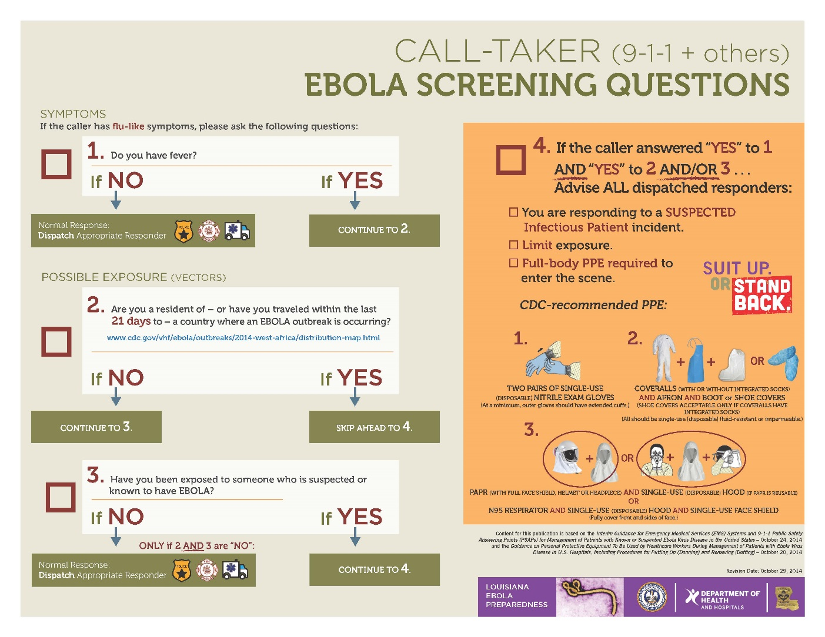
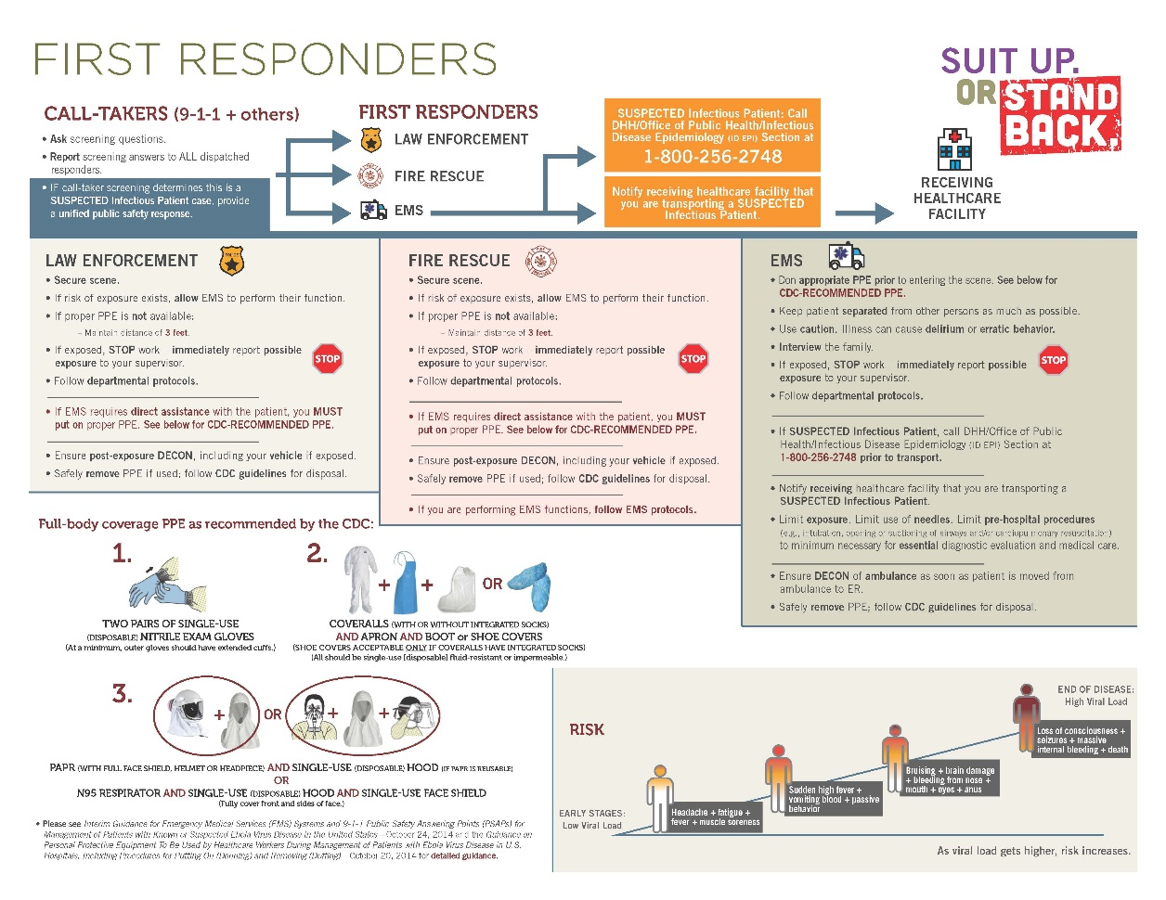
Call-Taker / First Responder Guide

Slide 7
First Responder Tools
First Responder Training PowerPoint
Web Based Standardized Training for Mass Distribution
Provide Ebola Awareness Education
Identifies Required Personal Protective Equipment (PPE) with pictures
Proper Donning and Doffing of PPE

Slide 8
PPE Power Point Training
Published
November 13, 2014

Slide 9
First Responder Tools
First Responder Checklists:
How to Don PPE using PAPR (Powered Air Purifying Respirators)
How to Doff PPE using PAPR
How to Don PPE using N95 Respirator
How to Doff PPE using N95 Respirator

Slide 10
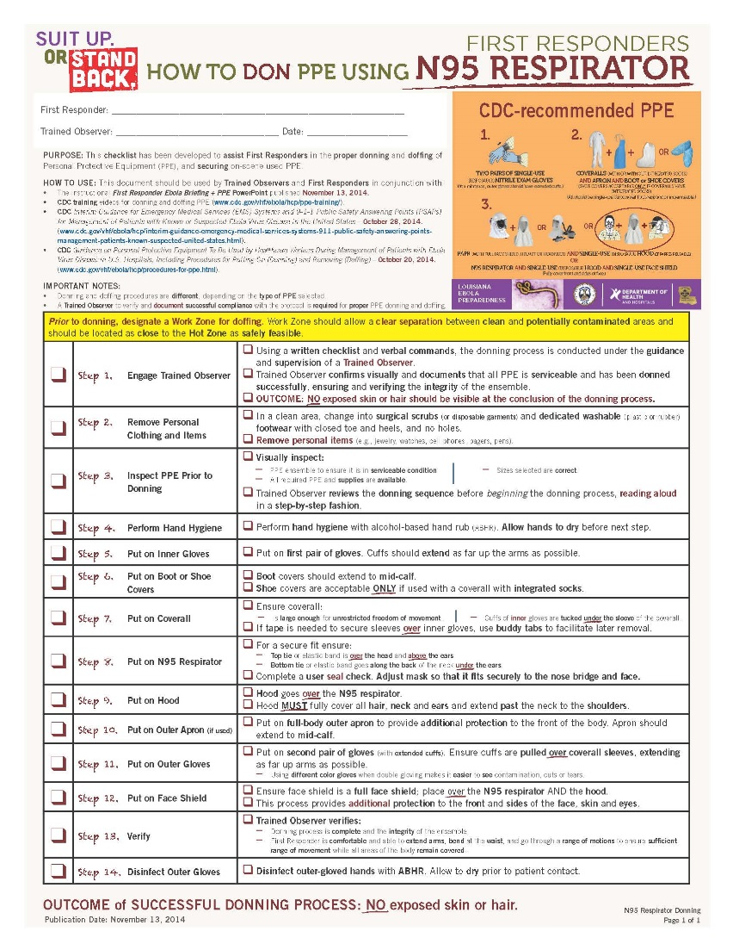
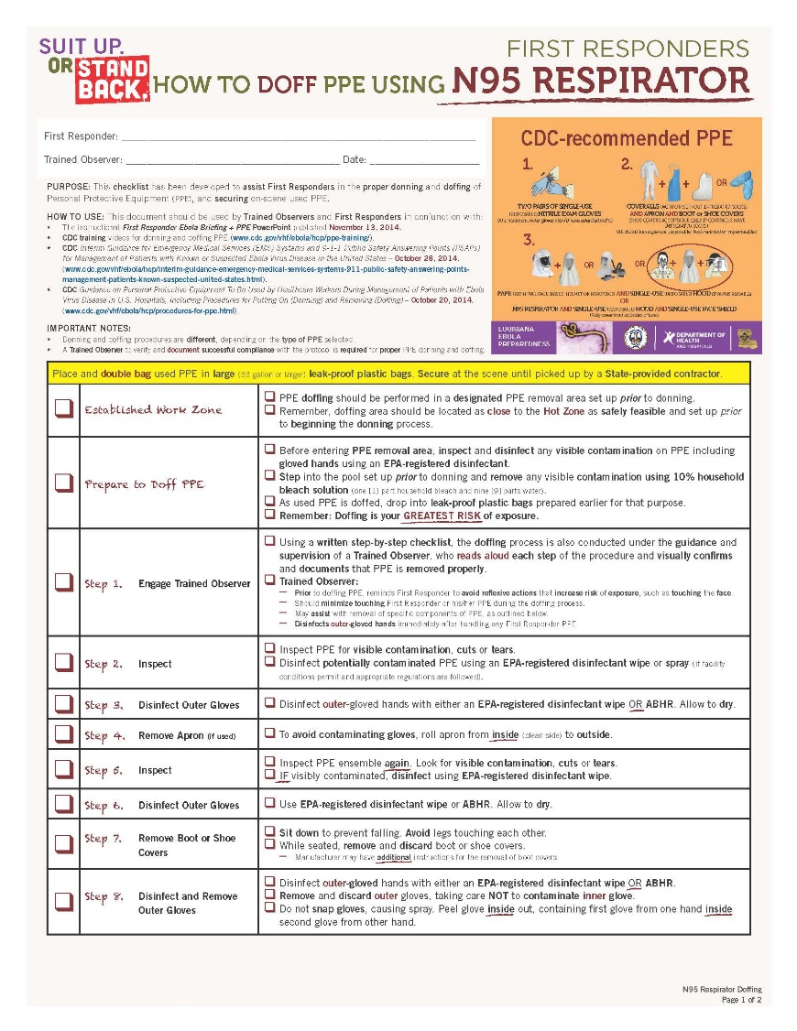
Donning & Doffing Checklist

Slide 11
Louisiana’s Ebola Response Plan

Slide 12
Prevention of EVD
Public Health Investigation: Upon receipt of Epi-X Data, ID Epi investigates the potential case to determine if the preliminary data provided by CDC meets the criteria to require monitoring.
Criteria for Monitoring: Travel to one of the three EVD affected countries.
Public health monitoring:
For 21 days following travel, individuals are required to allow public health medical monitoring in order to quickly identify any potential symptoms of EVD.
Medical monitoring shall include, but is not limited to, the following:
Daily monitoring of body temperature and other vital signs, and
Daily monitoring of symptoms that could be related to EVD.
Individuals must also maintain communication with DHH staff.

Slide 13
If an Actual Event Occurs
In the response to a suspect case of Ebola in Louisiana.
DHH/Office of Public Health Infectious Disease Epidemiology (ID Epi) is notified.
DHH notifies GOHSEP State EOC and LSP.
ID Epi determines if suspect cases rise to a Person Under Investigation (PUI).
No action for household or close contacts until determined to be a PUI.

Slide 14
If an Actual Event Occurs
In the response to a PUI or confirmed case of Ebola the Governor will activate the State’s emergency response plan under the command of the Director of GOHSEP.
State EOC will be activated to appropriate level.
Unified Command Group will assemble immediately to set response actions in motion.
A Public Health Emergency will be declared.

Slide 15
If an Actual Event Occurs
PUI or Confirmed Case (continued)
Joint Information Center (JIC) will be activated
Provide factual information sharing to the public/news media
Parish conference calls will be conducted immediately to obtain and provide information and guidance.
State would support requests for local and state agencies facilitated via WebEOC.

Slide 16
If an Actual Event Occurs
PUI or Confirmed Case (continued)…
Determine level of risk
Sample sent for testing
Patient in isolation
ID Epi contact tracing begins
Patient moved to appropriate facility or remains in hospital facility in isolation for ongoing care
Household operations begin

Slide 17
If an Actual Event Occurs
Household Contacts
Wrap-around provisions for up to 42 days
Sustenance (food, water, etc.)
Laundry
Pharmaceutical
Family care items (diapers, etc.)
Financial

Slide 18
If an Actual Event Occurs
Household Contacts (continued)
Pet Care
Behavioral Health
Voluntary quarantine/confinement with possible enforcement once a suspected case is confirmed.
Involuntary quarantine/confinement –would require a court order.

Slide 19
If an Actual Event Occurs
ESF 10: Unified Command - Lead by State Police Emergency Services Unit
Manage the collection, decontamination, transportation, treatment and disposal and remediation of Ebola waste.
The State, through GOHSEP will contract for services.

Slide 20
Questions?

