Slide 1

New Organizational Structure and
Senior Leadership Titles
GOHSEP Director & GOHSEP Deputy Director
Confidential Assistant
Business Liaison
GOHSEP Five Assistant Directors
  Assistant Director- Emergency Management
  Assistant Director- Financial Operations & Administration
  Assistant Director- Hazard Mitigation
  Assistant Director- Public Assistance
  Assistant Director- Security and Interoperability
GOHSEP Regional Structure
Director- Regional Support Operations
Three Area Directors
Nine Regional Coordinators

Slide 2
GOHSEP Vision: To serve as an extension of the Office of the Governor and provide sound leadership during crisis events while also enhancing the day-to-day state agency programs servicing Louisiana residents, businesses and organizations.
GOHSEP Mission: The mission of GOSHEP is to utilize three priorities to save lives, protect property and maintain infrastructure:
Priority Number One: Ensure that GOHSEP serves as the emergency arm of the Governor and works hand in hand with all emergency support function agencies as part of the U.S. National Response Framework and the Louisiana Homeland Security, Emergency Assistance and Disaster Act in preparation, response, recovery, mitigation and prevention of crisis events.
Priority Number Two: Ensure that all Municipalities, Parishes/Parish Organizations, Sub-Recipients and State Agencies have a voice and an agency to champion for them in obtaining maximum funds in all applicable federal and state programs in an expeditious manner.
Priority Number Three: Consistently review internal best business practices and potential for Improvements. It is essential to review the actual mission and output of internal departments to ensure elite levels of support to all stakeholders in Louisiana.
GOHSEP Goals:
GOHSEP will apply leadership directly towards lifesaving measures, mitigation efforts to protect public/private property and establish/maintain a safety net to protect, operate and improve our infrastructure.
GOHSEP will quickly and efficiently move resources through the emergency management cycle: preparation, response, recovery, mitigation and prevention. The definition of resources at each stage involves all five divisions and changes depending upon the stage. The five divisions will all operate in support of each other in a deliberate, synchronized fashion.
GOHSEP will internally hold ourselves accountable as an operational arm of government with a strategic directive: GOHSEP will be unwavering in our efforts to save lives, protect property and maintain infrastructure.
GOHSEP will standardize internal strategic concepts in a specific format to streamline communication into clear concise products. The format is task, purpose, issue, discussion and recommendation:
  Task- What is this situation?
  Purpose- What is the real problem? What is likely to happen? What is the center of gravity of the issue?
  Issue- How should I think about this situation to define the problem or opportunity? How could this situation happen? What do I know about situations like this? What do I not know that I should?
  Discussion- What other situation is like this one? What is this situation not like? What else could this situation or solution be? How should I prepare for future situations?
  Recommendation- What needs to be accomplished? What is the solution or plan? Is there a specific path to decide the solution? Does the solution support the purpose (center of gravity)?

Slide 3
GOHSEP Vision: Serve as an extension of the Office of the Governor and provide sound leadership
GOHSEP Mission: Utilize three priorities to save lives, protect property and maintain infrastructure:
Priority Number One: GOHSEP serves as the emergency arm of the Governor
Priority Number Two: Ensure Agencies have a voice and an agency to champion for them
Priority Number Three: Review internal best business practices and potential for improvements
GOHSEP Goals:
Apply leadership directly towards lifesaving, protect public/private property and protect, operate and improve our infrastructure
Quickly and efficiently move resources through the emergency management cycle
Strategic directive: GOHSEP will be unwavering in our efforts to save lives, protect property and maintain infrastructure
Standardize internal strategic concepts in a specific format to streamline communication

Slide 4


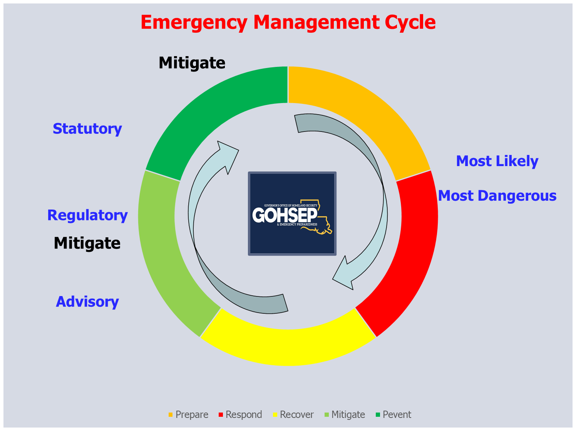
Prevent
Prepare
Respond
Recover

Slide 5
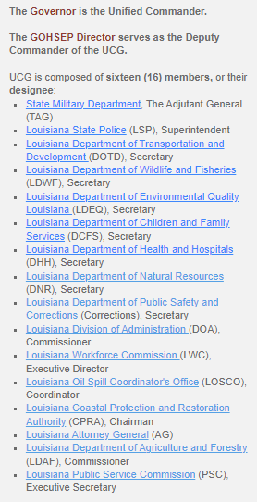
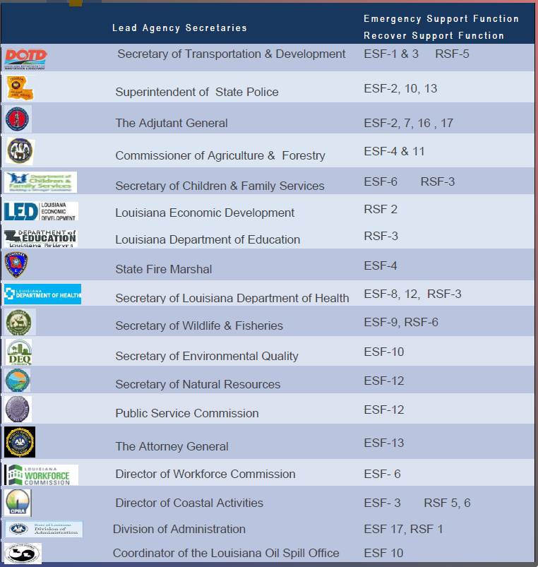
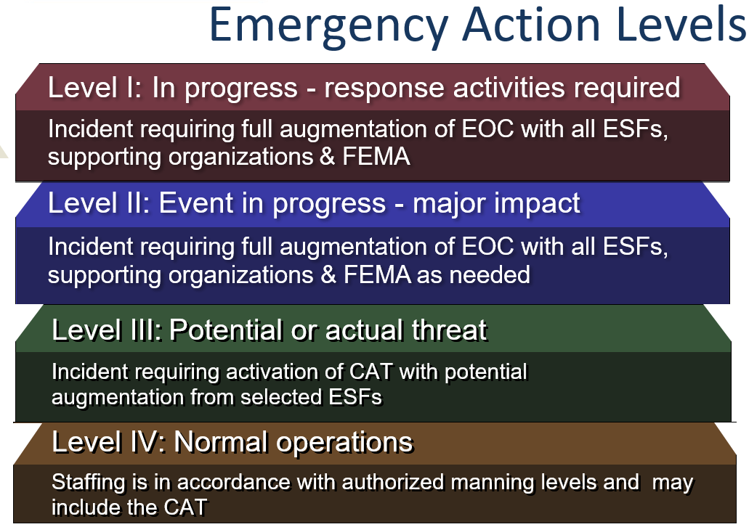
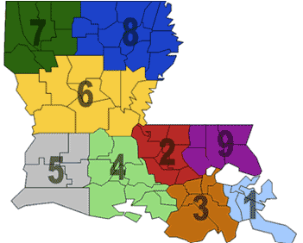
1
2
Regional OHSEP Directors Sub-Committee
GOHSEP has designated nine (9) emergency management Regions. The Regional Directors Subcommittee is composed of one (1) Parish Office of Homeland Security and Emergency Preparedness (OHSEP) Director from each Region. Representatives are selected from among their peers and represent their Region. Terms are determined by OHSEP Directors within the Region and terms vary.
The Subcommittee provides a forum where the different Regions collectively discuss homeland security and emergency management issues with each other and the Director of GOHSEP. Members provide a Regional perspective as they offer advice and counsel to Parish or Police Jury Presidents regarding strategic emergency management issues and planning
3

Slide 6
GOHSEP Org Chart EOC Activation Level IV, Normal Operations
Confidential Assistant
GOHSEP
Director
Louisiana
Business Liaison
Chief Executive Counsel
Director- Regional Support Operations
Confidential
Exec. Assistant
Director-
External Affairs
Deputy
Director
General
Council
Director-
Individual Assistance
Executive
Officer
Director-
Strategic Engagement
Deputy General Council (2)
Quality
Control
Director- Human
Resources
Assistant Director- Financial Operations & Administration
Assistant Director-
Public Assistance
Assistant Director- Emergency Management
Assistant Director-
Security & Interoperability
Assistant Director-
Hazard Mitigation
Executive Officer
Executive Officer
Executive Officer
Executive Officer
Executive Officer
Financial
Services
Facility Management
Grants Management
Applicant Liaisons
Current
Operations
Preparedness& Plans
AI & UAS
Operations
Intelligence
Fusion Center
Applicant Liaisons
Grants Management
Financial
Spt. Services
Sub-Recipient
Monitoring
Closeout
Disaster
Oversight
State
EOC
Future
Plans
GIS
Services
Cyber Operations
Quality
Control
Applicant Closeout
Quality
Control
Quality
Control
Technical Services
Logistics
Support
Community Preparation
Inter-Operability
School
Safety
Technical Services
Training & Exercises
Non-Disaster Ops Grants
Critical Infrastructure
& Nuclear Facilities
HM
Planning
- - - A coordination line is a formal organizational relationship to allow departments to operate in support of each other.
Training Programs

Slide 7
GOHSEP Org Chart EOC Activation Level IV, Normal Operations
Confidential Assistant (LEPA)
GOHSEP
Director
Louisiana
Business Liaison/LBEOC
Director- Regional Support Operations
Deputy
Director
GOHSEP Regional Structure
Director- Regional Support Operations
Three Area Directors
Nine Regional Coordinators
Regional OHSEP Directors Sub-Committee
GOHSEP has designated nine (9) emergency management Regions. The Regional Directors Subcommittee is composed of one (1) Parish Office of Homeland Security and Emergency Preparedness (OHSEP) Director from each Region. Representatives are selected from among their peers and represent their Region. Terms are determined by OHSEP Directors within the Region and terms vary.
The Subcommittee provides a forum where the different Regions collectively discuss homeland security and emergency management issues with each other and the Director of GOHSEP. Members provide a Regional perspective as they offer advice and counsel to Parish or Police Jury Presidents regarding strategic emergency management issues and planning

Slide 8
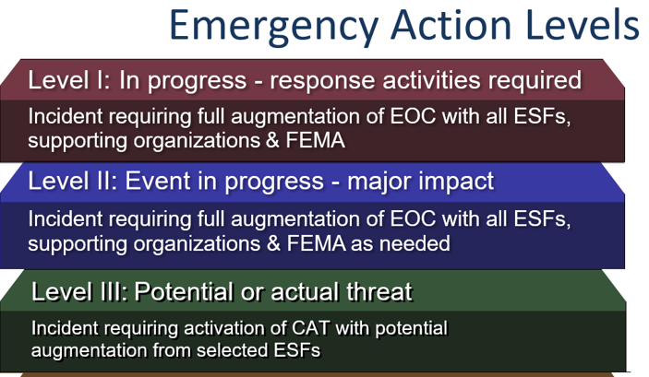
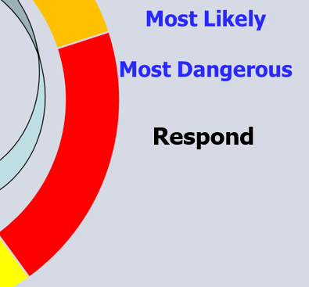
GOHSEP Org Chart EOC Activation Level III,II,I
Parish
OEP Team
GOHSEP
Executive Team
GOHSEP
Business Team
Parish
OEP Team
GOHSEP
Executive Team
GOHSEP
Legal Team
GOHSEP
Executive Team
GOHSEP
External Affairs Team
GOHSEP
IA TEAM
GOHSEP
FEMA LNO
GOHSEP
Employee HR
GOHSEP GA
Finance & Admin Team
GOHSEP PA
PDA & EMAC Team
GOHSEP EM
EM Team
GOHSEP SI UCG,
Interoperability & Intel Team
GOHSEP HM
Logistics Team
Executive Officer
Executive Officer
Executive Officer
Executive Officer
Executive Officer
Recovery- Grants
Facility Services
Grants Management
Applicant Liaisons
Current
Operations
Preparedness& Plans
AI and UAS
Operations
Intelligence
Fusion Center
Quality
Control
Grants Management
State Management
Admin Services
Applicant Closeout
Disaster
Oversight
State
EOC
Future
Plans
GIS
Services
Cyber Operations
Applicant Liaisons
Applicant Closeout
Sub-Recipients
Homeland Sec. Grants
Quality
Control
Technical Services
Logistics
Support
Community Preparation
Inter-Operability
School
Safety
Technical Services
Quality
Control
Site Inspections
Training & Exercises
Non-Disaster Ops Grants
Critical Infrastructure
& Nuclear Facilities
HM
Planning
Training Programs

Slide 9







Linking Emergency Management
Via the Private Sector
To Law Enforcement

Slide 10
Mission essential tasks have countless sub tasks that are classified as specified tasks(what leaders are directed to do) and implied tasks (what leaders sense needs to be done) to support strategic change. This document lists mission essential tasks only. Each mission essential task has an individual strategic action plan that covers the task, purpose, issue, discussion and recommendation for the respective task.
What does strategic change look like?
Key tasks and purposes form mission essential tasks

Slide 11
GOHSEP Strategic Action Plans (SAP)
Vision, mission & goals: Refocus the organization
First 100 Days Concept: Transition in the “first 100 days”
Organizational Restructuring: Restructure the team
Field Visitation Schedule: Get senior leaders in the field
Employee Engagement Program: Improve engagement
90/10% Reimbursement: Expedite reimbursement
Website Redevelopment: Streamline the website
Quality Control Monitor Position: Establish a QC Monitor
30 Day Financial Payments: Expedite payments
QR to Annual Certification: Change an internal policy to help parishes and municipalities
Emergency Hiring Procedures: Modify the hiring process when staffing drops below 85%
Procurement Restructuring: Ensure senior leaders are involved in the process
LABEOC Partnership Expansion: Expand the LABEOC partnership
Cyber Program Restructuring: Reorganize the state cyber program
Emergency Cycle Evolution: Use a most likely and/or most dangerous course of action to determine if a statewide or regional response is required, then act accordingly.
GOHSEP Executive Leadership Program: Provide a central location for agencies to train leaders

Slide 12
Questions
Jacques Thibodeaux 504-915-3120
Federal Fiscal Situation
State Fiscal Situation
GOHSEP Next Steps:
Day 101-180/EMPG-SHSPG/Regional Concepts
2024
For Official Use

