Slide 1
Governor’s Office of
Homeland Security & Emergency Preparedness
Alert & Warning
IPAWS & Alert FM
February 26, 2014

Slide 2
Annual GOHSEP Conference
OHSEP Directors + LEPA + LEPC Members
Alert FM

Slide 3
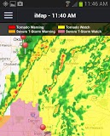
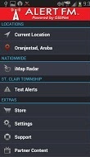
Alert FM Overview
Transmit digital messages based on geographic or organizational groupings
Messages delivered via data subcarrier of existing FM transmitters to multiple receiving FM devices & to a downloadable Apple or Google smart phone App
No recurring usage fees paid by government customers after initial license fee
App based emergency notifications for a user’s current geo-specific location & a single bookmarked location are free
www.alertfm.com

Slide 4
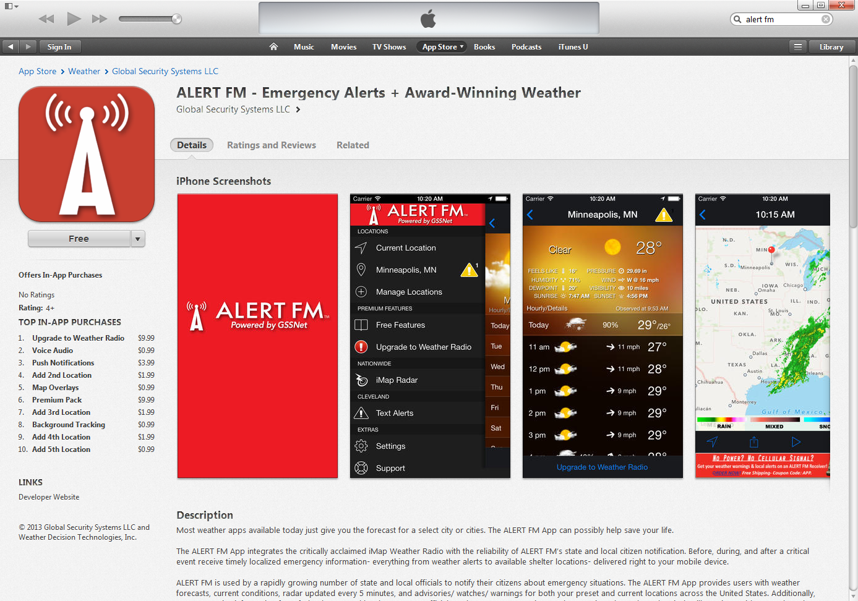

Slide 5
Alert Studio Overview
https://app.alertfm.org
Alert Studio is a FEMA certified, portal that allows federal, state & local emergency officials to create Common Alerting Protocol (CAP) formatted alerts & distribute them to multiple delivery methodologies simultaneously
Provides secure web interface for sending public messages via ALERT FM Receivers, ALERT FM Mobile App, Facebook, Twitter, GSSNet Direct EAS & FEMA’s IPAWS system

Slide 6
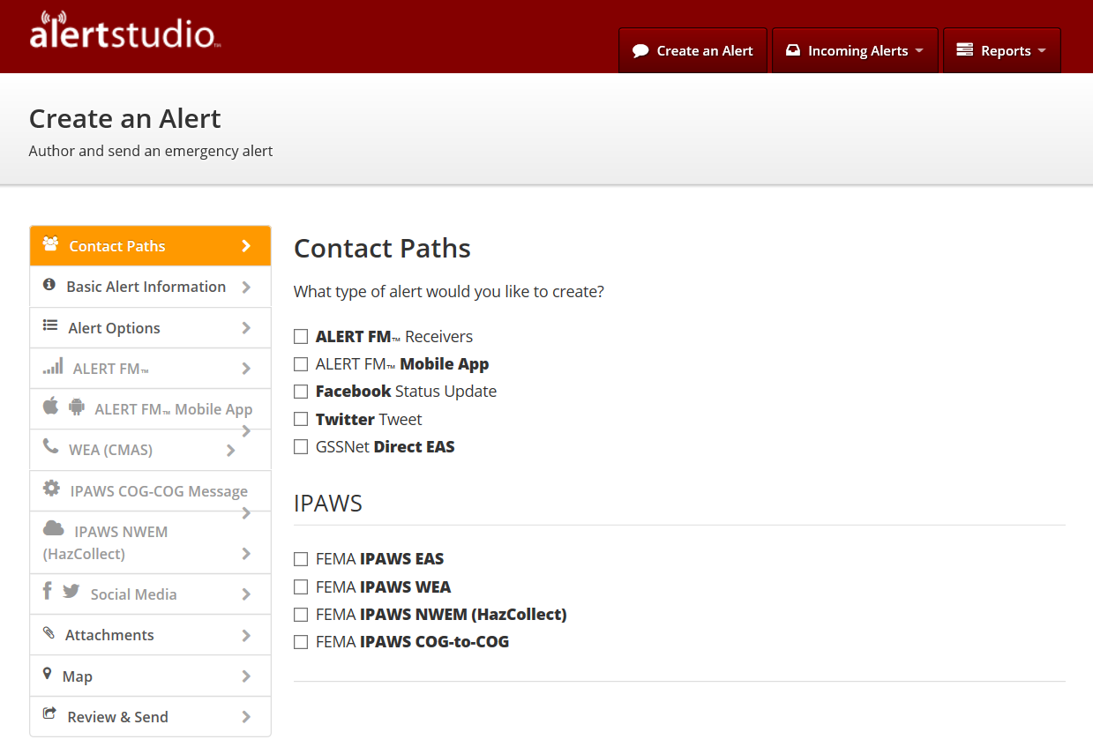
Alert Studio Overview
Alert FM
IPAWS

Slide 7
Annual GOHSEP Conference
OHSEP Directors + LEPA + LEPC Members
IPAWS

Slide 8
IPAWS Overview
FEMA’s Integrated Public Alert & Warning System (IPAWS) is an internet-based system that Federal, State, territorial, tribal & local authorities can use to issue critical public alerts & warnings
IPAWS is accessed through software that meets specific IPAWS system requirements
There is no cost to send messages through IPAWS, although there may be costs associated with acquiring compatible alert origination software
IPAWS does not replace existing methods of alerting, but instead complements existing systems & offers additional capabilities

Slide 9
IPAWS Overview
IPAWS improves alert & warning capabilities by allowing delivery of alerts simultaneously through multiple communications devices reaching as many people as possible to save lives & protect property
These communication pathways currently include:
Emergency Alert System (EAS): Audio to radio & television
Wireless Emergency Alerts (WEA): Text message
National Weather Service Dissemination Systems (HazCollect): Audio messages to Weather Radio & EAS

Slide 10
Qualifying for IPAWS
Federal, State & local laws determine which public safety officials are granted authority to alert the public of emergency situations
Specific authorities may be designated in a state’s Emergency Alert System (EAS) plan & AMBER Alert plan, eligible organizations may include:
Federal Agencies
State Governments
Local Governments
Other public/private sector organizations may be eligible depending on their public safety mission
Territorial Governments
Tribal Governments

Slide 11
Louisiana IPAWS Certification Status
Certified IPAWS Public Alerting Authorities
Louisiana Governor's Office of Homeland Security & Emergency Preparedness
Jefferson Parish
Calcasieu Parish
IPAWS Applications in Progress
Lafourche Parish
Orleans Parish
Plaquemines Parish
St. Bernard Parish
Tangipahoa Parish
West Baton Rouge Parish
Winn Parish
As of November 4, 2013

Slide 12
IPAWS Signup Process
Complete the Memorandum of Agreement (MOA) application & Rules of Behavior
Once submitted to FEMA, the MOA will be prepared & returned to the applicant for signature
Once executed, a Collaborative Operating Group (COG) ID & digital certificate will be generated
A copy of the executed MOA, COG ID, & digital certificate will be returned to the Primary Point of Contact

Slide 13
IPAWS Signup Process
Public alerting permissions
Complete the application defining the types of alerts & the applicable geographic warning areas
Reviewed & signed by GOHSEP
Complete the IPAWS web-based training - IS-247.a: Integrated Public Alert & Warning System
Course web address:
http://training.fema.gov/EMIWeb/IS/courseOverview.aspx?code=is-247.a

Slide 14
Annual GOHSEP Conference
OHSEP Directors + LEPA + LEPC Members
Questions

Slide 15
For More Information:
Steven Burr
Sean Wyatt
Or
steve.burr@la.gov
sean.wyatt@la.gov
(225) 925-7423
(225) 358-5412

Slide 16
FIND US ON THE WEB
+
gohsep.la.gov
getagameplan.org

