Slide 1
Debris

Slide 2
Debris
There will always be debris.
Debris removal is one of the most expensive activities that takes place after an event.

Slide 3
Debris
Best practices. . .recommend 3 things to help maximize your reimbursements and minimize your risk . . .

Slide 4
SUCCESSFUL OUTCOME
Own the process.
Develop a Debris Management Plan.
Document everything.
Notes:
Briefly speak to each of the 3 and the importance of each in planning for a debris causing event

Slide 5
Own the process
Who is ultimately responsible?
YOU, the Applicant, are ultimately responsible.

Slide 6
YOU OWN IT!
Designate someone on your staff to be responsible for Debris Oversight.

Slide 7
You don’t want this guy?

Slide 8
You want this guy!!

Slide 9
Own the process
You have a responsibility to monitor your contractors and ensure they comply with the conditions of the program.
Don’t turn the keys of the kingdom over to your contractor.

Slide 10
Own the process
Failure to know what’s going on puts your funding at risk.

Slide 11
Debris Plan
Develop a Debris Management Plan NOW . . .
and use it!

Slide 12
Debris Plan
Who should have a plan?
Parish Government
Municipalities
School Board
Levee District
Etc.

Slide 13
Debris Plan
Address every possibility . . .
Vegetation
Construction/Demolition (C&D)
White Goods
E-waste
Vehicles/ Waterways/vessels
Private Property Debris Removal (PPDR)
Putrescent

Slide 14
Operations Plan
Recommended components
Generic event forecasting (USACE, etc.)
Develop damage assessment protocols
Debris priority removal
Procurement protocols (RFP/RFQ)
Debris disposal sites + permits

Slide 15
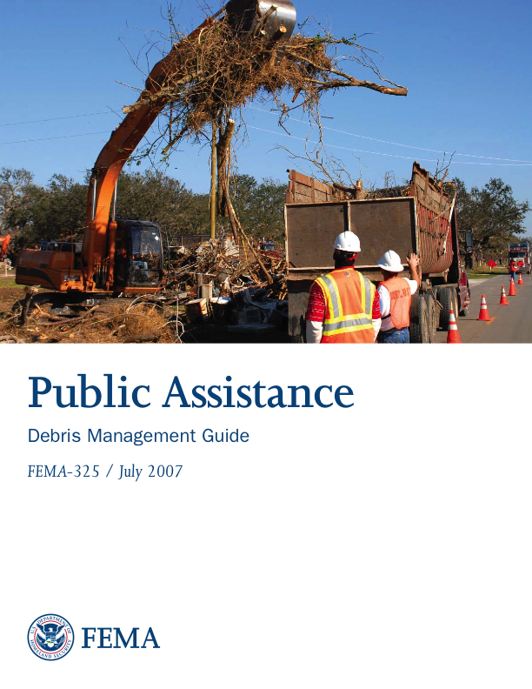
See:
FEMA 325 PA Debris Management Guide (July 2007) (Chapters 5 – 14)
Pilot Program Guide for Debris Removal

Slide 16
Documentation
Invoices
Photos
Equipment Logs
Contracts
Load tickets
Tipping fees
FAL timesheets

Slide 17
Documentation
Each debris stream has specific documentation requirements . . .
DEFINE IN YOUR DEBRIS
MANAGEMENT PLAN!

Slide 18
Today’s takeaways
Own it
Plan it
Document it

Slide 19
Best Practices
= Risk Reduction
= Keep your Money

Slide 20
Current FEMA Pilot Program
Four (4) Separate Opt In/Opt Out Alternatives
Force Account Labor (FAL)
Sliding Scale
Approved Debris Management Plan
Recycling Revenues

Slide 21
***IMPORTANT***
The alternative procedures FEMA is piloting are for large projects ONLY . . .
With the exception of reimbursement for straight time force account labor (FAL) which can be applied to both small and large projects.

Slide 22
Straight time force account labor (FAL)
If an Applicant uses their own labor forces to perform all or part of debris removal operations . . .
FEMA will reimburse (at the appropriate cost share level) the REGULAR + OVERTIME wages for existing employees + hiring of additional staff.

Slide 23
Debris Removal Operations Timeline
30
60
90
85
80
75
v

Slide 24
Debris Management Plans (DMP)
An Applicant that has a FEMA-reviewed pre-disaster Debris Management Plan . . .
Eligible for a ONE-TIME incentive of a 2% cost-share adjustment applied to debris removal work completed within first 90 days.

Slide 25
Recycling revenues
Applicants may retain revenues received through recycling eligible disaster debris.

Slide 26
Resources
GOHSEP Debris Guide.
FEMA 325/PA Guide
FEMA Debris Management Plan Checklist

Slide 27
Web Resources
LouisianaPA.com
gohsep.la.gov
FEMA Independent Study Course for Debris Management

Slide 28
G. Stewart Jones
State Debris Manager
(985) 768-2574
george.jones@la.gov
John Gonzales
Section Chief
(225) 573-0473
john.gonzales@la.gov

