Slide 1
WebEOC SITREP Publisher

Slide 2
Why Was an Update Needed?
To remove errors in current SITREP process
Duplicate SITREPs
Blank updates
E-mail notification issues
To provide a quick, easy user experience
Larger text and more organized input
Easier to access specific data
Addition of new data types
To extend data to additional boards (closure maps, etc.)

Slide 3
What Has Changed?
Board’s overall design
Agency and Parish SITREP board consolidated into one board
SITREP details don’t clear on input side—you don’t have to rewrite a full SITREP with each update
New fields for closures, staffing levels, and more
Only one attachment slot
SITREP details are categorized (for parishes)

Slide 4
What Is Still the Same?
Most types of data remain in the new board (damage assessment, declaration status, etc.)
Users still create an initial SITREP, then update that one SITREP
Updates still subject to deadlines and cut-off times during an activation
Parish and agency SITREPs will still be collected and compiled into a single GOHSEP SITREP.

Slide 5
Header Section
Like the other new boards, the SITREP Publisher has a simplified header.
The board name and incident can be found on the left side of the header.

Slide 6
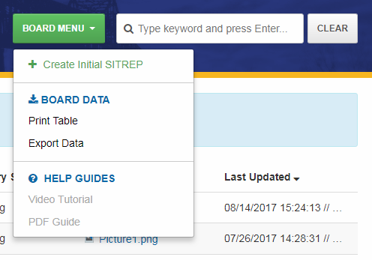
Header Section
On the right side is the Board Menu button and the search feature.
All board-level actions, export options, and help guides are available here.
Click the “Create Initial SITREP” option to begin your SITREP. This link will not be available if a SITREP has already been created for your position.

Slide 7
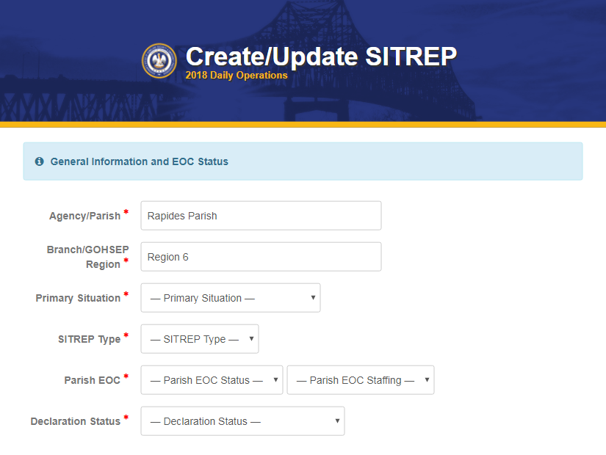
Creating a SITREP: General Info/EOC Status
Required fields are marked with a red asterisk.
Your parish name and region will be populated automatically.
The “Primary Situation” input allows you to mark which specific event type is impacting your parish.
The Parish EOC activation and staffing levels can also be logged.
A Declaration Status field is also available.

Slide 8
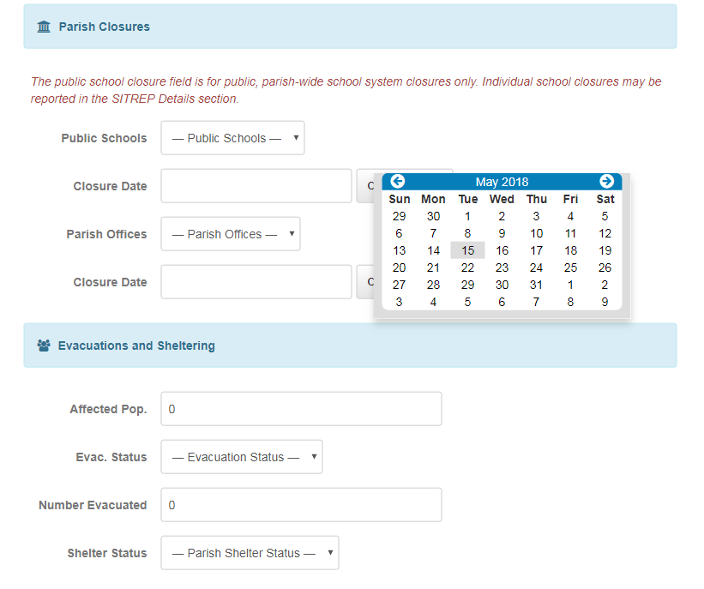
Creating a SITREP: Closures and Population
Next, closure statuses and dates can be set for public school systems and parish offices.
Affected population, evacuation status and totals, as well as parish sheltering status can be logged.

Slide 9
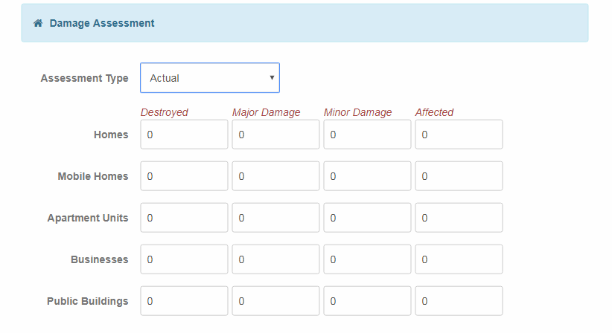
Creating a SITREP: Damage Assessment

Slide 10
Creating a SITREP: Damage Assessment
The damage assessment table allows parishes to record the number and type of structures that have been destroyed, damaged, or affected.
Parishes can mark the assessment totals as Pre-Impact Estimate, Estimate, or Actual.
If no information is entered in a cell, it will default to zero.

Slide 11
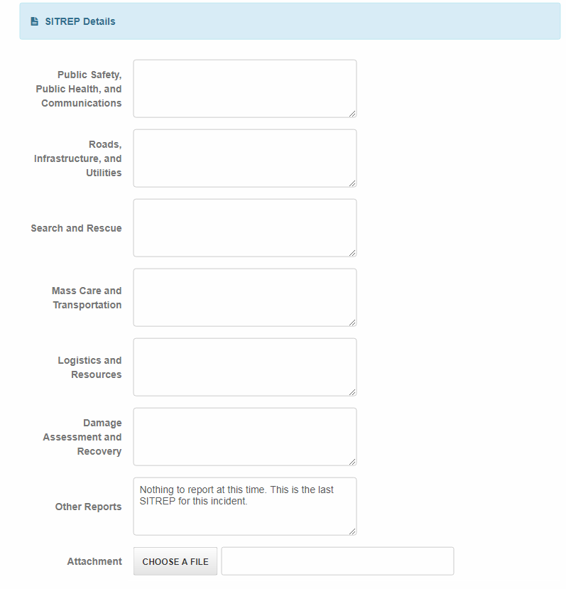
Creating a SITREP: Detailed Reports
The SITREP Details section allows the parish to report on various topics, rather than typing a comprehensive report into one field.
Data is saved in these fields, so there’s no need to start from scratch when making a new update.
There is one attachment field, typically for a declaration. Parishes are encouraged to use the File Library for multiple uploads.

Slide 12
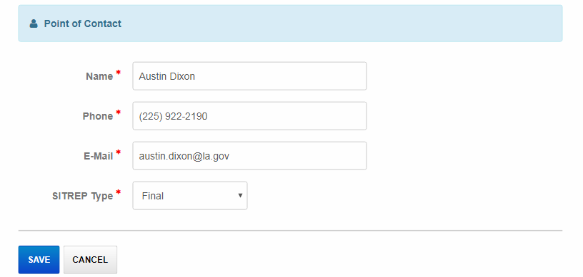
Creating a SITREP: Preparer Info
The Point of Contact is added in the last section. This is not necessarily the person that prepared the SITREP.
The SITREP type can be marked as initial, update, or final. An initial or final SITREP will be labeled on the list view. Click Save to submit your SITREP.

Slide 13
SITREP List View
On the list view, the blue filter bar above the table allows users to view only parish, only state agency, or all SITREPs.
Each column header can be clicked to sort SITREP records by that field.
Attachments can be opened directly from this view.

Slide 14
Updating Your SITREP
Once your parish has created a SITREP, you can update it by clicking the pencil icon to the right of your entry. Parishes can only edit their own entry.

Slide 15
Viewing a SITREP
To view a SITREP, click the folder icon to the far left of an entry. SITREPs can be viewed by all WebEOC users.

Slide 16
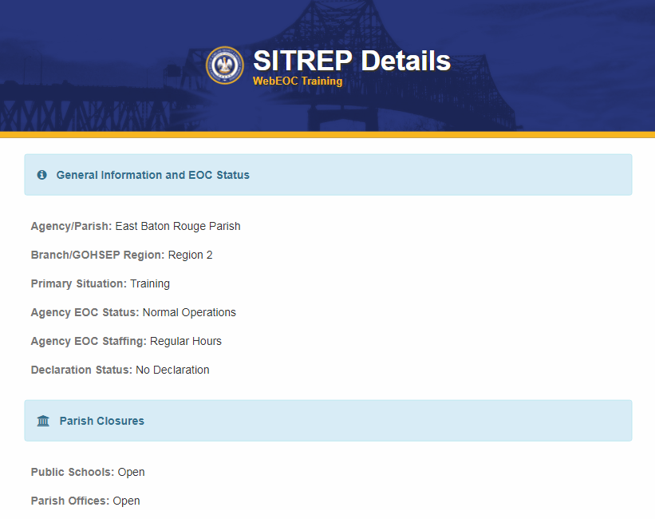
SITREP Details View
Information is listed in the same order as the input view.

Slide 17
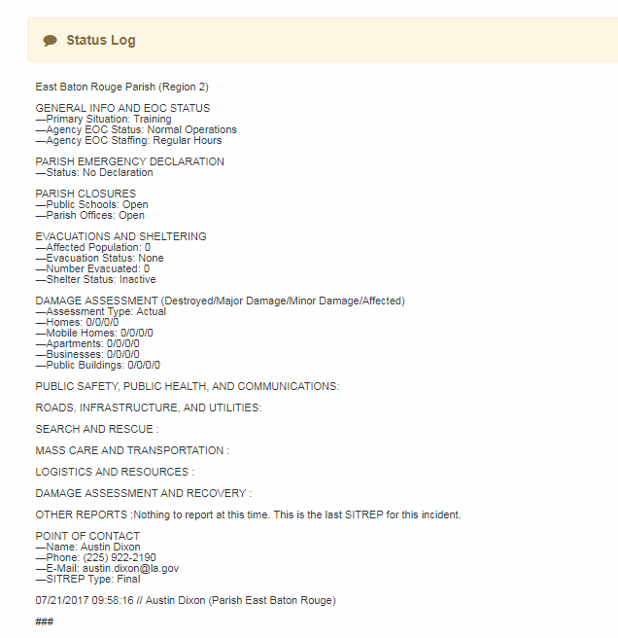
SITREP Details View
The Status Log section contains the full history of all SITREP updates.
This information is included in an e-mail to the State EOC whenever a SITREP is created or updated.
This replaces the SITREP comments section in the old SITREP board.

Slide 18
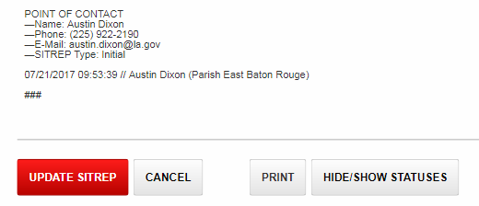
SITREP Details View
If you’re looking at your own SITREP, you’ll have the option to click the “Update SITREP” button at the bottom of the page.
The Print button will create a SITREP that can be printed or saved as a PDF. To print only the current SITREP without the full history, click the “Hide/Show Statuses” button before clicking Print.

Slide 19
WebEOC Board Dev. Timeline
January 2016:
Begin accepting board ideas via e-mail and at WebEOC trainings across the state
September 2016:
Contacts Manager and POD Status Log released
October 2016:
Shelter Manager and SITREP board development begins (major projects)
January 2017:
Director’s Conference presentation on SITREP board draft and ideas, request for additional input
April 2017:
Shelter Manager released

Slide 20
WebEOC Board Dev. Timeline
June 2017:
SITREP Publisher development mostly complete
December 2017:
Planning/scheduling for 2018 projects
April 2018:
AAR Board beta released for Statewide Exercise
May 2018:
SITREP Board presentation and full release (postponed from January)

Slide 21
Upcoming (and In-Progress) Projects
Louisiana WebEOC Network (in Progress)
First meeting in April 2018
Develop WebEOC personnel connections across state agencies and parishes
Bring more agencies/parishes into the GOHSEP Fusion network
Active FUSION subscribers are NOHSEP/Region 1 and East Baton Rouge Parish
Preparedness/Yearly Reports Board (in Progress)
Met with Preparedness Section in late March
One board to replace PEMAC, Annual Report, EOP, etc.

Slide 22
Upcoming (and In-Progress) Projects
Incident Creator Board (Spring 2018)
Tracks data on past incidents (declarations, days activated, dates, etc.)
WebEOC “Juvare” Update (TBD, Summer 2018)
Long-Term: Resource Request Board (Late 2018/Early 2019)
Large-scale project like the Shelter and SITREP boards
Possible draft presentation at next year’s Director’s Conference

Slide 23
Contact Information
While the new SITREP board and process is nearly complete, we’re still open to any suggestions from parishes before it goes live in WebEOC.
Submit Questions or Provide Feedback:
Austin Dixon
WebEOC Administrator
(225) 922-2190
austin.dixon@la.gov

