Slide 1
Louisiana - State Analytical & Fusion Exchange (LA-SAFE)
Analytical Support Unit
Criminal Intelligence Unit

Slide 2
UNCLASSIFIED//FOR OFFICIAL USE ONLY
LA-SAFE Mission Statement
The Louisiana State Analytical & Fusion Exchange (LA-SAFE) promotes collaboration in an all-crimes/all-hazards environment, supporting federal, state, local and private sectors by working together to provide timely information for use in promoting public safety and national security against terrorist and other criminal threats. LA-SAFE will support the state during major disasters and emergencies by gathering, analyzing and disseminating information to assist relevant agencies.
LA-SAFE will actively work to collect and analyze information, providing responsible parties with pertinent background for decision making processes, which permit resource maximization in the protection of citizens of the state of Louisiana.
LA-SAFE evaluates all information provided ensuring that the information that is retained and utilized is directly related to legitimate law enforcement purposes and has been legally obtained. It shall not interfere with the exercise of constitutionally guaranteed rights and privileges of individuals.
UNCLASSIFIED//FOR OFFICIAL USE ONLY

Slide 3
UNCLASSIFIED//FOR OFFICIAL USE ONLY
Current Partners
UNCLASSIFIED//FOR OFFICIAL USE ONLY

Slide 4
UNCLASSIFIED//FOR OFFICIAL USE ONLY
LA-SAFE Capabilities
All Crimes/All Hazards
Rapidly disseminate bulletins & announcements
Directly access data maintained by others
Standardized means of reporting information
Capacity to perform analysis and dissemination
UNCLASSIFIED//FOR OFFICIAL USE ONLY

Slide 5
UNCLASSIFIED//FOR OFFICIAL USE ONLY
LA-SAFE - Products
Situational advisories
Threat assessments
Daily Intel Report
Weekly FOUO bulletin
DOC releases
Information dissemination to other first responder customers
UNCLASSIFIED//FOR OFFICIAL USE ONLY

Slide 6
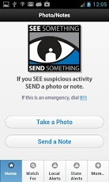
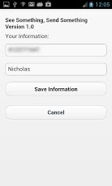
UNCLASSIFIED//FOR OFFICIAL USE ONLY
See Something Send Something-Application Screenshots
UNCLASSIFIED//FOR OFFICIAL USE ONLY
Notes:
The free app is a nationwide suspicious activity reporting (SAR) tool for citizens to help in the fight against terrorism and criminal activity but not to replace 911 for emergency situations.
The system connects concerned citizens, first responders and law enforcement to key intelligence centers including LA-SAFE.
The system routes geo-tagged suspicious activity reports and location-based messages to intelligence centers providing intel analysts the ability to receive, sort, search and analyze inbound SAR’s.
The free smartphone application allows suspicious activity to be captured as a photo and as written text and sent directly to LA-SAFE where the tips and information can be evaluated and then forwarded to law enforcement across the state as needed.
The application can be downloaded for iPhone and Android phone users, as well as iPad users, and is provided by My Mobile Witness.
For further information please visit http://www.mymobilewitness.com/consumer-services.php.
To download the free application please visit the itunes store or google play store.
iPhone or iPad
https://itunes.apple.com/us/app/see-send/id556069712?mt=8
Android
https://play.google.com/store/apps/details?id=com.mymobilewitness.seesend

Slide 7
UNCLASSIFIED//FOR OFFICIAL USE ONLY
LA-SAFE – Human Trafficking
Human Trafficking Task Force with FBI, local Sheriff’s Office, local District Attorney’s Office and victim advocacy groups
Creation of Human Trafficking portal within HSIN
Creation of a Beta National Human Trafficking Database
Human Trafficking Report – Sent to the US Congress for review
Participation in the Capitol Area Joint Child Abduction Rapid Deployment (JCARD) Team
Human Trafficking Awareness Presentations to Law Enforcement and Community Interest Groups
Coordination with the Department of Children & Family Services to implement a streamlined process to report Human Trafficking incidents
Creation of a National Human Trafficking Working Group
UNCLASSIFIED//FOR OFFICIAL USE ONLY
Notes:
Human Trafficking Task Force with FBI, local Sheriff’s Office, local District Attorney’s Office and victim advocacy groups.
Creation of Human Trafficking portal within HSIN.
LA-SAFE Human Trafficking Analyst and Cyber Unit was recognized by DHS and the Tennessee Fusion Center for their willingness to share information in regards to automated searches in relation to Human Trafficking.
On October 29, 2013, LA-SAFE received a tip through the “See Something Send Something” mobile app and disseminated that information to its CIU section which was able to rescue a local Baton Rouge female who was a victim of Human Trafficking.

Slide 8
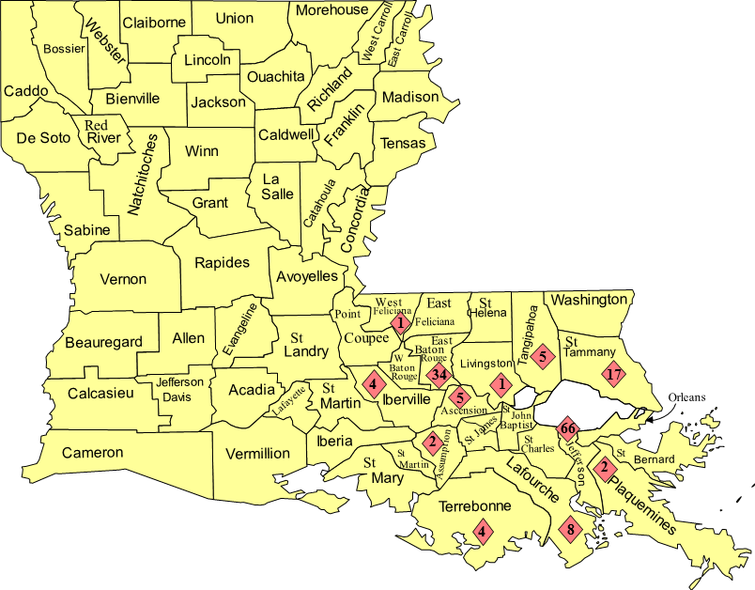
UNCLASSIFIED//FOR OFFICIAL USE ONLY
LA-SAFE – Heroin Report
This map shows the number of heroin related deaths in 2013 as reported to LA-SAFE by the coroner’s offices.
UNCLASSIFIED//FOR OFFICIAL USE ONLY
Notes:
There was an increase in the number of heroin-related deaths in Louisiana in 2013.
There were at least 310 heroin-related arrests made by Louisiana State Police and sheriff’s offices in Louisiana in 2013.
Based on information reported to LA-SAFE by the Louisiana sheriff’s offices, 152.45 pounds of heroin were seized in 2013.

Slide 9
Notes:
SOURCE: Center for Behavioral Health Statistics and Quality, Substance Abuse and Mental Health Services Administration, Treatment Episode Data Set (TEDS)
In 2013, there were 1,888 people admitted for heroin abuse according to TEDS.
Two thirds of those admitted for treatment were men.
Sixty-nine percent of those admitted were white.
The majority of those treated for heroin abuse are between the ages of 21-40 years old.

Slide 10
LA-SAFE – Gangs
LA-SAFE monitors the different gang types
There are hundreds of gangs in Louisiana
The number of criminal street gangs is increasing
Gang members range in age from preteens to adults
Louisiana gangs have little or no identifiable hierarchy
Gangs have access to weapons and narcotics
Gang members use social media to post criminal activity
Use music industry operations to conceal criminal activity
Notes:
LA-SAFE monitors the following gang types:
Criminal Street Gangs
Hybrid Gangs
Gangs committing criminal activity that is not designated in the criminal street gang statute (RS 15:1404)
Outlaw Motorcycle Gangs
Department of Corrections Security Threat Groups
Formerly known as prison gangs
There are hundreds of gangs in Louisiana and most of them are hybrid gangs.
Gang members range in age from preteens to adults.
With the exception of outlaw motorcycle gangs, Louisiana gangs have little or no identifiable hierarchy
Successes
LA-SAFE analysts trained over 200 Louisiana Probation and Parole Agents
The continued outreach and education efforts from the LA-SAFE gang analysts has doubled the size of the gang database in the last 12 months

Slide 11
UNCLASSIFIED//FOR OFFICIAL USE ONLY
LA-SAFE – Cyber Fusion Unit
LA-SAFE Cyber Fusion Unit's (LCFU) primary function is to provide actionable cyber intelligence to LA-SAFE customers, with the goal of assisting those customers in protecting their networks. Collaborates with:
FBI’s Cyber Division in New Orleans
National Cybersecurity & Communications Integration Center (NCCIC)
Louisiana Higher Education Institutions
The CIN (Cyber Intelligence Network)
Critical Infrastructure and Key Resource (CIKR) Entities
UNCLASSIFIED//FOR OFFICIAL USE ONLY
Notes:
The LA-SAFE Cyber Fusion Unit is currently run by the Cyber Security Officer from the GOHSEP.
Primary Function is to provide actionable cyber intelligence to LA-SAFE customers.
Member of FBI Cyber Task Force in New Orleans
DHS National Cyber security and Communications Integration Center (NCCIC)
Co-founder of the Cyber Intelligence Network (CIN) – a collaborative network of cyber analysts from fusion centers across the country. 45 agencies in 35 states with approximately 240 cyber professionals.
The LCFU is a co-founder of the CIN (Cyber Intelligence Network), a collaborative of cyber intelligence analyst from fusion centers across the country. Through the CIN, the LCFU has worked to:
Establish the Cyber Performance Levels Categorical Framework
Recognized as a model for best practices in the field of cyber for the network of fusion centers.
Selected for F.C. Cyber Pilot sponsored by Office of the Program Manager of the Information Sharing Environment (PM-ISE) & DHS Offices of Cybersecurity & Communications (CS&C) and I&A.
For the identification of computer infections in a national research facility & in numerous CIKR, Higher Education & Internet Service Provider networks.
The production of over 30 national level intelligence reports.
The Cyber Liaison Officer (CLO) Program serves as an extension of the LCFU & as a regional working group of vetted subject matter experts from both Louisiana based law enforcement and CIKR organizations.
A model and a best practice for the entire network of fusion centers
The LCFU operates an awareness group where cyber bulletins and situational advisories are delivered.
Represents over 230 organizations across LA-SAFE’s area of responsibility
Pushed out over 30 products to this group in 2015

Slide 13
UNCLASSIFIED//FOR OFFICIAL USE ONLY
LA-SAFE–(CI/KR) Critical Infrastructure and Key Resources
Created a CI/KR statewide contact list for quick response to facilities
Incorporating Facility Security Officers into the Fusion Liaison Officer program
Information sharing about new fraud trends and cyber threats with the banking industry
LA-SAFE Bank Robbery Assessment
Successes
UNCLASSIFIED//FOR OFFICIAL USE ONLY
Notes:
Information sharing with Louisiana petro/chem/port facilities through their Facility Security Officers.
Created a CI/KR statewide contact list for quick response to facilities.
Incorporating Facility Security Officers into the Fusion Liaison Officer program.
Assist in keeping our maritime and port security officers aware of trends and significant incidents overseas involving maritime security. Our maritime private sector operates vessels, platforms, pipelines, etc. in areas overseas where security is a concern.
Information sharing about new fraud trends and cyber threats with the banking industry.
Successes
Counterfeit check group arrests, FBI Intel NOTE, may go Federal.
Marsha Cole, ID theft, counterfeit checks, bank fraud, etc. Going Federal
Cell phone armed robberies in FL. Crimedex alert from T-Mobile Loss Prevention leads to suspects arrested by Jennings PD.
ATM and gas pump skimming
Immerging Drone technology impacts to CIKR

Slide 14
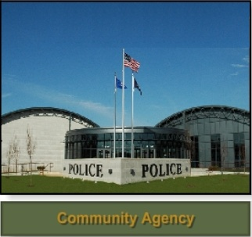
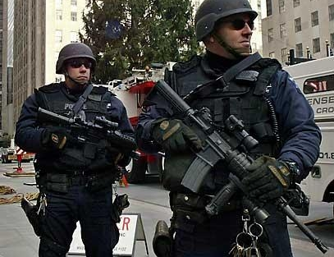
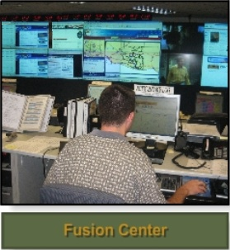
UNCLASSIFIED//FOR OFFICIAL USE ONLY
LA-SAFE - FLO Program
Fusion Liaison Officers (FLOs) are:
The information bridge between the Fusion Center and their agency = Intelligence Force Multipliers
A critical connection for relaying terrorism and crime-related intelligence, or other all-hazards information
INFORMATION SHARING
INFORMATION SHARING
UNCLASSIFIED//FOR OFFICIAL USE ONLY

Slide 15
UNCLASSIFIED//FOR OFFICIAL USE ONLY
QUESTIONS
UNCLASSIFIED//FOR OFFICIAL USE ONLY

Slide 16
CONTACT INFORMATION
CHUCK MCNEAL
EMAIL: CHUCK.MCNEAL@LA.GOV
CELL: 225-202-6111
FUSION CENTER
EMAIL: LAFUSION.CENTER@LA.GOV
PHONE: 225-925-4192

