Slide 1
Governor’s Office of
Homeland Security & Emergency Preparedness
Louisiana Wireless Information Network (LWIN) Procedures
February 26, 2014

Slide 2
gohsep.la.gov
From the GOHSEP home page, click on the “LWIN” link
LWIN

Slide 3
Use these links to view Policy & sample forms to gain access

Slide 4
LWIN Subscribers
7.13
Upgrade

Slide 5
Subscriber Statistics
Security Groups/Agencies: 184/457
Talkgroups: 5,624
Subscribers: 74,277

Slide 6
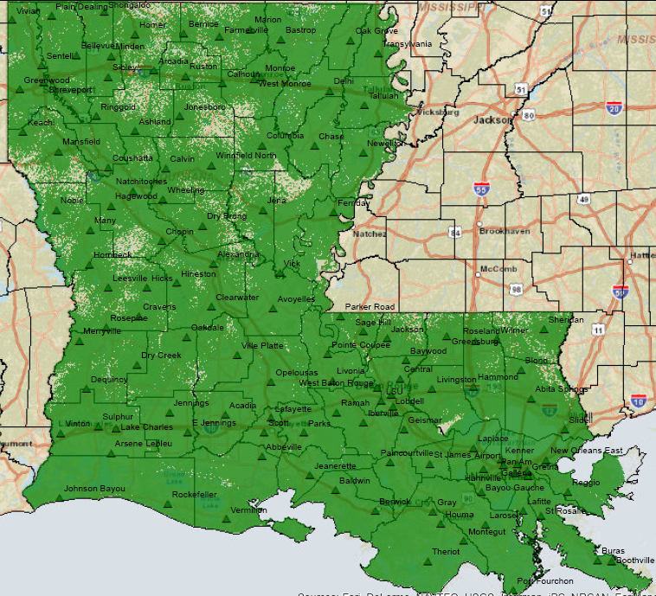
Current Coverage
LWIN Network

Slide 7
For More Information:
Chris Guilbeaux
christopher.guilbeaux@la.gov
(225) 925-7333

Slide 8
FIND US ON THE WEB
+
gohsep.la.gov
getagameplan.org

