Slide 1
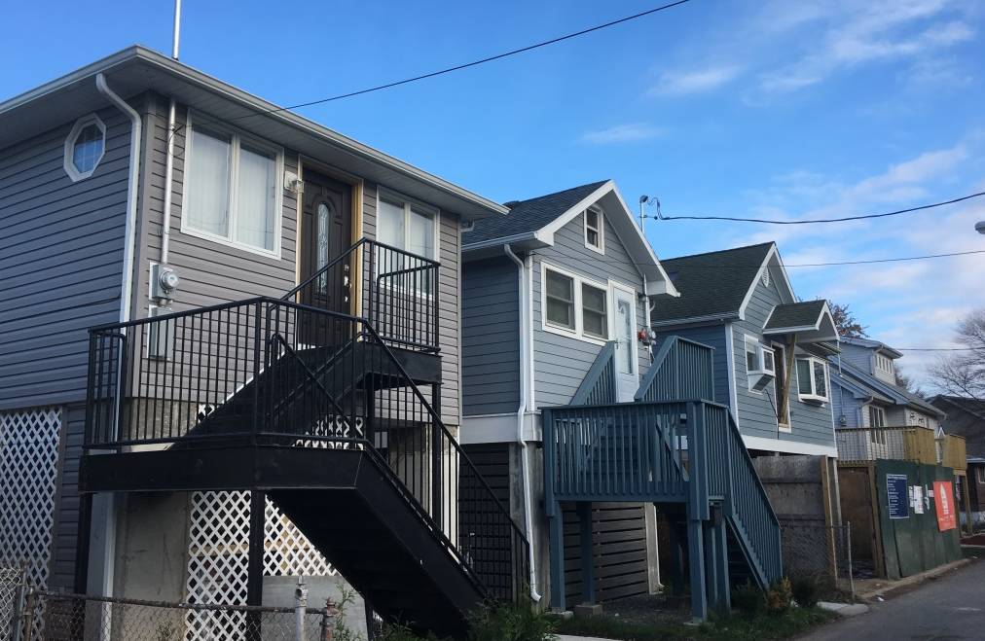
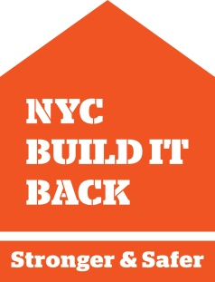
NEW YORK CITY
HOUSING RECOVERY – BUILD IT BACK
April 2018

Slide 2
HURRICANE SANDY
Approximately
10 percent of
New York City’s population resided in the area flooded by Hurricane Sandy
FEMA FLOOD ZONES & FLOOD INSURANCE
1/2 of housing flooded outside of FEMA’s 100‐year floodplain
1/2 of housing in the 100‐yr floodplain had flood insurance
REPAIR & REIMBURSEMENT
2/3 outside 100‐year floodplain
1/4 received NFIP payments
2

Slide 3
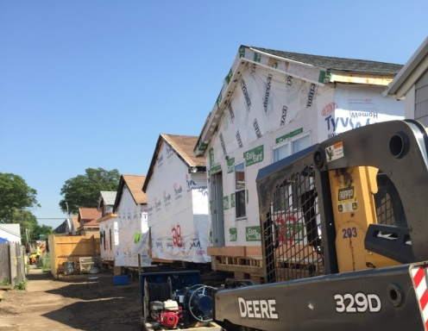
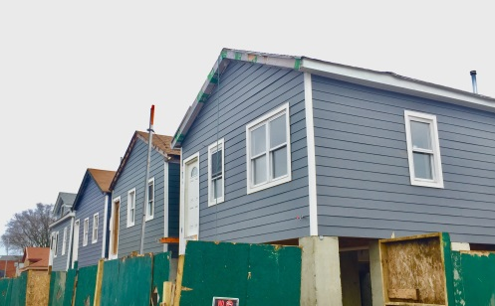
BUILD IT BACK AND LONG-TERM RESILIENCY
Build It Back |  | Community Housing Recovery |  | Long-Term Planning
Repair & Reimburse |  | Neighborhood-Based Construction |  | Resilient Neighborhoods Studies + Zoning Updates
Elevate |  | Attached Home Intake & Alternative Mitigation |  | Street and Sewer Infrastructure Projects
Rebuild |  | Strategic Acquisition |  | Urban Renewal Area Edgemere Initiative
Acquisition for Redevelopment/ Buy-Out |  | Upgrades to Public and Private Infrastructure |  | Long-Term Resiliency Projects and Infrastructure

Slide 4
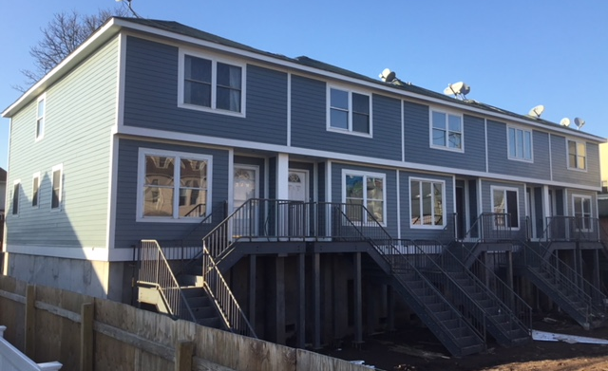
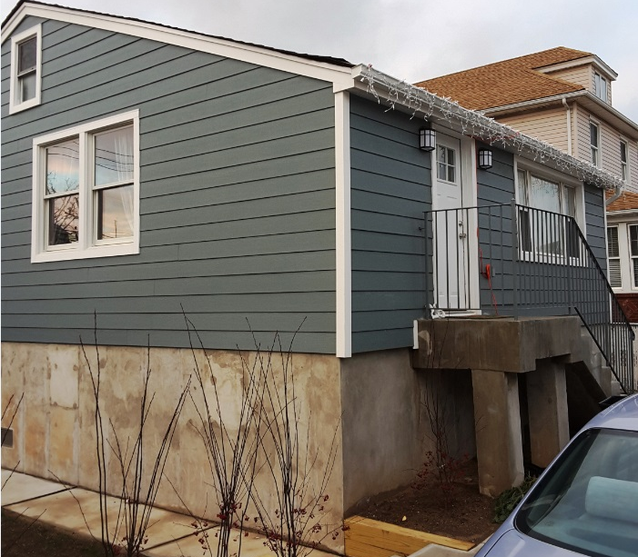
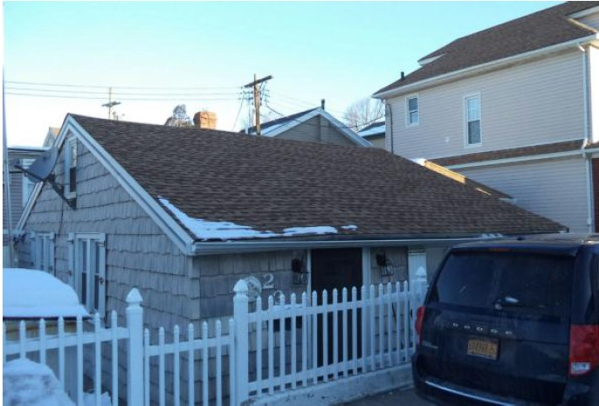
CONSTRUCTION COMPLEXITIES
Elevated DFE
Grade
Original Elevation

Slide 5
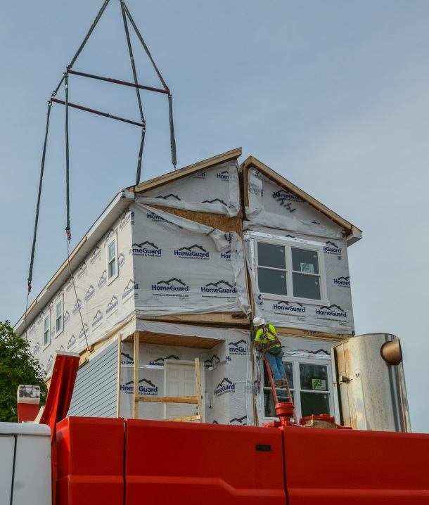
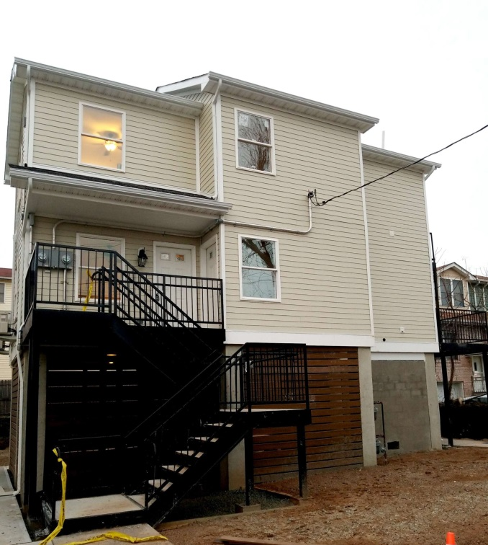
MODULAR PROGRAM
New Build It Back Program
100 Homes
69 in Queens
31 in Staten Island
Three Phases:
1: Demo & foundations
2: In-factory construction, transportation to site, and assembly
3: Connect utilities, stairs, underbelly
Timeframes:
3 months –design, approvals, move-out
3-4 months construction
Notes:
Lou

Slide 6
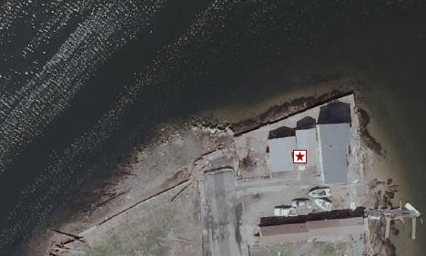
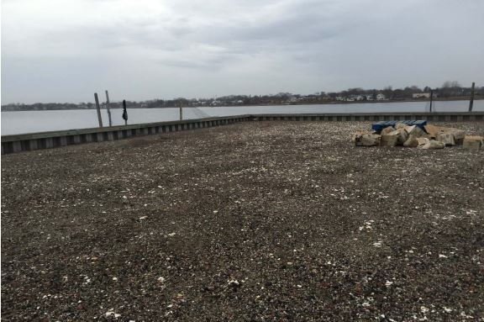
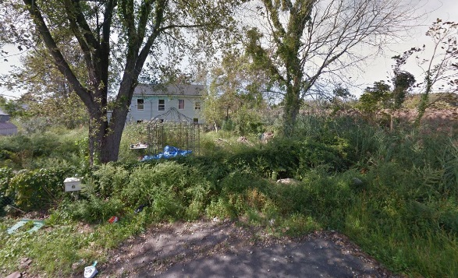
ACQUISITION AND BUYOUT
City Funded Acquisition and Buyout Program
ACQUISITION TIMELINE
2013
State Enhanced Buyout in 3 Staten Island neighborhoods
2014
City/State Acquisition For Redevelopment (AFR) offered to all SD homes
City review of AFR neighborhood projects in New Dorp Beach and Sunnymeade Village, Staten Island
City began identification of Unbuildable Sites
2015
State AFR limited eligibility to developable sites; intake closed in October 2015
City created Build It Back Acquisition/Buyout Program
2016
City encourages applicants with most complex construction projects to use new Resettlement Incentives Program to relocate to a move-in ready home
2017
City begins collaborating with communities and agency partners to implement disposition plan for housing and open space sites
Unbuildable Homes
City established a criteria to identify unbuildable homes:
Limited developable land due to wetlands and CEHA
Substandard or nonexistent infrastructure
City, State and Federal regulations
City’s long-term planning goals
Health and safety concerns
Cost reasonableness
70+ homes have been identified as unbuildable
Pre-Storm
Pre-Storm
Acquisition & Buyout Program
City program expanded eligibility to sites that did not qualify for State programs, including unbuildable homes and strategic locations
228 sold homes
13 applicants have used resettlement incentives to purchase a new home
Post-Storm
Post-Storm
BUYOUT
Coastal A Flood Zone
598 Beach 43rd Street
Edgemere, Staten Island
BUYOUT
CEHA + Designated Open Space
355 Tennyson Drive
Great Kills, Staten Island
BUYOUT
Freshwater Wetland + Septic System
50 Baden Place
Midland Beach, Staten Island
Post-Storm
Notes:
Amy

Slide 7
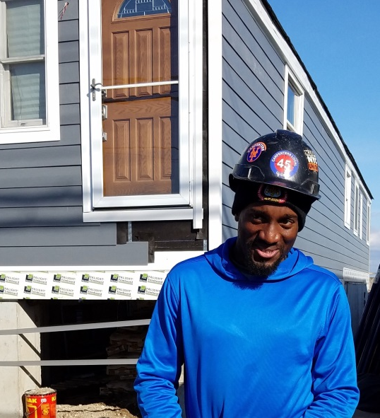
SANDY RECOVERY HIRING PLAN
“Words can’t even describe how I’m feeling. To have the opportunity to join the carpenters union because of Sandy and stay in my neighborhood and rebuild the community, makes it all worth it.”
Goals | Results
Contractors to employ twenty percent (20%) Sandy-impacted residents | 23% of trades workers are Sandy-impacted residents
NYC/HUD funded Sandy Workforce1 Centers to match job opportunities with Sandy impacted residents | 1,600 Sandy‐impacted New Yorkers found jobs 1,110 Sandy‐impacted New Yorkers worked for Build It Back
NYC funded an initial 100 Sandy-impacted residents through pre-apprenticeship programs | 150 Sandy‐impacted New Yorkers are working as apprentices
Jamel Dickerson
Carpenter, NYC District Council of Carpenters
Far Rockaway, Queens
Edward J. Malloy Initiative for Construction Skills
Linda Ramirez-Gonzalez
Laborer, Laborers' Local 79
Staten Island
Nontraditional Employment for Women (NEW)

