Slide 1
L.W.I.N.
Louisiana Wireless Information Network
System Management & Maintenance
January 21, 2026
Department of Public Safety
Office of State Police
Mobility and Communication Services
(225) 925-6036

Slide 2

Infrastructure Update

Slide 3
SYSTEM SUMMARY
153 Total Tower Sites in Operation
6 Operational Mobile Sites

Slide 4
Zone 1:
44 Sites in Full Operation
Pan Am
Bridge City
Livonia
Laplace
St. Tammany Simulcast
Lacombe
Abita Springs
Waldheim
Pearl River
Covington
Slidell
Talisheek
Blond
Sheridan
Geismar
St. James
Larose
Gibson
BR Simulcast
BR
Central
LSU
WBR
Hammond
Gray
Berwick
Baywood
Ramah
Sage Hill
Parker Road
Iberville
Livingston
Jackson
Greensburg
Superdome
South Baton Rouge
Baldwin
Pointe Coupee
Theriot
Paincourtville
Boothville
Mobile Units
94
96
97
98
99
100
Denham Springs
Clinton
St. George
Independence
Zachary

Slide 5
Zone 2:
19 Sites in Full Operation
N. Simulcast
Gretna
Galleria
NO East
Houma
Lafitte
Bayou Gauche
Hahnville
St. Rosalie
Kenner
Airport
Port Fourchon
Reggio
Montegut
Bourg
Buras
Wilmer
Grand Isle
Thibodeaux

Slide 6
Zone 3:
56 Sites in Full Operation
Clearwater
Monroe
Winnfield
Delhi
Chopin
Dry Prong
Hagewood
Bossier(City)
Farmerville
Minden
Natchitoches
Bastrop
Greenwood
Ruston
Hineston
Ashland
Vivian
Newellton
Noble
Transylvania
Alexandria
Avoyelles
Bellevue
Bernice
Calhoun
Columbia
Ferriday
Homer
Jena
Jonesboro
Mansfield
Many
Marion
Oak Grove
Plain Dealing
Ringgold
Sentell
Tallulah
Wheeling
Shreveport
West Monroe
Chase
Keachi
Coushatta
Shongaloo
Sibley
Vick
Calvin
Arcadia
Enterprise
Holloway
Chatham
Cypress/
Ouachita
Logansport
Pelican
Hunter Road

Slide 7
Zone 4:
35 Sites in Full Operation
Abbeville
Acadia
Arsene LeBleu
DeQuincy
Dry Creek
Jeanerette
Jennings
Johnson Bayou
Lafayette
Lake Charles
Leesville
Merryville
Opelousas
Parks
Rockefeller
Rosepine
Scott
Sulphur
Vermillion
Ville Platte
Vinton
Craven
Hicks
Hornbeck
Oakdale
Roseland
E. Jennings
Anacoco
Oberlin
Moss Bluff
New Iberia
Eunice
Starks
Bell City
Calcasieu Jail

Slide 8
Channel Summary
Total Channels 1637
1586 Channels on 153 Sites
51 Channels on 6 Mobile Sites

Slide 9
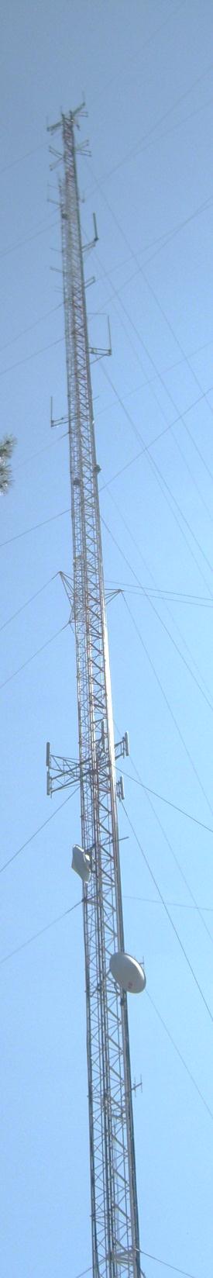
System
Statistics

Slide 10
SUBSCRIBERS

Slide 11
PUSH TO TALK

Slide 12
PUSH TO TALK PER DAY

Slide 13
BUSIES

Slide 14

Top Busy Sites
Calcasieu Jail 612
St. George 32
Denham Springs 15

Slide 15
SITE OUTAGES
Acadia | Airport | Arsene Lebleu | Avoyelles | Bastrop
Bell City | Bellevue | Blue | Boothville | Bossier
Bourg | Buras | Calcasieu Jail | Calvin | Chatham
Clearwater | Coushatta | Cravens | Cypress | Dequincy
Dry Creek | East Jennings | Grand Isle | Green | Greensburg
Greenwood | Hahnville | Holloway | Homer | Jena
Johnson Bayou | Jonesboro | Kenner | Lake Charles | Laplace
Larose | Livingston | Livonia | Merryville | Minden
Total Downtime: 1269 Hours

Slide 16
SITE OUTAGES
Newellton | Noble | Oak Grove | Oakdale | Parker Road
Pelican | Plain Dealing | Port Fourchon | Ramah | Rockefeller
Roseland | Rosepine | Ruston | Sentell | Shongaloo
Sibley | South Baton Rouge | Starks | Tallulah | Theriot
Trailer 96 | Trailer 97 | Trailer 99 | Transylvania | Vermilion
Vick | Ville Platte | Vinton | Vivian | Wheeling
Wilmer
Total Downtime: 1269 Hours

Slide 17
SITE OUTAGE DATA
69%

Slide 18
SYSTEM STATISTICS

Slide 19
Subscriber Statistics
Security Groups
192
Agencies
618
Talkgroups
6,669

Slide 20

Agencies Added Last 3 Months
none

Slide 21
System Coverage

Slide 22
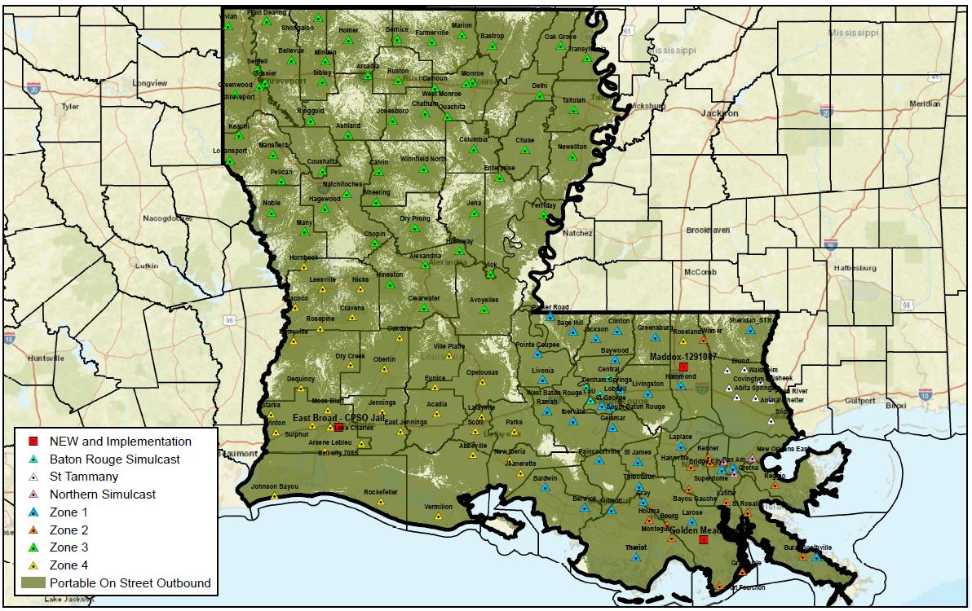
Present Coverage
Updated: 10/2025

Slide 23
Questions?

Slide 24
Ethernet Update

Slide 25
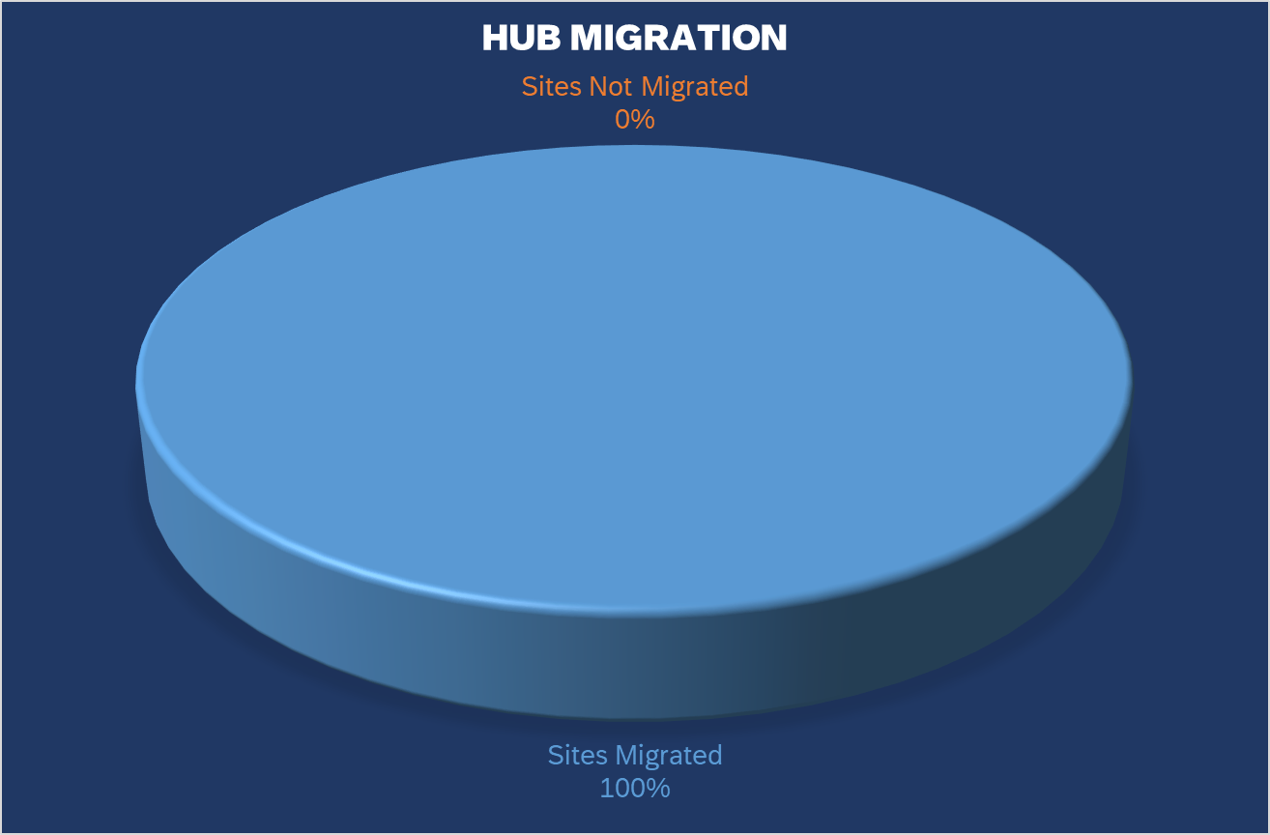
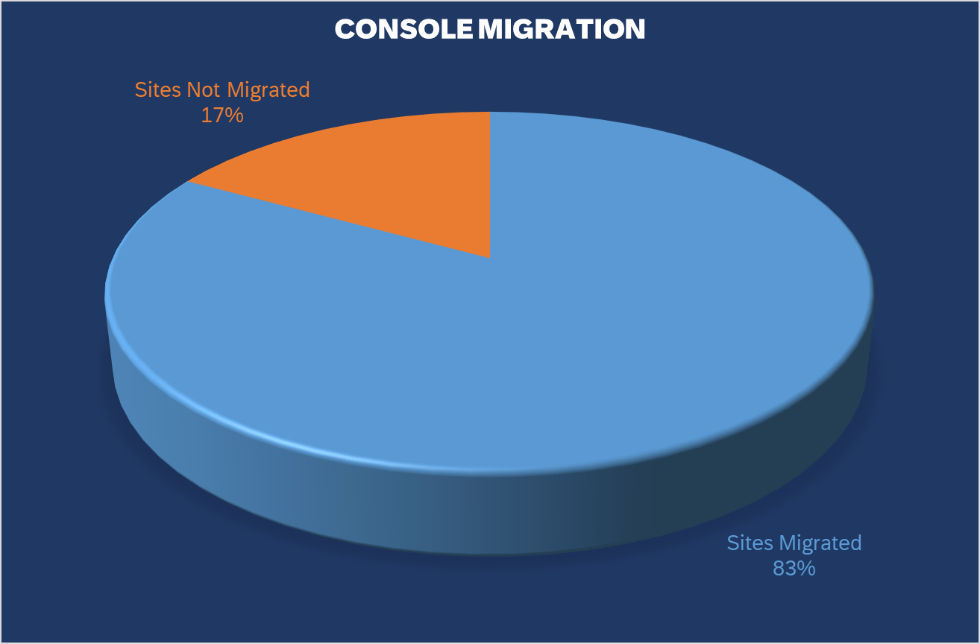
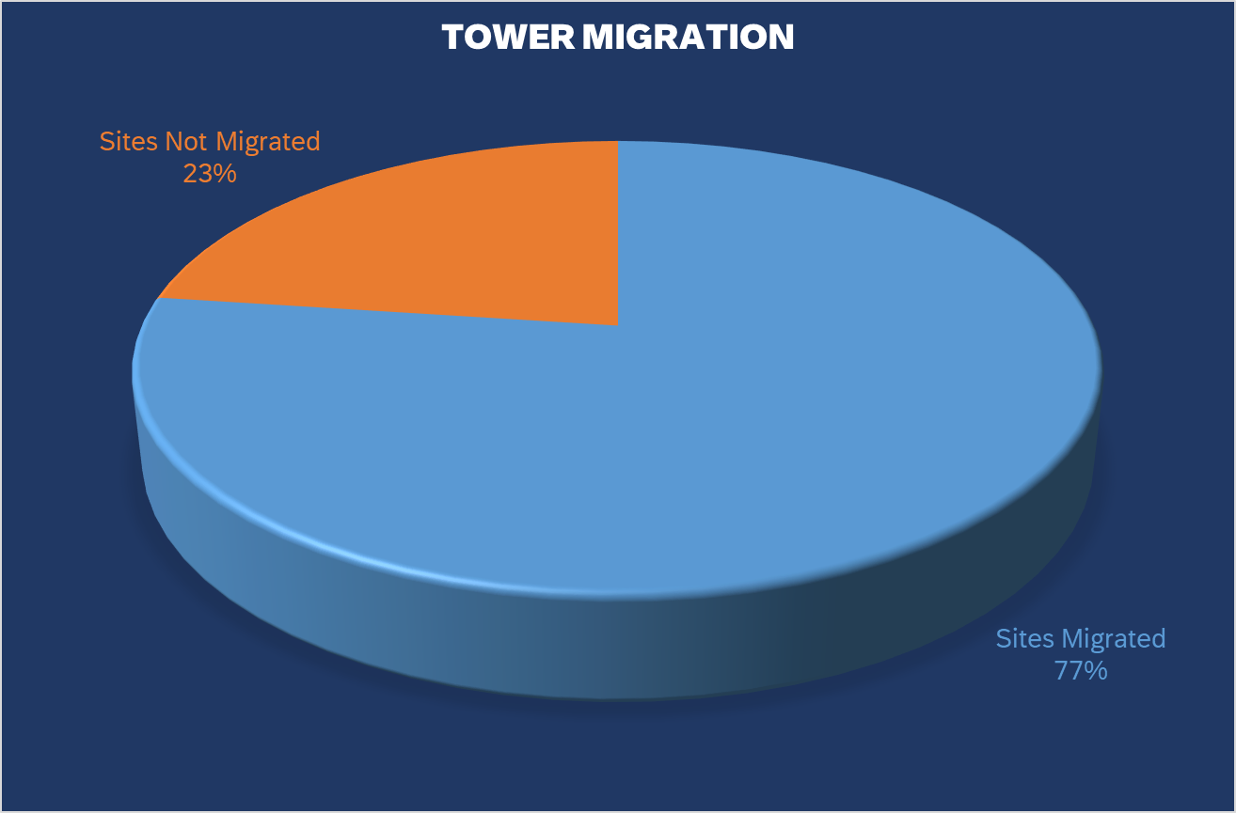
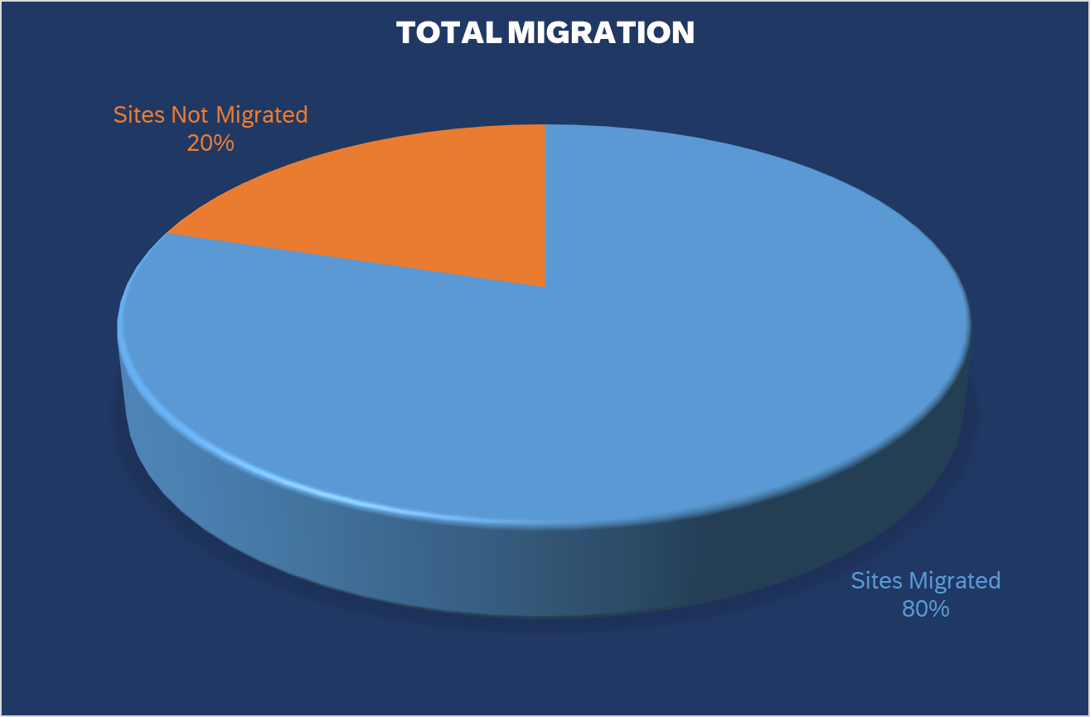
State of Louisiana - LWIN Program Review
 | Ckts On Order | Ckts Delivered | ATT Trouble Sites | Ckts Pending Order | Cradlepoint Installed | External Antenna Installed | Program Ckt Total | Sites Migrated | Sites Not Migrated
Hubs | 8 | 8 | 0 | 0 | 0 | 0 | 8 | 8 | 0
Consoles | 55 | 52 | 2 | 4 | 52 | 25 | 59 | 49 | 10
Towers | 121 | 111 | 14 | 10 | 111 | 100 | 131 | 101 | 30
Total | 184 | 171 |  | 14 | 163 | 125 | 198 | 158 | 40

Slide 26
Thank You!

