Slide 1



Annual GOHSEP Conference
OHSEP Directors + LEPA + LEPC Members
Uniform Guidance, 2 C.F.R. 200 – Procurement & Documentation

Slide 2
AGENDA
What is the new “Super Circular” or Uniform Guidance, 2 C.F.R. 200?
Major Changes
  Uniform Grant Administrative Requirements
  Cost Principles
  Audit
Procurement & Documentation
Resources

Slide 3
New Guidance
2 CFR Chapter I, and Chapter II, Parts 200, 215, 220, 225, and 230
Uniform Administrative Requirements, Cost Principles, and Audit Requirements for Federal Awards

Slide 4
What is the Super Circular?
The Super Circular consolidates and changes the administrative requirements for all federal assistance.
It became effective on December 26, 2014.
  New Grant Awards after this date
  Disasters declared after this date
This presentation is not an exhaustive list of all requirements in 2 C.F.R. Part 200 and you are encouraged to review the regulation in full.

Slide 5
What is the Super Circular?
2 C.F.R. Part 200 streamlines the language from eight existing Office of Management and Budget (OMB) circulars into one consolidated set of guidance.
Guidance will improve the integrity of the financial management and operation of Federal programs and strengthen accountability for Federal dollars by improving policies that protect against waste, fraud, and abuse.
Minimizes time spent complying with unnecessarily burdensome administrative requirements.

Slide 6
Grants Management
A-89, Federal Domestic Assistance Program Information
A-102, Grant Awards and Cooperative Agreements with State & Local Governments (44 C.F.R. part 13)
A-110, Uniform Administrative Requirements for Awards & Other Agreements with Institutions of Higher Education, Hospitals, & Other Nonprofit Organizations (2 C.F.R. 215)
Cost Principles
A-21, Cost Principles for Educational Institutions (2 C.F.R. part 220)
A-87, Cost Principles for State, Local & Indian Tribal Governments (2 C.F.R. part 225)
A-122, Cost Principles for Non-Profit Organizations
(2 C.F.R. part 230)
Audit
A-133, Audits of States, Local Governments & Non-Profit Organizations
Sections of A-50 related to audits performed under Subpart F—Audit Requirements
Notes:
Supersession
Will no longer refer to OMB Circulars except to the extent of previous grants

Slide 7
What is the Super Circular?
No change to programmatic substance of FEMA’s programs:
  Eligibility criteria for FEMA’s programs
  FEMA’s disaster declaration criteria
  FEMA’s disaster grant appeals process
  Statutory purposes and objectives of any FEMA assistance program
  Statutorily allowable costs and activities under any FEMA assistance program
Notes:
No substantive programmatic changes:
Eligibility criteria for Homeland Security Grant Program; Emergency Management Performance Grants Program; Tribal Homeland Security Grant Program; National Earthquake Hazard Reduction Program; National Dam Safety Program; and other non-disaster grants

Slide 8
What is FEMA doing to implement the Super Circular?
Adoption of the Super Circular by DHS
The administrative requirements for FEMA grants WILL BE affected by the new changes.
Check for Interim Guidance on FEMA.gov for disaster grant programs.
All Notices of Funding Opportunities will reflect the necessary changes.
Notes:
Although Appendix I contains a list of information required to be included in the Notice of Funding Opportunity, Have yet to see what a FEMA Notice of Funding Opportunity will look like.
First FOA, will probably be the 2015 Homeland Security grant programs.

Slide 9
Which guidance governs?
The terms and conditions of the original Federal award always govern, even once the uniform guidance goes into effect.
The Super Circular will apply to:
  all non-disaster grants and cooperative agreements FEMA makes on or after December 26, 2014.
  all awards made under Stafford Act declarations declared on or after December 26, 2014.
The Super Circular will not apply retroactively to existing awards, EXCEPT:
  Non-federal entities will follow the Audit Requirements in Subpart F for existing awards in some circumstances.
  Recipients and subrecipients who wish to implement entity-wide system changes to comply with the new guidance after the effective date will not be penalized for doing so.

Slide 10
The Super Circular contains substantive changes – review it carefully.

Slide 11
Major Changes
The Super Circular consists of 6 different subparts and 11 appendices:
  Subpart A: Acronyms and Definitions
  Subpart B: General Provisions
  Subpart C: Pre-Federal Award Requirements and Contents of Federal Awards
  Subpart D: Post-Federal Award Requirements Standards for Financial and Program Management
  Subpart E: Cost Principles
  Subpart F: Audit Requirements

Slide 12
Major Changes
200.1 – 200.99: Definitions
The definitions are indexed because they are listed in separate sections
Terms are broad to encompass
  all requirements (administrative, cost principles, audit) and
  all types of entities receiving Federal awards

Slide 13
Major Changes
200.1 – 200.99: Definitions
Recipient
Sub recipient
Pass-through Entity (PTE)
Non-Federal Entity (NFE)
Federal Award
Federal Award Date
Federal Financial Assistance
Fixed Amount Awards
Performance Goal
Period of Performance
Notes:
No longer referred to as grantee/ sub grantee OR grant/sub grant
200.69. Non-Federal Entity (NFE)- means a state, local government, Indian tribe, institution of higher education (IHE), or non-profit organization
200.74. Pass-through entity- means a NFE that provides a sub award to a sub recipient to carry out part of a Fed. Prog.
200.86. Recipient- means a NFE that receives a Federal award directly from a Federal awarding agency
200.93. Sub recipient- means a NFE that receives a sub award from a PTE to carry out part of a Fed. Prog. (not an individual)

Slide 14
New Administrative
Grant Requirements
NEW!
General Provisions
200.112: Conflict of Interest
  Recipients and subrecipients must disclose, in writing to FEMA or its pass-through entity, any potential conflict of interest in the Federal award’s lifecycle.
200.113: Mandatory Disclosures
  Recipients and subrecipients must disclose, in a timely manner and in writing to FEMA or the pass-through entity, all violations of Federal criminal law involving fraud, bribery, or gratuity potentially affecting the Federal award.
Notes:
Two new requirements that strengthen oversight:
200.112, Conflict of interest (partly new)
1. The Federal awarding agency must now establish conflict of interest policies for their Federal awards
2. The NFE must disclose in writing any potential conflict of interest within five days to the Federal awarding agency (or PTE) in accordance with applicable Federal awarding agency policy (5 days per FEMA Info bulletin No. 400 on 12/23/14)
200.113, Mandatory disclosures
Non-Federal entities (and applicants) must disclose in writing all violations of Federal criminal law involving fraud, bribery, or gratuity violations potentially affecting the Federal award

Slide 15
New Administrative
Grant Requirements
NEW!
Specific Requirements for Pass-Through Entities
Pass-through entity is a new term– It is a recipient that provides a subaward to a subrecipient to carry out part of a Federal program.
Some of the requirements for pass-through entities include (See 2 C.F.R. 200.331):
  Identifying specific information in its subawards to subrecipients.
  Performing a risk assessment for subrecipients prior to award.
  Conducting required monitoring of subawards.
  Completing subaward close-out activities per 2 C.F.R. 200.343.
Notes:
Risk review of applications and imposition of Specific Conditions
- Pass-through entities who make subawards must conduct a risk assessment prior to making awards.
- For all subawards, pass-through entities must evaluate the applicant’s risk of noncompliance with Federal statutes, regulations, and the terms of the subaward before making the award. Factors that the pass-through entity may consider in doing this risk analysis can be found at 2 C.F.R. §200.331.
- If risk is identified, FEMA or the pass-through entity may add specific conditions to the award.

Slide 16
New Administrative
Grant Requirements
NEW!
Risk review of applications and imposition of Specific Conditions
Pass-through entities who make subawards must conduct a risk assessment prior to making awards.
For all subawards, pass-through entities must evaluate the applicant’s risk of noncompliance with Federal statutes, regulations, and the terms of the subaward before making the award. Factors that the pass-through entity may consider in doing this risk analysis can be found at 200.331.
If risk is identified, FEMA or the pass-through entity may add specific conditions to the award.
Notes:
Risk review of applications and imposition of Specific Conditions
- Pass-through entities who make subawards must conduct a risk assessment prior to making awards.
- For all subawards, pass-through entities must evaluate the applicant’s risk of noncompliance with Federal statutes, regulations, and the terms of the subaward before making the award. Factors that the pass-through entity may consider in doing this risk analysis can be found at 2 C.F.R. §200.331.
- If risk is identified, FEMA or the pass-through entity may add specific conditions to the award.

Slide 17
Administrative
Grant Requirements
Pre-Federal Award Info
200.203: Notices of funding opportunities
200.205: Federal agency review of risk
200.206: Standard application requirements
200.210: Information contained in a federal award
NEW!
Notes:
200.203, Notices of funding opportunities
Federal awarding agencies must announce specific funding opportunities by posting a public notice on the OMB-designated government-wide Web site
Specifies a set of six data elements that must be included in the public notice
Full Text of Funding Opportunities identifies required information that must be included in the full text of each Federal funding opportunity & Detailed instructions for the full text of the notice of funding opportunity.
4. Establishes minimum timeframes Federal awarding agencies must generally make all funding opportunities available for application
NEW! 200.205, Federal agency review of risk (Formerly in 13.12 but no longer optional)
New language requires Federal agencies PTEs to review the risk associated with a potential recipient prior to making an award (including by making better use of available audit information where appropriate).
Federal awarding agencies must have a framework for evaluating the risks posed by applicants prior to receipt of a federal award
Must utilize government wide repositories of eligibility qualification or financial integrity information such as Dun and Bradstreet and “Do Not Pay”. See also 2 CFR 180 Suspension and Debarment regulations
Can use:
history of performance i.e. applicant’s record of managing a Fed award when a prior recipient of Fed awards including but not limited to: timeliness of compliance w/applicable reporting requirements, conformance to the terms and conditions of previous Fed. awards, and
audit findings
200.206, Standard application requirements
Standardizes OMB-approved application and collections process
200.210, Information contained in a federal award
Provides a standard set of 15 data elements which must be provided in all Federal awards

Slide 18
Administrative
Grant Requirements
NEW!
Post-Federal Award Info
200.301: Performance management
200.303: Internal controls
200.305: Payments
200.307: Program Income
200.309: Period of performance
Notes:
STANDARDS FOR FINANCIAL AND PROGRAM MANAGEMENT (300-309)
(Same as Part 13 but…..more robust guidance)
200.301: Performance Management (partly new)
Provides more robust guidance to Federal agencies and intended to ensure clear performance goals, indicators, and milestones for pass-through entities and recipients
200.303: Internal Controls (partly new)
Requires NFEs to take reasonable measures to safeguard PII or other sensitive information
200.305: Payments (partly new)
Allows recipients to pay interest earned on Federal funds annually to the Department of Health and Human Services, rather than “promptly” to each Federal awarding agency.
Interest amounts up to $500 per year may be retained by the non-federal entity for administrative expenses
Allows one single depository account
200.307. Program Income:
More robust guidance and allows NFE to negotiate agreements re: appropriate uses of income earned after the period of performance as part of the grant closeout process (no change otherwise)
NEW! 200.309: Period of Performance
Can only charge allowable costs incurred during the period of performance and as otherwise authorized by the federal awarding agency or PTE

Slide 19
Administrative
Grant Requirements
Post-Federal Award Info
200.310 – 200.316: Property Standards
  200.313: Equipment
  200.314: Supplies
  200.315: Intangible property
  200.316: Property trust relationship
Notes:
PROPERTY STANDARDS (310-316), Mostly unchanged but more robust guidance
200.313, Equipment (No substantive changes).
Ensures that the non-Federal entity maintains an equipment inventory system to show an effective system of controls exists to account for and track equipment that has been acquired with Federal funds.
200.314. Supplies (Unchanged- more robust guidance)
200.315. Intangible property
Provides same property rights as tangible property
Fed’s have right to use (Same as 13.34)
200.316. Property trust relationship
No change from 13.20(b)(3) duty to safeguard prop. and 13.31(b) use for originally authorized purpose

Slide 20
Administrative
Grant Requirements
While not completely new, some of the following categories contain important changes that you should review for more information.
Post-Federal Award Info
200.317 – 200.326: Procurement Standards
  200.318: General Procurement Standards
    Comply with documented procedures in place
    Open competition (to the extent required by each method)
    Proper documentation for each purchase
Notes:
200.318(j). General procurement Standards:
NEW Time and materials definitional formula. How would this “high degree” of “oversight” be documented???

Slide 21
New Administrative
Grant Requirements
NEW!
Post-Federal Award Info
200.318: General Procurement Standards
  “Conflict of Interest”
    Must establish conflict of interest policies
      Entity- NFE’s own employees & family, etc.
      Organizational-parent, affiliate or subsidiary organization
    Must disclose in writing any potential conflicts of interest
NEW!
NEW!
Notes:
200.318(c)(2) General Procurement Standards:
NFEs use own documented procurement procedures but Federal rules govern whenever conflict w/State/Local law.
New provision adding “organizational conflict of interest” (See also 200.112. Conflict of Interest)
Protects the integrity of procurements under federal awards and sub awards

Slide 22

New Administrative
Grant Requirements
NEW!
Post-Federal Award Info
200.319: Competition
  Full and open
  Avoid restrictions i.e. specifying “brand name”
  Have written procedures for procurement transactions

Slide 23
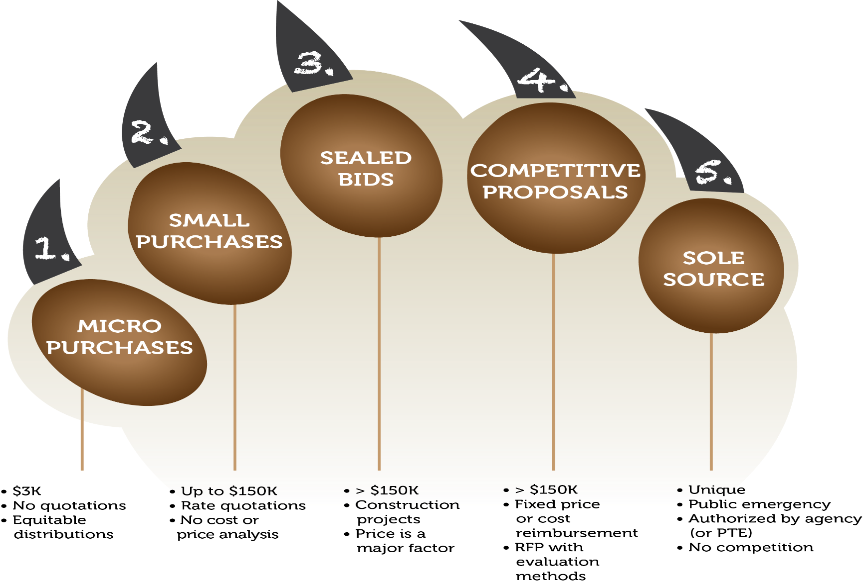
Procurement
Procurement “Claw” Sec. 200.320
Notes:
200.320, Methods of procurement to be followed
The non-Federal entity must use one of the 5 methods:
(1) Micro-purchases for acquisition of supplies or services if aggregate amount does not exceed $3,000 [New method]
- Micro purchase may be awarded without soliciting competitive quotations if the non-Federal entity considers the price to be reasonable
(2) Small purchase procedures
(3) Sealed bids (formal advertising)
(4) Competitive proposals
(5) Noncompetitive proposals

Slide 24
New Administrative
Grant Requirements
NEW!
Post-Federal Award Info
200.321: Contracting with small & minority businesses, women’s business enterprises, & labor surplus area firms.
200.322: Procurement of recovered materials
NEW!
Notes:
200.321 Contracting with small and minority businesses, women’s business enterprises, and labor surplus area firms.
Divide total requirements when “economically feasible” into smaller tasks or quantities to permit maximum participation
“Economically”=thrifty. “Feasible”= achievable/capable of being accomplished
200.322. Procurement of recovered materials
NEW! Adds new requirement to comply w/EPA contracting guidelines for contracts in excess of $10K
http://www.rurdev.usda.gov/SupportDocuments/TX_CF_Clean%20Water%20Act.pdf

Slide 25
New Administrative
Grant Requirements
NEW!
Post-Federal Award Info
200.323: Contract cost and price
200.324: Federal awarding agency or pass- through entity review
200.325: Bonding requirements
200.326: Contract provisions (App. II)
NEW!
Notes:
200.323. Contract cost and price:
Unchanged- still must:
perform cost or price analysis
Negotiate fair and reasonable profit
Not contract for costs + % of construction costs method of contracting
200.324. Federal awarding agency or pass-through entity review (substance unchanged)
New language added, however, which permits PTEs (States) to conduct pre-award reviews of technical specifications on proposed procurements i.e. RFP, ITB, etc when procurement non-compliant
200.325. Bonding Requirements (substance unchanged)
Bid guarantee 5%
Performance bond 100%
Payment bond 100%
200.326. Contract provisions
removed to Appendix II (substance unchanged)

Slide 26
Administrative
Grant Requirements
Post-Federal Award Info
200.327: Financial reporting
200.328: Monitoring and reporting program performance
Notes:
PERFORMANCE & FINANCIAL MONITORING & REPORTING
200.327, Financial Reporting (no substantive changes from 13.41)
44 CFR 13.12(b)(3) already permitted the Federal awarding agency to require more frequent reporting where necessary for the effective monitoring of the Federal award as could significantly affect program outcomes.
200.328. Monitoring and reporting program performance (no substantive changes from 13.40)

Slide 27
New Administrative
Grant Requirements
NEW!
Post-Federal Award Info
200.329: Reporting on real property
200.330-332: Sub-recipient monitoring & management
200.333: Retention requirements for records
200.335: Methods for collection, transmission and storage of information
200.338-342: Remedies for noncompliance
200.343: Closeout
Notes:
200.329, Reporting on Real Property
Must submit annual reports on status of immovable/real property acquired with federal grant funds (fed. Gov’t retains an interest)
200.331, Requirements for pass-through entities
1. Slightly varied requirements for pass-through entity with additional responsibility to make risk evaluations and any necessary adjustments to the pass-through entity’s records based on reviews and audits of subrecipients and consider actions to address subrecipient noncompliance
2. Specifies information which must be identified to subrecipient at time of award and put in the subaward (and when changes are made to the subaward)
3. Same audit review
200.338-342: Remedies for noncompliance (partly new)
NEW! Adds actions that may be taken by the pass-through entity, not just by the Federal awarding agency and follow-up requirements
Provides Federal agencies with strong remedies to address non-compliance
200.343: Closeout
Expressly provides one year (12 months) for close out.

Slide 28
New Cost Principles
NEW!
Guidance on allowable costs, including:
Reasonable costs
Allocable costs
Direct and indirect costs
Special considerations for governments and tribes
Audit services
Contributions and donations
Pre-award costs
Notes:
Too diverse a suite of federal assistance programs to delve into
According to the COFAR the significant changes were to these cost principles
New de minimis rate of 10%
200.428 Collections of Improper Payments (NEW)
The costs incurred by a non-Federal entity to recover improper payments are allowable as either direct or indirect costs, as appropriate.
Family-friendly policies (NEW):
200.432. Conferences- Personnel policies that allow employees to balance their personal responsibilities while maintaining successful careers i.e. easing dependent care costs
200.474. Travel costs - Travel costs that allow temporary dependent care costs during travel to conferences is now allowable

Slide 29
New Cost Principles
NEW!
All recipients and subrecipients will now follow the same set of cost principles located at 2 C.F.R. Part 200, Subpart E.
Hospitals are excepted from the new cost principles and will continue to follow 45 C.F.R. Part 74.
Notes:
Too diverse a suite of federal assistance programs to delve into
According to the COFAR the significant changes were to these cost principles

Slide 30

New Audit Requirements
NEW!
2 C.F.R. Part 200, Subpart F on Single Audit Act Audits:
A non-Federal entity that expends $750,000 or more during the non-Federal entity’s fiscal year in ALL Federal awards must have a single or program-specific audit conducted for that year.
Effective Date for Audit Requirements:
  Recipient and subrecipient fiscal years beginning on or after December 26, 2014.
This is the only subpart in 2 C.F.R. Part 200 that will apply to FEMA awards, regardless of whether FEMA made the award before or after December 26, 2014.
Notes:
Basic Structure of Single Audit Process Unchanged
Still have:
Auditee prepares financial statements & SEFA(200.510).
Audit follow-up & corrective action(200.511 & 200.521).
9 month due date (set in law) (200.512(a)).
Reporting to Federal Audit Clearinghouse (200.512) etc
BUT:
Raising the threshold would allow Federal agencies to focus their audit resolution resources on the findings that put higher amounts of taxpayer dollars at risk, thus better mitigating overall risks of waste, fraud, and abuse across the government
Strengthens agency use of the single audit process.
FAC Repository of Record for Reporting Packages
Federal agencies, pass-through entities, and others obtain copies by accessing FAC website.
Subrecipient only required to submit report to FAC and no longer required to submit to pass-through entity.
Pass-through entity no longer required to retain copy of subrecipient report as available on the Web.

Slide 31
New Audit Requirements
NEW!
Audit Findings
Increases the threshold for reporting known and likely questioned costs from $10,000 to $25,000 (200.516(a)(3) & (4)).
Requires that questioned costs be identified by CFDA number and applicable award number (200.516(b)(6)).
Requires Identification of whether audit finding is a repeat from the immediately prior audit and if so the prior year audit finding number (200.516(b)(8)).
Notes:
Increases the threshold for reporting known and likely questioned costs from $10,000 to $25,000 (200.516(a)(3) & (4)).
Requires that questioned costs be identified by CFDA number and applicable award number (200.516(b)(6)).
Requires Identification of whether audit finding is a repeat from the immediately prior audit and if so the prior year audit finding number (200.516(b)(8)). ****Avoids redundancy*********
Provides that audit finding numbers be in the format prescribed by the data collection form (200.516(c)).

Slide 32
Procurement & Documentation…a deep dive

Slide 33
Procurement
Procurement “Claw” Sec. 200.320
Notes:
200.320, Methods of procurement to be followed
The non-Federal entity must use one of the 5 methods:
(1) Micro-purchases for acquisition of supplies or services if aggregate amount does not exceed $3,000 [New method]
- Micro purchase may be awarded without soliciting competitive quotations if the non-Federal entity considers the price to be reasonable
(2) Small purchase procedures
(3) Sealed bids (formal advertising)
(4) Competitive proposals
(5) Noncompetitive proposals
Follow your contract. Do not exceed the scope of your contracts
*****The higher the aggregate dollar value the higher the competition standard******

Slide 34

320. Methods of Procurement
Micro purchases:
Aggregate amount < $3,000.00
No quotations
Equitable distributions
Reasonable price
Notes:
(1) Micro-purchases for acquisition of supplies or services if aggregate amount does not exceed $3,000 [New method]
Micropurchase may be awarded without soliciting competitive quotations if the non-Federal entity considers the price to be reasonable
The non-Federal entity must, to the extent practicable, distribute these purchases equitable among qualified suppliers. Meaning "rotate" among qualified suppliers if they offer the same rates.
No word yet on:
Impact on procurement card policies? the increases in time/burden to document/ complete a procurement action? any impact on productivity?

Slide 35


320. Methods of Procurement
Small purchases:
Aggregate amount= $3K- Simplified
Acquisition Threshold ($100K/$150K)
Three quotes from (an adequate number of) “qualified sources”
Reasonable costs
Notes:
(2) Small purchase procedures
$3,000.00-$100,000.00 (old awards)
or
$3,000.00-$150,000.00 (new awards)

Slide 36
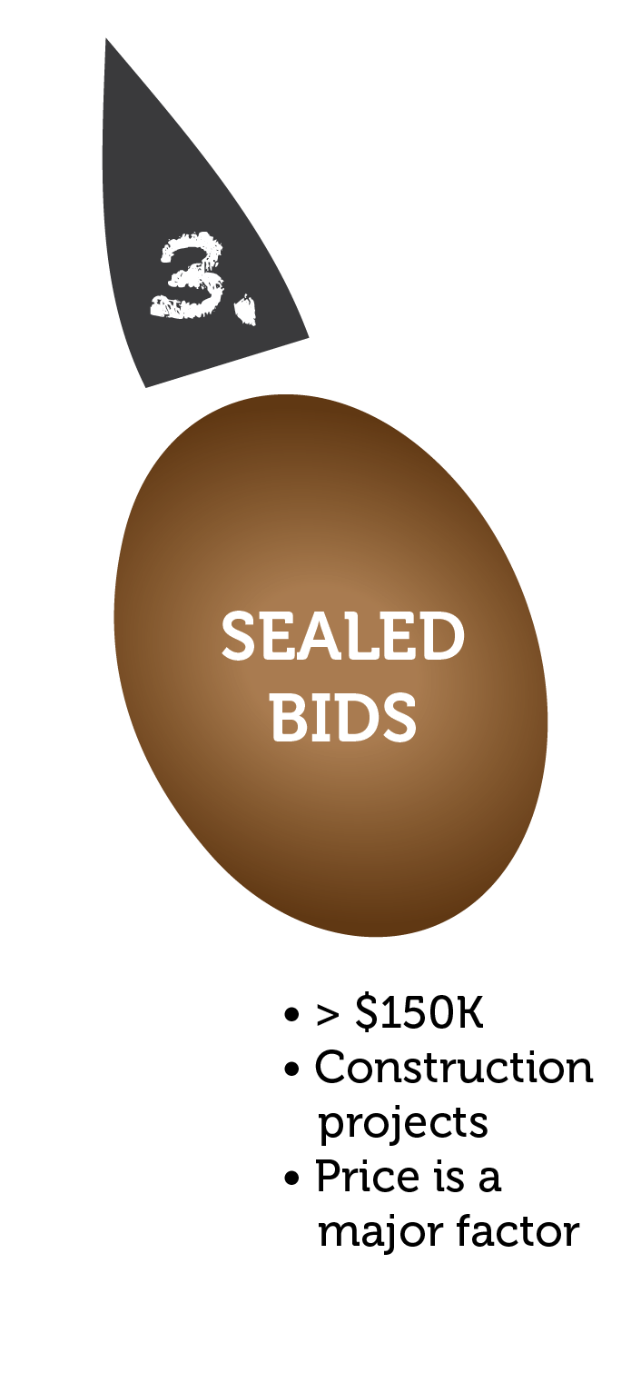
320. Methods of Procurement
Sealed Bids (formal advertising):
Two or more bidders
Firm fixed-price contract award
Awarded to lowest responsible bidder
Reasonable costs
Notes:
(3) Sealed bids (formal advertising)

Slide 37
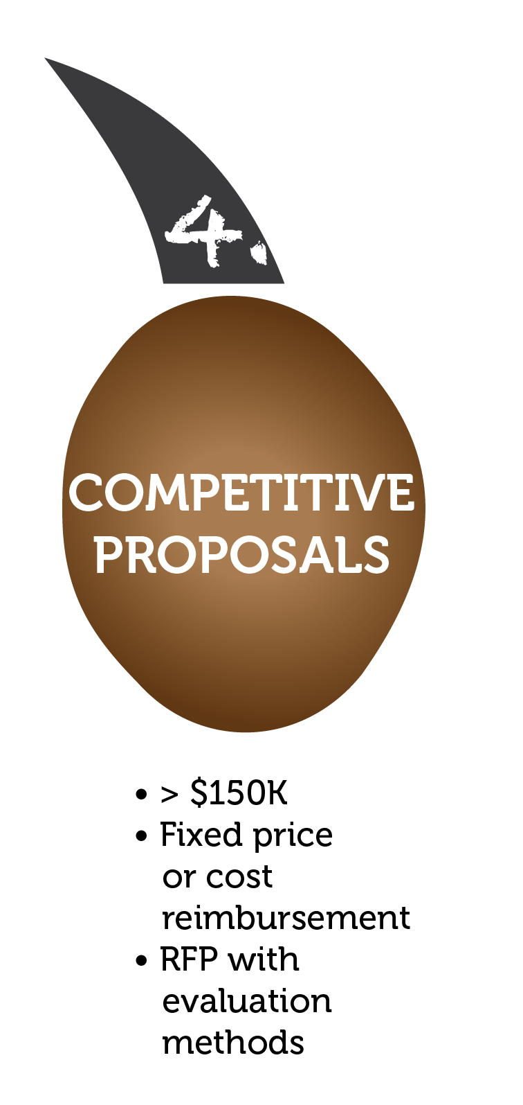
320. Methods of Procurement
Competitive proposals:
Either a fixed price or cost reimbursement type contract awarded
At least two quotations
Publicized and solicited from an adequate number of qualified sources
Notes:
(4) Competitive proposals **REMINDERS**
Still have to identify all evaluation factors and their relative importance in publicized proposal.
Still need written method for conducting technical evaluations of the proposals received and for selecting recipients
Still cannot use RFQ to purchase non-A&E/other types of services even though A/E firms are a potential source to perform the proposed effort

Slide 38
320. Methods of Procurement
Competitive proposals (cont’d):
Contracts must be awarded to the responsible firm whose proposal is most advantageous to the program, with price and other factors considered;
Reasonable price
Notes:
(4) Competitive proposals

Slide 39
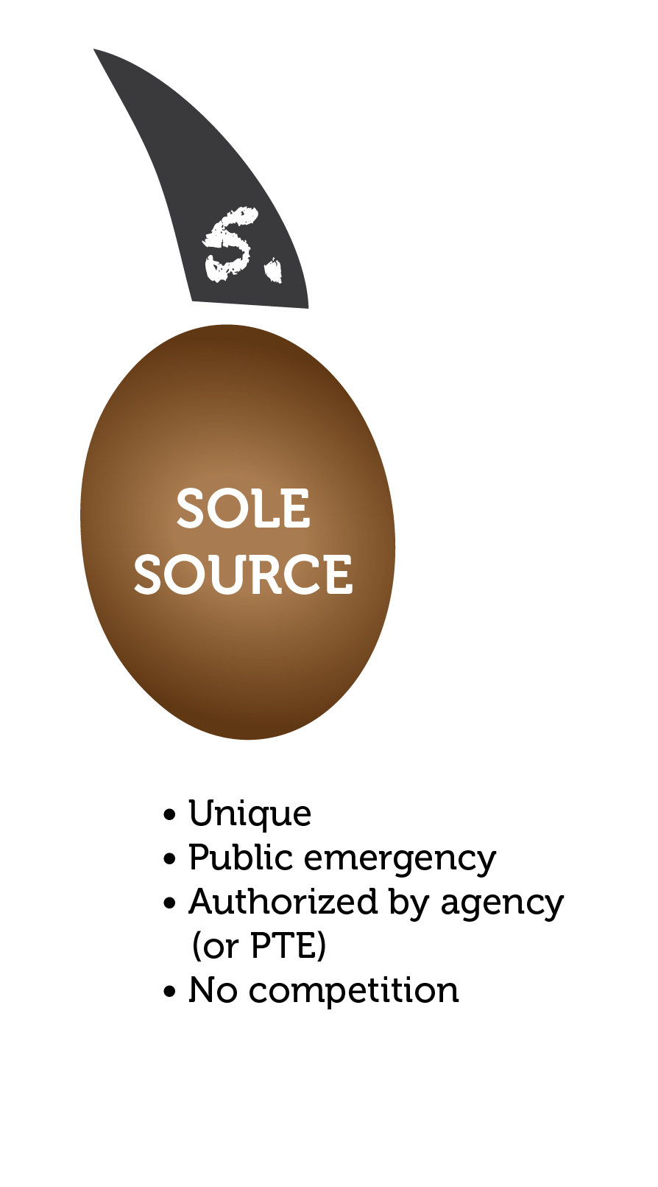
320. Methods of Procurement
Noncompetitive proposals:
The item is available only from a single source or after solicitation of a number of sources, competition is determined inadequate.
To avoid delays due to public exigency/emergency
Express written authorization
Notes:
(5) Noncompetitive proposals
Revised to clarify that solicitation of a proposal from only one source
New! Authorizes pass-through entity to approve sole source in response to a written request from the NFE

Slide 40
Documentation
Insufficient or lack of documentation prevents a reviewer from discerning whether a payment was proper
Costs that are not supported by adequate documentation face later disallowances

Slide 41
RECAP
Be aware of new rules
Comply with written policies
Ensure costs are supported by adequate documentation
Notes:
Comply with written policies, even your own:
Follow your own written policies.

Slide 42
Super Circular Resources
2 C.F.R. Part 200:
  http://www.ecfr.gov/cgi-bin/text-idx?tpl=/ecfrbrowse/Title02/2cfr200_main_02.tpl
Interim Final Rule Published in the Federal Register:
  http://www.gpo.gov/fdsys/pkg/FR-2014-12-19/pdf/2014-28697.pdf
Crosswalk of Changes:
  http://www.whitehouse.gov/omb/grants_docs
Council on Financial Assistance Reform Frequently Asked Questions:
  https://cfo.gov/cofar/
FEMA information:
  http://www.fema.gov/grants
Notes:
OR http://www.gpo.gov/fdsys/pkg/CFR-2014-title2-vol1/pdf/CFR-2014-title2-vol1-subtitleA.pdf

Slide 43
Future Outreach
GOHSEP Initiatives:
  Outreach Workshops
  Toolkit Updates
FEMA Initiatives:
  Webinars
  Update E705 Fundamentals of Grants Management
  Update internal SOPs, policy, and directives.
  Rewrite the FEMA Grants Management Directive. This is an internal document that replaces the 2006 FEMA Grants Handbook.
  DHS Financial Assistance Policy Office (FAPO) plans to issue updated grants management guidance.
  Development and presentation of webinars targeted to specific types of grant recipients.
Notes:
Awareness

Slide 44
Recovery Legal Contacts
Ben Plaia, Jr.– Legal Counsel, Disaster Recovery Division
  ben.plaia@la.gov
  (225) 242-6030
  Jordan Parker – Attorney, Disaster Recovery Division
  jordan.parker@la.gov
  (225) 334-7756
LaShaunté S. Martin– Deputy Legal Counsel, Disaster Recovery Division
  lashaunte.martin@la.gov
  (225) 379-4048

Slide 45
Administrative Contacts
Christina Dayries– Chief of Staff
Deputy Director, Grants and Administration
christina.dayries@la.gov
  (225) 358-5599
James Clark– Assistant Deputy Director, Grants and Administration
  james.clark@la.gov
  (225) 925-1800

Slide 46
Questions?

