Slide 1
Maximize Reimbursement Roads & Bridges
Transportation Infrastructure Damage Assessment Working Group

Slide 2
Collaborative, Informal Team
FEMA Region 6
Federal Highway Administration (FHWA) LA
GOHSEP
DOTD
Local Technical Assistance Program – LTRC
Louisiana Municipal Association
Police Jury Association

Slide 3
Working Group Objectives
Enhance local agencies recovery for road & bridge damages
Coordinate state/federal resources and technical assistance
Improve local agency documentation to meet federal guidance
Describe effective pre-event condition documentation to expedite damage assessment/repair and reimbursement processes
Identify beneficial asset management programs
Communicate with Emergency Response Directors and Coordinators

Slide 4
Enhance Local Recovery
Help Identify Federal Aid (FHWA) eligible roads and bridges
Explain road/bridge features eligible for FEMA assistance
Understand damage inspection and evaluation criteria
Improve Pre-event planning - transportation infrastructure facilities
Involve all functional groups in planning:
City/Parish Administrative/Financial Documentation Managers
Administration and Contracts
Public Works Departments
Data management groups
OEP offices
Law Enforcement

Slide 5
Local Issues Identified by DOTD/FHWA
Don’t Know Which Roads are Federal Aid Routes/Connectors
Don’t Know How to Apply for FHWA Emergency Repairs
Don’t/Can’t Send Timely Damage Reports for Inspection
Assume DOTD/FHWA Will Conduct Damage Survey
Assume Reporting Damage to GOHSEP/FEMA Covers Need for a Report to DOTD/FHWA
Lack of Documentation for Construction, Maintenance and Repairs

Slide 6
Why Focus on Damage to Roads & Bridges
Public Works Cost to Municipalities Generally Greatest Drain on Budgets Besides Law Enforcement
Extensive Damage Reporting & Documentation Requirements to Demonstrate Quantifiable & Provable Damages
Eligibility is Limited to Pre-Event Condition Restoration
FHWA May Preempt FEMA But Must Be Reported Separately

Slide 7
Where to Find Info on Federal Aid Routes

Slide 8
Facility (Roads & Bridges) Eligibility
To be eligible for repair/restoration, the facility must:
Be the legal responsibility of an eligible applicant
Have been in active use at the time of the disaster
Be damaged as a result of the declared disaster
Be located in the designated disaster area
Not be fundable by another federal agency

Slide 9
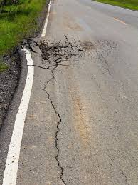
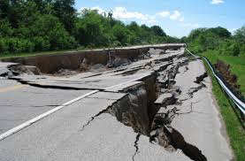
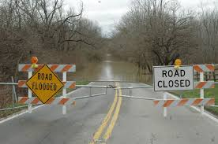
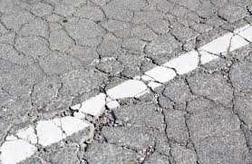
Eligible for Reimbursement ? ? ?

Slide 10
Pre-Event condition Elements
Applicants need to have maintenance & inspection records available
Maintenance - Routine and heavy maintenance is not eligible. Potholes and surface ruts are maintenance items, which are not eligible.
Paving - Loss of paved surface may be eligible, but . . .
Alligator cracking of asphalt surface considered normal deterioration and not eligible.
Standards - Bridge and road standards that have been formally adopted and are in practice, or adopted and placed in effect prior to project approval by the applicant, are eligible.

Slide 11
* FEMA Policy Guidance - Maintenance
The incident may cause minor damage to roads that result in damage similar to that which may occur over time from other causes, such as the age of the road, traffic flow, and frequent rain.
Therefore, distinguishing between pre-existing damage and damage caused by the incident is often difficult. For the repair of this type of damage to be eligible . . .
the Applicant must demonstrate that the damage was directly caused by the incident.
* Source - FEMA Public Assistance Policy Guide – January 18, 2018

Slide 12
Loss of Useful Service Life
If a road has been inundated by flood waters for an extended period of time . . .
FEMA cannot provide funding for the value of useful life of the road due to the long-term effects the inundation might have on the road.
The State continues to work with FEMA and others to expand the eligibility beyond the current policy limitations.
Notes:
The eligible direct costs include the following:
Salaries, wages and fringe benefits for the applicant’s employees. For emergency work, only applicant overtime labor costs including fringe benefits are eligible.
Materials and equipment costs are also eligible as are contract costs including engineering and design services where appropriate.

Slide 13
Pre-Event Planning
How to Document Quantifiable Specific Damages / Repair Estimates
Form road and bridge team
Develop a plan to collect and document pre-event conditions
Collect data to document key facilities (at a minimum)
Develop a plan to collect data during and post event
Implement data management and retention system

Slide 14
Elements of Asset Management
Basic Asset Inventory
Construction details
Pavement and Bridge Condition Ratings
Bridge and culvert ratings
Other Transportation Facility records
Photo/Video logs of Pre & Post Event Condition
Ensure Verifiable Maintenance Records

Slide 15
Event and Post Event Conditions
Activate Immediate Pre-Event Plan for Roads and Bridges
Photo/video documentation of priority and/or at risk facilities
Activate team to document event impacts/conditions
Plan post event actions, monitoring and assessment
Monitor/record deterioration on debris haul routes
Record inundation depth/duration

Slide 16
Training and Resources
FHWA Federal Aid Essentials
Asset Management Training Modules (contact LTAP/LTRC)
DOTD/FHWA Technical Assistance & Training
GOHSEP/FEMA Technical Assistance & Training
Series of Team Training Sessions Around State in July

Slide 17
Contact Information
Federal Highways Administration Josh Cunningham Emergency Repair Program Lead 225-757-7615 joshua.cunningham@dot.gov https://www.fhwa.dot.gov/asset/guidance.cfm | LA Local Technical Assistance Program Marie B. Walsh, PhD Director, LTAP / Louisiana Transportation Research Center 225-767-9184 Marie.Walsh@la.gov https://www.ltrc.lsu.edu/ltap/
Louisiana DOTD Skip Breeden Chief, Emergency Operations 225-379-1898 Skip.breeden@la.gov http://wwwsp.dotd.la.gov/Inside_LaDOTD/Divisions/Multimodal/Data_Collection/Pages/Asset-Management.aspx | GOHSEP Daniel Crothers Group Lead-Technical Section (225) 267-2761 daniel.crothers@la.gov http://gohsep.la.gov/

