Slide 1

Hazard mitigation defined
Hazard Mitigation (HM) is any sustained action taken to reduce or eliminate future risk to people and property from natural and man-made disasters.

Slide 2
Most important 3 takeaways
Funding availability + how to apply.
  What’s included in a complete application.
Types of projects.
GOHSEP staff is here to help.

Slide 3





NON-DISASTER
Pre-Disaster Mitigation (PDM)
Flood Mitigation Assistance (FMA)
DISASTER
3. Hazard Mitigation Grant Program (HMGP)

Slide 4
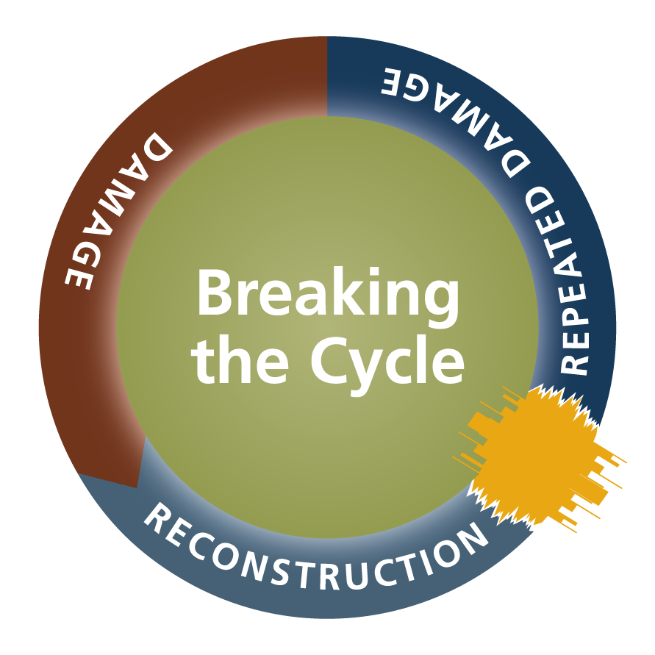
Mitigation is breaking the cycle of disaster – damage – reconstruction – repeated damage.

Slide 5

Mitigation’s value to society
Creates safer, more resilient communities.
Enables communities to recover rapidly from disasters.
Lessens the financial impact of disasters.

Slide 6

For every $1 spent on hazard mitigation, approximately $4 are saved in future reduced losses.
SOURCE: United States Congressional Budget Office, Potential Cost Savings from the Pre-Disaster Mitigation Program, 2007.

Slide 7
Authorities
44 Code of Federal Regulations (CFR)
  Part 80 Property Acquisition and Relocation for Open-Space
  Part 206.434 Hazard Mitigation Grant Program (HMGP), Eligibility
  Part 209 Acquisition and Elevation Assistance
  Part 9.6 Floodplain management + protection of wetlands, Decision-making

Slide 8
Authorities (Continued . . . )
Section 404 of the Robert T. Stafford Disaster Relief and Emergency Assistance Act (Stafford Act)
Hazard Mitigation Assistance Unified Guidance July 12, 2013
Addendum to the Hazard Mitigation Assistance Unified Guidance

Slide 9
Authorities (Continued . . . )
National Flood Insurance Reform Act (NFIRA) of 1994
Consistent with Biggert-Waters Flood Insurance Reform Act of 2012 (Public Law 112-141)

Slide 10
Authorities (Continued . . . )
FEMA P-804 Wind Retrofit Guide for Residential Buildings, Chapter 5
Design and Construction Guidance for Community Safe Rooms, FEMA P-361, 2008 Edition
Taking Shelter From the Storm, Building a Safe Room For Your Home or Small Business, FEMA P-320, 2008 edition

Slide 11
Acronyms
BCA Benefits Cost Analysis
BFE Base Flood Elevation
FIRM Flood Insurance Rate Map
FMA Flood Mitigation Assistance
H + H Hydrology & Hydraulic Study
HMA Hazard Mitigation Assistance

Slide 12
Acronyms (Continued . . . )
HMGP Hazard Mitigation Grant Program
LAHM Louisiana Hazard Mitigation
NFIP National Flood Insurance Program
O + M Operations + Maintenance Plan
PDM Pre-Disaster Mitigation
SAL State Applicant Liaison

Slide 13
Acronyms (Continued . . . )
RL Repetitive Loss
SFHA Special Flood Hazard Area
SRL Severe Repetitive Loss

Slide 14
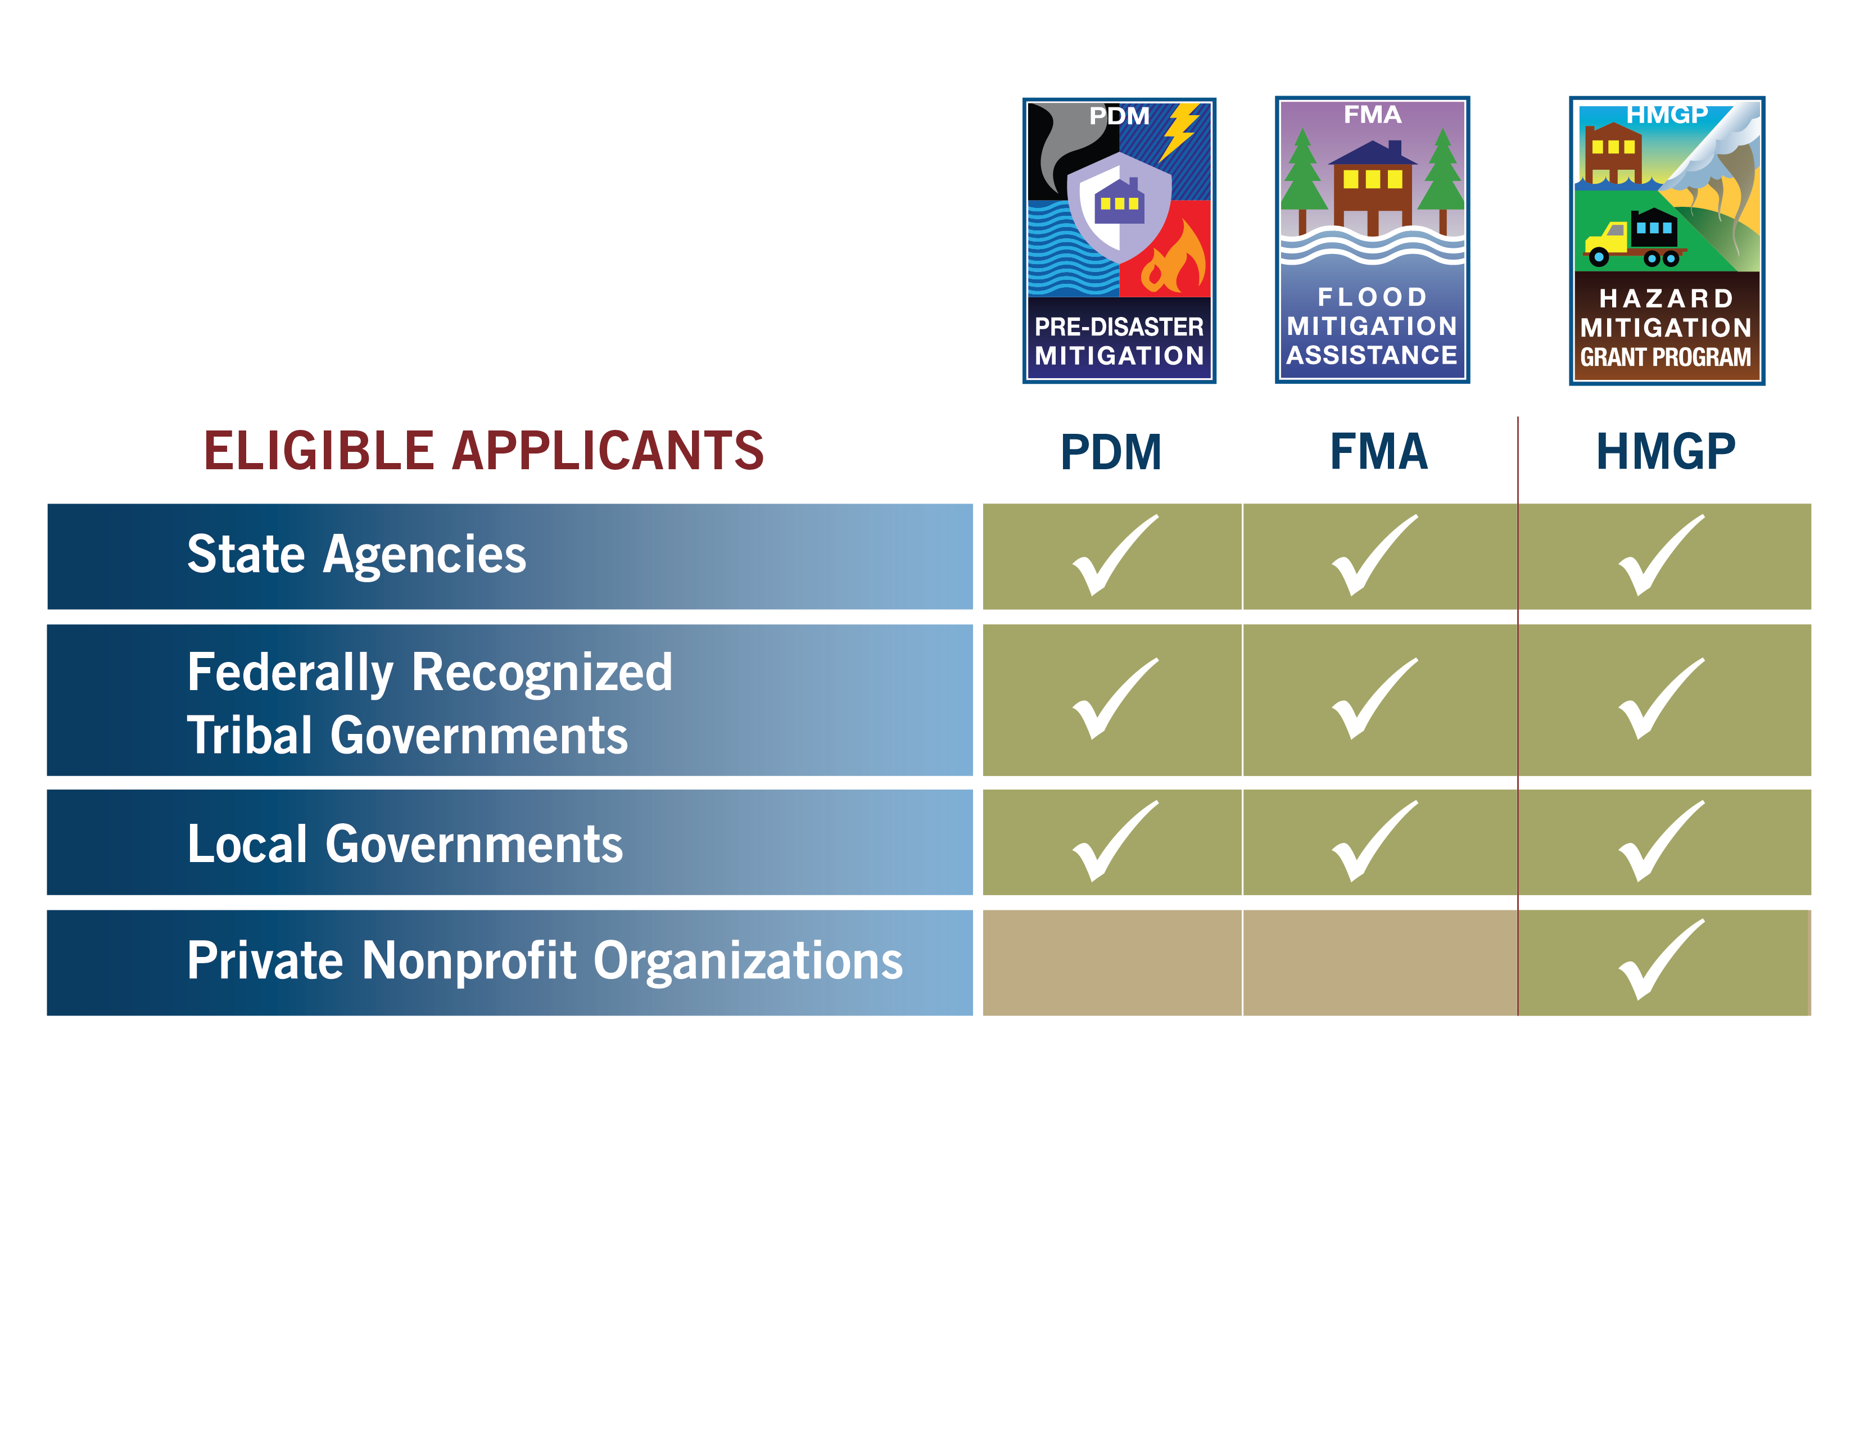
*
* Apply through local jurisdictions

Slide 15
Minimum Applicant criteria
Have a FEMA-approved hazard mitigation plan.
Be able to provide the non-Federal cost-share.
Utilize best-available flood hazard data.

Slide 16
What about homeowners?
To pursue HM funding, homeowners should contact, or be contacted by, their Parish governing authority.

Slide 17
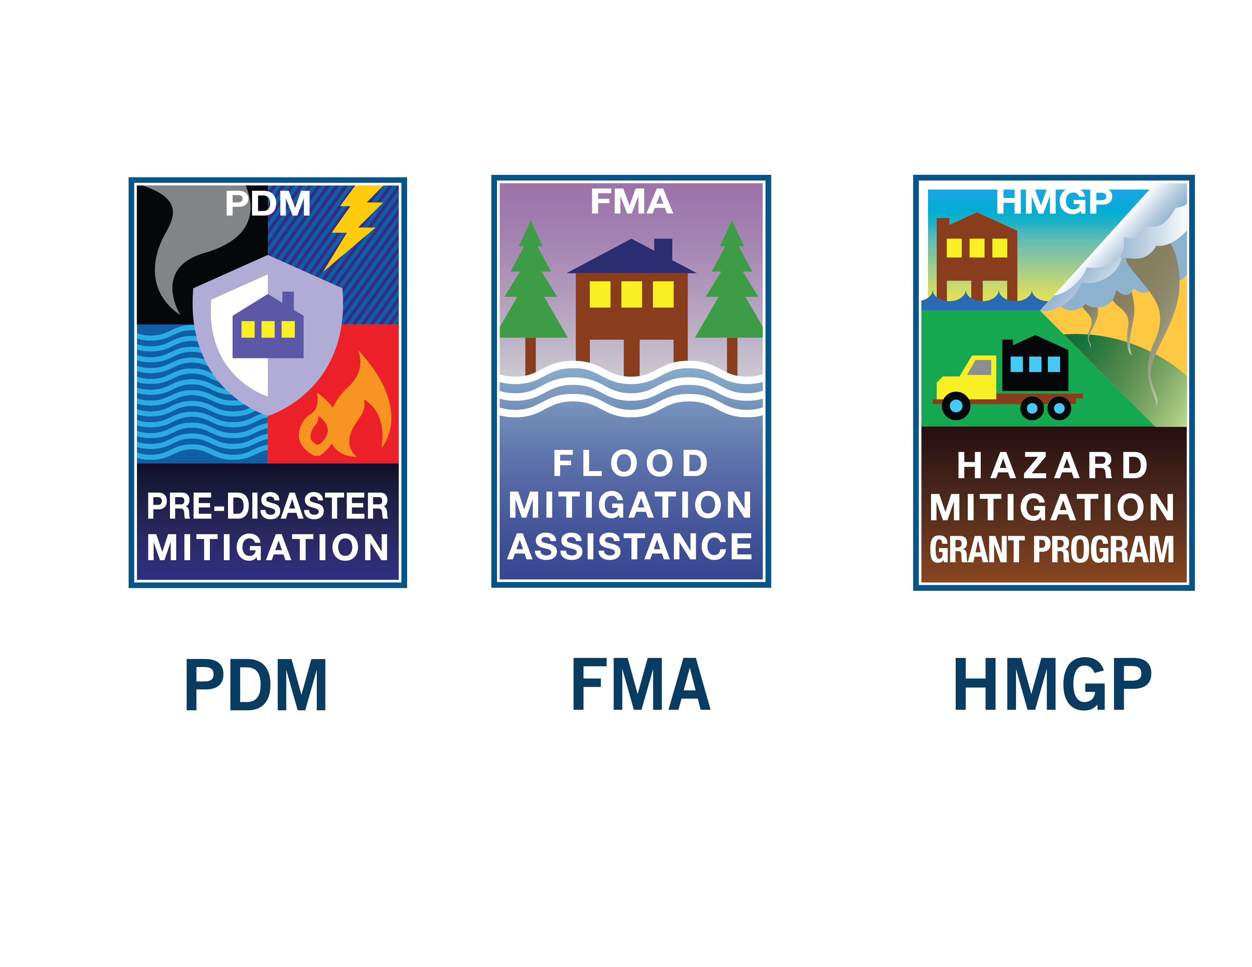
Non-disaster grants overview

Slide 18
Cost-share
PDM + FMA are cost-reimbursement grant programs.
25% Local Share
75% Federal Share

Slide 19
Non-disaster grant cycle

Slide 20
Flood Mitigation Assistance (FMA) overview

Slide 21
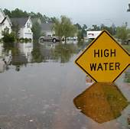

Flood Mitigation Assistance (FMA)
Congress provides funding on an annual basis so measures can be taken to reduce or eliminate risk of flood damage to buildings insured under the National Flood Insurance
Program (NFIP).

Slide 22
FMA (Continued . . . )
Funding is subject to congressional appropriations.
FY13 – approximately $120 million appropriated.
FY14 – approximately $89 million appropriated.

Slide 23
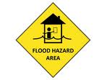
Flood grant participation requirements
FMA
Applicant must participate in the NFIP.
  Structure must be insured at time of application.
A FEMA-approved hazard mitigation plan is required to apply for project grants.

Slide 24
Changes to FMA
No limit on in-kind contributions for the non-Federal cost-share.
Mitigation reconstruction is an eligible activity.

Slide 25

Changes to FMA (Continued . . . )
The Biggert-Waters Flood Insurance Reform Act of 2012 eliminated the Repetitive Flood Claims (RFC) and Severe Repetitive Loss (SRL) programs.
Elements of these flood grant programs have been incorporated into FMA.

Slide 26
Changes to FMA (Continued . . . )
Cost-share requirements have been reduced to allow more Federal funds for properties with SRL and repetitive loss (RL) flood claims.

Slide 27

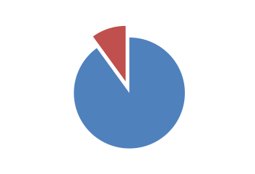
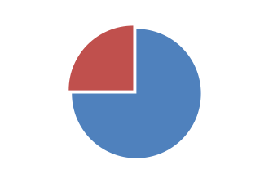
FMA cost-shares
Up to 100-percent Federal cost-share for SRL properties.
Up to 90-percent Federal cost-share for RL properties.
Up to 75-percent Federal cost-share for NFIP insured properties.

Slide 28
Changes to FMA (Continued . . . )
Flood portion ONLY of mitigation plan development and update cannot exceed $25,000 Federal share.

Slide 29

FMA eligible activities
Going forward, mitigation reconstruction is an eligible activity ONLY under FMA.

Slide 30
Pre-Disaster Mitigation (PDM)
overview

Slide 31
Pre-Disaster Mitigation (PDM)
Funding is subject to congressional appropriations.
FY13 – approximately $22 million appropriated.
FY14 – approximately $23 $63 million appropriated.

Slide 32
PDM (Continued . . .)
FEMA awards each State up to $250,000 for the highest ranked eligible application(s).
Remainder of available funding is awarded on a nationally competitive basis to the highest ranked applications.

Slide 33
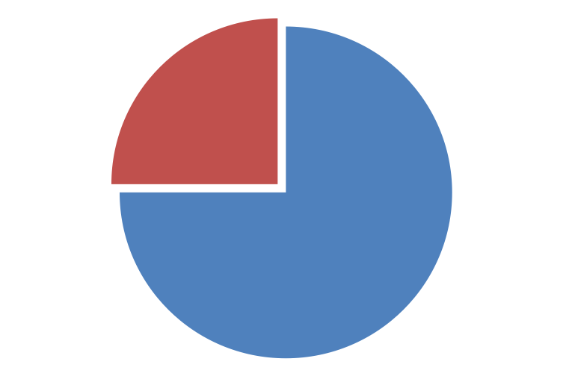
PDM cost-share
All PDM grants have a 75-percent Federal cost-share.
25% Local
Share
75% Federal Share

Slide 34
Post-disaster grant program overview
Hazard Mitigation Grant Program (HMGP)

Slide 35
HMGP funding availability
Presidential Disaster Declaration
↓
$$$ FEMA $$$
↓
State
↓
Applicant
↓ ↓ ↓
$$$$ Project $$$$

Slide 36
HMGP funding availability (Continued . . . )
PA + IA x % = HMGP funding availability

Slide 37
HMGP grant cycle

Slide 38
HMGP cost-share
HMGP is a cost-reimbursement grant program.
Cost-share is 75% Federal share and 25% local share.
25% Local
Share
75% Federal Share

Slide 39
Eligible activities overview

Slide 40
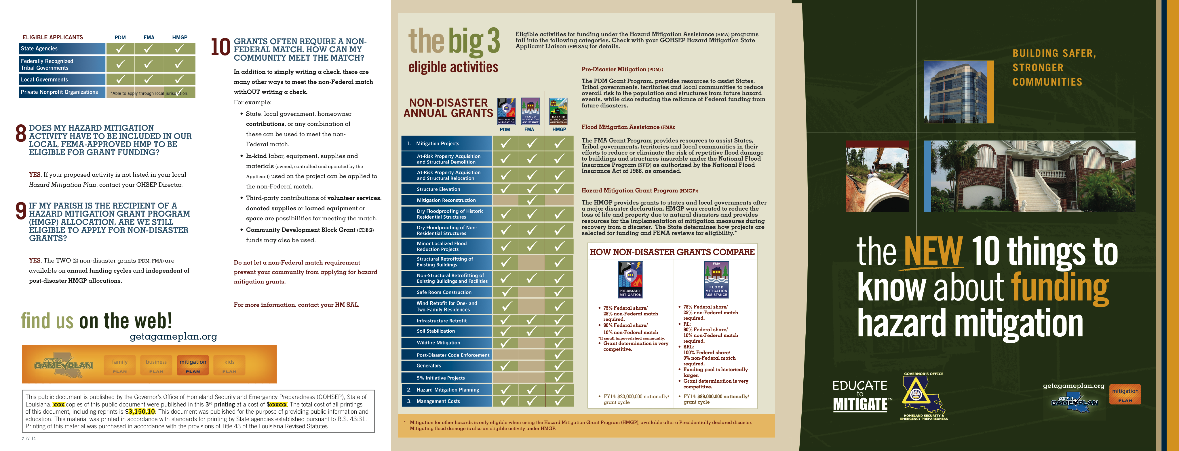

Slide 41
Elevations

Slide 42
Project activities
Elevation
Structure elevation activities generally involve physically raising an existing structure to an elevation at the base flood elevation (BFE) or higher if required by FEMA or local ordinance.
  Using the best available data.
  Traditionally located within a SFHA.

Slide 43
Property selection
Subgrantees prioritize using:
  SRL list.
  RL list.
  Consider other properties in SFHA.
  Other.

Slide 44
Why elevations can be important to YOU
Is a key strategy to building safer, more resilient communities.
The challenge is how to pay for them.
HMA funds are typically used to elevate structures.

Slide 45
Funding
45
Elevations are an eligible activity within the PDM + FMA + HMGP programs.

Slide 46
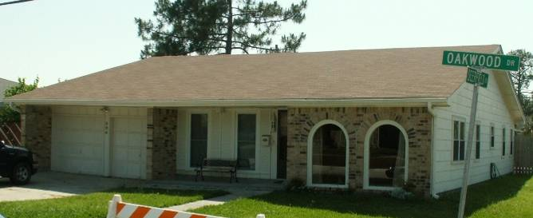
Project activities
Elevation

Slide 47
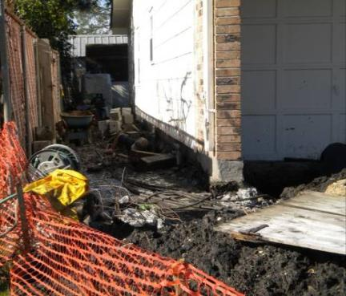
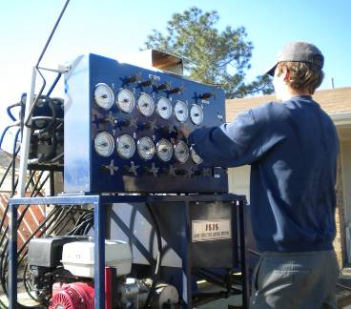
Elevation day

Slide 48
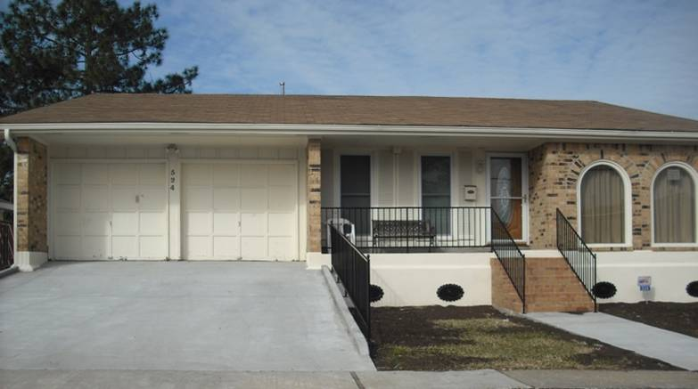
Elevated dwelling

Slide 49
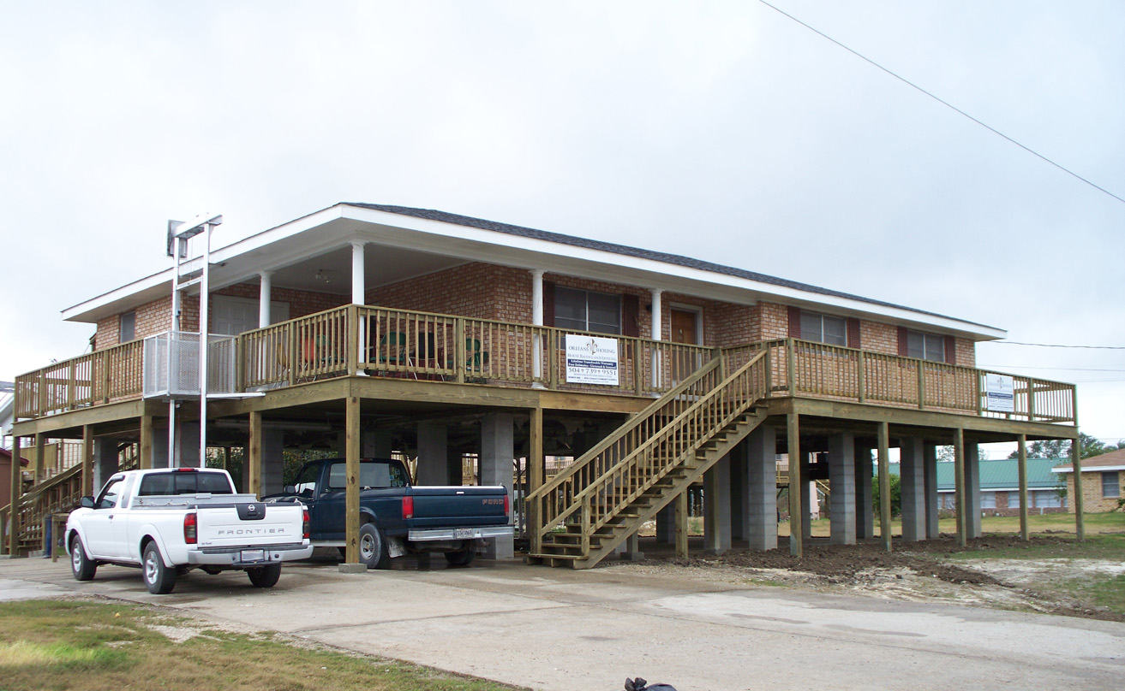
Elevation of flood prone structures

Slide 50
Mitigation
Reconstruction

Slide 51
Project activities
Mitigation reconstructions
Demolition of a damaged structure.
Reconstruction compliant with:
  NFIP standards.
  Applicable building codes.

Slide 52
Why mitigation reconstruction can be important to YOU
Viable opportunity for reducing future losses on flood-prone properties.

Slide 53
Project activities
Unique characteristics: Mitigation reconstruction
$150,000 cap Federal share per property.
Property cannot be located in a V-zone.
Cannot exceed 10% of the original square footage.

Slide 54
Funding
54
Mitigation reconstruction is an eligible activity ONLY in the FMA program.

Slide 55
Acquisitions

Slide 56
Project activities
Unique characteristics: Acquisitions
Acquisition + relocation or demolition of structures located in hazard-prone areas.
All improvements must be removed.

Slide 57
Project activities
Unique characteristics: Acquisitions (Continued . . . )
Property remains deed restricted as open-space permanently.
  New owner (Subgrantee) is now responsible for the maintenance of the property.
  Subdividing property is not allowed post-project approval.

Slide 58
Why acquisitions can be important to YOU
Acquisitions are a permanent way to eliminate damage to flood-prone properties.
Acquisition projects remove properties from SFHAs and return the land to open-space.

Slide 59
Allowable open-space uses
Wetland restoration.
Recreation area for athletic fields, hunting and fishing areas, trails, etc.
Campground.
Community farm/garden.
Wildlife refuge.
Bird sanctuary.
Other . . .

Slide 60
Funding
60
Acquisitions are an eligible activity within the PDM + FMA + HMGP programs.

Slide 61
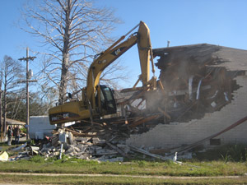
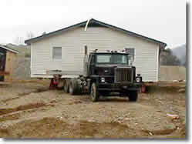
Project activities
Acquisition
Demolition
Relocation

Slide 62
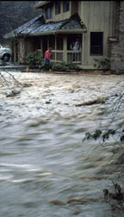
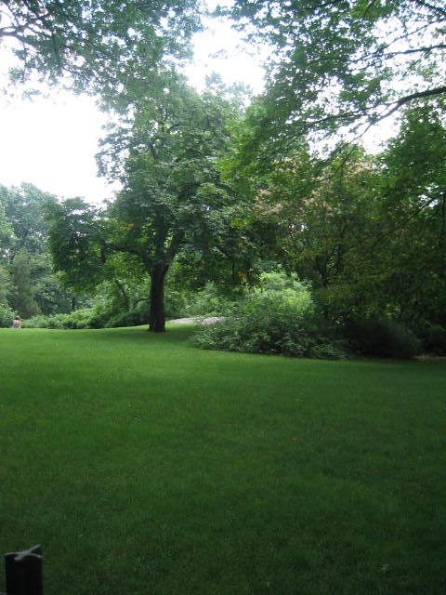
Acquisition of flood-prone property
Before
After

Slide 63
Retrofits

Slide 64
Project activities
Retrofits
Modifications that protect property + inhabitants by reducing or eliminating the risk of future damages from wind + flood + other natural hazards.

Slide 65
Project activities
Sample of activities: Retrofits
If wind . . .
  Protect the complete facility envelope.
  Protect the load path to keep the roof from blowing off.
If flood . . .
  Use flood resistant building materials.
  Flood walls + sump pumps.
  Sealants.

Slide 66
Funding
66
Retrofits are an eligible activity within the PDM + FMA* + HMGP programs.
*Only flood retrofits

Slide 67
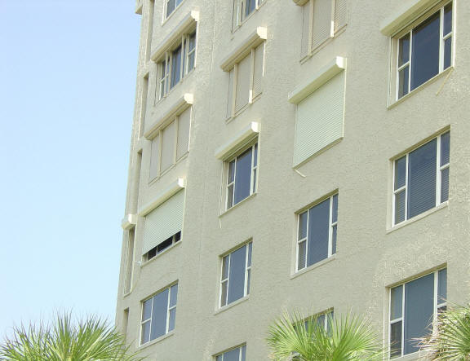
Retrofit (Shutter protection)

Slide 68
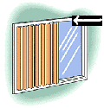
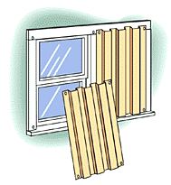
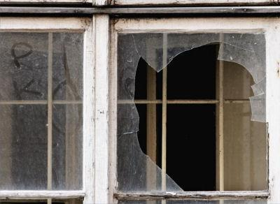

Shutter protection
Mitigated

Slide 69
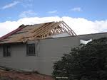
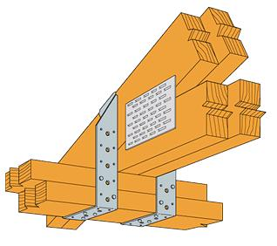

Roof strap
Mitigated

Slide 70
Drainage

Slide 71
Project activities
Drainage
Constructing certain types of minor + localized flood-control projects.

Slide 72
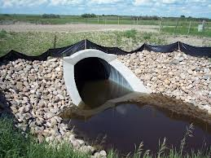
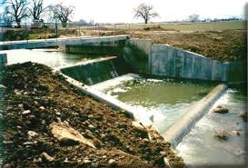
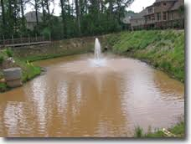
Sample activities
Drainage
Flood walls
Bar screen cleaners
Culverts
Grading
Retention/detention ponds
Pump stations
Erosion control

Slide 73
How to decide when to phase a drainage project
Phase a project when you have significant unknowns.
  1 year to complete Phase 1.

Slide 74
How to decide when to phase a drainage project (Continued . . . )
Phase I includes:
  Design + engineering + environmental + feasibility.
  Eligibility determinations.
  Hydrology + Hydraulic (H + H) studies.
    How much water + where it goes.
Phase II is the construction phase.

Slide 75
H + H Study
Who can do it?
  Licensed engineer or hydrologist.
Why is it important?
  It determines water surface elevations.
  It establishes site conditions + frequencies.
    Pre-mitigation damages.
    Post-mitigation damages.

Slide 76
H + H Study (Continued . . . )
What should it include?
  Climate changes.
  Land-use changes.

Slide 77
What are the benefits of phasing a drainage project?
Time + resources to fund the development of a hydraulic model + determine downstream effects.
  E.g., identify the drainage basin.

Slide 78
What are the benefits of phasing a drainage project? (Continued . . . )
Determines project feasibility.
  Validate (or not) proposed solutions.
Provides an opportunity for required public input (44 CFR 9.6).

Slide 79
What are the benefits of phasing a drainage project? (Continued . . . )
Determine environmental + historical + archeological effects.
Define a detailed construction budget.
Identify permitting requirements.

Slide 80
What are Phase I deliverables?
Final engineering design plan.
H + H study.
BCA.
Permit-ready construction documents.

Slide 81
Funding
81
Drainage projects are an eligible activity within the PDM + FMA + HMGP programs.

Slide 82
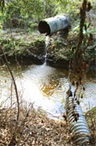
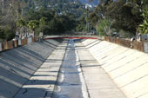
Drainage system improvements

Slide 83
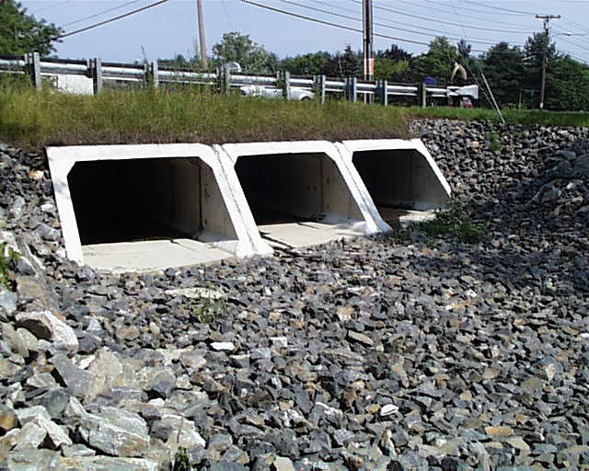
Storm water management
Culvert upgrade

Slide 84
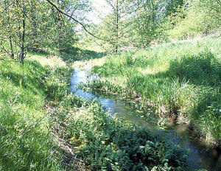
Flood control

Slide 85
Safe rooms

Slide 86
Which of these is a safe room?
86
  A hardened structure that provides life-safety protection from extreme-wind events.
  A place where people go after their homes have been destroyed.
  A place where people evacuate in order to be safe from storm surge + high winds.
  A building staffed by the American Red Cross.
  A hardened structure that provides life-safety protection from extreme-wind events.

Slide 87
Project activities
Safe room
A structure that meets FEMA criteria AND provides “near-absolute protection” from extreme-wind events.

Slide 88
88
Near-absolute protection means that occupants of a safe room built to FEMA P-361 standards will have a high probability of being protected from injury or death . . .

Slide 89
Safe room publication
FEMA P-361
89
Presents criteria:
  Design + construction to withstand wind.
Specific to identified hazards + highest of multi-hazards.
Meets or exceeds all tornado + hurricane hazard design requirements set forth in ICC-500.

Slide 90
Safe room publication
FEMA P-361 (Continued. . .)
90
Geared toward architects + engineers + building officials.
Stresses design guidance- construction drawings.
Prescriptive solutions are NOT provided.

Slide 91
Eligibility parameters
91
Not located in high-risk flood hazard where water has potential to endanger occupants.
Allowable costs are directly related to + necessary for near-absolute protection.
Population to be protected must be documented in the application + verified.

Slide 92
Eligibility parameters (Continued . . . )
92
Safe room operations + maintenance plan (O + M) developed.
Must demonstrate cost-effectiveness.
Must adhere to other program guidelines.

Slide 93
Funding
93
Construction of safe rooms is an eligible activity within the PDM + HMGP programs.

Slide 94
Summary
Safe room guidance:
  HMA Unified Guidance
  FEMA P-361
  FEMA P-320
Funding
  PDM + HMGP
Safe room tools
  O + M
  FEMA P-361, Appendix B Checklist

Slide 95
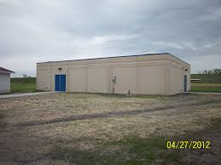
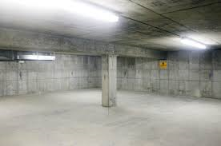
Safe room - Community

Slide 96
Application Types

Slide 97
Application types
eGRANTS
A web-based, electronic grants (eGrants)
management system that allows Applicants to apply for + manage their mitigation grant application processes electronically.
PDM
FMA

Slide 98
Application types (Continued . . . )
PAPER/LAHM APPLICATION
HMGP applications are currently completed on paper, however, the State is releasing a program which will allow the application to be completed + submitted electronically.
HMGP

Slide 99
Mitigation goals + objectives
When considering types of projects:
  Prioritize actions that achieve the goals identified in your plan.
  Provide repetitive benefits over time.

Slide 100
Mitigation goals + objectives (Continued . . . )
In most cases, projects will consider:
  Prevention
  Property protection
  Public education + awareness
  Natural resource protection
  Emergency services protection
  Structural projects

Slide 101
Mitigation goals + objectives (Continued . . . )
Proposed projects should also:
  Clearly reduce loss of life, loss of essential services and/or damage to critical facilities.
  Address severe economic hardship.
  Be in conformance with the 44 CFR 206.434(b).

Slide 102
5 minimum criteria
Activities must . . .
  Be included in current State + local hazard mitigation plans.
  Achieve State + local mitigation strategies.

Slide 103
5 minimum criteria (Continued . . . )
Provide a beneficial impact and reduce loss of life + property.

Slide 104
5 minimum criteria (Continued . . . )
Comply with ALL applicable environmental + historical + other regulations.

Slide 105
5 minimum criteria (Continued . . . )
Solve a problem . . .
  Independently or as a functional part of a solution where there is assurance that the project as a whole will be completed.

Slide 106
5 minimum criteria (Continued . . . )
Demonstrate cost-effectiveness.
  Must be cost-effective + substantially reduce the risk of future damage, hardship, loss or suffering resulting from a major disaster.
  Should be demonstrated by performing a BCA.

Slide 107
Application criteria
Well-defined SOW.
Line-item budget (Duplication of Benefits [DOB] check).
BCA (Fully supported).
Identified milestones.
Alternatives (2 or more).

Slide 108
Benefit Cost Analysis (BCA)

Slide 109
Basics
What is it?
Why is it important?
Understanding BCA fundamentals.

Slide 110
What is a BCA?
A methodology to compare the value of the lifetime benefits of a project to the cost of the project.

Slide 111

Why is it important?
BCA is a way of determining if funding a project is a wise use of taxpayers’

Slide 112
BCA fundamentals
Start early in the project evaluation process.
Every BCA needs to be credible and defensible to FEMA.

Slide 113
6 things to remember
Before-mitigation vs. after-mitigation conditions.
Benefits = avoided future damages.
Damages reduced after mitigation = benefits to count.

Slide 114
6 things to remember (Continued . . . )
Benefits (avoided future damages in dollar value) > costs = cost-effective.
Some mitigation projects are more cost-effective than others.
Benefit Cost Ratio (BCR) is used to compare cost-effectiveness.

Slide 115
Benefit cost ratio (BCR)
A project is cost-effective if:
Project Benefit (in $$$)
  Total Project Cost
≥
1

Slide 116
Project costs
Costs should be . . .
  Appropriate for the project.
  In present-day dollars.
  Well documented + from a credible source.
Project costs occur up front and are determined by cost estimates.

Slide 117
What is a benefit?
A benefit is an avoided loss.
Damages are reduced or eliminated due to the project.
Consistent approach to determine value of avoided loss.

Slide 118
What is a benefit? (Continued . . . )
Benefits have historically considered the value of avoided loss expressed in $$$:
Damages to buildings + contents + infrastructure.
Deaths + injuries in certain circumstances.
Loss of function for economic impacts.

Slide 119
What is a benefit? (Continued . . . )
Deaths + injuries
When they are a primary impact of disasters: Earthquakes + tornadoes.
Do not count except for flash floods or dam/levee failures.
Benefits of reducing casualties are always counted for safe room projects.

Slide 120
Benefits count (Continued . . . )
FEMA uses statistical values of:
  $5.8 – $6.6 million per person for deaths.
  $1.08 million for major injuries.
  $90 thousand for minor injuries.

Slide 121
What is a benefit? (Continued . . . )
Loss of function
Non-residential
Occurs when a government facility, road, utility or business is interrupted by a natural hazard event.
Usually the largest single benefit for projects that protect buildings or infrastructure.
Often overlooked by analysts.

Slide 122
What is a benefit? (Continued . . . )
Loss of function
Examples (as a result of a hazard):
Damage to a hospital’s electrical or gas connections.
Road washing out.
EOC losing the roof.
Utility line breaking.

Slide 123
What is a benefit? (Continued . . . )
Loss of function
Residential
For residential buildings, a loss of function impact results in a “displacement” to temporary quarters and includes:
  Temporary rental costs.
  Other monthly costs.
  One-time costs.
  Per diem.

Slide 124
What is a benefit? (Continued . . . )
NEW considerations
$$$ Value of benefits to society
Mental stress + anxiety:
  Treatment cost $2,443 per person.
  Lost productivity cost:
    $8,743 per worker.

Slide 125
What is a benefit? (Continued . . . )
NEW considerations
$$$ Value of volunteer labor
Based of prevailing labor rate per State.
  Louisiana = $22.13 per hour.
Per diem + lodging can be included.

Slide 126
Concept of risk
“Risk” is a simple term for the monetary value of future damages.
  Based on vulnerability + frequency.
Risk is the single most important concept in mitigation planning + BCAs.

Slide 127
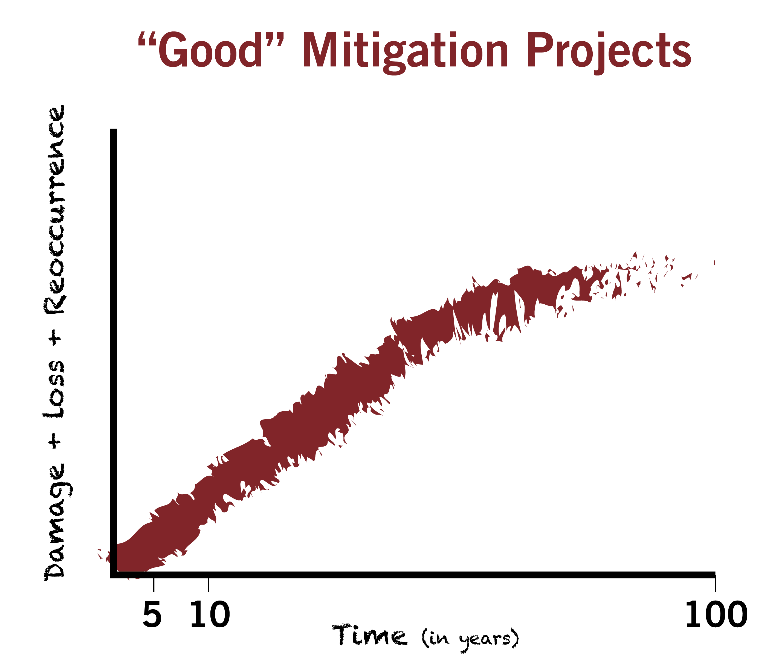

Slide 128
Is it worth $1 million to protect . . .
Probably | Probably Not
1 doghouse or 1 outhouse?
1 house that floods infrequently?
A flood-prone hospital + city hall + school + other important buildings?
150 flood-prone houses?

Slide 129
Frequency
All reoccurring events can be assigned a frequency.

Slide 130
Frequency + severity
100-year flood = 510’
10-year flood = 502’
FFE = 500’

Slide 131
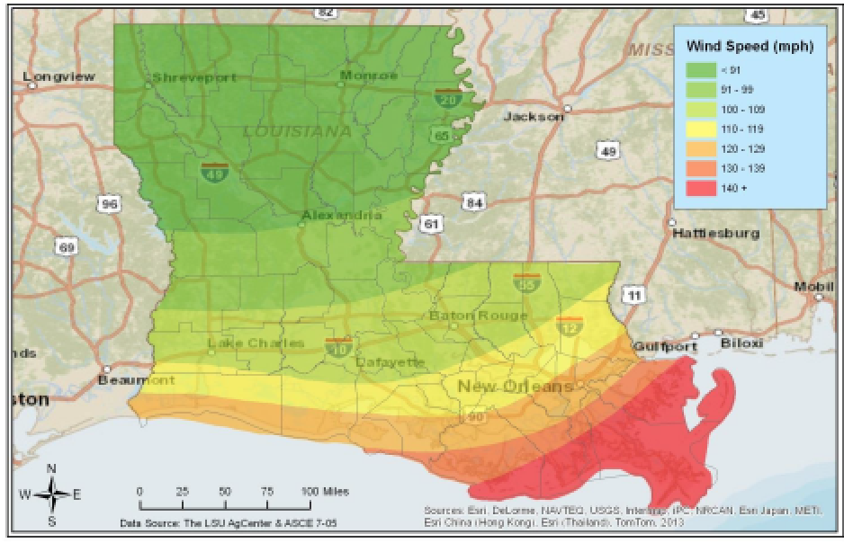
Frequency + severity (Continued . . . )

Slide 132
Documentation
Document! Document! Document!
It is important to track + record + include in the application:
  Data sources
  Dates
  Assumptions
  Analysis procedures

Slide 133
Documentation (Continued . . . )
Data Documentation Template (DDT).
Acceptable forms of documentation:
  Project Useful Life
  Loss of Function
  Frequency
  Building Replacement
  Values

Slide 134
Damage frequency assessment
Calculated using either:
  Various FEMA BCA full data modules OR . . .
    Use if you have specific data.
  Damage-Frequency Assessment module.
    Use if you have to estimate.

Slide 135
BCA modules
Damage-Frequency Assessment
  Formerly known as Limited Data module.
  Requires detailed documentation.
  Full explanation of damage scenarios before- and after-mitigation.

Slide 136
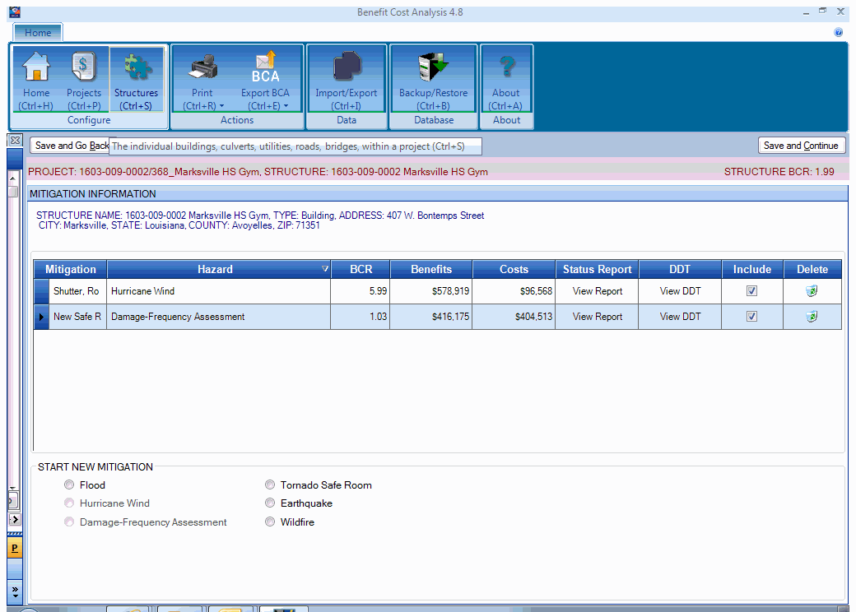
Add image of modules

Slide 137
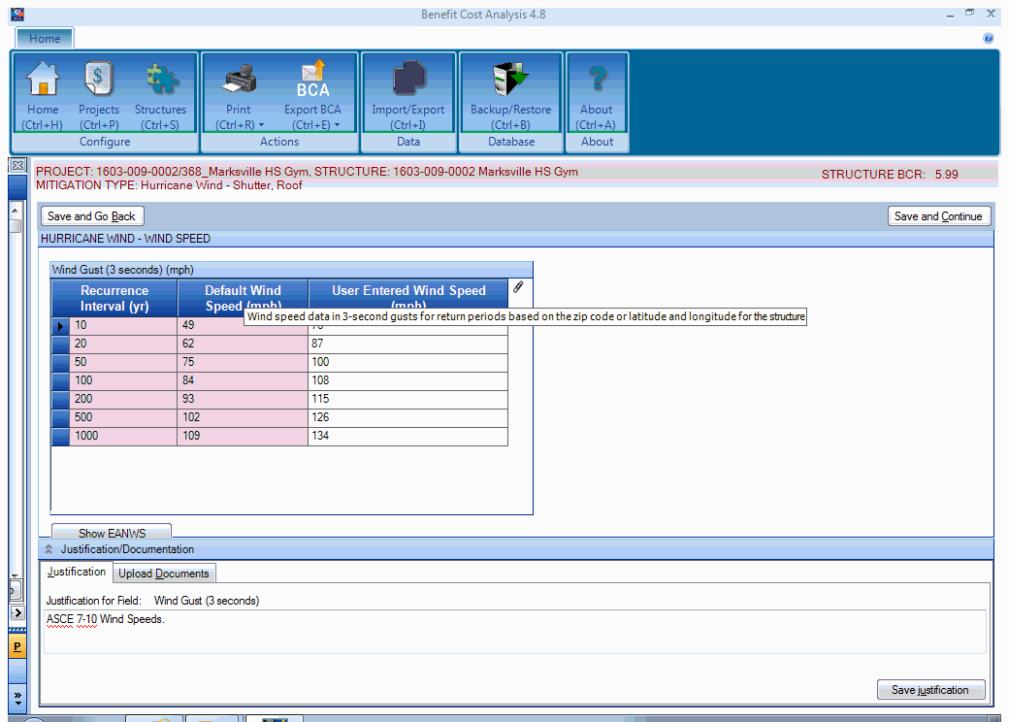

Slide 138
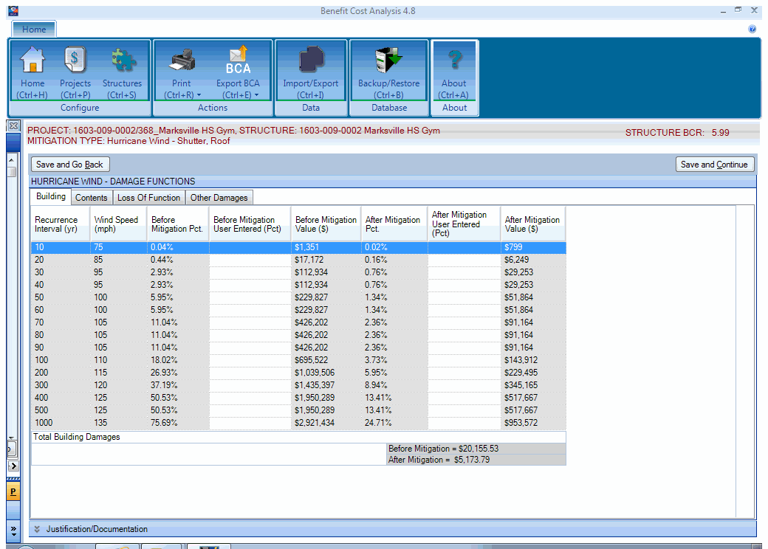

Slide 139
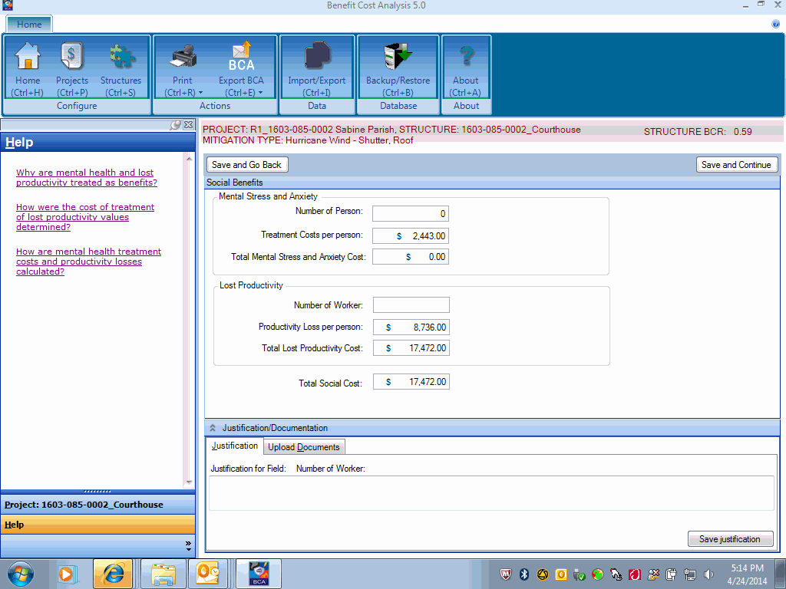

Slide 140
BCA full data modules
FEMA has BCA modules for various hazards:
  Two (2) for riverine flooding.
  One (1) for coastal A-zone flooding.
  One (1) for coastal V-zone flooding.
  Two (2) for earthquakes.
  One (1) for tornado/hurricane shelters.
  One (1) for hurricane wind.
  One (1) for wildfire/urban fires.

Slide 141
FEMA BCA 5.0 module
Most recent release.
Incorporates several hazard modules.
Provides guidance or help button.
Wind Speed Data.
Wind Damage Functions.
Flood Damage Functions.
Upload Capability.

Slide 142
For more information
Benefit Cost Analysis Toolkit version 5.0
https://www.fema.gov/media-library/ assets/documents/92923
1-855-540-6744
www.bchelpline.com

Slide 143
2 keys to BCA success . . .
Start early in the project evaluation process and provide reasonable and defensible data.
Ensure that someone other than the original BCA analyst can easily verify and re-create the data inputs and conclusions of the BCA.

Slide 144
HMGP application process

Slide 145
HMGP application process (Continued . . . )
DISASTER EVENT
Step 1
State notifies potential Applicants of the availability of funds.
Applicants submit Letters of Intent (LOIs)/Request for Assistance to the State.

Slide 146
HMGP application process (Continued . . . )
DISASTER EVENT
Step 2
Applicants submit projects to the State - Application cycle closes.

Slide 147
HMGP application process (Continued . . . )
Step 3
State begins review of submitted applications, which includes:
  Program eligibility
  Budget
  Environmental coordination + compliance
  BCA
  Metrics + milestones

Slide 148
HMGP application process (Continued . . . )
Step 4
State submits applications to FEMA.
FEMA reviews the application; either sends an RFI, approves or denies.

Slide 149
HMGP application process (Continued . . . )
Step 5
If the application is approved
by FEMA,
  The State informs the Applicant of approval.
  Sets up a kickoff meeting.
  Begins the project/grant management process.

Slide 150
Most important 3 points
Know the funding sources:
  PDM + FMA + HMGP
Identify eligible projects within those sources.
How to avoid setbacks by submitting a complete application.

Slide 151
Contact
Jeffrey Giering
jeffrey.giering@la.gov
Kim Ryals
kimberly.ryals@la.gov
Leanne Guidry
leanne.guidry@la.gov

Slide 152
Questions?

Slide 153
For more information + to download materials from today’s seminar:
gohsep.la.gov/outreach.aspx

