Slide 1
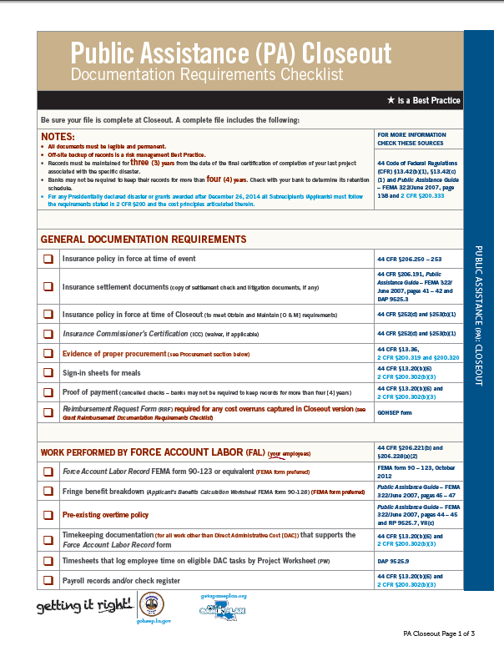
Closeout

Slide 2
Late Stage Activities
Sorting out funding questions (PART)
Administrative Close-out

Slide 3
P.A.R.T.
Approaching Disaster Closeout

Slide 4
What is P.A.R.T. ?
Progressive Applicant Reconciliation Team
Origin substantial “overpayments”
Net final overpayments = burden of the State
Last projects will be unfunded and likely de-obligated

Slide 5
General Landscape
Size
37,000 +/- PWs (projects)
$14-15B anticipated for Katrina/Rita
1,500 +/- applicants

Slide 6
General Landscape
Magnitude of disaster necessitated “business centers”
PW development
Grants management
Closeout
Finance payments
Cash Advances
Appeals
Result: Information silos

Slide 7
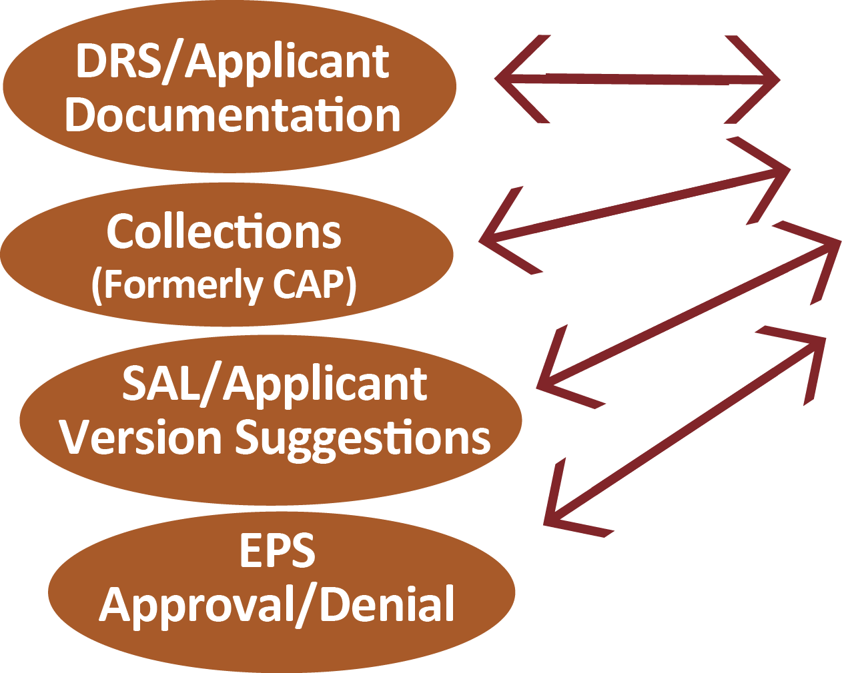
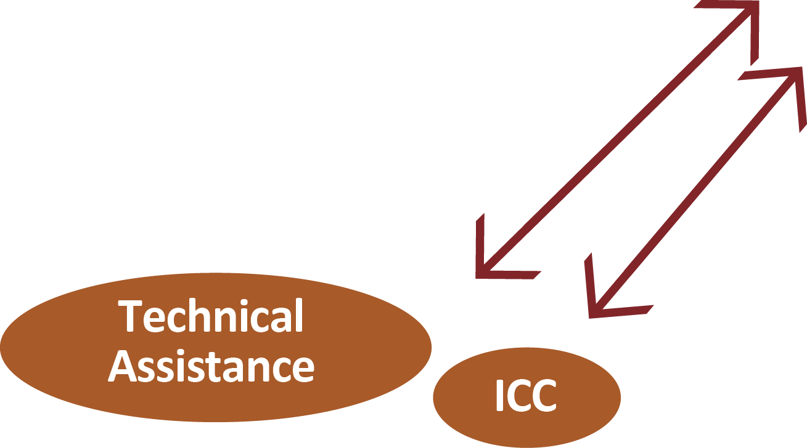
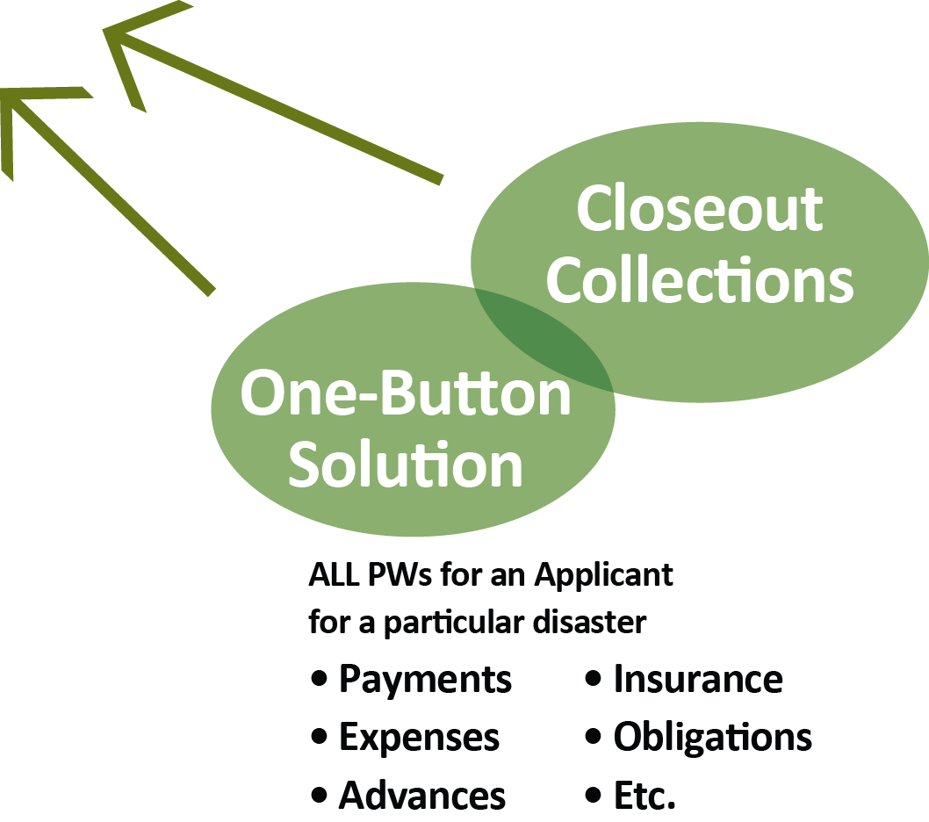
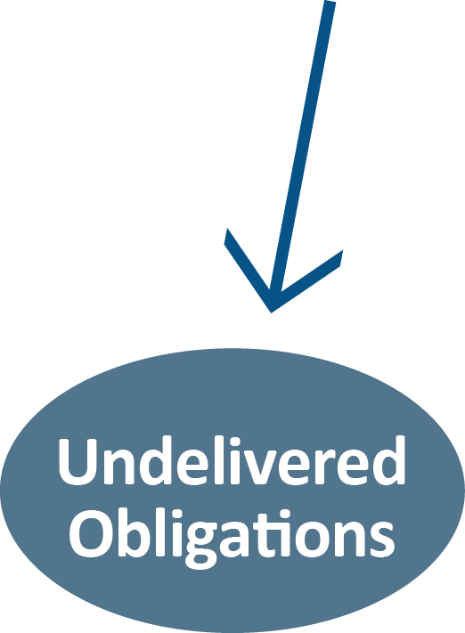
P.A.R.T
Analyze + Create/Track/
Bird Dog Action Items
LLA Applicant Reports

Slide 8
Overpayments
How? Why?
After the fact Insurance reductions
Change in eligibility determination (applicant, facility, work, cost reasonableness)
Scope of work (cost) transferred to another PW (Alt/Imp)
Expedited PW duplications
Closeout Reconciliation

Slide 9
At Risk Funding
Plus
“Under expensed”:
Insurance proceeds documentation
Undocumented expedited payments
Undocumented Advances
EPS credits
Payment Reductions based on Cost Reasonableness

Slide 10
Sorting out the funding overpayments…

Slide 11
Overpayment Resolution Tools
Progressive Applicant Resolution Team (P.A.R.T.)
Used to identify specific problems
Communicate to applicants
Tracks resolution progress
Dynamic and interactive
Guides resource priorities
PART Progressive Applicant Resolution Team

Slide 12
How Overpayments are Resolved
Additional support documentation
New PW versions
Applied payments from other PWs
Check from the Applicant
*Some applicants are on hold for all current and future disaster payments until overpayments are resolved.

Slide 13
P.A.R.T. Mission
Identify the Problem -
Find a Solution

Slide 14
P.A.R.T. Goal

Slide 15
Questions?

Slide 16
Time to Close-Out!
...it has been 11 years!

Slide 17
Community Recovery
Priorities
# 1. Saving lives and property
# 2. Rebuilding the community
# 3. Tying up loose ends – Close out

Slide 18
When should we finish?
Regulatory “Period of Performance” - 8 yrs. (Max)
Grantee Administrative Cost (+ COI)
Katrina/Rita – Aug./Sept. 2013
Gustav/Ike – Aug./Sept. 2016

Slide 19
When should we finish?
Current Deadlines:
Katrina/Rita – Aug./Sept. 2016 (extended)*
Gustav/Ike – Aug./Sept. 2016
*Now on year by year status

Slide 20
GOHSEP Mandatory closeout metrics
High bar
Additional resources to meet requirements
Need support from all applicants
Consequence of failure – eliminate SMC + DAC
State funded recovery administration
FEMA to close out PWs/disasters

Slide 21
Reality
Competing Priorities

Slide 22
GOHSEP Priorities
Education Outreach
Technical Support
Close-Out
Reimbursement Payments
Express Pay Backlog
Appeals
Arbitrations
Financial Reconciliation
Version Requests
ICC Coordination
Site Inspections

Slide 23
Applicant Priorities
Planning recovery activities
Community outreach
Contracts procurement
Managing A/E design
Construction oversight
Close Out
Rebuilding the community
GOHSEP Compliance
Audits
Quarterly Reports
Site
Inspections
Applicant
DHSOIG Audits
Day Job
Financial reconciliation and final claim
Payment
Reimbursement Requests
Time Extension requests
Grant Versions
Appeals
Arbitrations

Slide 24
FEMA’s No. 1 Priority
Closeout
Not versions
Not time extensions
Not insurance proceeds reallocations
Not appeals or arbitrations
Not policy discussions

Slide 25
Closeout Focus
Applicant’s assistance is essential
Appreciate the importance to our funding partner
Assign adequate resources
Respond to RFIs timely

Slide 27
Population | Criteria
A | Applicants are overpaid with no positive obligation balances remaining
B | Applicants are net overpaid with some offsetting positive obligation balances
C | Applicants are net overpaid but have overpayments on the PW level greater than $3 Million
D | Applicants are net overpaid with at least $1 in overpayment on the PW level, but less than $3 Million
E | Applicants are not overpaid and have no overpayments on the PW level
HIDDEN SLIDE

Slide 28
Redacted
HIDDEN SLIDE

Slide 29
HIDDEN SLIDE

Slide 30
Redacted
HIDDEN SLIDE

Slide 31
HIDDEN SLIDE

Slide 32
HIDDEN SLIDE

Slide 33
P.A.R.T - Due Diligence
Prior to sending overpayment letters & putting applicants on hold
Data refresh and internal research/vetting
Management review
ALL Steps are sequenced, tracked & timed for follow-up
HIDDEN SLIDE

Slide 34
Applicants on hold
Beauregard Parish Office of Homeland Security and Emergency Preparedness
Brother Martin High School
Caldwell Parish
Cameron Parish Waterworks District 1
Chennault International Airport Authority
City of Eunice
City of Gonzales
Iberia Parish School Board
Iberville Parish
Jefferson Davis Electric Cooperative, Inc.
John Curtis Christian Schools
Louisianan Dept. of Culture of Recreation and Tourism
Orleans Levee District
Ouachita Parish Sheriff’s Department
Pointe Coupee Electric Membership Corporation
Slidell Memorial Hospital
St. Augustine High School
St. Bernard Parish
St. Charles Parish
St. Charles Parish Public Schools
St. James Parish
St. Tammany Parish School Board
St. Tammany Parish Sheriff’s Office
Tangipahoa Parish School System
Ursuline Nuns of the Parish of Orleans dba Ursuline Academy of New Orleans
Valley Electric Membership Corporation
HIDDEN SLIDE

